Slide 1
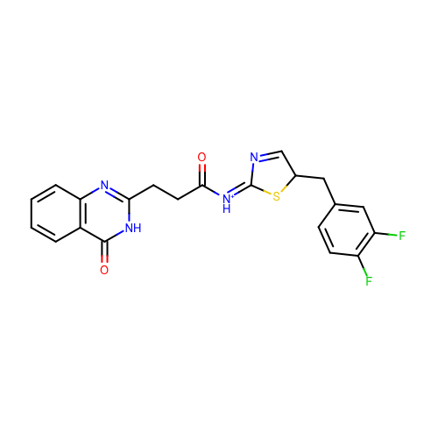
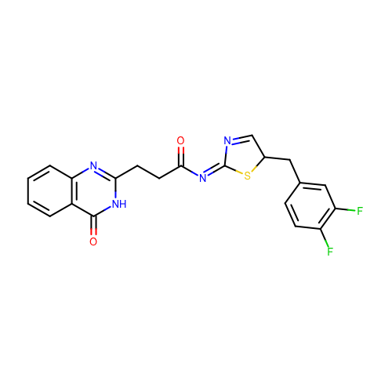
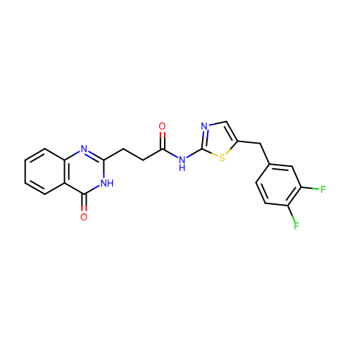
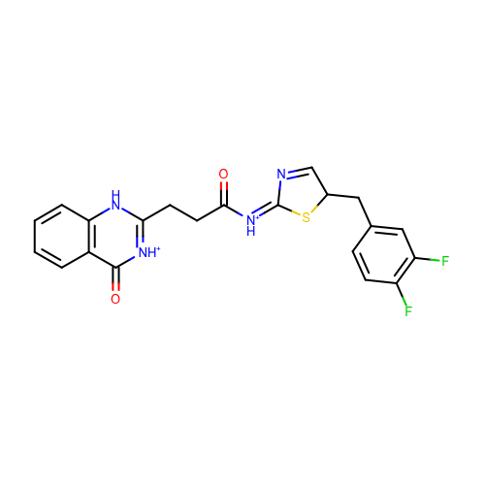
SM18_micro001 | c1ccc2c(c1)c(=O)[nH]c(n2)CCC(=O)/[NH+]=C/3\N=CC(S3)Cc4ccc(c(c4)F)F
SM18_micro013 | c1ccc2c(c1)c(=O)[nH]c(n2)CCC(=O)/N=C/3\N=CC(S3)Cc4ccc(c(c4)F)F
SM18_micro016 | c1ccc2c(c1)c(=O)[nH]c(n2)CCC(=O)Nc3ncc(s3)Cc4ccc(c(c4)F)F
SM18_micro029 | c1ccc2c(c1)c(=O)[nH+]c([nH]2)CCC(=O)/[NH+]=C/3\N=CC(S3)Cc4ccc(c(c4)F)F

