Slide 1
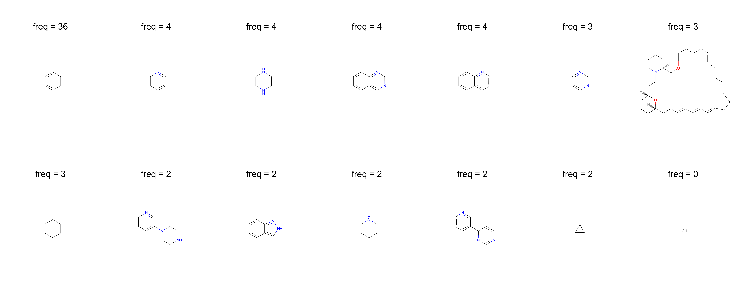
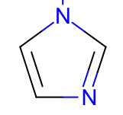
pyridine
piperazine
quinazoline
quinoline
pyrimidine
freq = 5
freq = 2
indazole
pyrazole
imidazole

