Slide 1
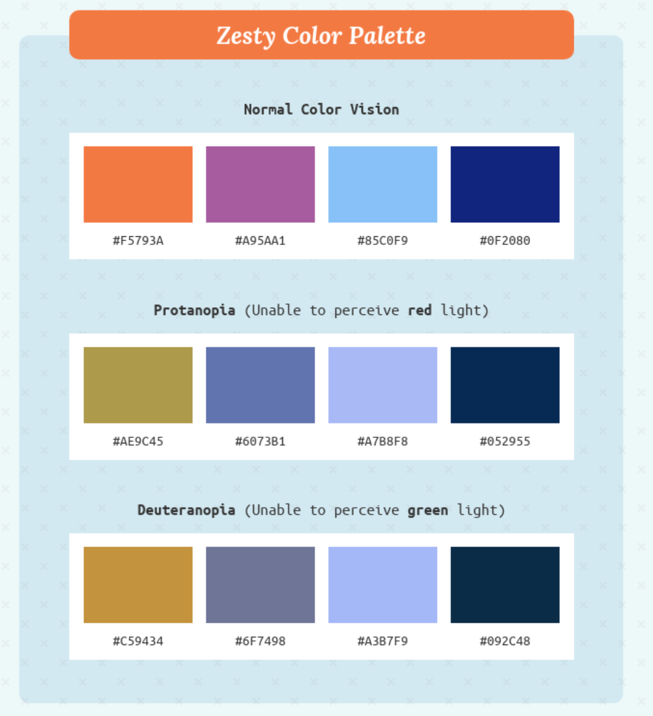


#zesty_color_palette
color0 = "#0F2080"
color1 = "#F5793A"
color2 = "#85C0F9"
color3 = "#A95AA1"
https://matplotlib.org/2.0.0/examples/color/named_colors.html
https://venngage.com/blog/color-blind-friendly-palette/
Similar to PLASMA

Slide 2




