Slide 1
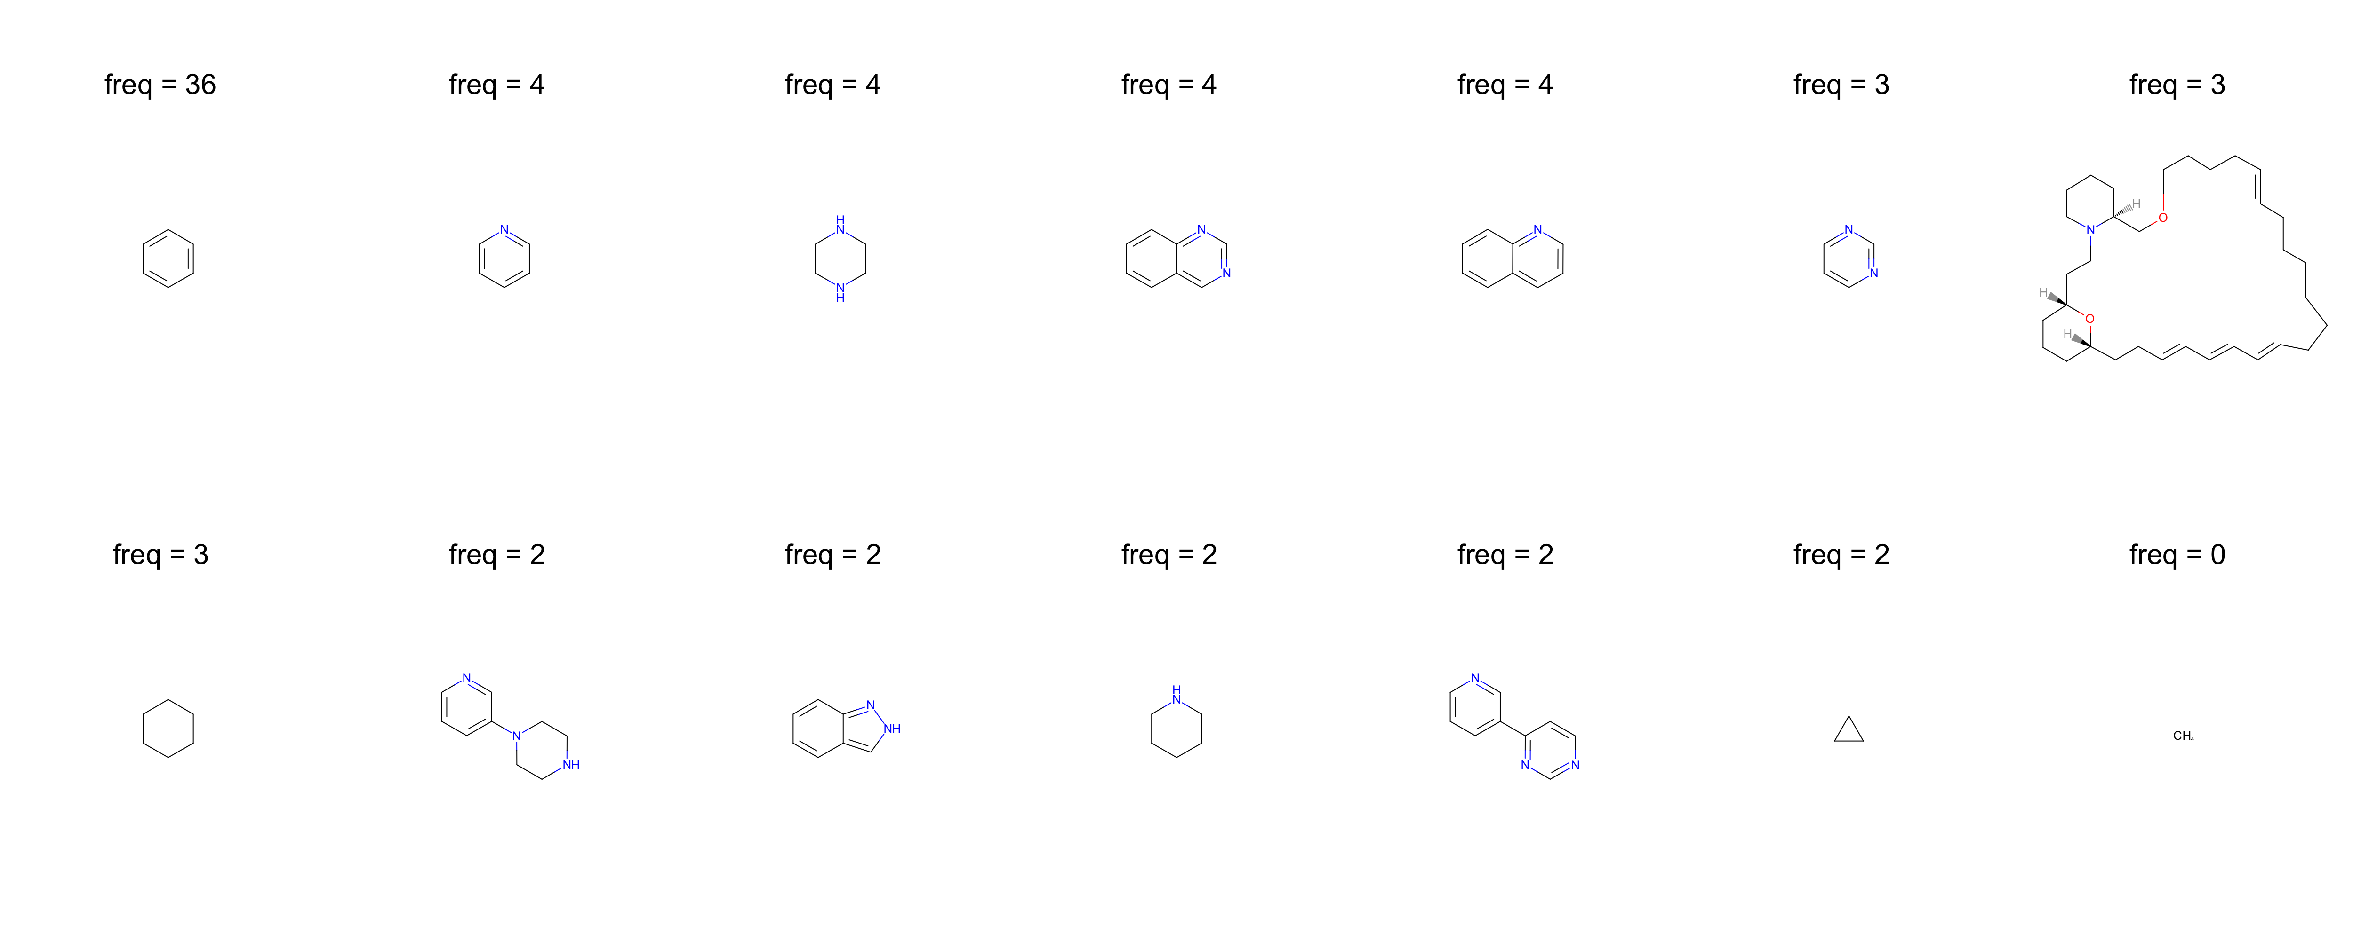
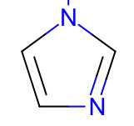
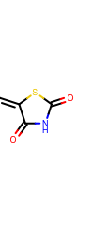
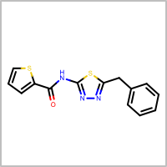
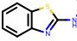
AT LEAST ONE
pyridine
piperazine
quinazoline
quinoline
pyrimidine
Not found!
indazole
pyrazole
imidazole
AT MOST ONE
aminothiazole
thiophene
1,3,4-thiadiazole
5-methylenethiazolidine-2,4-dione

