Slide 1
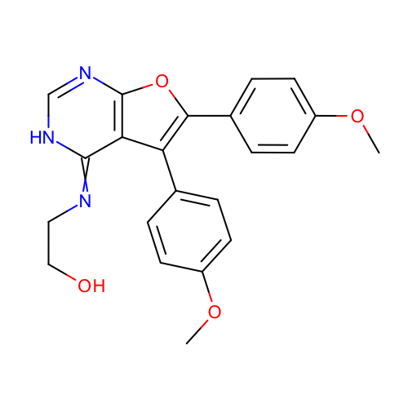
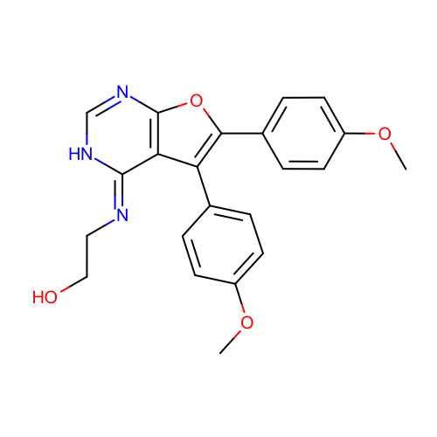
 | SM24_micro007 | COc1ccc(cc1)c2c3c(=NCCO)[nH]cnc3oc2c4ccc(cc4)OC
 | SM24_micro008 | COc1ccc(cc1)c2c3/c(=N/CCO)/[nH]cnc3oc2c4ccc(cc4)OC
Deprecate: SM24_micro008

Slide 2
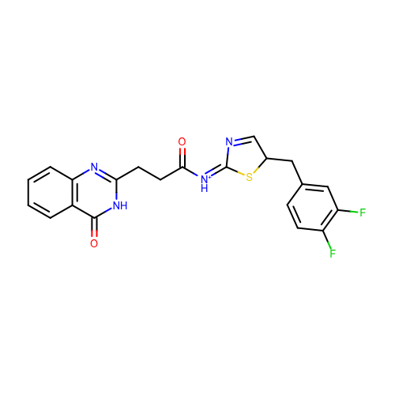
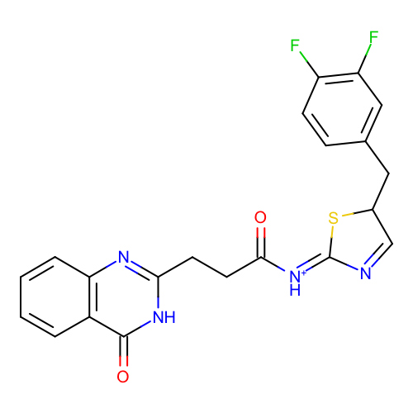
SM18_micro001 | c1ccc2c(c1)c(=O)[nH]c(n2)CCC(=O)/[NH+]=C/3\N=CC(S3)Cc4ccc(c(c4)F)F
SM18_micro041 | c1ccc2c(c1)c(=O)[nH]c(n2)CCC(=O)/[NH+]=C\3/N=CC(S3)Cc4ccc(c(c4)F)F
('SM18_micro001', 'SM18_micro041') - Geometric isomers. Deprecate: SM18_micro041

Slide 3
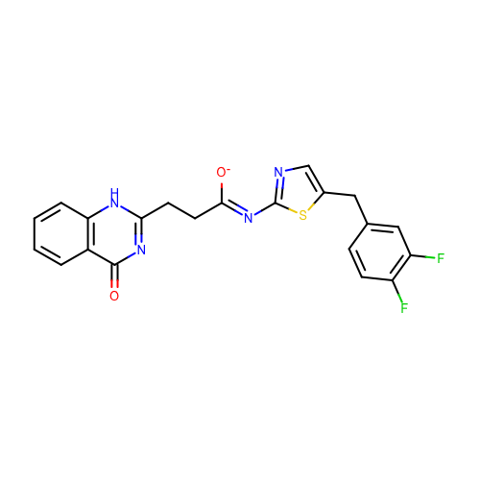
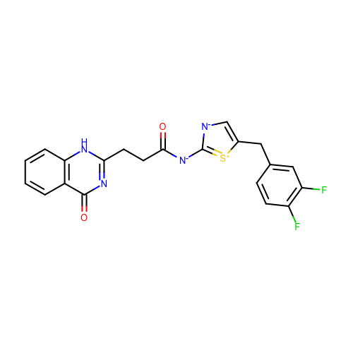
SM18_micro005 | c1ccc2c(c1)c(=O)nc([nH]2)CC/C(=N/c3ncc(s3)Cc4ccc(c(c4)F)F)/[O-]
SM18_micro008 | c1ccc2c(c1)c(=O)nc([nH]2)CCC(=O)[N-]c3[n-]cc([s+]3)Cc4ccc(c(c4)F)F
('SM18_micro005', 'SM18_micro008') - Resonance structures. Deprecate: SM18_micro008

Slide 4
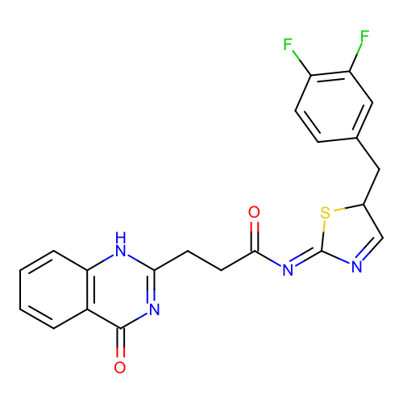
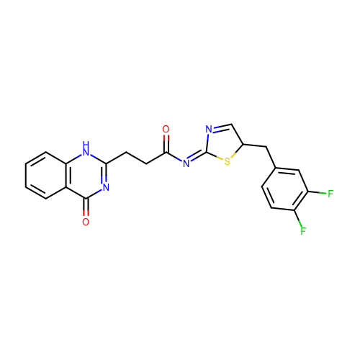
SM18_micro009 | c1ccc2c(c1)c(=O)nc([nH]2)CCC(=O)/N=C\3/N=CC(S3)Cc4ccc(c(c4)F)F
SM18_micro035 | c1ccc2c(c1)c(=O)nc([nH]2)CCC(=O)/N=C/3\N=CC(S3)Cc4ccc(c(c4)F)F
('SM18_micro009', 'SM18_micro035') - - Geometric isomers. Deprecate: SM18_micro035

Slide 5


SM18_micro010 | c1ccc2c(c1)c(=O)nc([nH]2)CCC(=O)/N=C/3\[NH+]=CC(S3)Cc4ccc(c(c4)F)F
SM18_micro073 | c1ccc2c(c1)c(=O)nc([nH]2)CCC(=O)/N=C\3/[NH+]=CC(S3)Cc4ccc(c(c4)F)F
('SM18_micro010', 'SM18_micro073') - Geometric isomers. Deprecate: SM18_micro073

Slide 6
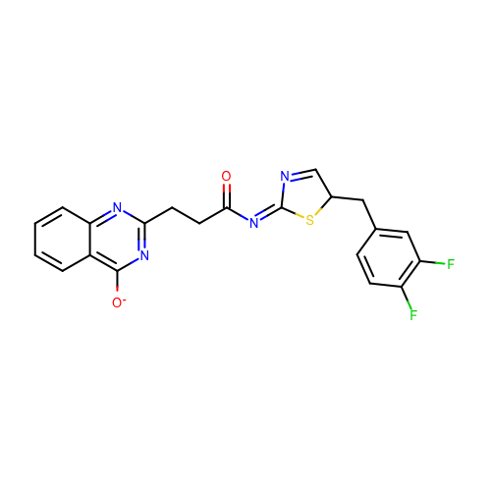
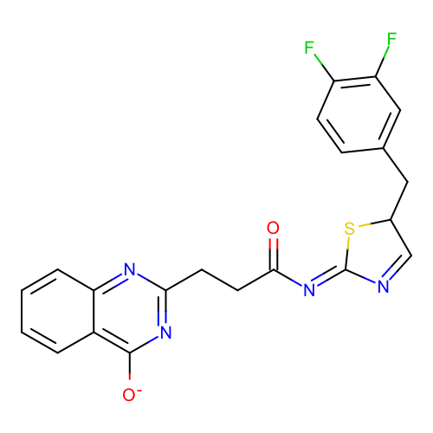
SM18_micro011 | c1ccc2c(c1)c(nc(n2)CCC(=O)/N=C/3\N=CC(S3)Cc4ccc(c(c4)F)F)[O-]
SM18_micro039 | c1ccc2c(c1)c(nc(n2)CCC(=O)/N=C\3/N=CC(S3)Cc4ccc(c(c4)F)F)[O-]
('SM18_micro011', 'SM18_micro039') - Geometric isomers. Deprecate: SM18_micro039

Slide 7
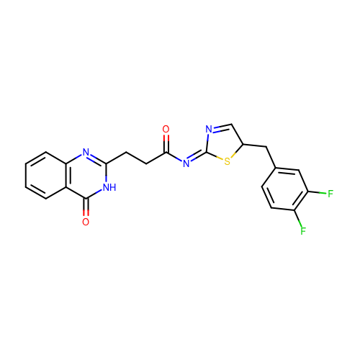
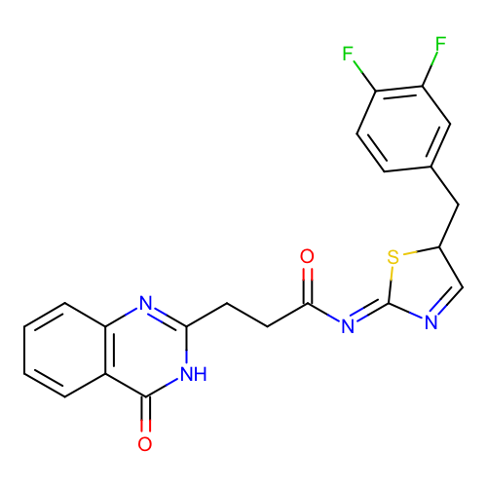
SM18_micro013 | c1ccc2c(c1)c(=O)[nH]c(n2)CCC(=O)/N=C/3\N=CC(S3)Cc4ccc(c(c4)F)F
SM18_micro067 | c1ccc2c(c1)c(=O)[nH]c(n2)CCC(=O)/N=C\3/N=CC(S3)Cc4ccc(c(c4)F)F
('SM18_micro013', 'SM18_micro067') - Geometric isomers. Deprecate: SM18_micro067

Slide 8

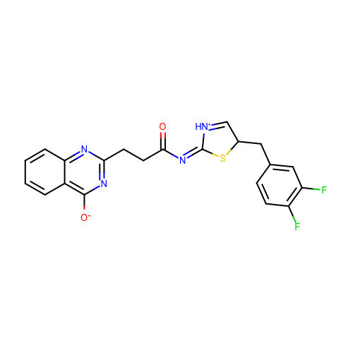
SM18_micro015 | c1ccc2c(c1)c(nc(n2)CCC(=O)/N=C\3/[NH+]=CC(S3)Cc4ccc(c(c4)F)F)[O-]
SM18_micro061 | c1ccc2c(c1)c(nc(n2)CCC(=O)/N=C/3\[NH+]=CC(S3)Cc4ccc(c(c4)F)F)[O-]
('SM18_micro015', 'SM18_micro061') - Geometric isomers. Deprecate: SM18_micro015

Slide 9

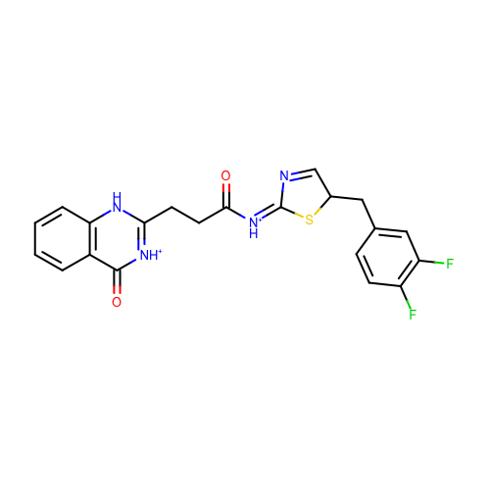
SM18_micro019 | c1ccc2c(c1)c(=O)[nH+]c([nH]2)CCC(=O)/[NH+]=C\3/N=CC(S3)Cc4ccc(c(c4)F)F
SM18_micro029 | c1ccc2c(c1)c(=O)[nH+]c([nH]2)CCC(=O)/[NH+]=C/3\N=CC(S3)Cc4ccc(c(c4)F)F
('SM18_micro019', 'SM18_micro029') - Geometric isomers. Deprecate: SM18_micro019

Slide 10


SM18_micro025 | c1ccc2c(c1)c(=O)nc([nH]2)CCC(=O)/N=c/3\[nH]cc(s3)Cc4ccc(c(c4)F)F
SM18_micro027 | c1ccc2c(c1)c(=O)nc([nH]2)CCC(=O)/N=c\3/[nH]cc(s3)Cc4ccc(c(c4)F)F
('SM18_micro025', 'SM18_micro027') - Geometric isomers. Deprecate: SM18_micro027

Slide 11
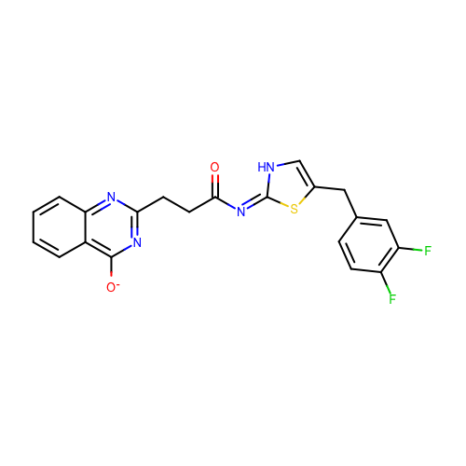

SM18_micro032 | c1ccc2c(c1)c(nc(n2)CCC(=O)/N=c/3\[nH]cc(s3)Cc4ccc(c(c4)F)F)[O-]
SM18_micro040 | c1ccc2c(c1)c(nc(n2)CCC(=O)/N=c\3/[nH]cc(s3)Cc4ccc(c(c4)F)F)[O-]
('SM18_micro032', 'SM18_micro040') - Geometric isomers. Deprecate: SM18_micro040

Slide 12


SM18_micro037 | c1ccc2c(c1)c(=O)nc([nH]2)CCC(=O)/[NH+]=C/3\N=CC(S3)Cc4ccc(c(c4)F)F
SM18_micro044 | c1ccc2c(c1)c(=O)nc([nH]2)CCC(=O)/[NH+]=C\3/N=CC(S3)Cc4ccc(c(c4)F)F
('SM18_micro037', 'SM18_micro044') - Geometric isomers. Deprecate: SM18_micro044

Slide 13
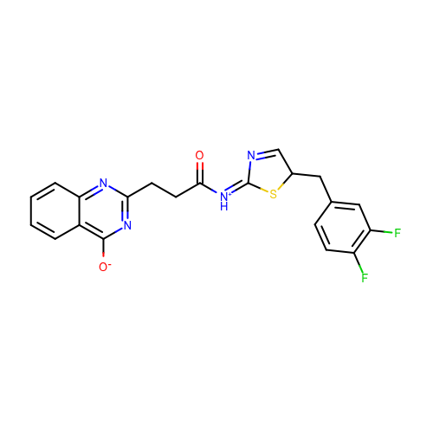
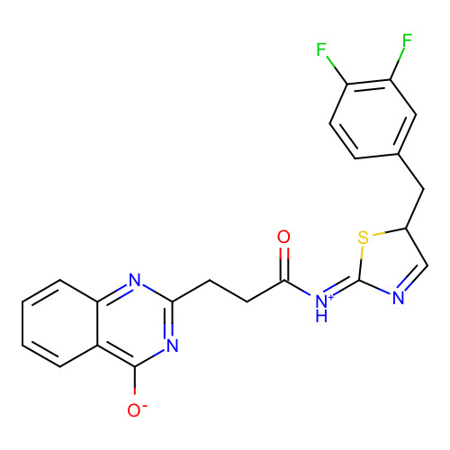
SM18_micro038 | c1ccc2c(c1)c(nc(n2)CCC(=O)/[NH+]=C/3\N=CC(S3)Cc4ccc(c(c4)F)F)[O-]
SM18_micro066 | c1ccc2c(c1)c(nc(n2)CCC(=O)/[NH+]=C\3/N=CC(S3)Cc4ccc(c(c4)F)F)[O-]
('SM18_micro038', 'SM18_micro066') - Geometric isomers. Deprecate: SM18_micro066

Slide 14
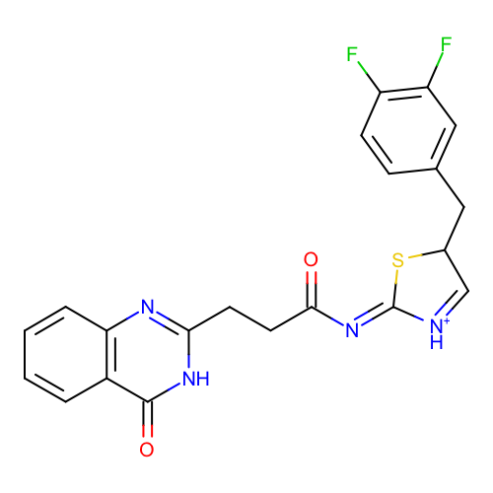
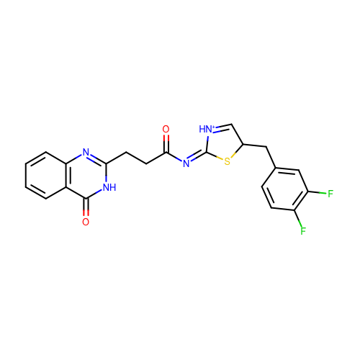
SM18_micro043 | c1ccc2c(c1)c(=O)[nH]c(n2)CCC(=O)/N=C\3/[NH+]=CC(S3)Cc4ccc(c(c4)F)F
SM18_micro053 | c1ccc2c(c1)c(=O)[nH]c(n2)CCC(=O)/N=C/3\[NH+]=CC(S3)Cc4ccc(c(c4)F)F
('SM18_micro043', 'SM18_micro053') - Geometric isomers. Deprecate: SM18_micro043

Slide 15


SM18_micro046 | c1ccc2c(c1)c(=O)[nH+]c([nH]2)CCC(=O)/N=c\3/[nH]cc(s3)Cc4ccc(c(c4)F)F
SM18_micro063 | c1ccc2c(c1)c(=O)[nH+]c([nH]2)CCC(=O)/N=c/3\[nH]cc(s3)Cc4ccc(c(c4)F)F

Slide 16
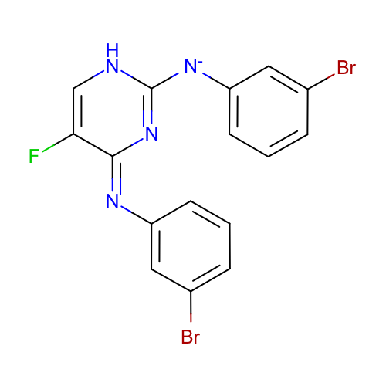
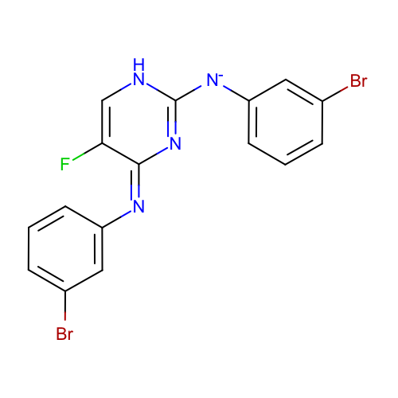
SM21_micro016 | c1cc(cc(c1)Br)[N-]c2[nH]cc(/c(=N/c3cccc(c3)Br)/n2)F
SM21_micro025 | c1cc(cc(c1)Br)[N-]c2[nH]cc(/c(=N\c3cccc(c3)Br)/n2)F
('SM21_micro016', 'SM21_micro025') - Geometric isomers. Deprecate: SM21_micro016

Slide 17
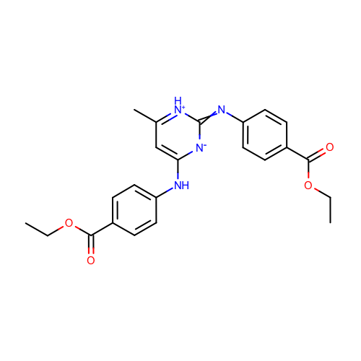
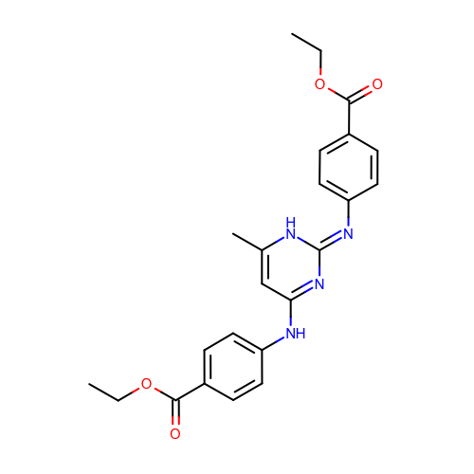
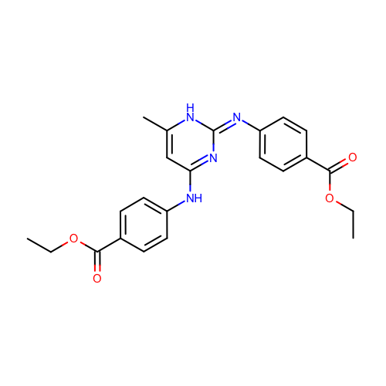
SM23_micro001 | CCOC(=O)c1ccc(cc1)Nc2cc([nH+]c(=Nc3ccc(cc3)C(=O)OCC)[n-]2)C
SM23_micro008 | CCOC(=O)c1ccc(cc1)Nc2cc([nH]/c(=N\c3ccc(cc3)C(=O)OCC)/n2)C
SM23_micro020 | CCOC(=O)c1ccc(cc1)Nc2cc([nH]/c(=N/c3ccc(cc3)C(=O)OCC)/n2)C

Slide 18
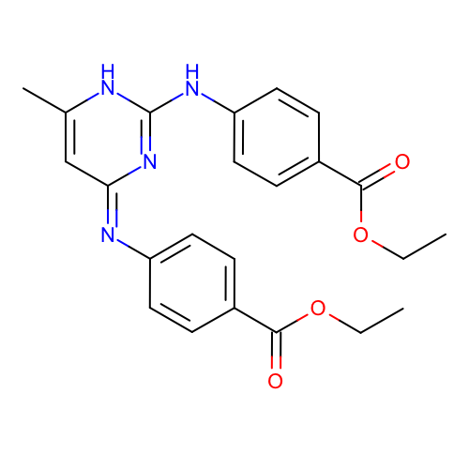
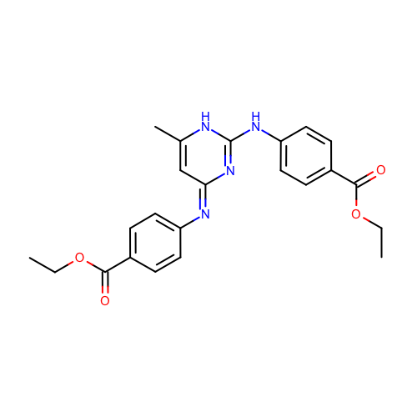
SM23_micro004 | CCOC(=O)c1ccc(cc1)Nc2[nH]c(c/c(=N/c3ccc(cc3)C(=O)OCC)/n2)C
SM23_micro011 | CCOC(=O)c1ccc(cc1)Nc2[nH]c(c/c(=N\c3ccc(cc3)C(=O)OCC)/n2)C

Slide 19
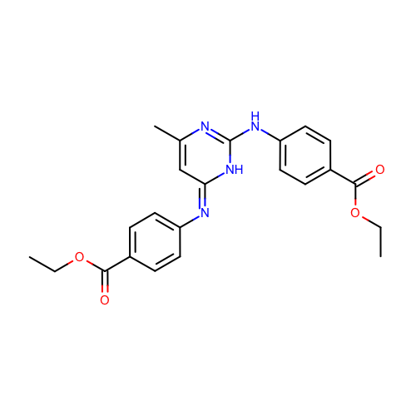
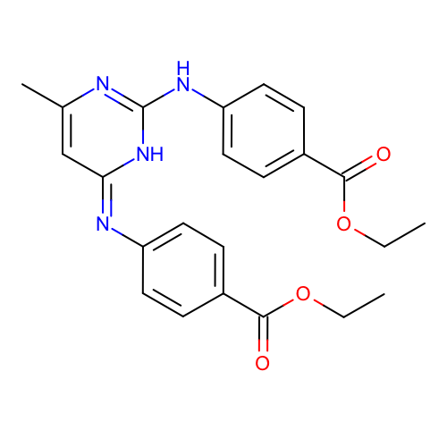
SM23_micro005 | CCOC(=O)c1ccc(cc1)Nc2[nH]/c(=N/c3ccc(cc3)C(=O)OCC)/cc(n2)C
SM23_micro016 | CCOC(=O)c1ccc(cc1)Nc2[nH]/c(=N\c3ccc(cc3)C(=O)OCC)/cc(n2)C

Slide 20
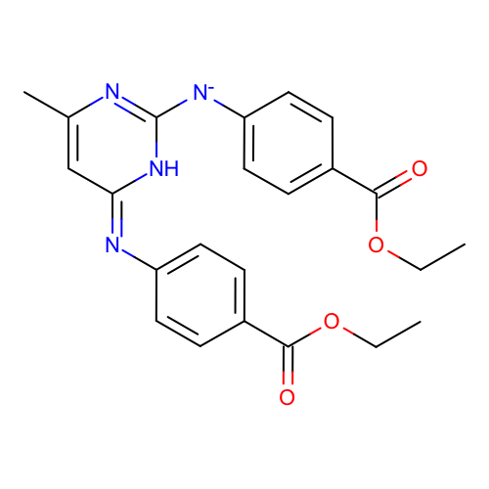
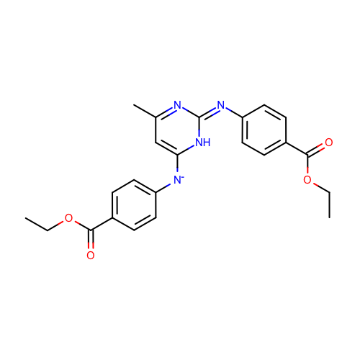

SM23_micro006 | CCOC(=O)c1ccc(cc1)[N-]c2[nH]/c(=N\c3ccc(cc3)C(=O)OCC)/cc(n2)C
SM23_micro014 | CCOC(=O)c1ccc(cc1)[N-]c2cc(n/c(=N/c3ccc(cc3)C(=O)OCC)/[nH]2)C
SM23_micro028 | CCOC(=O)c1ccc(cc1)[N-]c2[nH]/c(=N/c3ccc(cc3)C(=O)OCC)/cc(n2)C

Slide 21
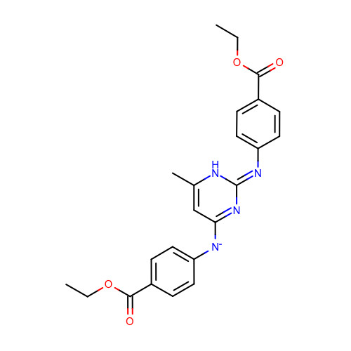

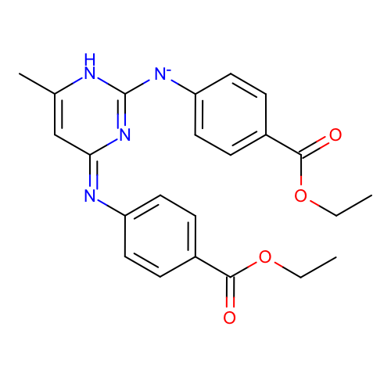
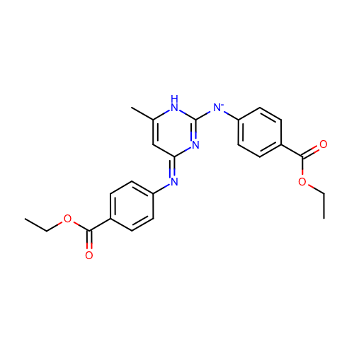
SM23_micro015 | CCOC(=O)c1ccc(cc1)[N-]c2cc([nH]/c(=N\c3ccc(cc3)C(=O)OCC)/n2)C
SM23_micro027 | CCOC(=O)c1ccc(cc1)[N-]c2cc([nH]/c(=N/c3ccc(cc3)C(=O)OCC)/n2)C
SM23_micro029 | CCOC(=O)c1ccc(cc1)[N-]c2[nH]c(c/c(=N/c3ccc(cc3)C(=O)OCC)/n2)C
SM23_micro036 | CCOC(=O)c1ccc(cc1)[N-]c2[nH]c(c/c(=N\c3ccc(cc3)C(=O)OCC)/n2)C

Slide 22
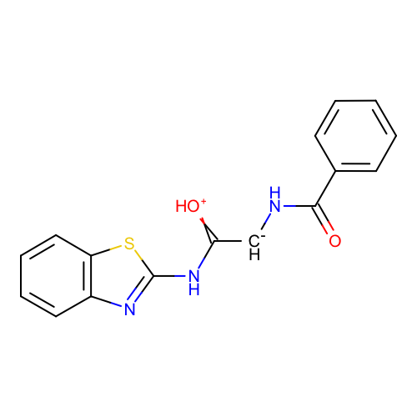
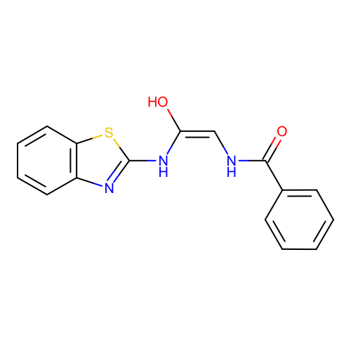
 | SM10_micro015 | c1ccc(cc1)C(=O)N[CH-]C(=[OH+])Nc2nc3ccccc3s2
 | SM10_micro029 | c1ccc(cc1)C(=O)N/C=C(\Nc2nc3ccccc3s2)/O
Resonance structures. Deprecate: SM10_micro029

