Slide 1
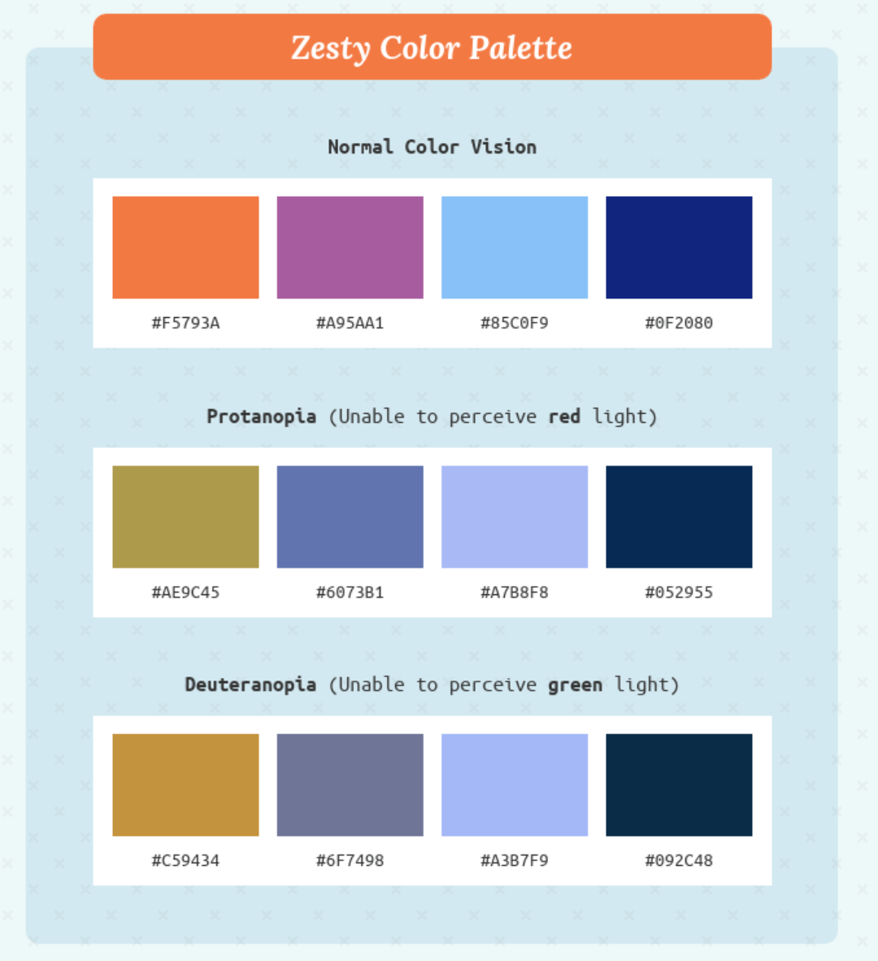


https://matplotlib.org/2.0.0/examples/color/named_colors.html
https://venngage.com/blog/color-blind-friendly-palette/
Similar to PLASMA

Slide 2




