Slide 1
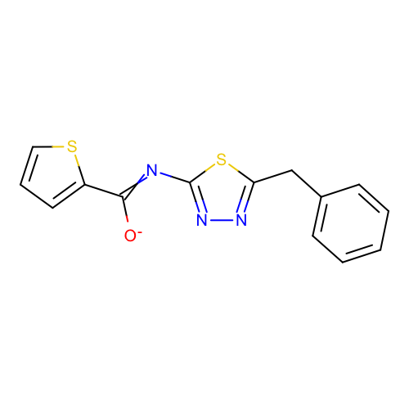
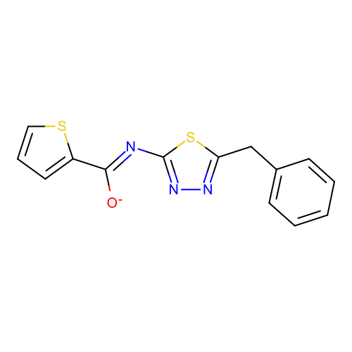
res1 = "c1ccc(cc1)Cc2nnc(s2)N=C(c3cccs3)[O-]" #SM03_micro002
res2 = "c1ccc(cc1)Cc2nnc(s2)/N=C(/c3cccs3)\[O-]" #SM23_micro007

