Slide 1
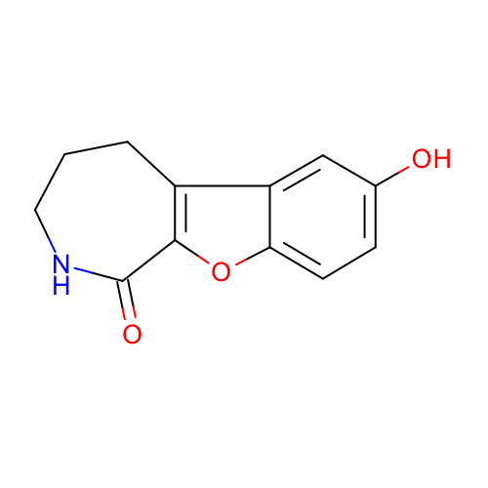
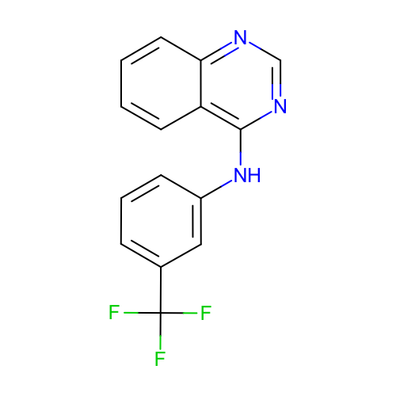
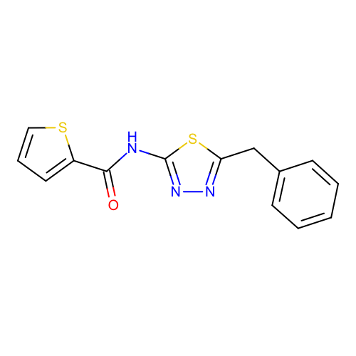
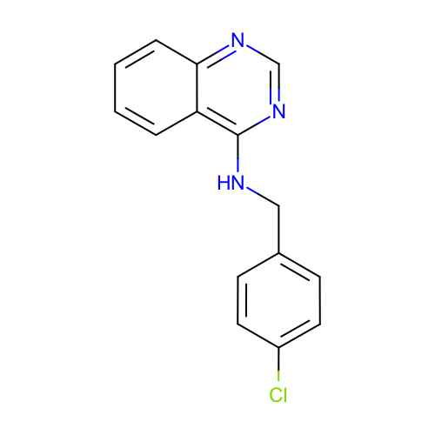
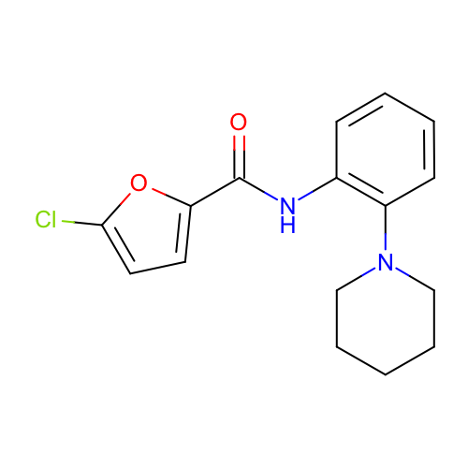
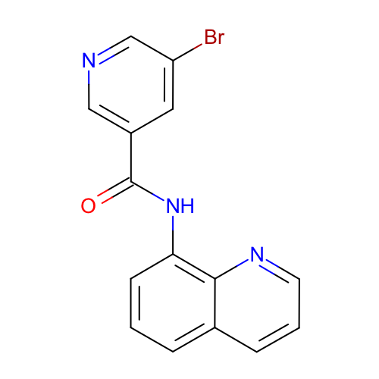
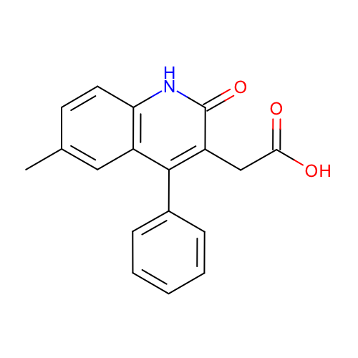
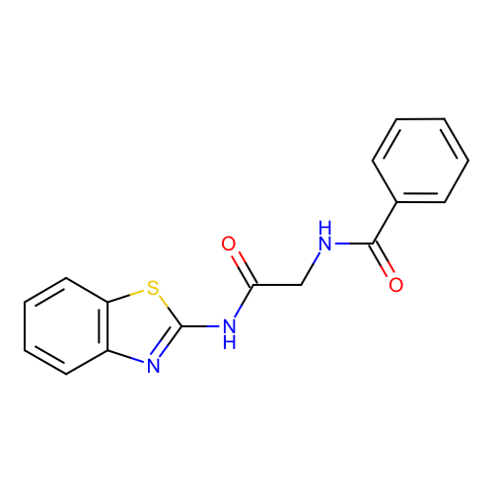
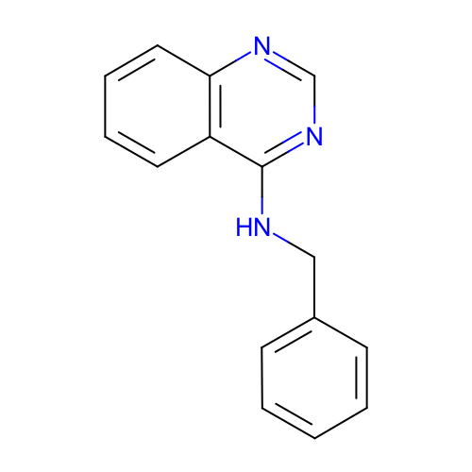
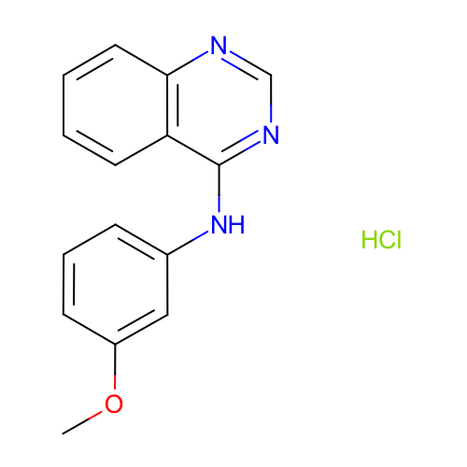
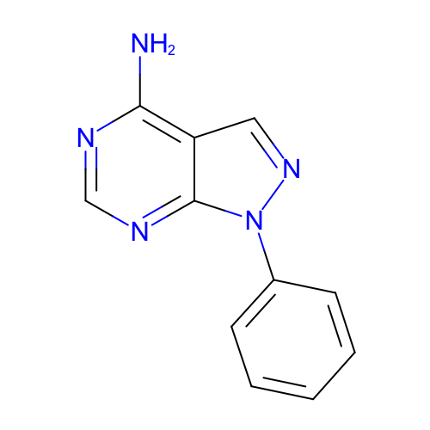
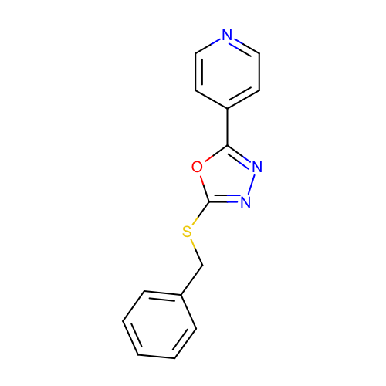
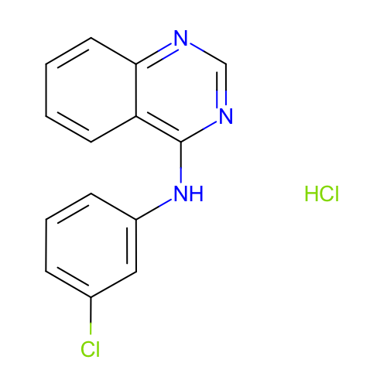
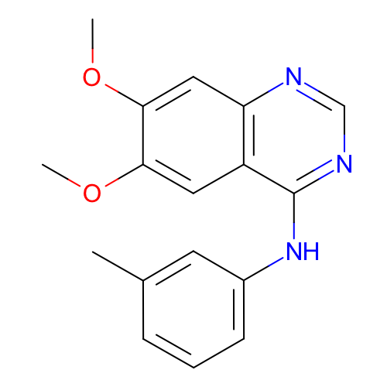
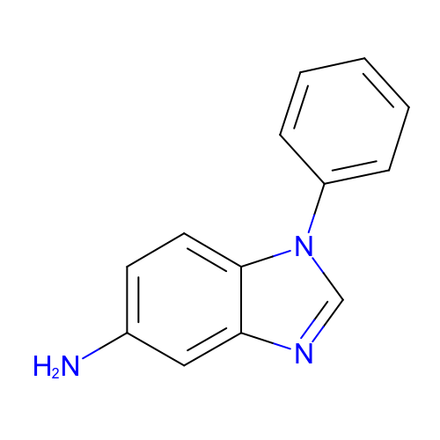
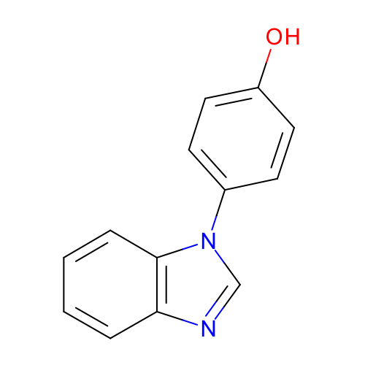
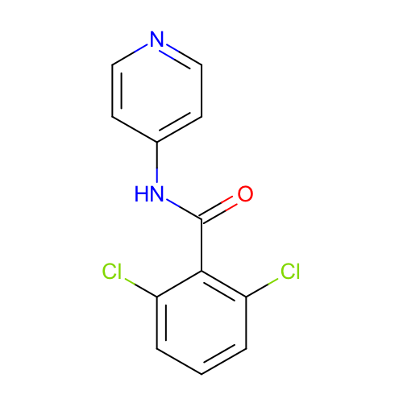
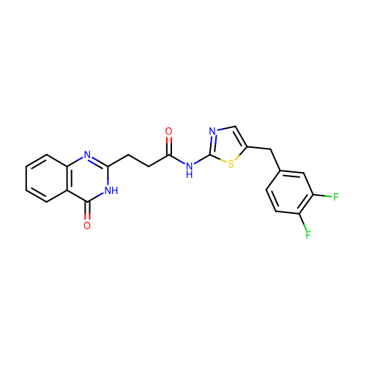
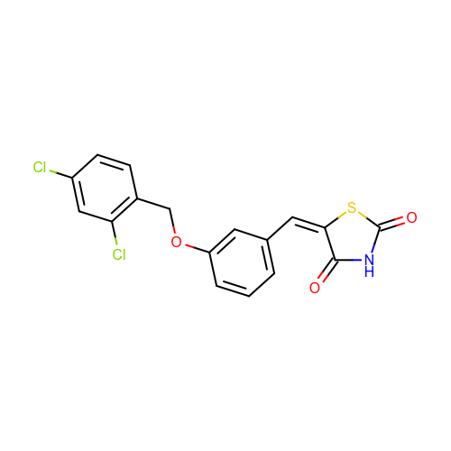
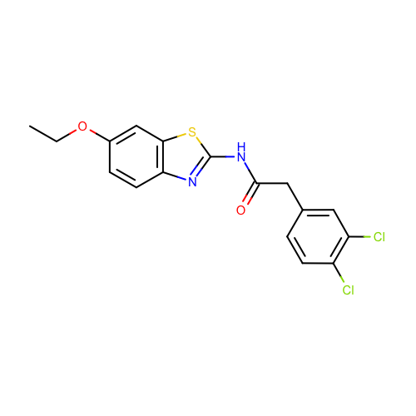
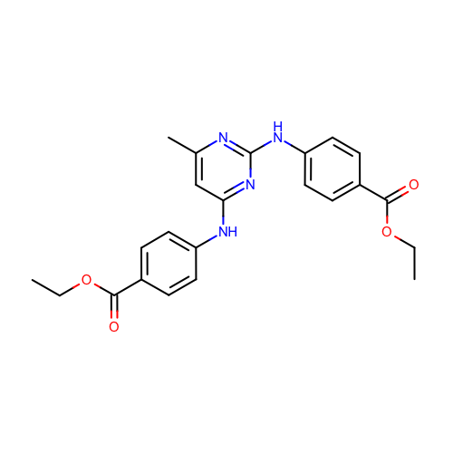
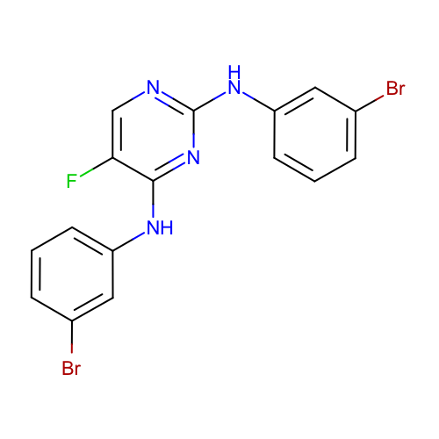
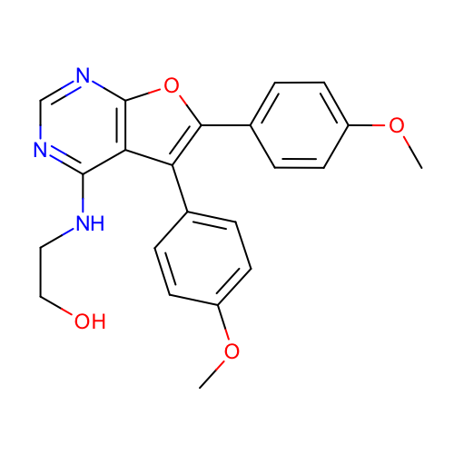
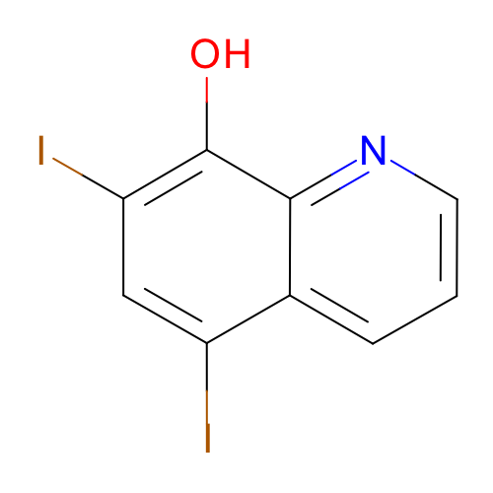
SM01
0.72 [0.51, 0.99]
SM02
1.01 [0.88, 1.15]
SM03
2.39 [1.78, 3.00]
SM04
0.98 [0.81, 1.15]
SM05
1.59 [1.24, 1.93]
SM06
2.03 [1.65, 2.47]
SM07
1.51 [1.11, 1.94]
SM08
0.87 [0.62, 1.15]
SM09
1.06 [0.87, 1.26]
SM10
2.24 [1.60, 2.93]
SM11
0.79 [0.54, 1.06]
SM12
1.05 [0.85, 1.26]
SM13
1.01 [0.76, 1.27]
SM14
1.45 [1.19, 1.73]
SM15
1.04 [0.86, 1.22]
SM16
1.07 [0.88, 1.28]
SM17
1.19 [0.92, 1.48]
SM18
1.06 [0.84, 1.33]
SM19
2.23 [1.64, 2.89]
SM20
1.69 [1.44, 1.93]
SM21
2.00 [1.46, 2.56]
SM22
1.73 [1.29, 2.21]
SM23
1.12 [0.80, 1.46]
SM24
1.01 [0.77, 1.26]

