Slide 1
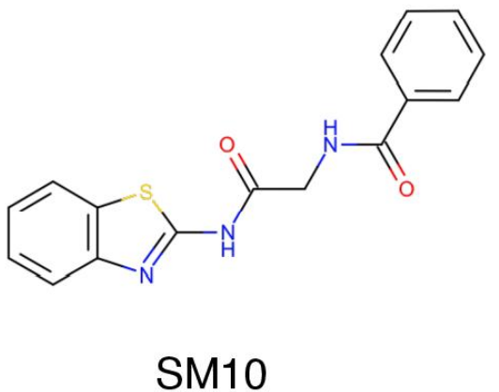
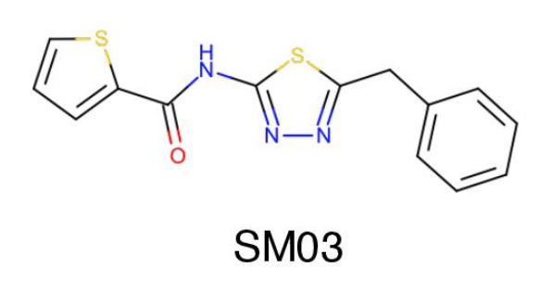
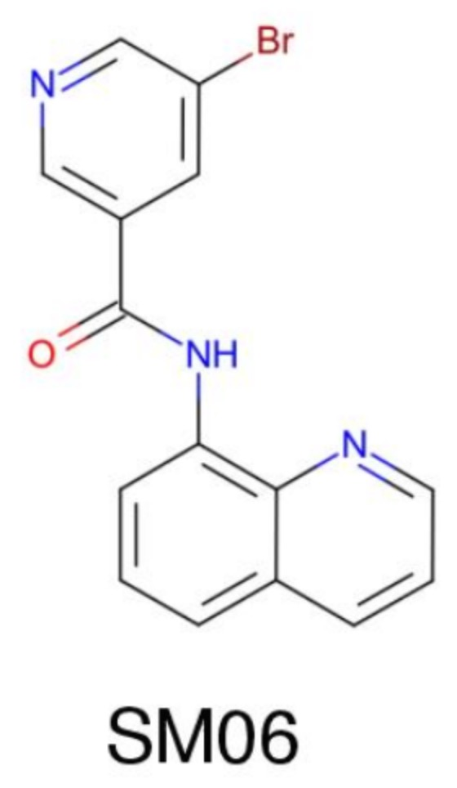
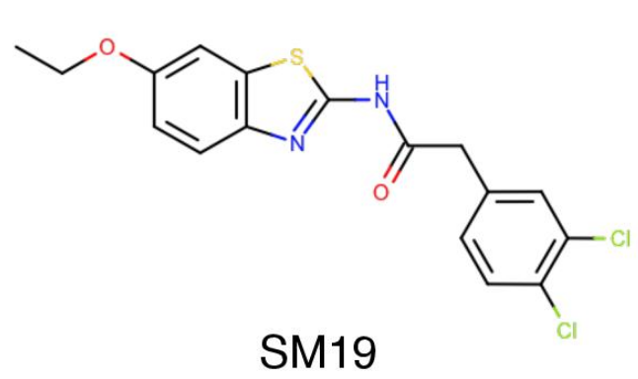
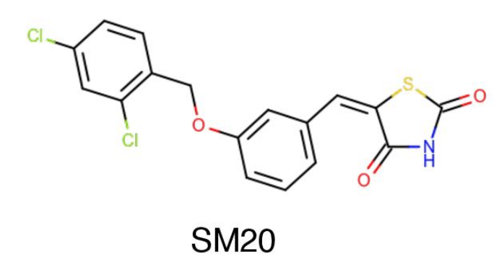
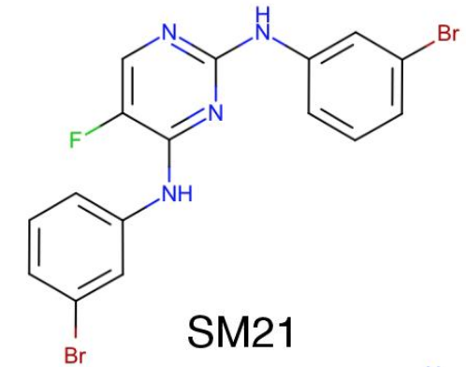
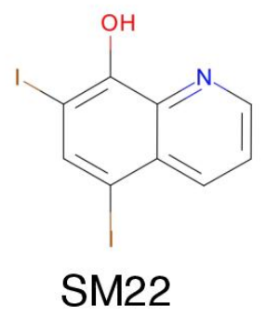
A
B
QM-based methods
Empirical methods
Molecule ID
Molecule ID
C SAMPL6 molecules with sulfur-containing heterocycles
3 experimental pK_{a} values
Sulfur-containing heterocycles
2 experimental pK_{a} values
Bromo and iodo groups
Amide groups
D SAMPL6 molecules with bromo and iodo groups

