Slide 1
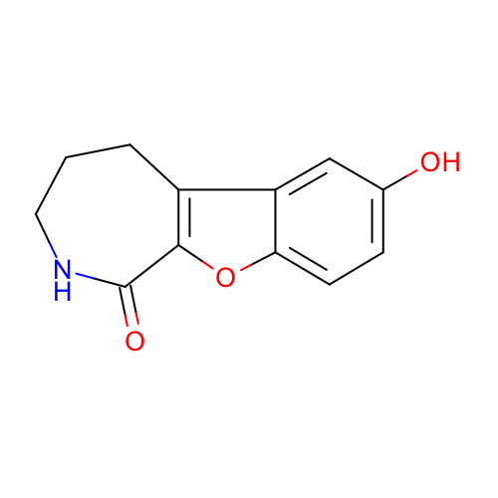
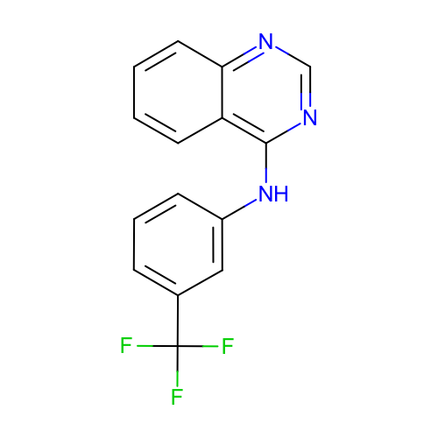
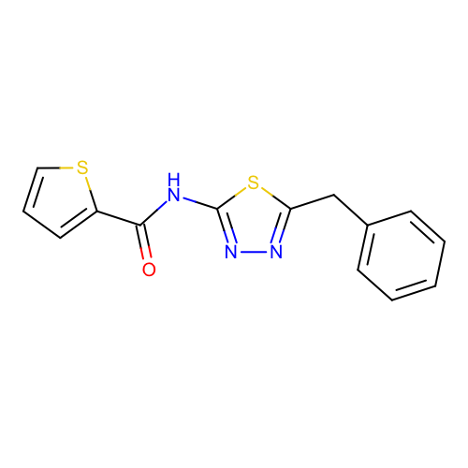
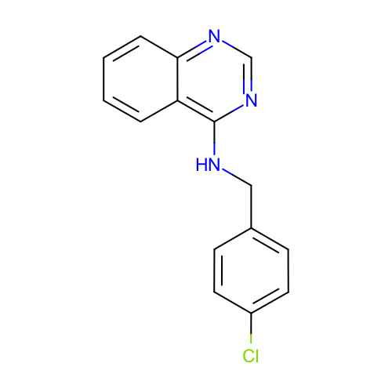
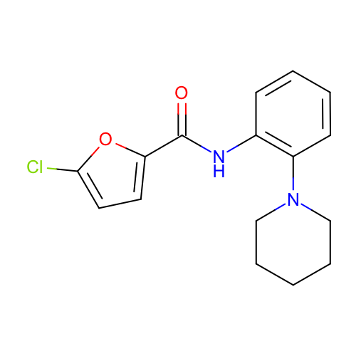
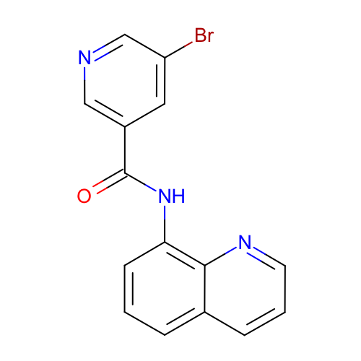
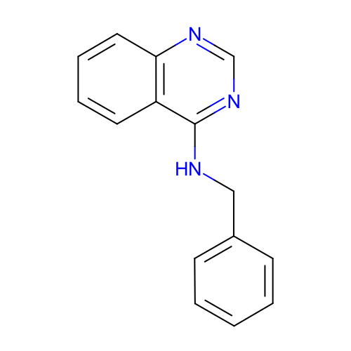
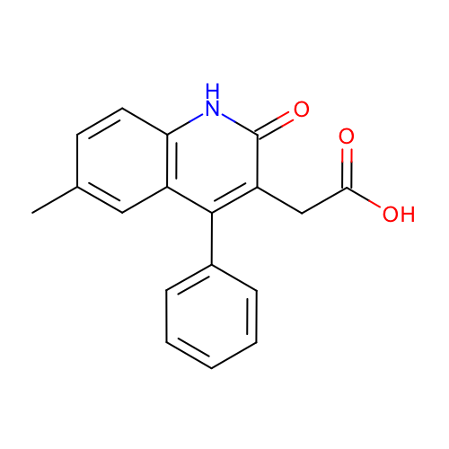
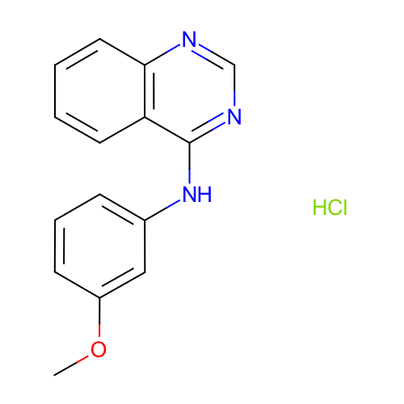
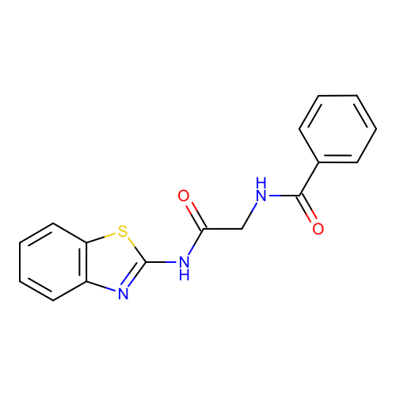
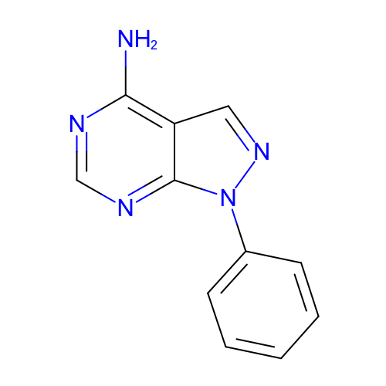
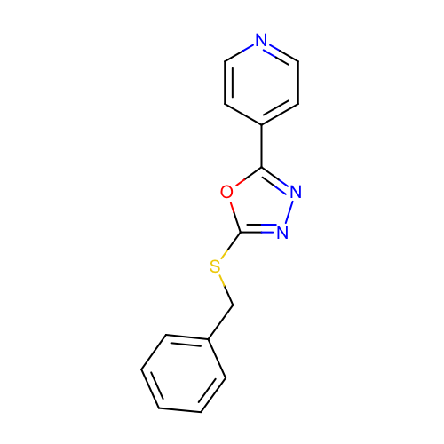
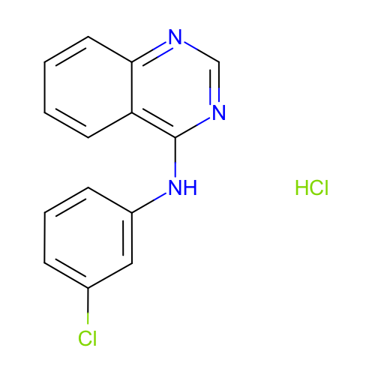
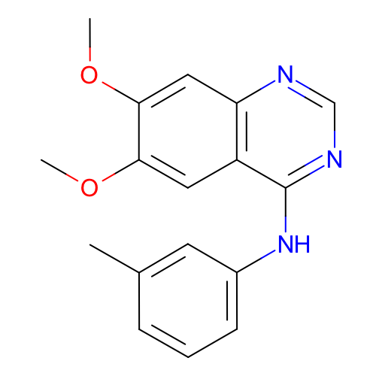
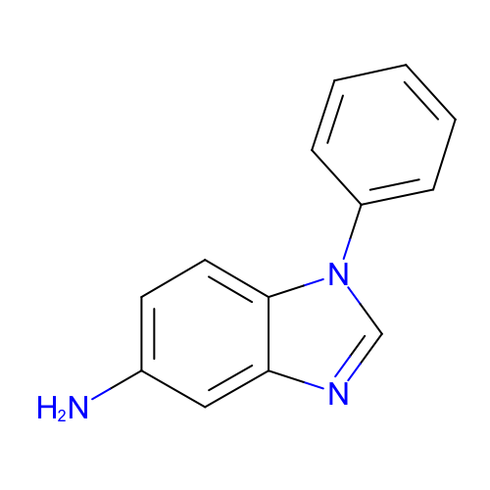
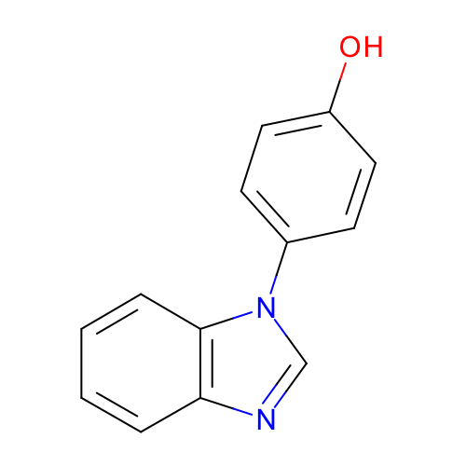
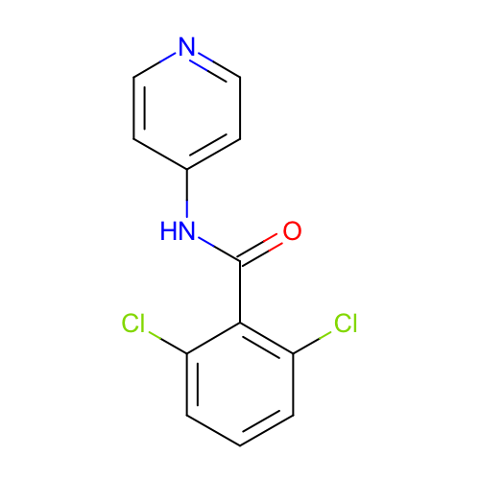
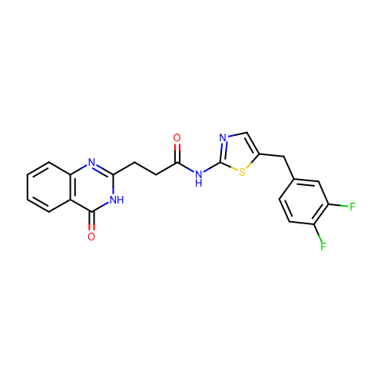
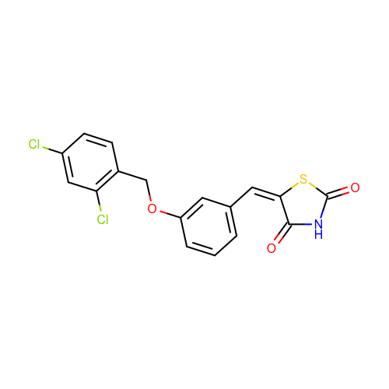
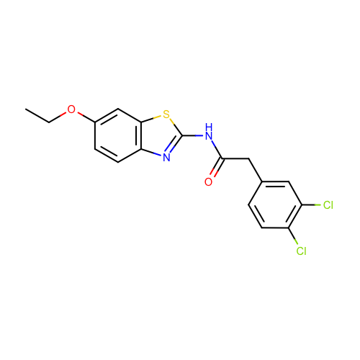
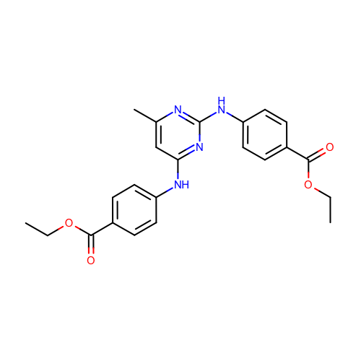
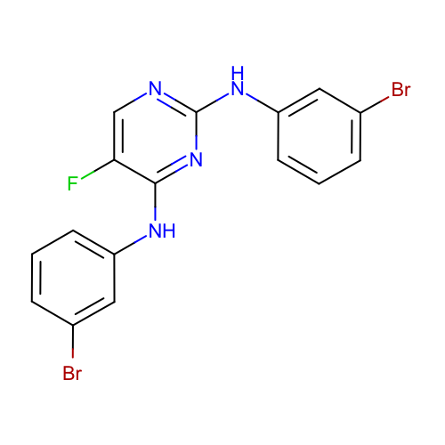
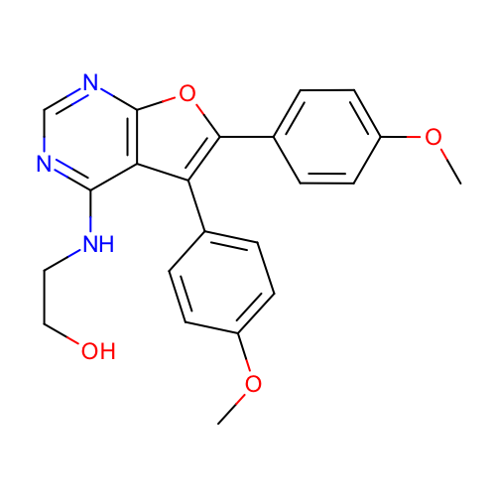
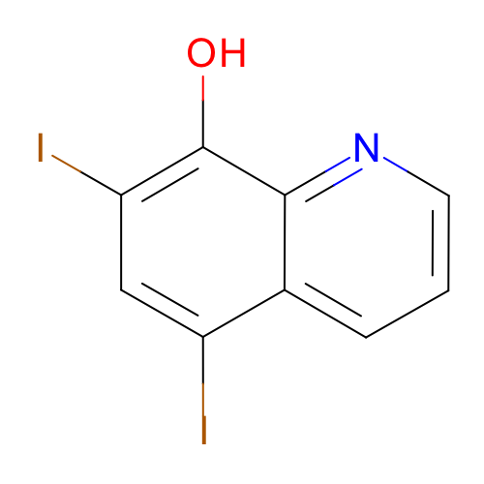
SM01
C: 0.72 [0.51, 0.99]
H: 0.72 [0.51, 0.99]
SM02
C: 1.01 [0.88, 1.15]
H: 1.01 [0.88, 1.15]
SM03
C: 2.39 [1.80, 3.02]
H: 2.39 [1.78, 3.00]
SM04
C: 0.98 [0.82, 1.16]
H: 0.98 [0.81, 1.15]
SM05
C: 1.59 [1.25, 1.94]
H: 1.59 [1.24, 1.93]
SM06
C: 1.67 [1.41, 1.95]
H: 2.03 [1.65, 2.47]
SM07
C: 1.51 [1.12, 1.94]
H: 1.51 [1.11, 1.94]
SM08
C: 0.87 [0.63, 1.13]
H: 0.87 [0.62, 1.15]
SM09
C: 1.06 [0.87, 1.26]
H: 1.06 [0.87, 1.26]
SM10
C: 2.24 [1.61, 2.90]
H: 2.24 [1.60, 2.93]
SM11
C: 0.79 [0.54, 1.05]
H: 0.79 [0.54, 1.06]
SM12
C: 1.05 [0.85, 1.26]
H: 1.05 [0.85, 1.26]
SM13
C: 1.01 [0.76, 1.26]
H: 1.01 [0.76, 1.27]
SM14
C: 2.72 [1.74, 3.89]
H: 1.45 [1.19, 1.73]
SM15
C: 1.02 [0.84, 1.20]
H: 1.04 [0.86, 1.22]
SM16
C: 1.04 [0.85, 1.25]
H: 1.07 [0.88, 1.28]
SM17
C: 1.19 [0.91, 1.47]
H: 1.19 [0.92, 1.48]
SM18
C: 0.62 [0.48, 0.76]
H: 1.06 [0.84, 1.33]
SM19
C: 2.23 [1.63, 2.90]
H: 2.23 [1.64, 2.89]
SM20
C: 1.69 [1.44, 1.94]
H: 1.69 [1.44, 1.93]
SM21
C: 2.00 [1.46, 2.57]
H: 2.00 [1.46, 2.56]
SM22
C: 1.61 [1.18, 2.10]
H: 1.73 [1.29, 2.21]
SM23
C: 1.12 [0.80, 1.47]
H: 1.12 [0.80, 1.46]
SM24
C: 1.01 [0.76, 1.26]
H: 1.01 [0.77, 1.26]

