Slide 1
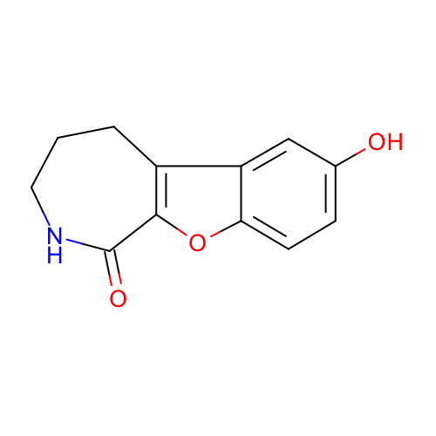
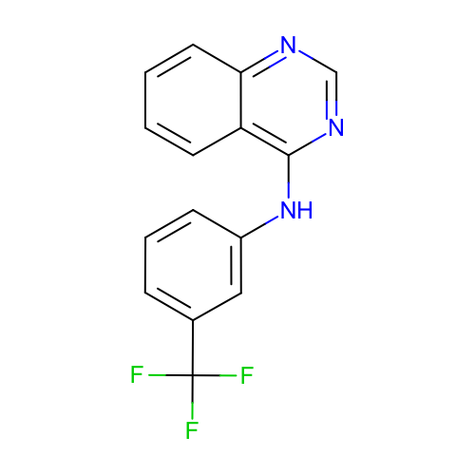
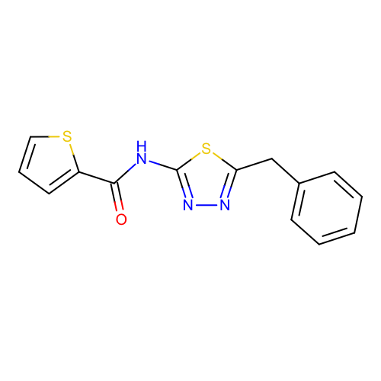
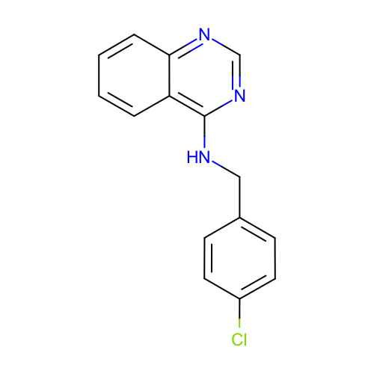
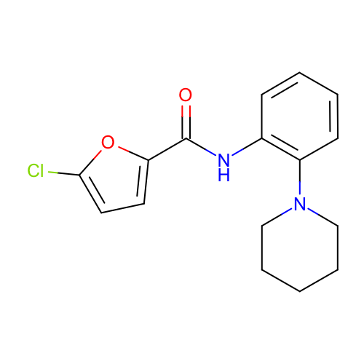
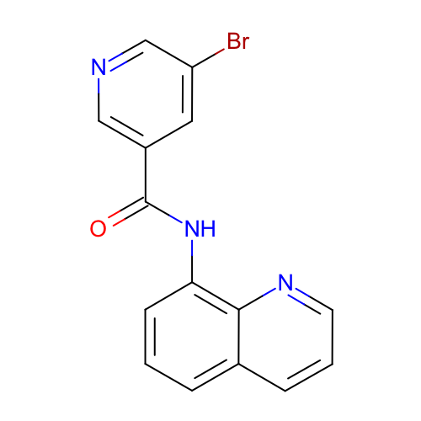
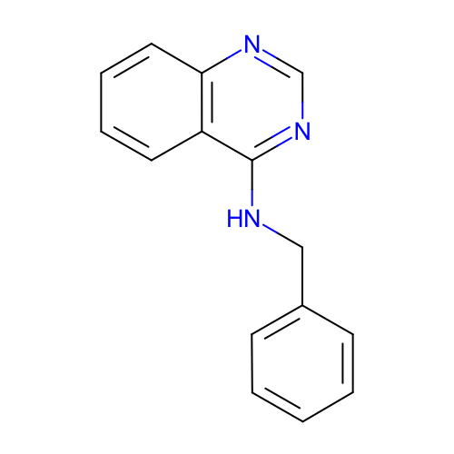
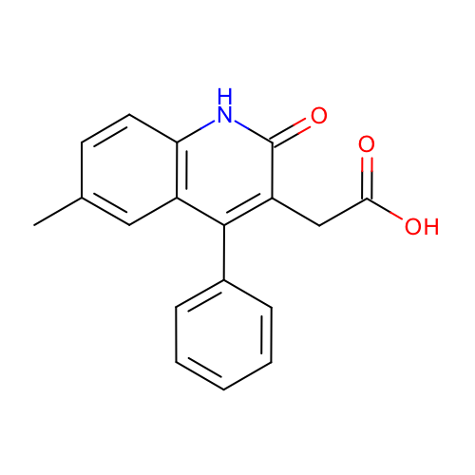
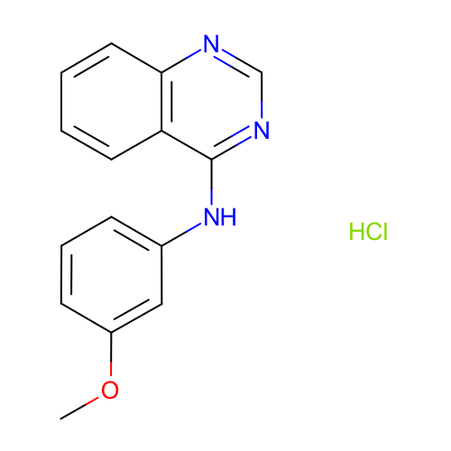
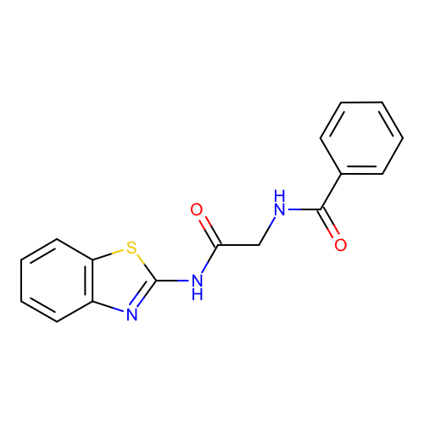
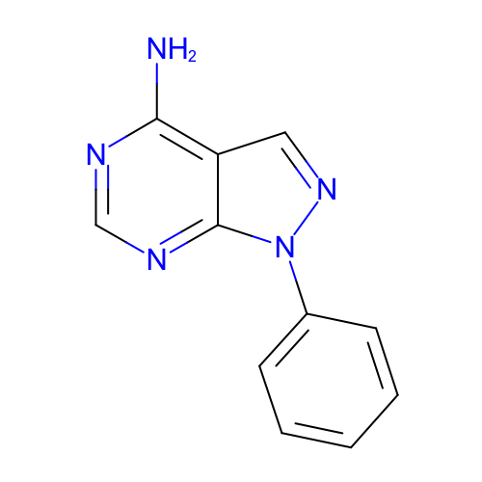
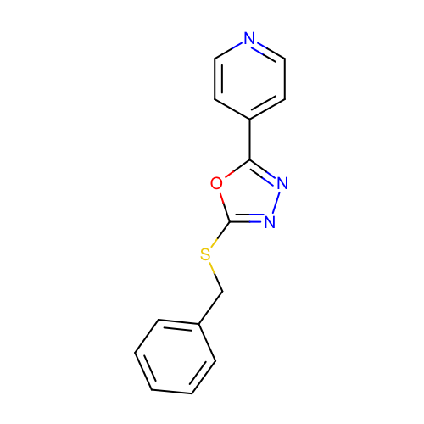
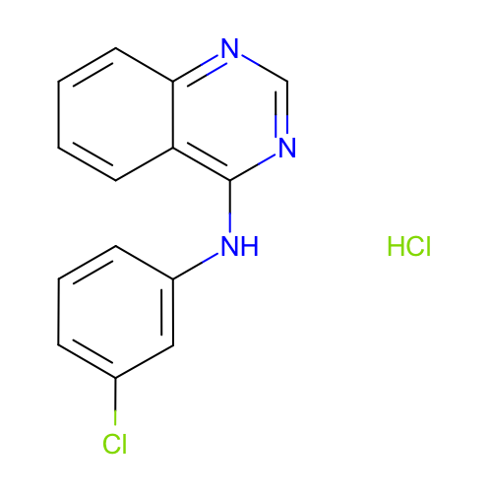
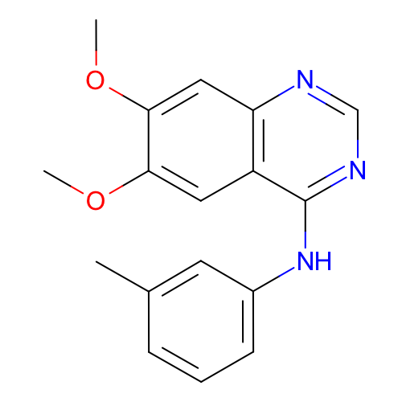
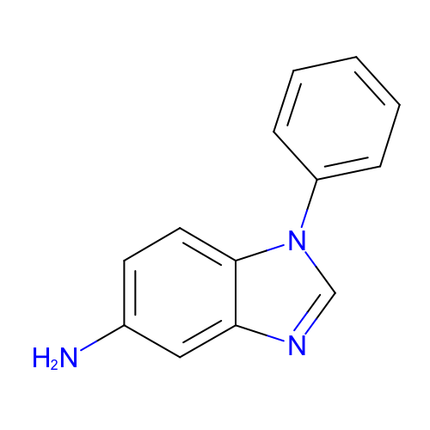
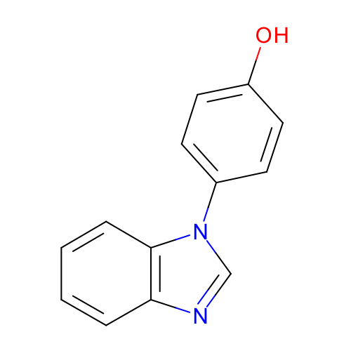
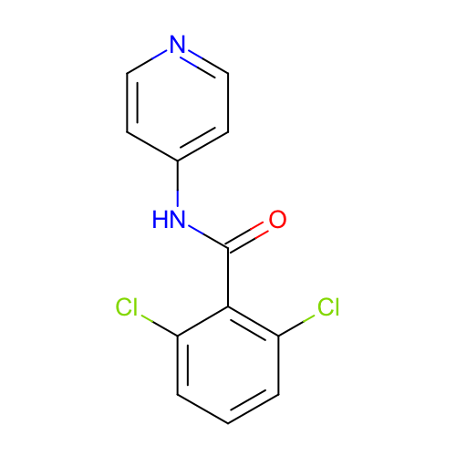
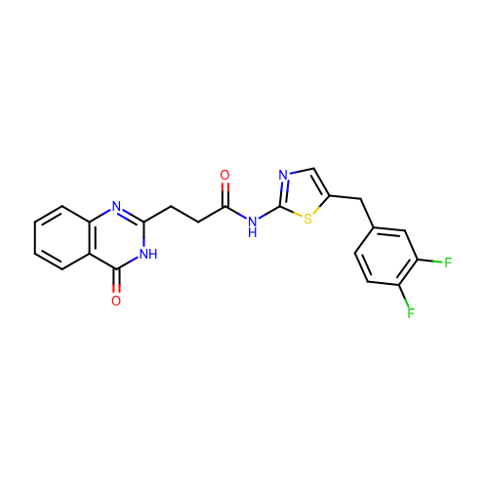
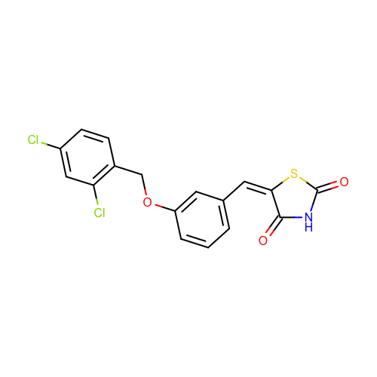
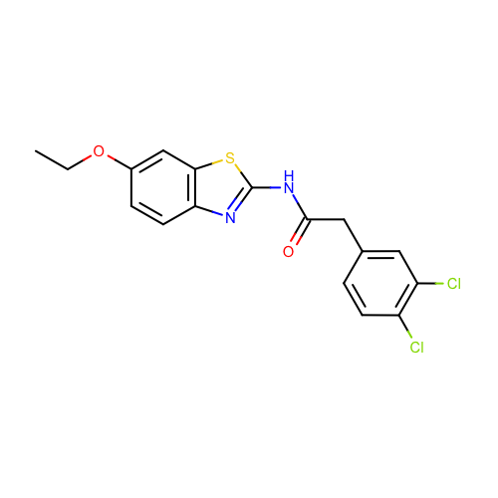
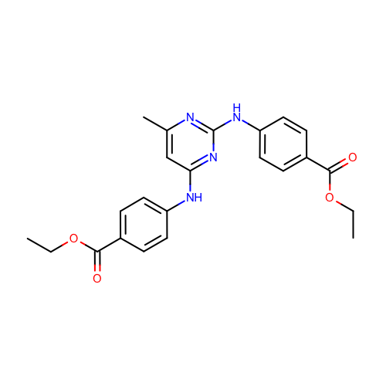
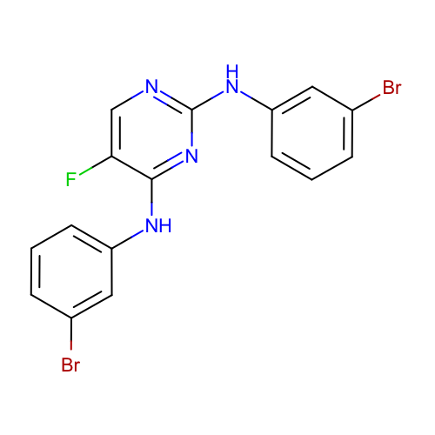
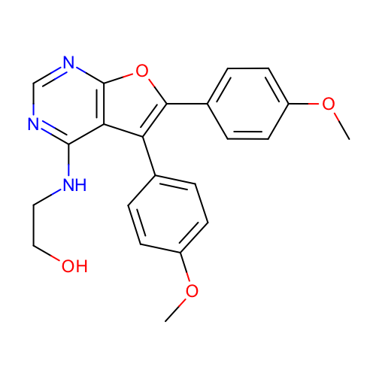
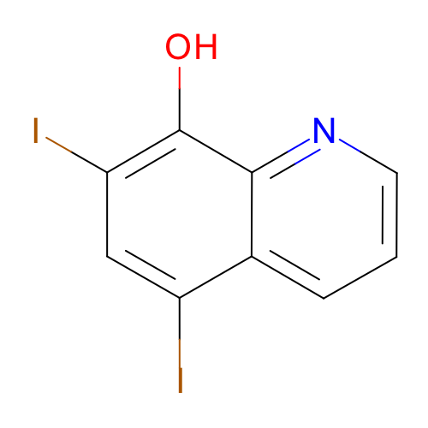
SM01
pK_{a} 9.53 ± 0.01
SM02
pK_{a} 5.03 ± 0.01
SM03
pK_{a} 7.02 ± 0.01
SM04
pK_{a} 6.02 ± 0.01
SM05
pK_{a} 4.59 ± 0.01
SM06
pK_{a1} 3.03 ± 0.04
pK_{a2} 11.74 ± 0.01
SM07
pK_{a} 6.08 ± 0.01
SM08
pK_{a} 4.22 ± 0.01
SM09
pK_{a} 5.37 ± 0.01
SM10
pK_{a} 9.02 ± 0.01
SM11
pK_{a} 3.89 ± 0.01
SM12
pK_{a} 5.28 ± 0.01
SM13
pK_{a} 5.77 ± 0.01
SM14
pK_{a1} 2.58 ± 0.01
pK_{a2} 5.30 ± 0.01
SM15
pK_{a1} 4.70 ± 0.01
pK_{a2} 8.94 ± 0.01
SM16
pK_{a1} 5.37 ± 0.01
pK_{a2} 10.65 ± 0.01
SM17
pK_{a} 3.16 ± 0.01
SM18
pK_{a1} 2.15 ± 0.02
pK_{a2} 9.58 ± 0.03
pK_{a3} 11.02 ± 0.04
SM19
pK_{a} 9.56 ± 0.02
SM20
pK_{a} 5.70 ± 0.03
SM21
pK_{a} 4.10 ± 0.01
SM22
pK_{a1} 2.40 ± 0.02
pK_{a2} 7.43 ± 0.01
SM23
pK_{a} 5.45 ± 0.01
SM23
pK_{a} 2.60 ± 0.01

