Slide 1
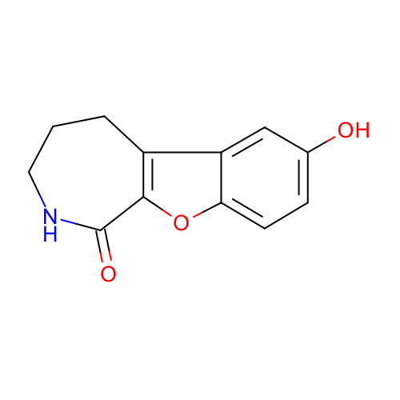
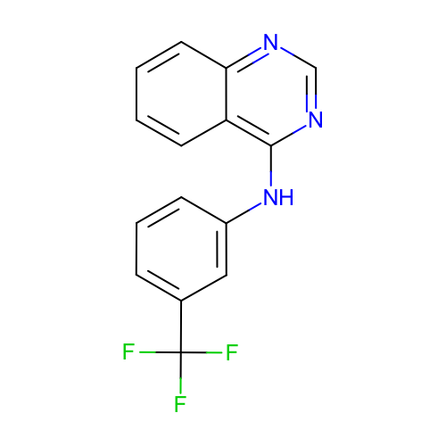
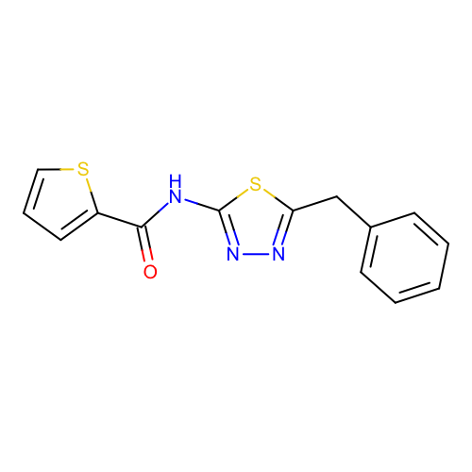
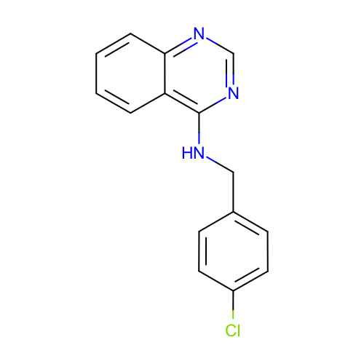
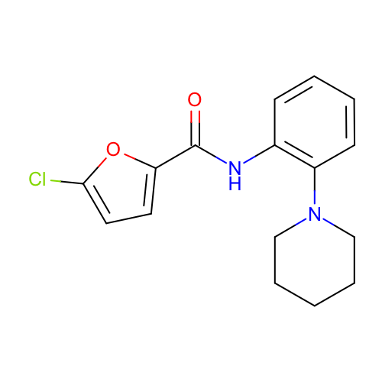
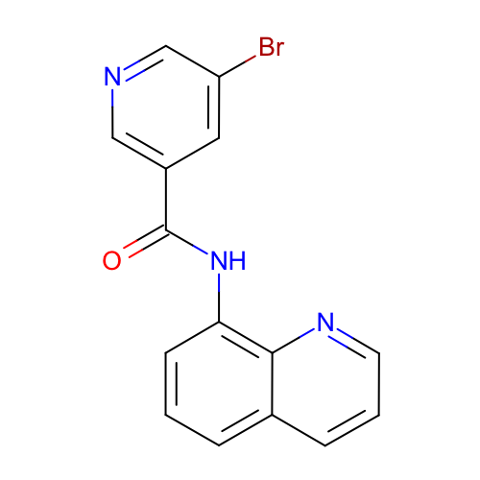
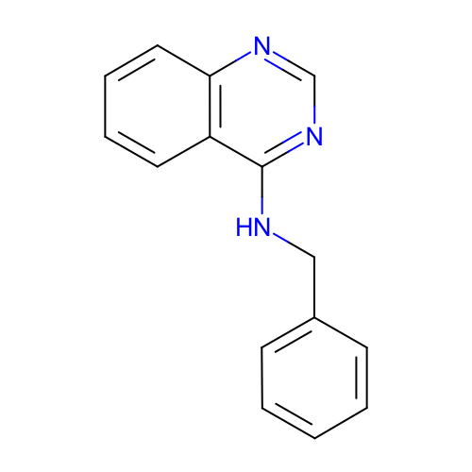
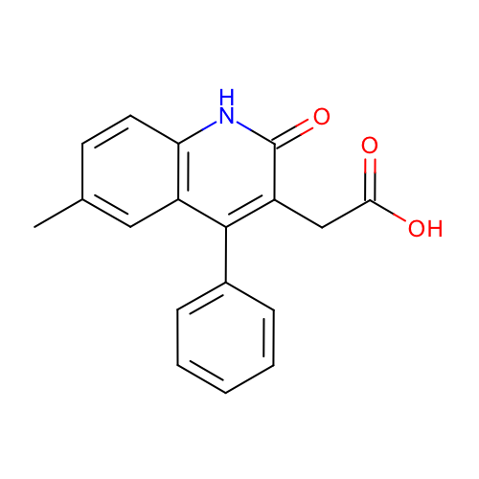
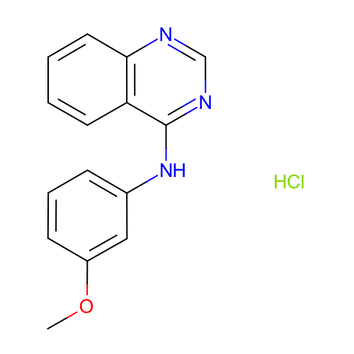
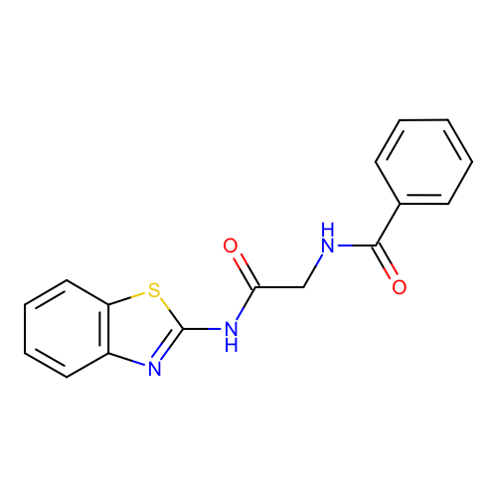
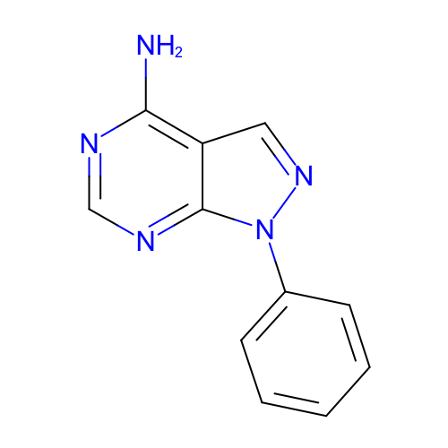
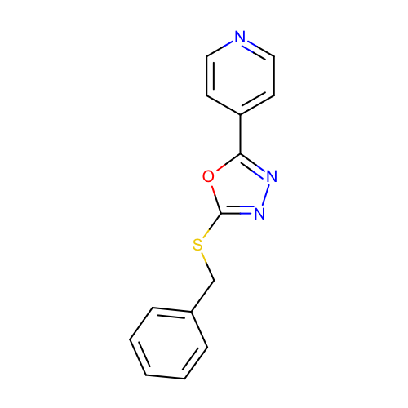
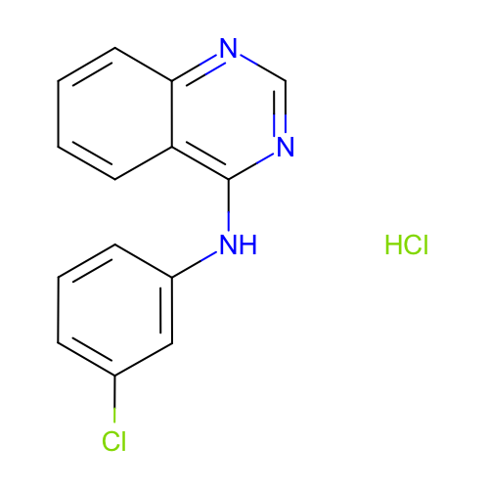
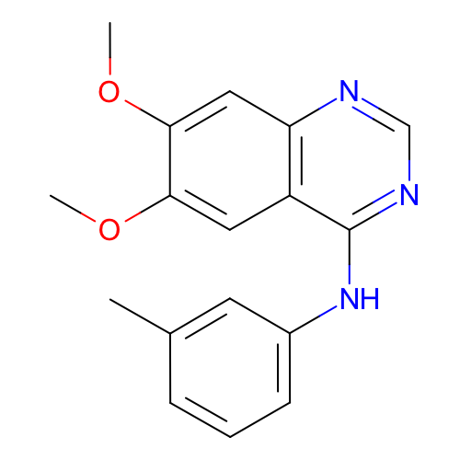
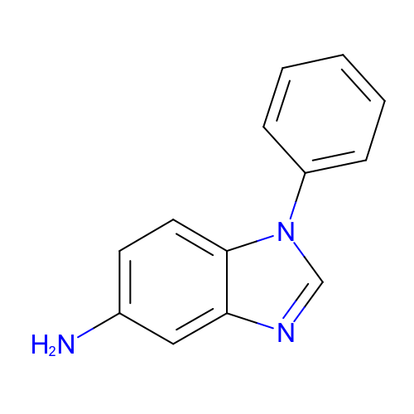
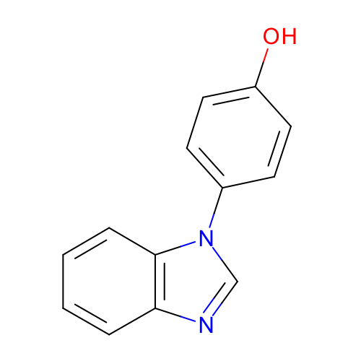
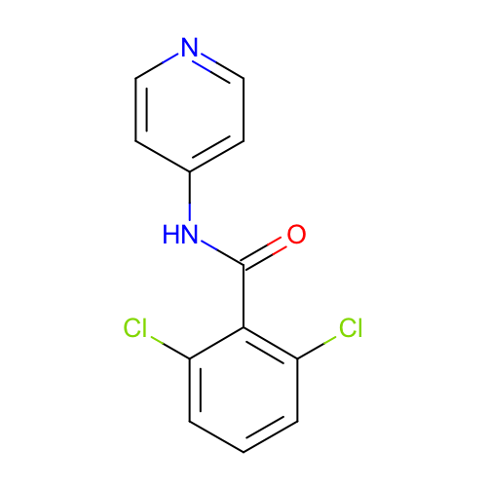
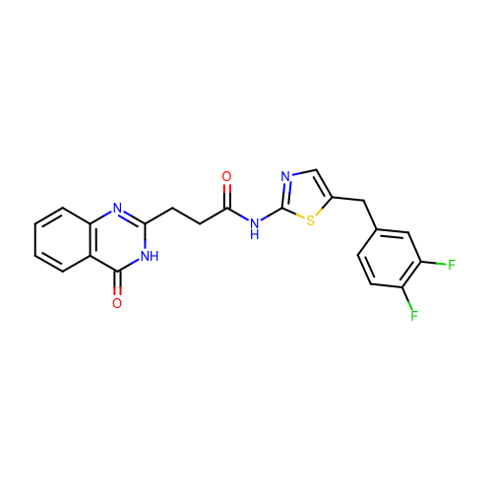
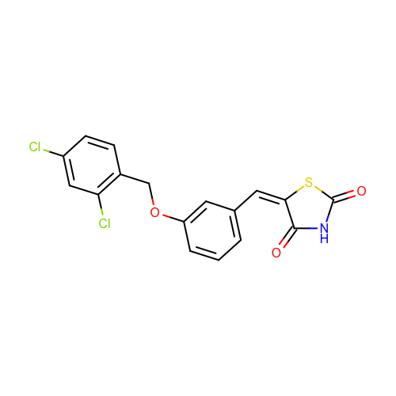
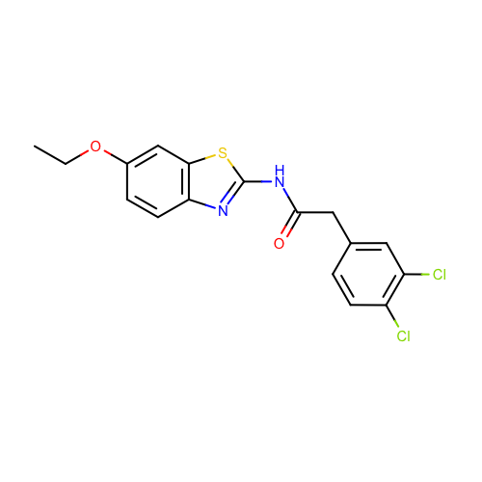
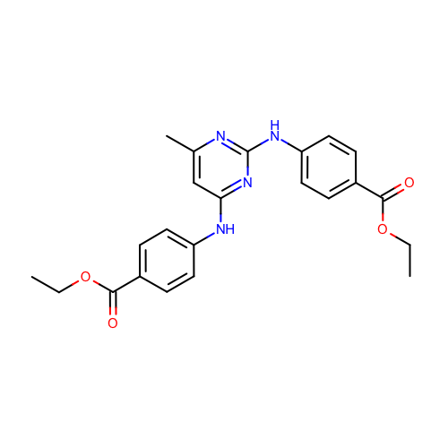
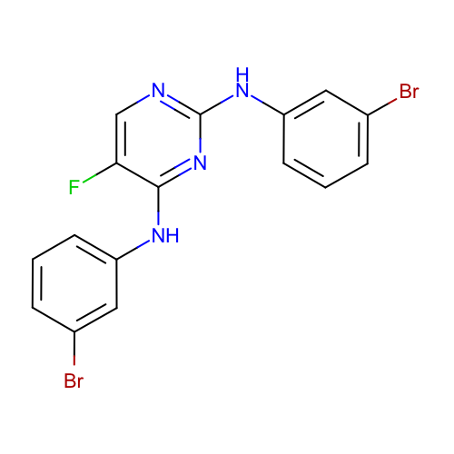
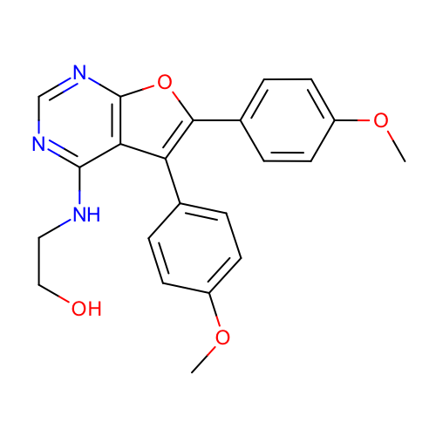
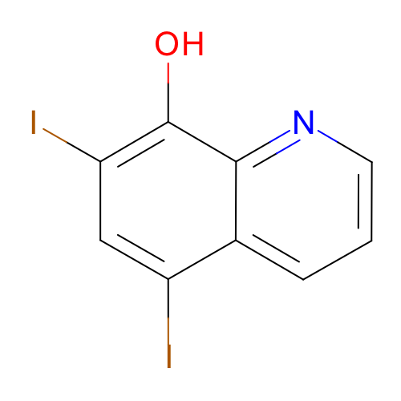
SM01
pKa₁ 9.53 ± 0.01
SM02
pKa₁ 5.03 ± 0.01
SM03
pKa₁ 7.02 ± 0.01
SM04
pKa₁ 6.02 ± 0.01
SM05
pKa₁ 4.59 ± 0.01
SM06
pKa₁ 3.03 ± 0.04
pKa₂ 11.74 ± 0.01
SM07
pKa₁ 6.08 ± 0.01
SM08
pKa₁ 4.22± 0.01
SM09
pKa₁ 5.37 ± 0.01
SM10
pKa₁ 9.02 ± 0.01
SM11
pKa₁ 3.89 ± 0.01
SM12
pKa₁ 5.28 ± 0.01
SM13
pKa₁ 5.77 ± 0.01
SM14
pKa₁ 2.58 ± 0.01
pKa₂ 5.30 ± 0.01
SM15
pKa₁ 4.70± 0.01
pKa₂ 8.94 ± 0.01
SM16
pKa₁ 5.37± 0.01
pKa₂ 10.65 ± 0.01
SM17
pKa₁ 3.16 ± 0.01
SM18
pKa₁ 2.15 ± 0.02
pKa₂ 9.58 ± 0.03
pKa₃ 11.02 ± 0.04
SM19
pKa₁ 9.56 ± 0.02
SM20
pKa₁ 5.70 ± 0.03
SM21
pKa₁ 4.10 ± 0.01
SM22
pKa₁ 2.40 ± 0.02
pKa₂ 7.43 ± 0.01
SM23
pKa₁ 5.45 ± 0.01
SM23
pKa₁ 2.60 ± 0.01

