Slide 1
From 0 to Spring Security 4.0
Rob Winch @rob_winch

Slide 2
Agenda
Introductions
Hello Spring Security (Java Config)
Custom Authentication
Spring Data Integration
Testing Support
WebSocket Support
White Hat Hacker

Slide 3

About Me
Open Source fanatic
Spring Security & Spring Project Lead
Committer on Spring Framework
Co-author of Spring Security 3.1 book
Twitter @rob_winch

Slide 4
What is Spring Security?
Comprehensive support for Authentication And Authorization
Protection against common attacks
Servlet API Integration
Optional integration with Spring MVC
Optional Spring Data Integration
WebSocket Support

Slide 5

Message Application
SPRING SECURITY
Notes:
7 minutes

Slide 6

Spring Security

Slide 7
web.xml
<filter>
<filter-name>springSecurityFilterChain</filter-name>
<filter-class> org.springframework.web.filter.DelegatingFilterProxy </filter-class>
</filter>
<filter-mapping>
<filter-name>springSecurityFilterChain</filter-name>
<url-pattern>/*</url-pattern>
</filter-mapping>

Slide 8
Hello Java Configuration – Replaces web.xml
public class SecurityWebInitializer
extends AbstractSecurityWebApplicationInitializer {
// optionally override methods
}

Slide 9
Hello Java Configuration – WebSecurityConfig
@Configuration
@EnableWebMvcSecurity
public class WebSecurityConfig
extends WebSecurityConfigurerAdapter {
...
}

Slide 10
Hello Java Configuration – WebSecurityConfig
@Autowired public void configureGlobal( AuthenticationManagerBuilder auth) throws Exception {
auth
.inMemoryAuthentication() .withUser("admin”) .password("password”) .roles("ADMIN","USER") .and() .withUser("user") .password("password") .roles("USER");
}

Slide 11
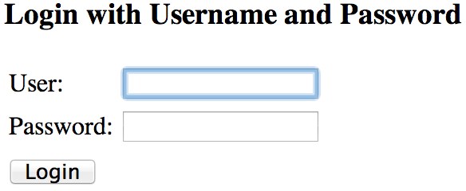
Hello Java Configuration

Slide 12


Hello Java Configuration

Slide 13
Hello Java Configuration
<div th:with="currentUser=${#httpServletRequest.userPrincipal?.name}">
<div th:if="${currentUser != null}">
<form th:action="@{/logout}" method="post”> <input type="submit" value="Log out" /> </form>
<p th:text="${currentUser}”> sample_user </p>
</div>

Slide 14
Hello Java Configuration
<div th:with="currentUser=${#httpServletRequest.userPrincipal?.name}">
<div th:if="${currentUser != null}">
<form th:action="@{/logout}" method="post”> <input type="submit" value="Log out" /> </form>
<p th:text="${currentUser}”> sample_user </p>
</div>
public interface HttpServletRequest … { Principal getUserPrincipal(); ...
}

Slide 15
Hello Java Configuration
<div th:with="currentUser=${#httpServletRequest.userPrincipal?.name}">
<div th:if="${currentUser != null}">
<form th:action="@{/logout}" method="post”> <input type="submit" value="Log out" /> </form>
<p th:text="${currentUser}”> sample_user </p>
</div>
public interface Principal … { String getName(); ...
}

Slide 16
Hello Java Configuration
<div th:with="currentUser=${#httpServletRequest.userPrincipal?.name}">
<div th:if="${currentUser != null}">
<form th:action="@{/logout}" method="post”> <input type="submit" value="Log out" /> </form>
<p th:text="${currentUser}”> sample_user </p>
</div>
</div>

Slide 17
Custom Log in Form
Notes:
13 min

Slide 18
Java Configuration
@Override protected void configure(HttpSecurity http) throws Exception {
http .authorizeRequests() .anyRequest().authenticated() .and() .formLogin().and() .httpBasic();
}

Slide 19
Java Configuration
http .authorizeRequests() .anyRequest().authenticated() .and() .formLogin().and() .httpBasic();
<http use-expressions="true">
<intercept-url pattern="/**" access="authenticated"/>
<form-login />
<http-basic />
</http>

Slide 20
Java Configuration
http
.authorizeRequests() .anyRequest().authenticated() .and() .formLogin() .loginPage("/login”) .permitAll() .and() .logout() .permitAll();

Slide 21
Java Configuration
http
.authorizeRequests() .antMatchers("/resources/**”).permitAll() .anyRequest().authenticated() .and() .formLogin() .loginPage("/login”) .permitAll() .and() .logout() .permitAll();

Slide 22
Java Configuration
<form th:action="@{/login}" method="post">
<label for="username">Username</label>
<input type="text" id="username" name="username"/>
<label for="password">Password</label>
<input type="password" id="password" name="password"/>
<button type="submit">Log in</button>
</form>

Slide 23
Java Configuration
<form th:action="@{/login}" method="post">
<label for="username">Username</label>
<input type="text" id="username" name="username"/>
<label for="password">Password</label>
<input type="password" id="password" name="password"/>
<button type="submit">Log in</button>
</form>

Slide 24
Java Configuration
<form th:action="@{/login}" method="post">
<label for="username">Username</label>
<input type="text" id="username" name="username"/>
<label for="password">Password</label>
<input type="password" id="password" name="password"/>
<button type="submit">Log in</button>
</form>
http
…. .formLogin() .loginPage("/login”)

Slide 25
Custom Authentication
Notes:
20 min / 25 min

Slide 26
Java Configuration – Custom Authentication
public interface UserDetailsService {
UserDetails loadUserByUsername(String username) throws UsernameNotFoundException;
}

Slide 27
Java Configuration – Custom Authentication
public interface UserDetails extends Serializable {
Collection<? extends GrantedAuthority> getAuthorities();
String getPassword();
String getUsername();
boolean isAccountNonExpired();
boolean isAccountNonLocked();
boolean isCredentialsNonExpired();
boolean isEnabled();
}

Slide 28
Java Configuration – Custom Authentication
@Entity
public class User implements Serializable {
@Id @GeneratedValue(strategy = GenerationType.AUTO) private Long id;
private String firstName;
private String lastName;
private String email;
private String password;
...
}

Slide 29
Java Configuration – Custom Authentication
pubic class CustomUserDetails extends User implements UserDetails {
public CustomUserDetails(User u) { super(user); }
public Collection getAuthorities() { return AuthorityUtils.createAuthorityList("ROLE_USER"); }
public String getUsername() { return getEmail(); }
public boolean isEnabled() { return true; }
...

Slide 30
Java Configuration – Custom Authentication
public UserDetails loadUserByUsername(String username) throws UsernameNotFoundException {
User user = userRepository.findByEmail(username); if(user == null) { throw new UsernameNotFoundException(…); }
return new CustomUserDetails(user);
}

Slide 31
Java Configuration – Custom Authentication
@Autowired public void configureGlobal( AuthenticationManagerBuilder auth, UserDetailsService userDetailsService) throws Exception {
auth .userDetailsService(userDetailsService);
}

Slide 32
Java Configuration – Custom Authentication
<div th:with="currentUser=${#httpServletRequest.userPrincipal?.name}">
<div th:if="${currentUser != null}">
<form th:action="@{/logout}" method="post”> <input type="submit" value="Log out" /> </form>
<p th:text="${currentUser}”> sample_user </p>
</div>

Slide 33
Java Configuration – Custom Authentication
<div th:with="currentUser=${#httpServletRequest.userPrincipal?.name}">
<div th:if="${currentUser != null}">
<form th:action="@{/logout}" method="post”> <input type="submit" value="Log out" /> </form>
<p th:text="${currentUser}”> sample_user </p>
</div>
public interface HttpServletRequest … { Principal getUserPrincipal(); ...
}

Slide 34
Java Configuration – Custom Authentication
<div th:with="currentUser=${#httpServletRequest.userPrincipal?.name}">
<div th:if="${currentUser != null}">
<form th:action="@{/logout}" method="post”> <input type="submit" value="Log out" /> </form>
<p th:text="${currentUser}”> sample_user </p>
</div>
public interface HttpServletRequest … { (Authentication) Principal getUserPrincipal(); ...
}

Slide 35
Java Configuration – Custom Authentication
<div th:with="currentUser=${#httpServletRequest.userPrincipal?.principal}">
<div th:if="${currentUser != null}">
<form th:action="@{/logout}" method="post”> <input type="submit" value="Log out" /> </form>
<p th:text="${currentUser}”> sample_user </p>
</div>
public interface Authentication … { Object getPrincipal(); ...
}

Slide 36
Java Configuration – Custom Authentication
<div th:with="currentUser=${#httpServletRequest.userPrincipal?.principal}">
<div th:if="${currentUser != null}">
<form th:action="@{/logout}" method="post”> <input type="submit" value="Log out" /> </form>
<p th:text="${currentUser}”> sample_user </p>
</div>
public interface Authentication … { (UserDetails) Object getPrincipal(); ...
}

Slide 37
Java Configuration – Custom Authentication
<div th:with="currentUser=${#httpServletRequest.userPrincipal?.principal}">
<div th:if="${currentUser != null}">
<form th:action="@{/logout}" method="post”> <input type="submit" value="Log out" /> </form>
<p th:text="${currentUser}”> sample_user </p>
</div>
public interface Authentication … { (CustomUserDetails) Object getPrincipal(); ...
}

Slide 38
Java Configuration – Custom Authentication
public class CustomUserDetails … { String getFirstName(); ...
}
<div th:with="currentUser=${#httpServletRequest.userPrincipal?.principal}">
<div th:if="${currentUser != null}">
<form th:action="@{/logout}" method="post”> <input type="submit" value="Log out" /> </form>
<p th:text="${currentUser.firstName}”> sample_user </p>
</div>

Slide 39
Java Configuration – Custom Authentication
@RequestMapping(method=RequestMethod.GET) public ModelAndView list() { SecurityContext ctx = SecurityContextHolder.getContext();
Authentication authentication = ctx.getAuthentication();
User custom = authentication == null ? null : (User) authentication.getPrincipal();
...
}

Slide 40
Java Configuration – Custom Authentication
@RequestMapping(method=RequestMethod.GET) public ModelAndView list(Authentication authentication) { User custom = authentication == null ? null : (User) authentication.getPrincipal();
...
}

Slide 41
Java Configuration – Custom Authentication
@RequestMapping(method=RequestMethod.GET) public ModelAndView list( @AuthenticationPrincipal User currentUser) {
...
}

Slide 42
Java Configuration – Custom Authentication
@Target(ElementType.PARAMETER) @Retention(RetentionPolicy.RUNTIME) @Documented @AuthenticationPrincipal public @interface CurrentUser { }

Slide 43
Java Configuration – Custom Authentication
@RequestMapping(method=RequestMethod.GET) public ModelAndView list( @CurrentUser User currentUser) {
Iterable<Message> messages = messageRepository.findByToId(currentUser.getId());
...
}

Slide 44
Spring Security / Spring Data
SpEL Support
Notes:
33 min / 38 min

Slide 45
Spring Security / Spring Data
@Bean public SecurityEvaluationContextExtension securityEvaluationContextExtension() {
return new SecurityEvaluationContextExtension();
}

Slide 46
Spring Security / Spring Data
public interface MessageRepository extends CrudRepository<Message, Long> {
@Query("select m from Message m where m.to.id = " + "?#{principal.id}”) Iterable<Message> findAllToCurrentUser();
}

Slide 47
Spring Security / Spring Data
public interface MessageRepository extends CrudRepository<Message, Long> {
@Query("select m from Message m where m.to.id = " + "?#{hasRole('ROLE_ADMIN') ? '%' : principal.id}”) Iterable<Message> findAll();
}

Slide 48

Spring Security / Spring Data

Slide 49
In the year 2000….
@EnableAclSecurity public interface SecuredMessageRepository extends MessageRepository {}

Slide 50
Password Storage
Notes:
53

Slide 51
Password Storage
auth .userDetailsService(userDetailsService)
.passwordEncoder(new BCryptPasswordEncoder());

Slide 52
CSRF Protection
Notes:
39 min

Slide 53
CSRF Protection
SPRING SECURITY

Slide 54
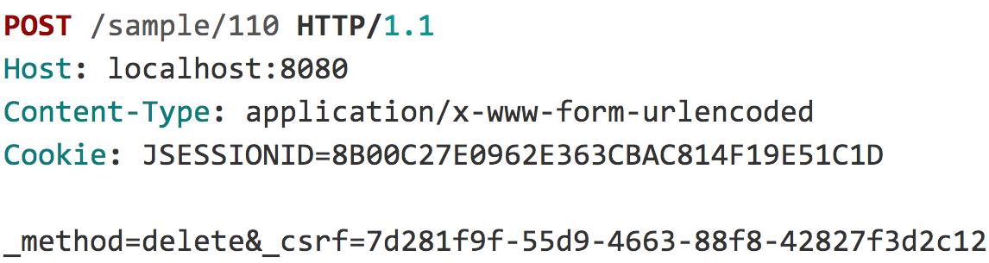
CSRF Protection

Slide 55
CSRF Protection

Slide 56
CSRF Protection
“
When do I use CSRF protection?
Notes:
When the application is intended to be ran in a browser

Slide 57
CSRF Protection
“
... but my application uses JSON

Slide 58
CSRF Protection
<form ... method="post" enctype="text/plain">
<input type='hidden'
name=’{"summary":"Hi", … "ignore_me":"' value='test"}' />
</form>

Slide 59
CSRF Protection
{ "summary": "Hi",
"message": "New Message",
"to": "luke@example.com",
"ignore_me": "=test"
}

Slide 60
CSRF Protection
“
… but my application is stateless

Slide 61
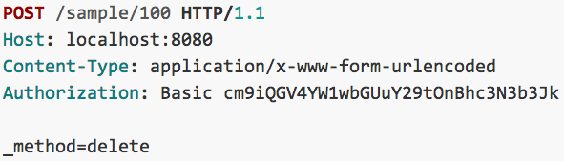
CSRF Protection

Slide 62
CSRF Protection
“
…and I use a custom header for authentication and ignore cookies

Slide 63
CSRF Protection
Use proper HTTP Verbs
Configure CSRF Protection
Include the CSRF Token

Slide 64
CSRF Protection – Providing the Token
<form ... method="post">
...
<input type="hidden"
name="${_csrf.parameterName}"
value="${_csrf.token}"/>
</form>

Slide 65
CSRF Protection – Providing the Token
<form ... method="post">
...
<sec:csrfInput />
</form>

Slide 66
CSRF Protection – Providing the Token
<form:form … method="post”>
...
</form:form>

Slide 67
CSRF Protection – Providing the Token
<form ... method="post">
...
<input type="hidden" name="_csrf" value="f81d4fae-…"/>
</form>

Slide 68
Security HTTP Response Headers
Notes:
52 min

Slide 69
Click Jacking
SPRING SECURITY

Slide 70
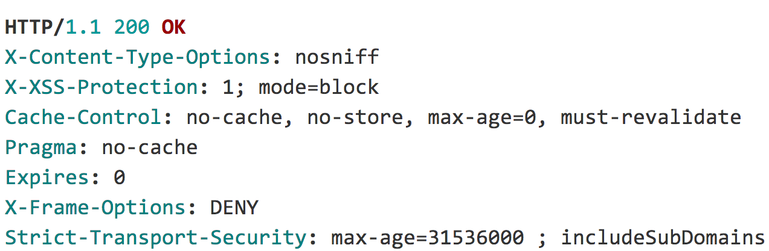
Security HTTP Response Headers
Notes:
112 min

Slide 71
Security HTTP Response Headers

Slide 72
Test Support
Notes:
101 min

Slide 73
Testing Support
@Before public void setup() { Authentication auth = new TestingAuthenticationToken("user",”pass","ROLE_USER");
SecurityContext ctx = SecurityContextHolder.getContext(); ctx.setAuthentication(auth); SecurityContextHolder.setContext(ctx); }
@After public void cleanup() { SecurityContextHolder.clearContext(); }

Slide 74
Testing Support
UserDetails user = ...
List<GrantedAuthority> roles = AuthorityUtils.createAuthorityList("ROLE_USER");
Authentication auth = new UsernamePasswordAuthenticationToken(user,”pass", roles);
SecurityContext ctx = SecurityContextHolder.getContext();
ctx.setAuthentication(auth);

Slide 75
Testing Support
User user = ...
List<GrantedAuthority> roles = AuthorityUtils.createAuthorityList("ROLE_USER");
Authentication auth = new UsernamePasswordAuthenticationToken(user,”pass", roles);
SecurityContext ctx = SecurityContextHolder.getContext();
ctx.setAuthentication(auth);

Slide 76
Testing Support
...
@WithMockUser public class SecurityMethodTests {
...
}

Slide 77
Testing Support
...
public class SecurityMethodTests {
@Test @WithMockUser public void findAllMessages() {
...
}
}

Slide 78
Testing Support
...
public class SecurityMethodTests {
@Test @WithMockUser(username="admin",roles="ADMIN”) public void findAllMessages() {
repository.findAll();
} }

Slide 79
Testing Support
...
public class SecurityMethodTests {
@Test @WithUserDetails(”rob@example.com") public void findAllMessages() {
repository.findAll();
} }

Slide 80
Testing Support
@Target({ ElementType.METHOD, ElementType.TYPE }) @Retention(RetentionPolicy.RUNTIME) @Inherited @Documented @WithSecurityContext(factory = WithCustomUserSecurityContextFactory.class) public @interface WithCustomUser {
String email() default "rob@example.com";
String firstName() default "Rob";
String lastName() default "Winch";
long id() default 0L;
}

Slide 81
Testing Support
public class WithCustomUserSecurityContextFactory implements WithSecurityContextFactory<WithCustomUser> {
public SecurityContext createSecurityContext(WithCustomUser customUser) {
User principal = new User(); principal.setEmail(customUser.email());
...
return ctx;
}
}

Slide 82
Testing Support
...
public class SecurityMethodTests {
@Test @WithCustomUser public void findAllMessages() {
repository.findAll();
} }

Slide 83
Testing Support
...
public class SecurityMethodTests {
@Test @WithCustomUser(id=1,email=”luke@example.com") public void findAllMessages() {
repository.findAll();
} }

Slide 84
Testing Support
“
…what about Spring Test MVC?

Slide 85
Testing Support
... public class SecurityMockMvcTests {
@Before public void setup() { mvc = MockMvcBuilders .webAppContextSetup(context) .apply(springSecurity()) .build();
}

Slide 86
Testing Support
@Test @WithCustomUser public void inboxShowsOnlyTo() throws Exception {
...
}

Slide 87
Testing Support
@Test @WithCustomUser(id=1,email=”luke@example.com") public void inboxShowsOnlyTo() throws Exception {
...
}

Slide 88
Testing Support
@Test @WithCustomUser public void compose() throws Exception {
MockHttpServletRequestBuilder compose = post("/”) .param("summary", "Hello Luke”) .param("message", "This is my message”) .with(csrf());
mvc .perform(compose) .andExpect(status().is2xxSuccessful());
}

Slide 89
WebSocket Security
Notes:
108 min
Already have authentication, how it works, need authorization

Slide 90
Web Socket Authorization
SPRING SECURITY

Slide 91
WebSocket Authorization
Browser
/app/im
@MessageMapping("/im")
/queue/messages-user<id>
Client (Web Browser)

Slide 92
WebSocket Authorization
@Configuration
public class WebSocketSecurityConfig extends AbstractSecurityWebSocketMessageBrokerConfigurer {

Slide 93
WebSocket Authorization
protected void configure( MessageSecurityMetadataSourceRegistry messages) {
messages
.matchers(message("/topic/**","/queue/**")).denyAll()
.anyMessage().hasRole("USER");
}

Slide 94
WebSocket Authorization
// avoid processing outbound channel
public void configureClientOutboundChannel(
ChannelRegistration registration) {}

Slide 95
WebSocket Security
Spring Session
Notes:
Keep Alive, Clustering, determine session id in header, allow users to invalidate suspicious sessions, sessions on other systems (i.e. Messaging)

Slide 96

Learn More. Stay Connected.
Source http://github.com/rwinch/spring-security-0-to-4.0
http://spring.io/spring-security
Twitter: @rob_winch
Security for Microservices with Spring & OAuth2 – 4:30 Today
Notes:
132 min

