Slide 1
Customer Retention Data Analysis
Team Members: Jingning Li, Rithvik Mundra, Aida Roxas, Zhian Wang, Rongchu Zhao, Zezhi Zhou, Daniel Chen

Slide 2
INTRODUCTON
We are the leading cellular provider in the US. To maintain this, we need to increase our customer base, or decrease our customer turnover. Our team investigated current data and will propose a course of action for our company to tackle the latter issue.
Currently we are losing 15% of our customers as they are moving to our competitors. We have developed a model that can predict this behavior and enable us to mitigate this risk.
Introduction | Data Preparation | Methods | Results | Conclusion | Appendix

Slide 3
Data Preparation
Examining and understanding data
3332 records, with no Missing Value
Dependent variable: Churn (14.5% TRUE; 85.5% FALSE)
18 Independent variables
Exploring data and transforming variables
Binning NV Mail Msgs : highly skewed to the right
Value Ordering – Churn, IntlPlan, VMPlan
Taking out State from independent variables for simplicity
Using Cross-Validation
Training=50%
Validation =25%
Test=25%
Introduction | Data Preparation | Methods | Results | Conclusion | Appendix

Slide 4
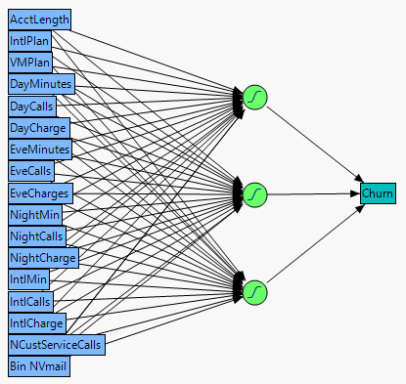
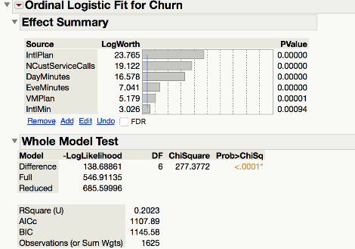
Attempted Models #1 & #2: Logistic & Neural Network
Introduction | Data Preparation | Methods | Results | Conclusion | Appendix

Slide 5
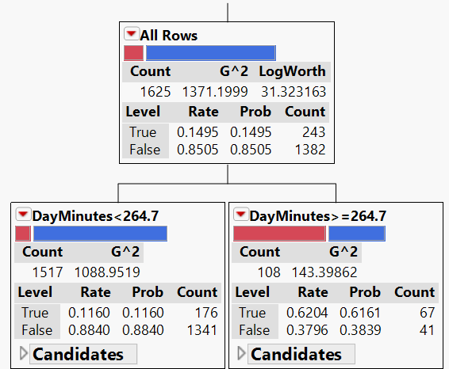
Model #3: Decision Tree
Decision Tree is an intuitive way to approach the churn problem.
Divide and Conquer technique.
Hierarchical tree like structure to split users based on a series of nested if-then statements.
Splits are made on the most significant variables.
14 splits in the model.
Introduction | Data Preparation | Methods | Results | Conclusion | Appendix

Slide 6
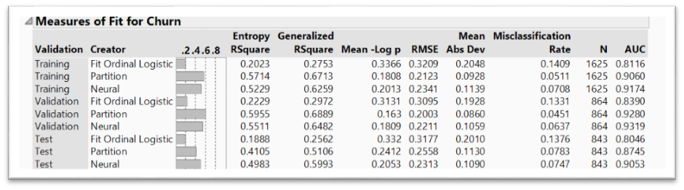
Results: Goodness-of-Fit
Common Statistical Measures:
R Squares
“Overall” Misclassification Rate
Introduction | Data Preparation | Methods | Results | Conclusion | Appendix

Slide 7
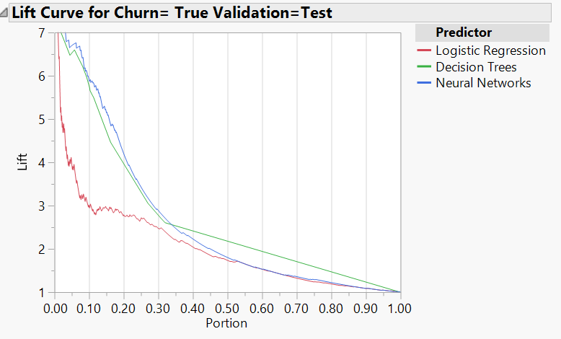
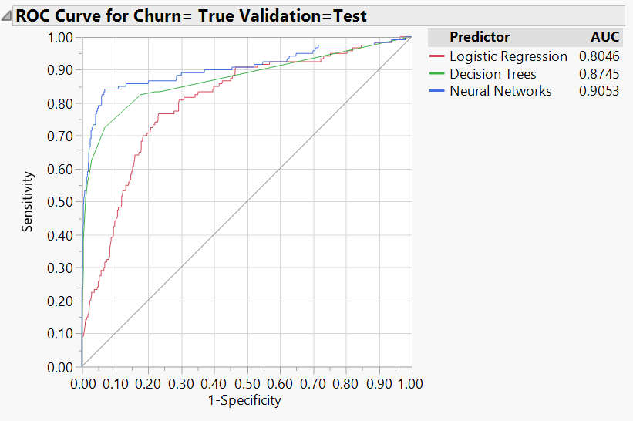
Results: ROC & Lift Curve
Top 10% of the sorted probability of Churn=True (Portion = 0.20), 6 times more churners than drawing 10% at random.
Area-Under-the-Curve (measure of how well our model is): Neural Network>Decision Tree>Logistic
However the difference between Neural and Decision Tree is small.
Introduction | Data Preparation | Methods | Results | Conclusion | Appendix

Slide 8
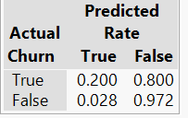
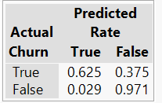
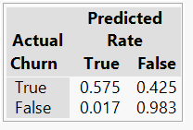
Results: Confusion Matrix
Logistic Regression
Decision Tree
Neural Networks
Decision Tree model has the highest True Positive rate (lowest False Negative rate) when compared to the other models.
Decision Tree is the winner.
Introduction | Data Preparation | Methods | Results | Conclusion | Appendix

Slide 9
Results: Final Model Selection
Selection Criteria:
Overall Goodness-of-Fit
Neural Network shows the best performance, closely followed by Decision Tree
Predictive Accuracy for “Churn”
Decision Tree shows the best accuracy in terms of both “True-Positive” and “False-Negative” Classifications
Simplicity that Leads to Actionable Plans
Neural Network lacks built-in variable selection mechanism
Decision Tree identifies the key predictors of “churn”
Decision Tree allows profit matrix that can further reduce the “False-Negative” classification error
Winner: Decision Tree
Introduction | Data Preparation | Methods | Results | Conclusion | Appendix

Slide 10
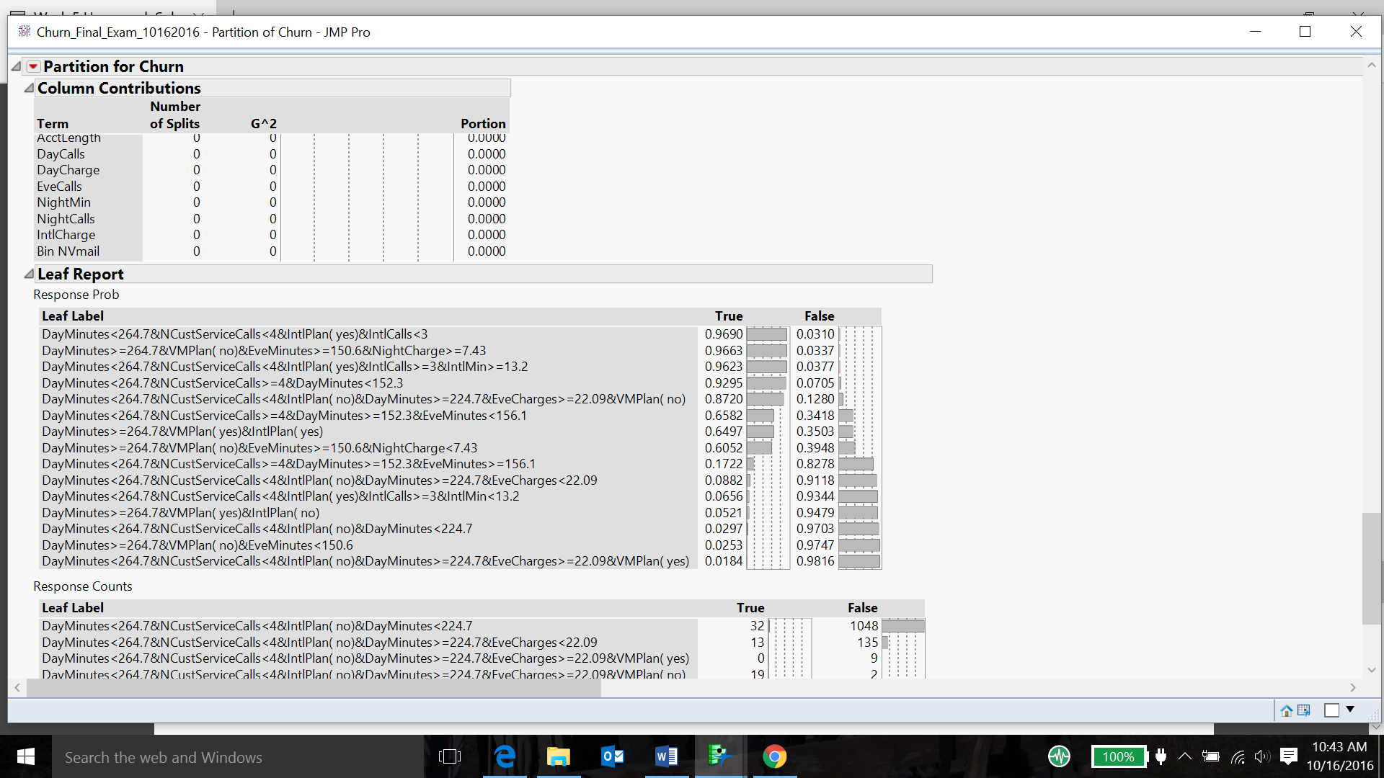
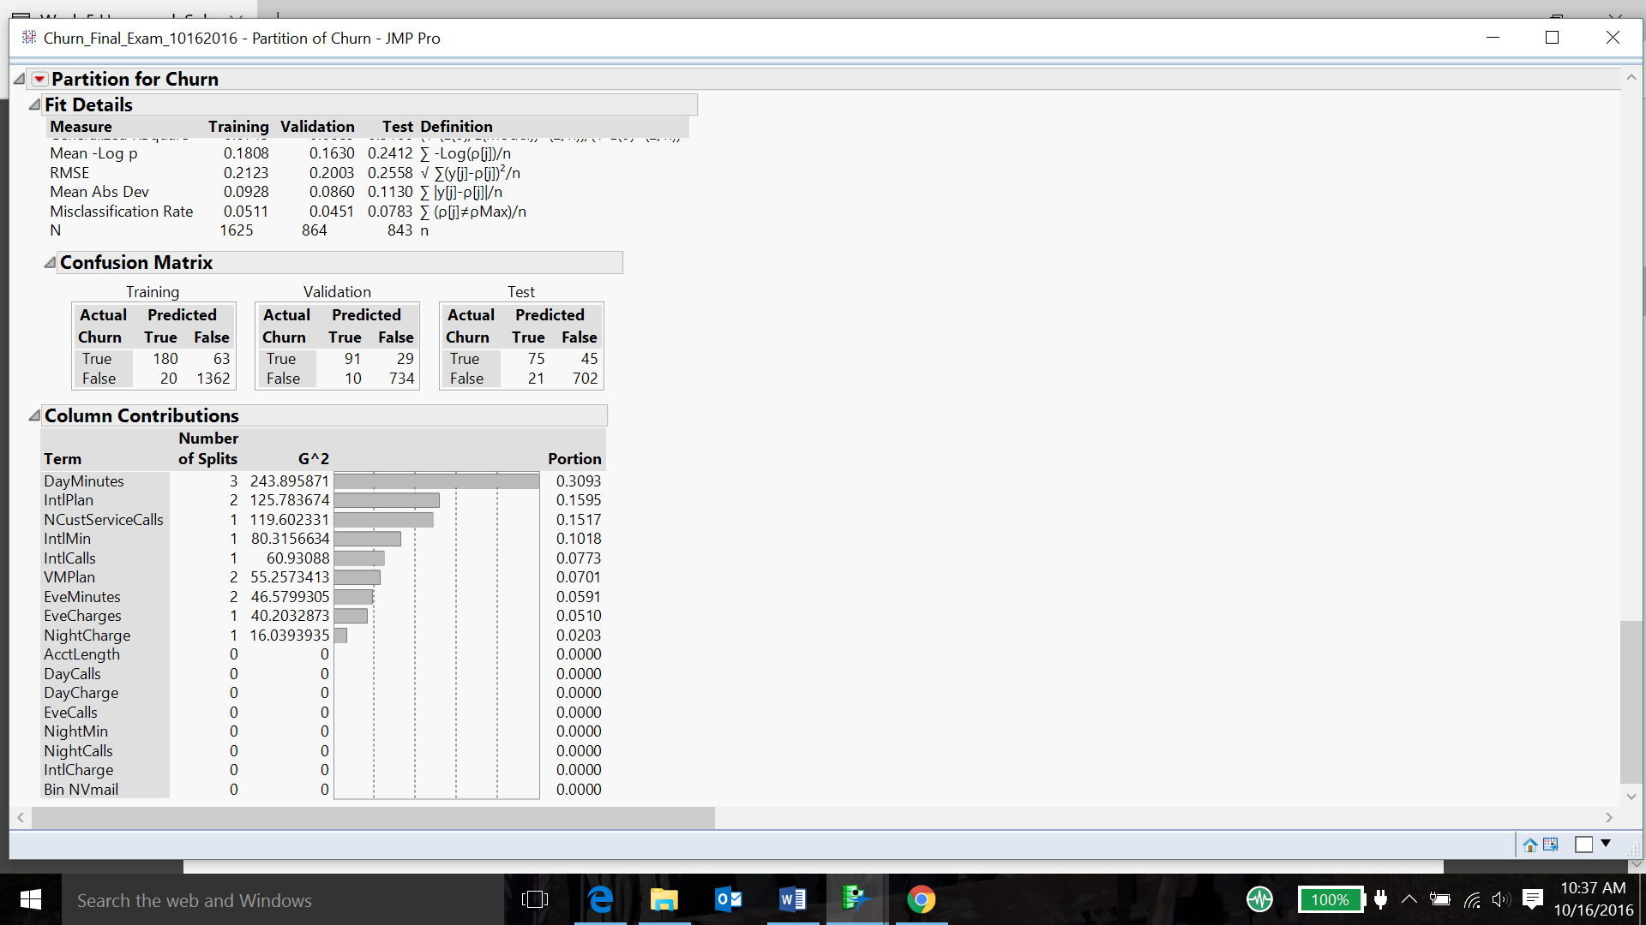
Decision Tree: Column & Leaf Reports
Introduction | Data Preparation | Methods | Results | Conclusion | Appendix

Slide 11
Decision Tree
International Plan = Yes
DayMinutes >= 264.7
VM Plan = Yes
International Plan = No
VM Plan = No
EveMinutes < 150.6
NightCharge < 7.43
What are the customer usage data drivers of “Churn”?
EveMinutes >= 150.6
NightCharge >= 7.43
DayMinutes >= 152.3
EveMinutes < 156.1
NCustomerCalls >= 4
EveMinutes >= 156.1
DayMinutes < 152.3
IntlMinutes >= 13.2
DayMinutes < 264.7
IntlCalls >= 3
IntlMinutes <13.2
VM Plan = Yes
International Plan = Yes
IntlCalls <3
NCustomer Calls < 4
EveCharges < 22.09
DayMinutes >= 224.7
VM Plan = No
International Plan = No
EveCharges >= 22.09
DayMinutes < 224.7
Introduction | Data Preparation | Methods | Results | Conclusion | Appendix

Slide 12
Recommendations
Recommended Strategies:
Offer lower rates / more minutes to our off-hour customers
Offer revamped int’l calling plan
Improve the efficiency of our customer services
Formulate long-term strategies based on our trial offers
Decision Tree result suggests that we should focus on 2 groups of customers:
Heavy Off-Hour Customers
International Plan Customers
TRIAL NEW NIGHT CALLING PLAN (11PM – 5AM)
TRIAL NEW INT’L PLAN (FREE CALLING TO 130 COUNTRIES)
BETTER CUSTOMER RETENTION
C
ONE-CALL RESOLUTION – CUSTOMER SERVICE
CONTINUOUS IMPROVEMENT
Introduction | Data Preparation | Methods | Results | Conclusion | Appendix

Slide 13
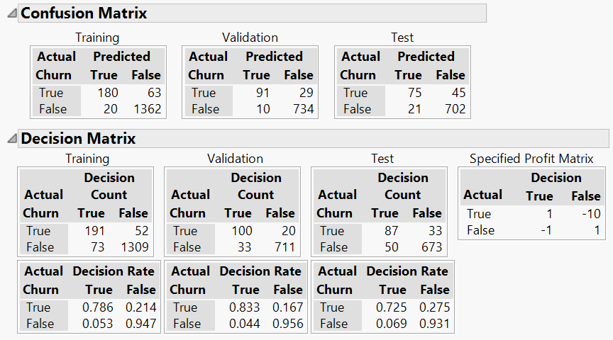
Appendix: Decision Tree Profit Matrix
Introduction | Data Preparation | Methods | Results | Conclusion | Appendix

Slide 14
Appendix: Neural Network
Output layer & Input layer
Hidden layer & Three nodes
Hidden layer use linear combination of the input variables, with estimated weights and bias
TanH function is applied to this linear combination as the output of all three hidden nodes
Estimate final formula using three nodes’ output to predict probability
Introduction | Data Preparation | Methods | Results | Conclusion | Appendix

Slide 15
Appendix
Please refer to our written report for more details.
Introduction | Data Preparation | Methods | Results | Conclusion | Appendix

