Slide 1
The Future of Natural Gas
DNSC 6219 Final Project
Kelly Berdelle, Daniel Chen,
Kevin Fitzgerald, Aida Roxas,
& Xing Zhang

Slide 2

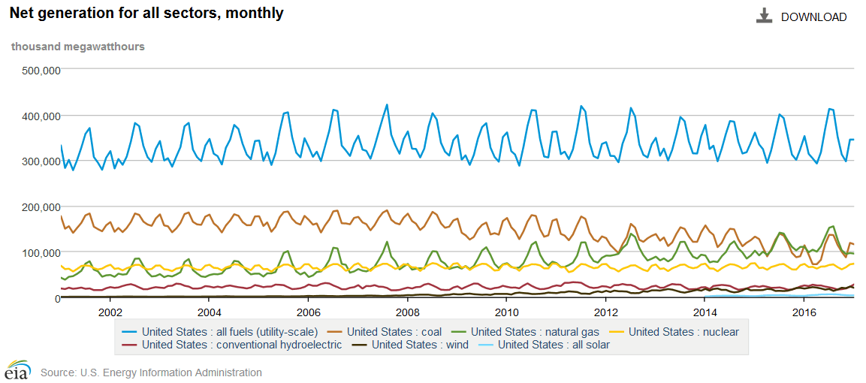
Natural Gas
Source: https://www.eia.gov/electricity/data/browser/

Slide 3
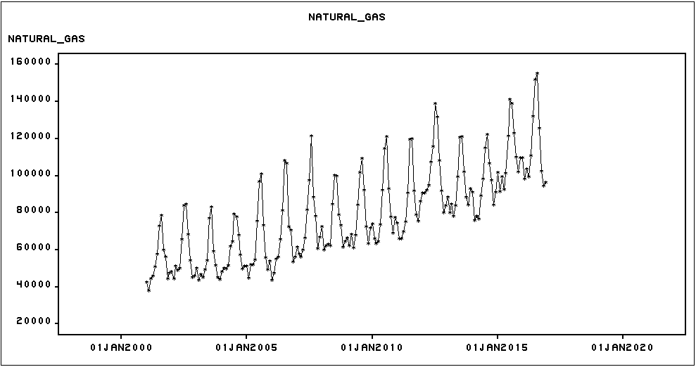
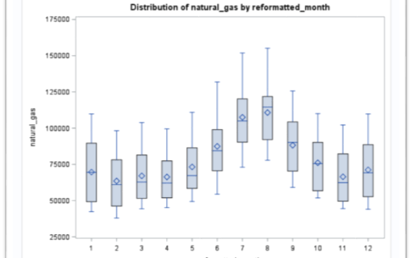
Natural Gas Series

Slide 4
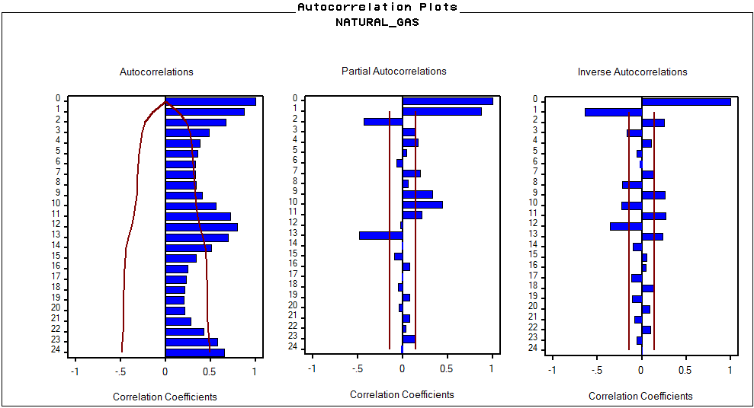
Natural Gas Series

Slide 5
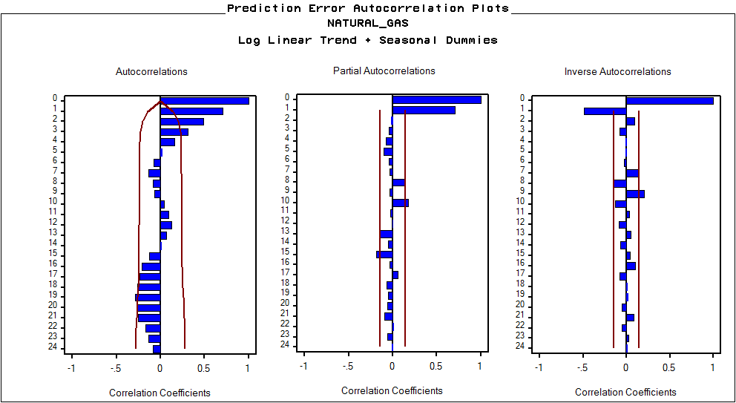
Univariate Modeling
Deterministic Model:
Log Linear Trend +
Seasonal Dummies

Slide 6
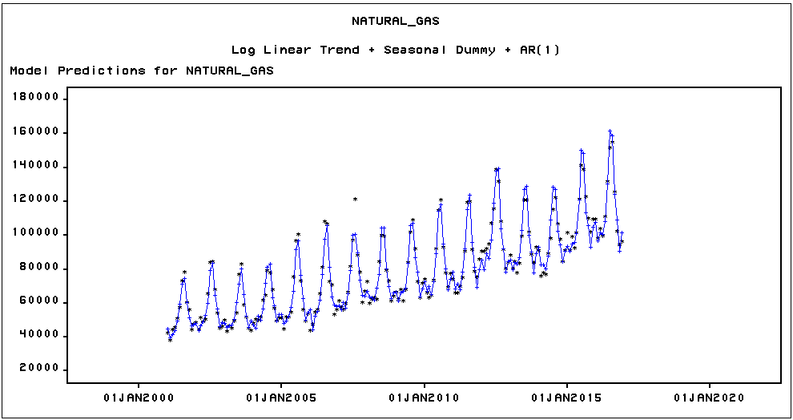
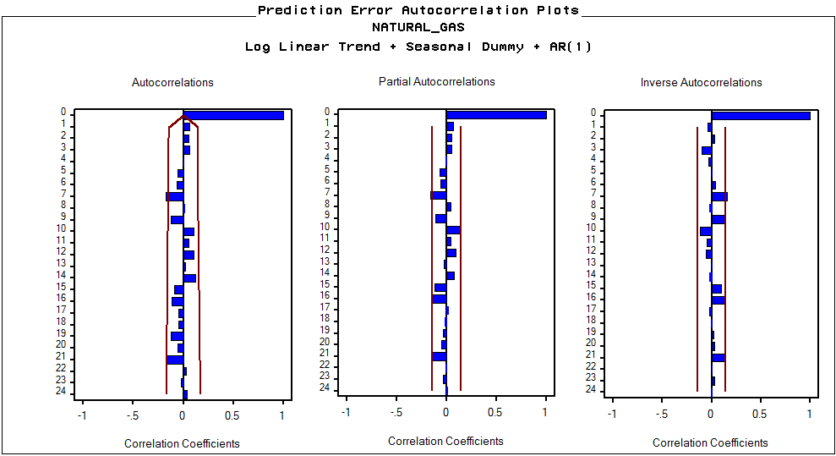
Univariate Modeling
Deterministic Model:
Log Linear Trend +
Seasonal Dummies + AR(1)

Slide 7
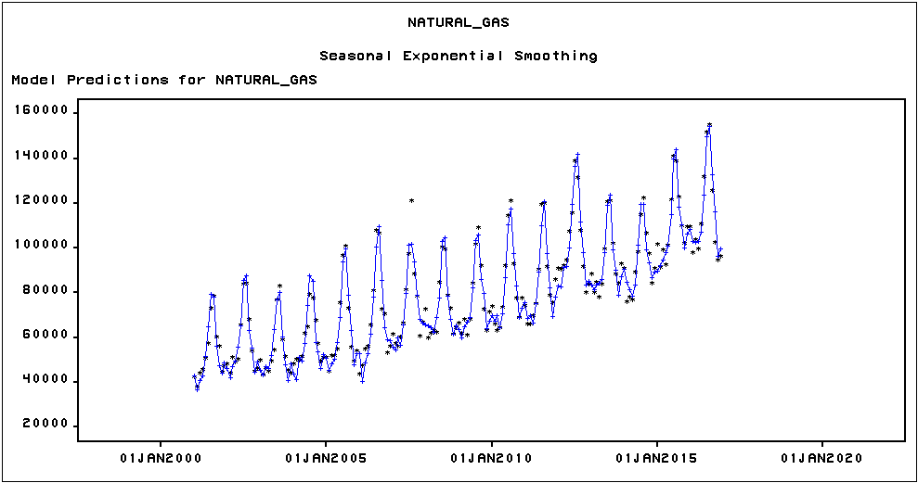
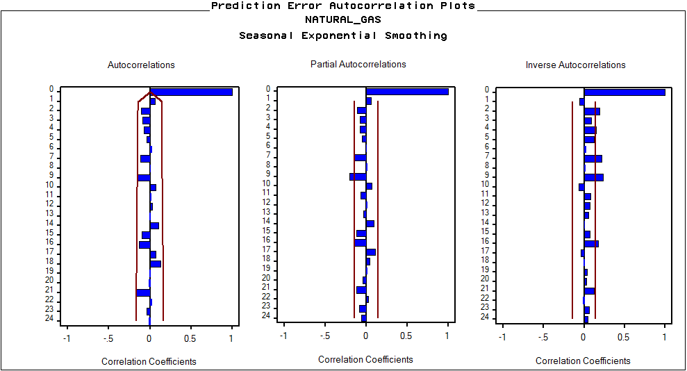
Univariate Modeling
Exponential Smoothing Model:
Seasonal Exponential Smoothing

Slide 8
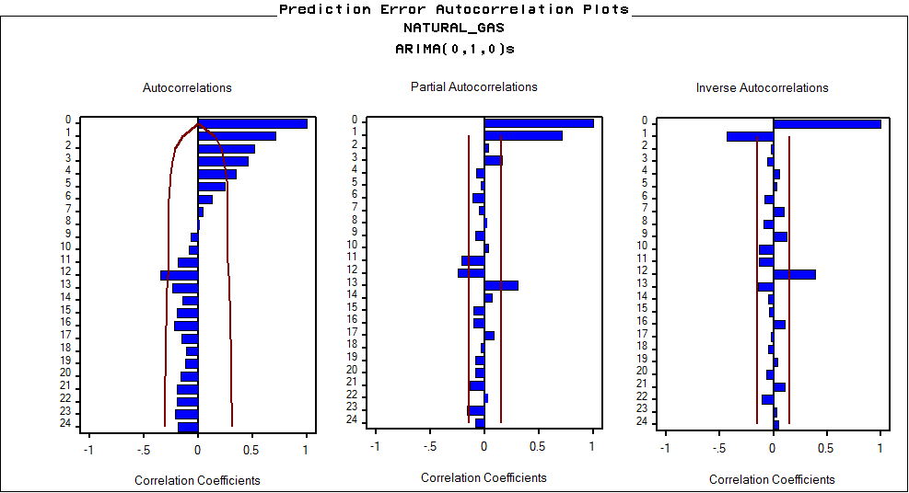
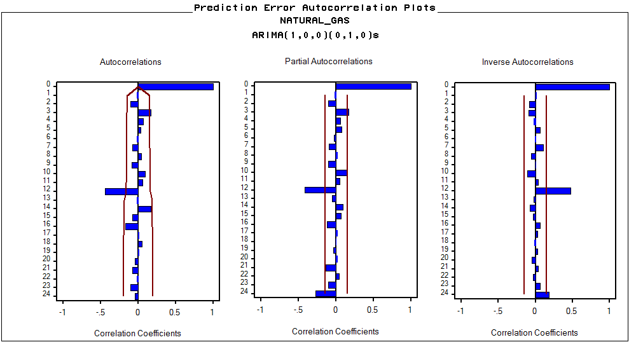
Univariate Modeling
Step 1: ARIMA (0,0,0) (0,1,0)
Step 2: ARIMA (1,0,0) (0,1,0)

Slide 9
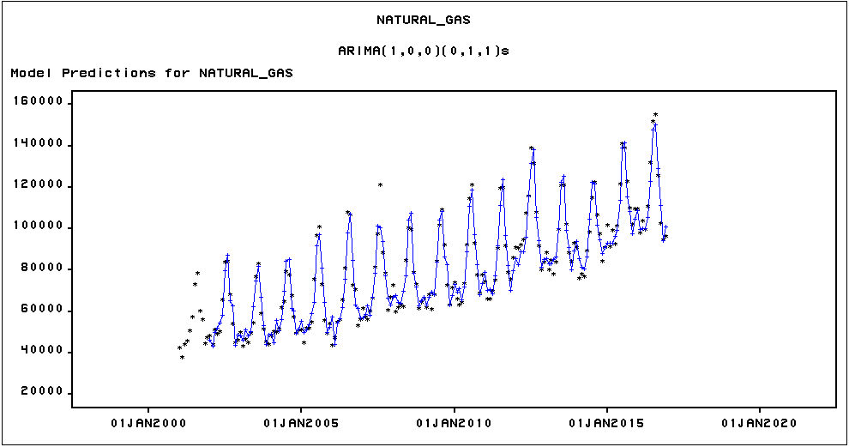
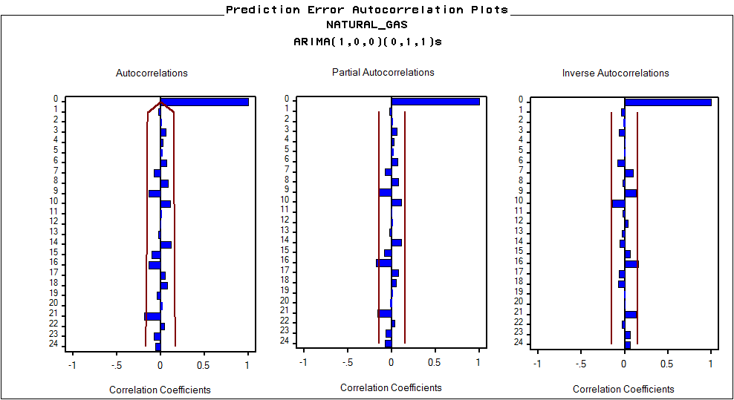
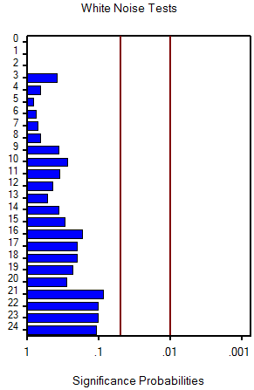
Univariate Modeling
ARIMA Model:
ARIMA (1,0,0) (0,1,1)

Slide 10
Model Comparison
Univariate Modeling
Model | RMSE
Log Linear Trend + Seasonal Dummies + AR(1) | 4259.6
Seasonal Exponential Smoothing | 5554.6
ARIMA (1,0,0) (0,1,1) | 4855.2

Slide 11
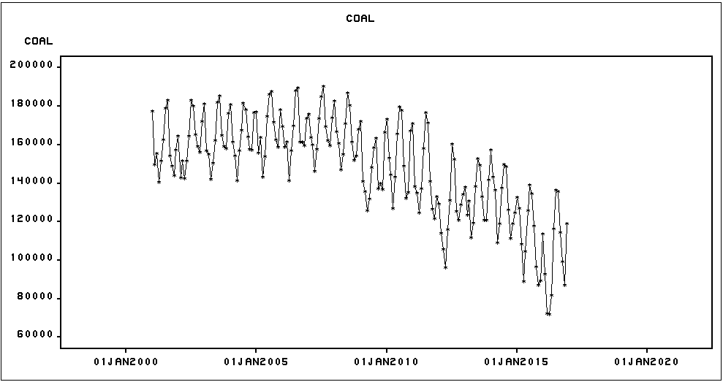
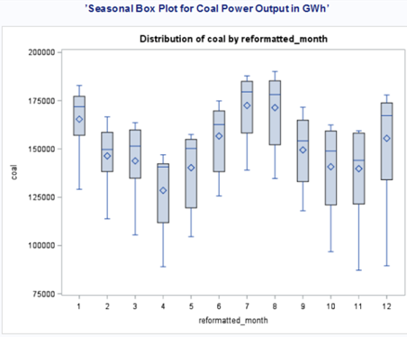
Bivariate Modeling {Coal}
Notes:
Time Series and the seasonal boxplot of the input variable COAL
Seasonality & Downward Trend

Slide 12
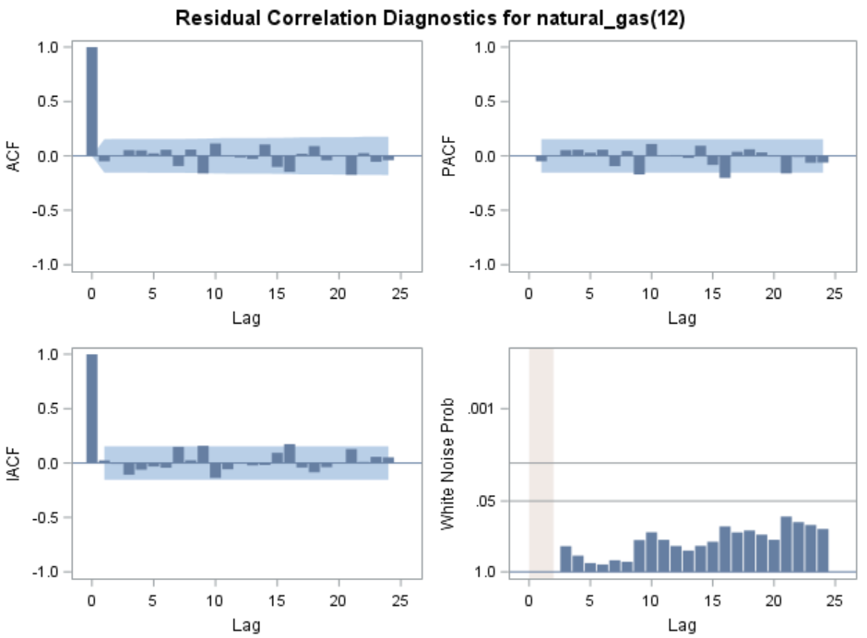
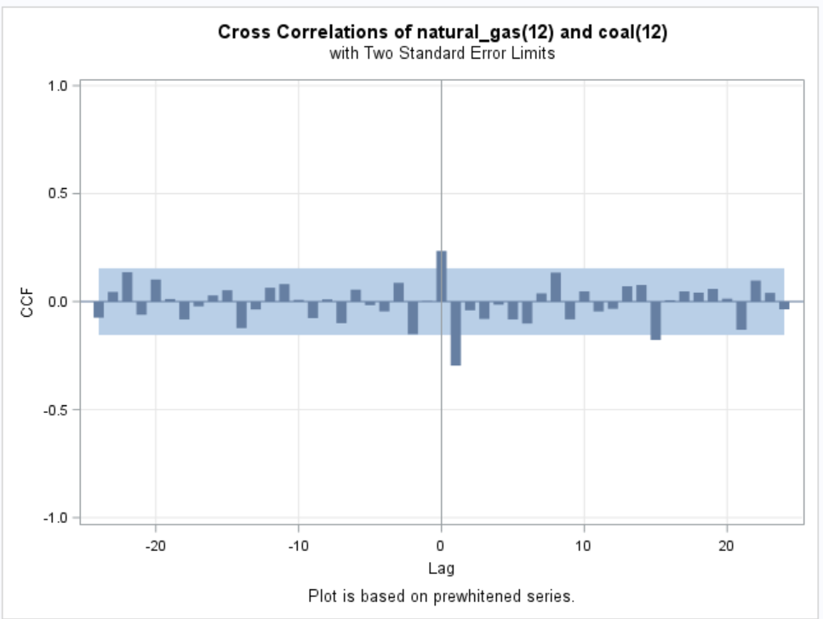
Bivariate Modeling {Coal}
Pre-Whitening: TS Model
ARIMA(1,0,0)(0,1,1)^12 + C
Notes:
Not Stationary & not white noise
Pre-whiten using the time series model
Stationary & white noise

Slide 13
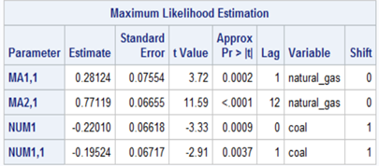
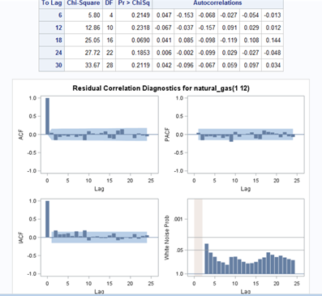
Bivariate Modeling {Coal}
Transfer Function Model:
b=1 r=0 s=1
Notes:
Stationary & white noise

Slide 14
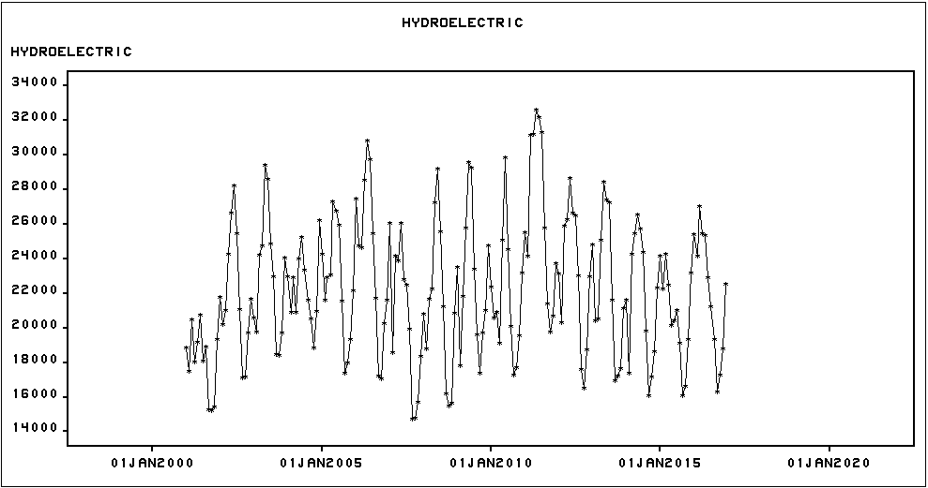
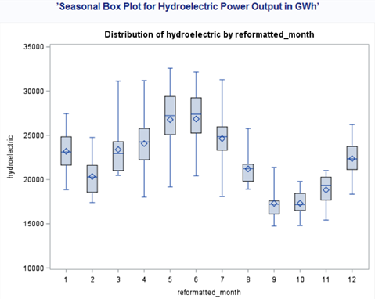
Bivariate Modeling {Hydro}
Notes:
Time Series and the seasonal boxplot of the input variable COAL
Seasonality & No Downward Trend

Slide 15
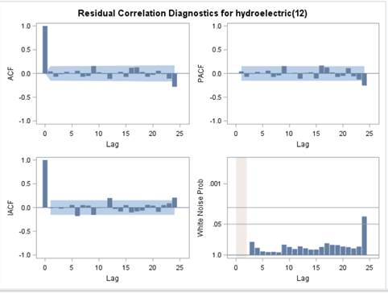
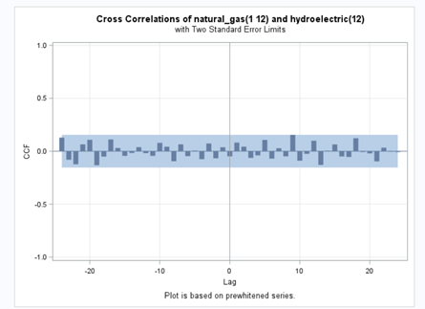
Bivariate Modeling {Hydro}
Pre-Whitening: TS Model
ARIMA(1,0,0)(1,1,0)^12 + C
Notes:
Not Stationary & not white noise
Pre-whiten using the time series model
Stationary & white noise

Slide 16
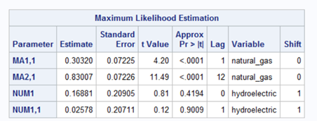
Bivariate Modeling {Hydro}
Transfer Function Model:
b=1 r=0 s=1

Slide 17
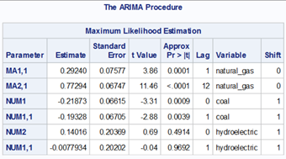
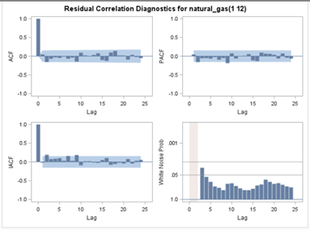
Multivariate Modeling {Coal & Hydro}
Transfer Function Model:
(b=1 r=0 s=1), (b=1 r=0 s=1)

Slide 18
Conclusion
Univariate Modeling:
Quadratic Trend +
Seasonal Dummies + AR(1)
Multivariate Modeling: Transfer Function Model

