Slide 1
Don’t Get Kicked
DNSC 6279 Final Project
Kelly Berdelle, Daniel Chen, Kevin Fitzgerald, Tianweibao Zheng
Notes:
GROUP INTRODUCTION

Slide 2

the NEW way to buy a car
Notes:
INTRODUCTION
Manheim is a large player in the wholesale auction of used cars in the US. They publish an annual report that makes it clear this is a very large industry: https://publish.manheim.com/content/dam/consulting/2017-Manheim-Used-Car-Market-Report.pdf
Nearly 10 million cars are traded at auction each year.
3 out of 4 automobile sales in the US involved a used car.
Average Profit Margin for used cars dealers: ~9% (page 24 of the report above)
Carvana:
An online dealership of used cars
They ship cars to customers for a 7-day trial period
Wants to avoid purchasing cars that may be “kicked” back to auction within months as this is costly.
“Kicked” cars:
Used cars purchased at auction that have serious issues (mechanical problems, issues with vehicle titles, etc.) that prevent them from being sold to customers & are then “kicked” back the wholesale auction to be re-auctioned.
Kicked cars are costly to dealerships (transportation cost, repair work, holding cost, market losses in reselling the vehicle).
In light of the low profit margins in the industry, avoiding “kicked” cars is critical to the bottom line. Losses from one kicked car could easily be equal to dealer profits from 3 or 4 successfully resold cars. For this reason it would be very valuable to used car dealers to identify cars most likely to be “kicked” so they may be avoided at auction. Building a robust model to identify “kicks” was the objective of this competition.

Slide 3
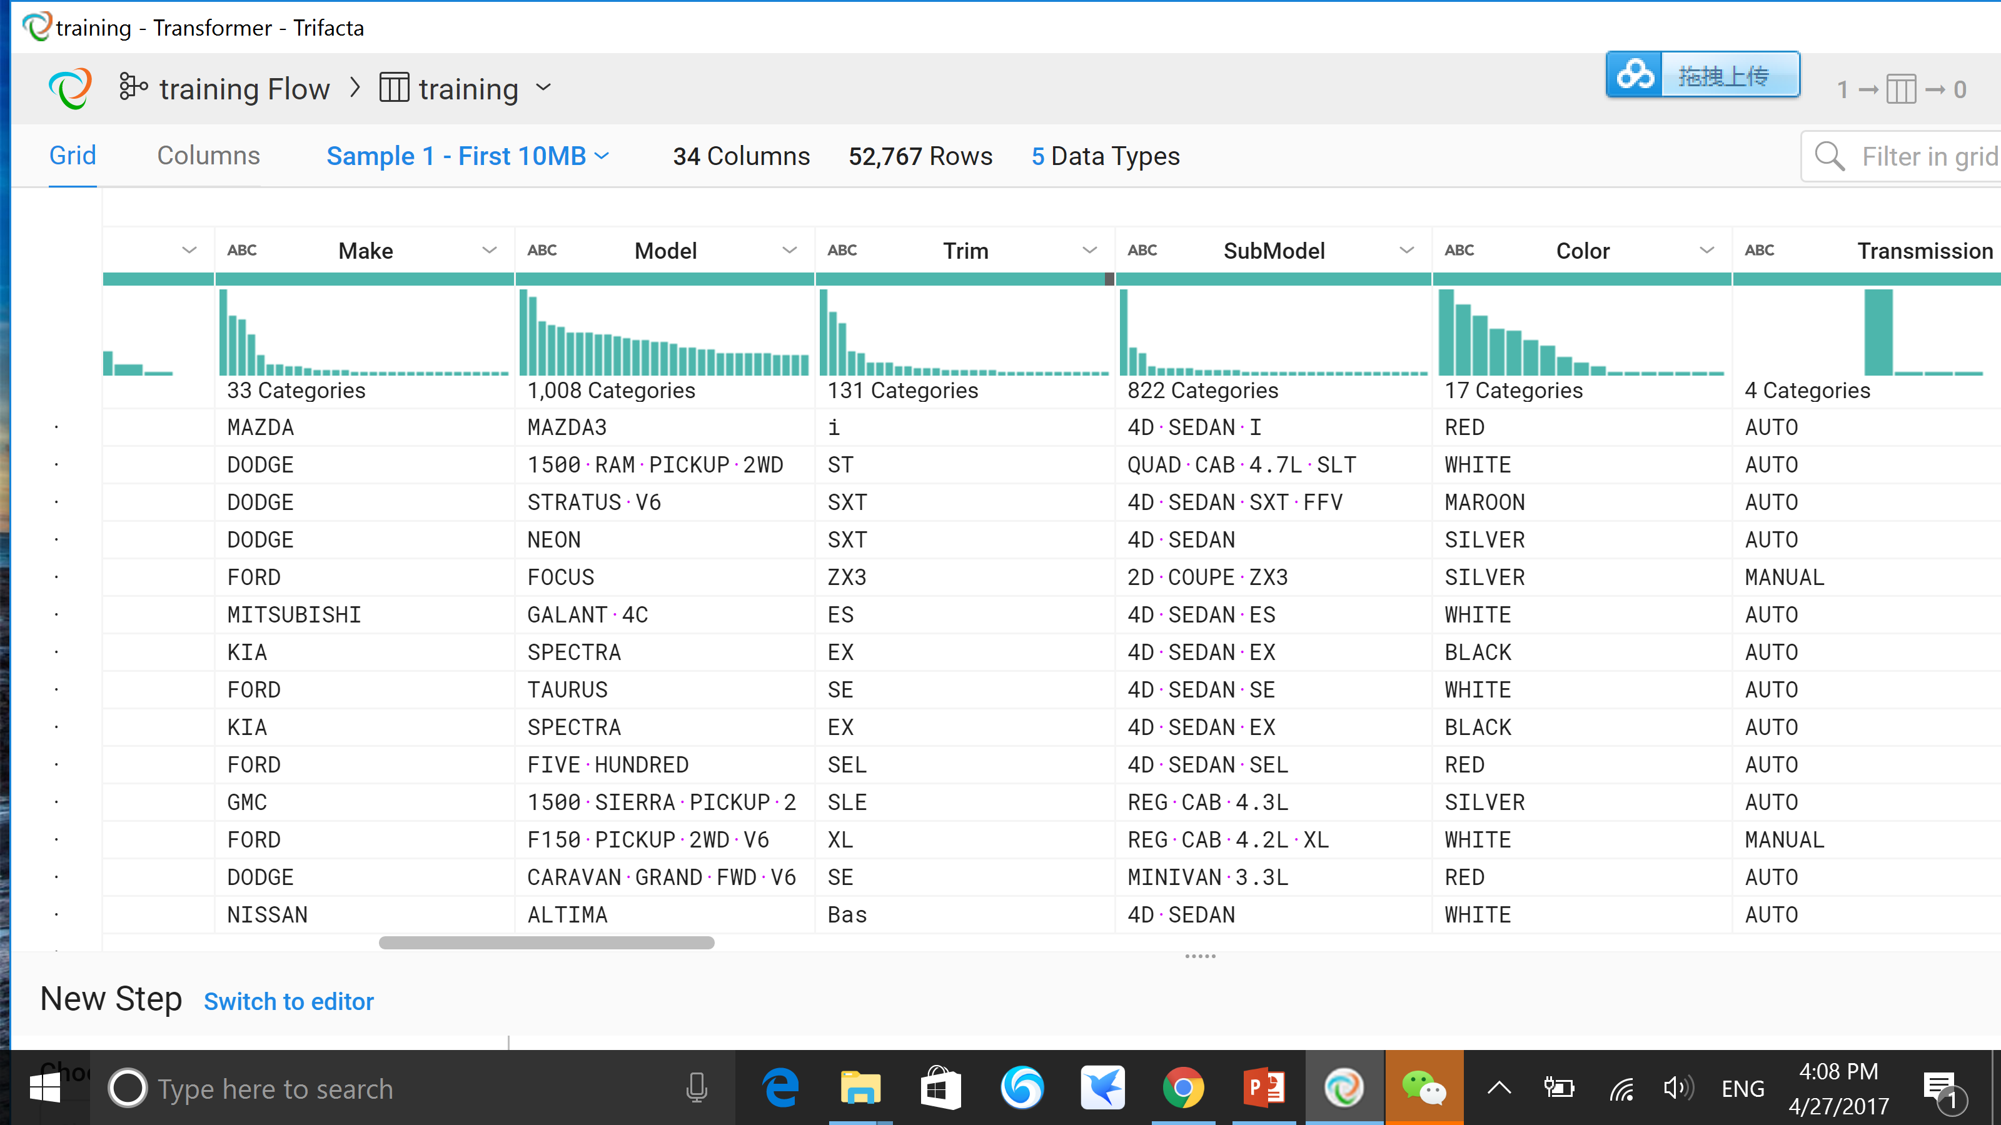
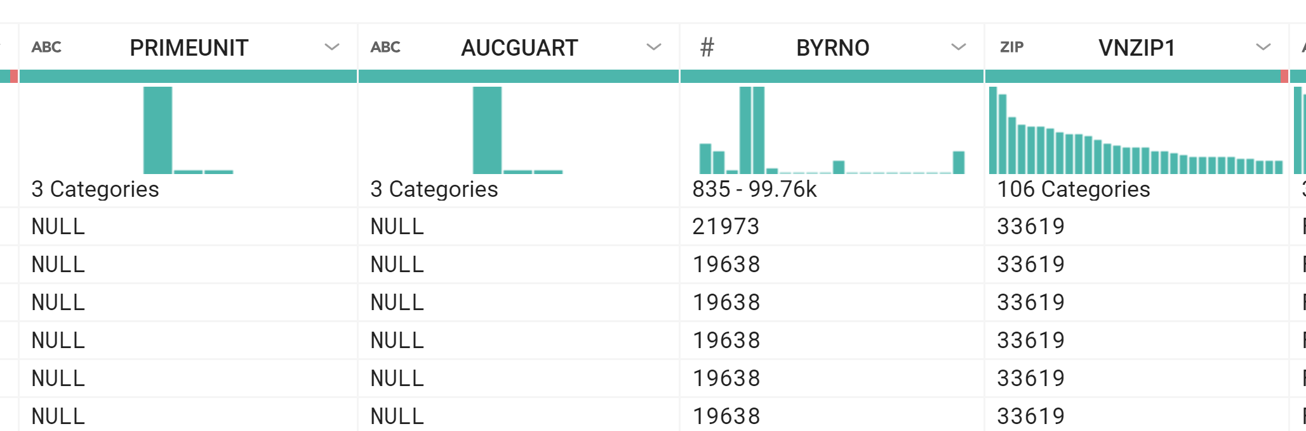
Data Exploration
Notes:
DATA EXPLORATION
Our first step was to explore the data in Trifacta Wrangler.
We learned immediately that we would need to deal with missing values in several categorical and numeric variables and a number of high cardinality categorical variables (with as many as 1,000 categories).
Other than these issues, the data contained the usual amount of data entry errors in both categorical and numeric variables—most of which are impossible to detect or address.
We prepared our data in SPSS. We cleaned what we could, converted high cardinality variables, extracted principal components and promising parts of the Purchase Date all before importing the data into Enterprise Miner.

Slide 4
CATEGORICAL
NUMERIC
IsBadBuy
PurchDate
Color
PrimeUnit
TopThree
AmericanName
Nationality
Auction
WheelTypeID
Transmission
BYRNO
Size
High-Cardinality
WheelType
Trim
SubModel
VNST
AucGuart
Model
Make
VNZIP
Notes:
DATA EXPLORATION AND PREPARATION
Definitions
Target variable IsBadBuy (Binary) = 0 if a good buy; = 1 if the car won’t sell (a “kick”).
Categorical Variables
Purchase characteristics: Purchase Date, Auction (3 levels), Auction Guarantee (3 levels), PrimeUnit (3 levels)
Origin: Nationality (4 levels), TopThreeAmericanName (4 levels), VNST (State 37 levels)
Car characteristics: Size (12 levels), WheelType (3 levels), WheelTypeID (3 levels), Transmission (2 levels), Color (16 levels)
High Cardinality: Make (32 levels), Model (1,008 levels), Trim (131 levels), Submodel (822 levels), BYRNO (a unique number for each buyer 74 levels), VNZIP (Zip code 153 levels)
Issues
Missing values
98% of AUCtionGUARanTee and PRIMEUNIT observations are missing. We use these variables in our models, treating the missing values as a valid category (we do not impute them).
Obvious data entry errors were in most variables. These were cleaned up in SPSS before importing into Enterprise Miner.
Imbalanced data
12% of cars in the dataset were kicked (IsBadBuy = 1). We balanced the dataset by undersampling the good cars and building a robust model. We then ran the full dataset and found that it performed even better (in terms of Gini index and ROC index). So what appeared to be an issue modeling a rare event actually was not. As a consequence, we present only the model built while working with the full dataset.
High cardinality
The high cardinality variables Make, Model, SubModel and Trim level of each vehicle are the most specific measures of what was on auction. What’s more they only made sense if nested in the order given here. These were converted into numeric variables by aggregating on unique nested combinations of Make > Model > SubModel > Trim and assigning the mean value within each level of the target variable IsBadBuy to each member of that level. Each of these converted variables had random noise added from a uniform distribution [-0.05, 0.05].

Slide 5
CATEGORICAL
NUMERIC
IsBadBuy
PurchDate
Color
MMRAcquisitionAuctionAveragePrice
MMRCurrent
RetailAverage
Price
PrimeUnit
VehicleAge
VehYear
TopThree
AmericanName
Nationality
MMRCurrent
RetailClean
Price
Auction
MMRAcquisitionRetailAverage
Price
MMRAcquisitionRetailClean
Price
VehOdo
WheelTypeID
Transmission
BYRNO
Size
MMRCurrent
AuctionClean
Price
MMRCurrent
AuctionAverage
Price
High-Cardinality
MMRAcquisitionAuctionClean
Price
VehBCost
WarrantyCost
WheelType
Trim
SubModel
VNST
Binary
Probabilities
AucGuart
Model
Make
VNZIP
IsOnlineSale
perMake
perModel
perSubMT
Notes:
DATA EXPLORATION AND PREPARATION
Numeric Variables
MMR (Manheim Market Report) prices: eight prices in the marketplace and at auction for average condition and above average condition cars specific for each Make, Model & Submodel. These variables are highly collinear (coefficients of correlation above 0.90). We extracted 3 Principal Components, FAC1, FAC2 & FAC3, and used them instead if these original variables to build our model. This was done in SPSS before importing the data and partitioning it in Enterprise Miner.
Vehicle characteristics: VehicleYear, VehicleAge, VehOdometer were pure numeric variables with no obvious issue.
Purchase characteristics: Similarly, WarrantyCost (the purchase price of a 36 month, 30,000 mile warranty offered by the auctioneer) and VehBCost (the cost of acquisition) had no apparent issues.
Binary variable: IsOnlineSale is a 0/1 variable indicating if sold at an online auction (only 3% were offered online).
Probability variables: perMake, perModel, perSubMT are the numerical variables resulting from the conversion of the High Cardinality Categorical variables Make, Model, SubModel and Trim. They represent the probability of being kicked from the training data in each nested category with a little random noise applied.

Slide 6
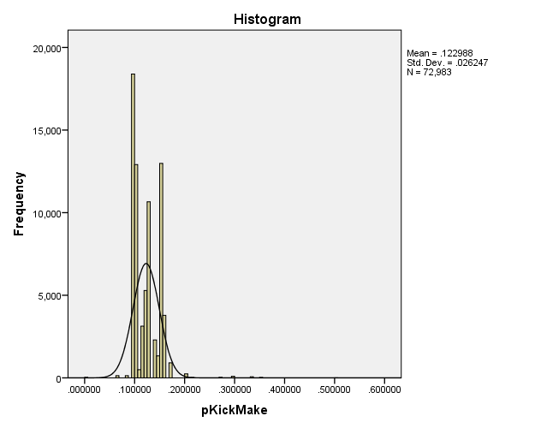
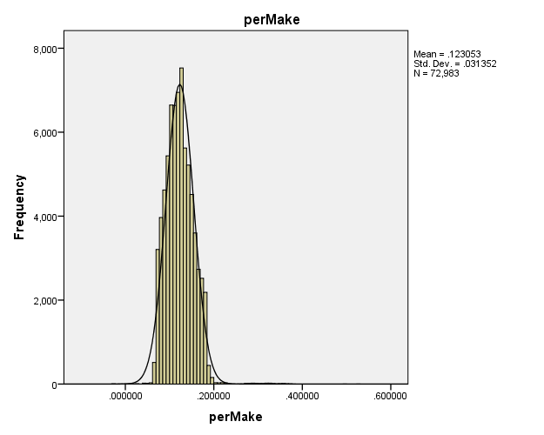
Adding Noise to Converted Categorical Variables
Notes:
PERTURBING VARIABLES WITH MANY DISCRETE VALUES
When categorical variables are converted to continuous numeric variables using rate-by-level (aggregation), several discrete values are bound to wind up with many observations. In such cases, it’s best to smooth out the distribution by adding a little random noise to each observation. The histograms here show a remarkable smoothing in distribution of the probability being kicked for the 32 makes of cars by simply adding a small random number from the uniform distribution [-.03, +.03]. All converted variables were perturbed in this way after conversion, to smooth out their probability distributions, most often adding a random draw from Uniform [-.05, +.05].

Slide 7
Data Transformation
Variable | Extract | Convert | Missing is Valid | Missing is Imputed | Rejected
RefID (Unique reference ID)
IsBadBuy (Binary Target)
MMR Price Variables | ü |  |  | ü
Purchase Date | ü
Make, Model, SubModel |  | ü
Trim (leads to overfitting) |  | ü |  |  | ü
Buyer Number |  | ü
VN Zip Code |  | ü
Color |  |  | ü
AUCGUART |  |  | ü
PRIMEUNIT |  |  | ü
Transmission |  |  |  | ü
WheelType |  |  |  | ü
Nationality |  |  |  | ü
Size |  |  |  | ü
TopThreeAmericanName |  |  |  | ü
WheelTypeID (redundant) |  |  |  |  | ü
Auction, VNST(State), IsOnlineSale
VehBCost, WarrantyCost
VehYear, VehicleAge, VehOdo
Notes:
DATA TRANSFORMATION
All data preparation and transformation was performed in SPSS.
Extraction
8 x MMR price variables were highly collinear. 3 Principal Components—FAC1, FAC2 & FAC3—were extracted. Nearly 200 missing values were imputed in EM.
Purchase Date was examined in SPSS. Day of Week and Year were extracted as they appeared to be at least somewhat associated with IsBadBuy. In the modeling they were not at all important.
Conversion
Make Model & Submodel were converted to Numeric perMake, perModel and perSubM (perturbed with random noise).
Trim was also included as a forth break variable in the rate-by-level conversion. However, the resulting variable had many levels with one or two members and so was clearly overfitting the data. Because of this Trim was rejected.
BuyerNumber and VN Zip were also converted and perturbed (into perBUYER, perZIP). But neither was influential in the modeling.
In future modeling, we should consider Leave-One-Out event rate or Weight-of-Evidence to handle high-cardinality variables.
Missing Values
All cars without a reported color were assigned to the existing “Not Avail” category.
AUCGUART is a guarantee offered by the auctioneer and PRIMEUNIT is a distinction indicating a well above average car. However, this was a new classification and was missing for nearly all of the cases. Not wishing to dicard possibly valuable information, we simply left the missing values as a valid category. Neither variable turned out to have any explanatory power in modeling.
The principal Components from the MMR prices—FAC1, FAC2 & FAC3—were
A few values were imputed using Decision Tree method in EM for Transmission, Nationality, Size and TopThreeAmericanName.
A substantial number of missing values for WheelType were imputed in the same way.
Bottom Line
All useful information was used—and with the rejection of Trim—no more information was used than was helpful.

Slide 8
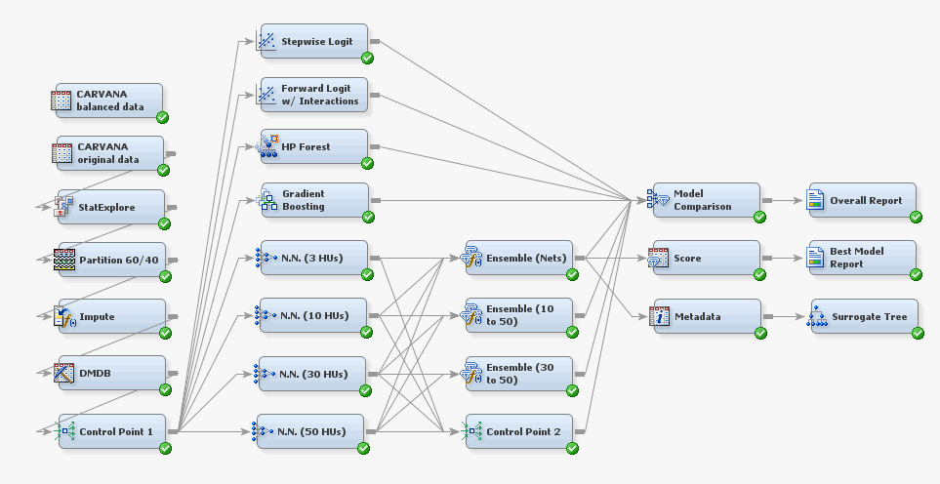
Process Flow Diagram
Notes:
MODELING & EVALUATION
Our approach in Enterprise Miner was straightforward. We have the Test set, but it is not labeled. And it’s way too late to send our model in to Kaggle (the competition ended five years ago). So we split the Kaggle Training data into 60% Training and 40% Validation and we’ll this Validation set to assess the quality of our effort.
Imputation is done immediately after partition and then we feed a few Logistic Regression Nodes, an HP Forest, Gradient Bosting and several Neural Nets.
Neural Networks
Our build features four multilayer perceptrons that have 3, 10, 30, and 50 hidden units.
Ensembles
They are then combined in several Ensemble nodes. The first Ensemble node combines the predicted probabilities of all neural network models, the second one combines the neural networks of 10 to 50 hidden units, and the last one combines the neural networks of 30 or more hidden units.
Ensemble (All) is our best performing model (See Variable Importance).

Slide 9
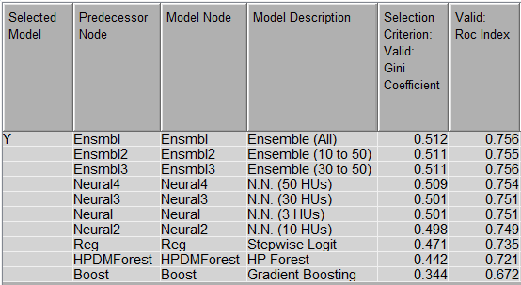
Notes:
MODEL COMPARISON
Regression Models
Our Stepwise Logistic Regression did a fairly good job, beating High Performance Forest and Gradient Boosting impressively.
Decision Tree Models
It’s surprising that the ensemble Decision models (Forests and Boosting) did not do better in this classification task.
Neural Networks
The Neural Net models really shine in this particular application. We suspect the actual fits of these models are highly nonlinear with plenty of interactions. This is so because using Trim as the fourth break variable delivered better performance (Gini 0.522 and ROC Index 0.761) that was clearly due to fitting noise. So we jettisoned the fourth dimension variable and present the model above: likely to be a more robust and stable model.
Ensemble Models
Produced the highest Gini scores (as anticipated).
Ensemble (All) was best, but by a small margin.
Winning Gini
As the competition is long since closed, we are unable to submit to Kaggle.
However we note that the winning test Gini coefficient (0.2672) was much lower than our result. So either the test data is wildly different from training data or the actual test statistic used was Gini/2 (in which case our Gini score of 0.512 would be reasonably below 0.2672 x 2 = 0.5344. In any case, we’re good with our models!

Slide 10
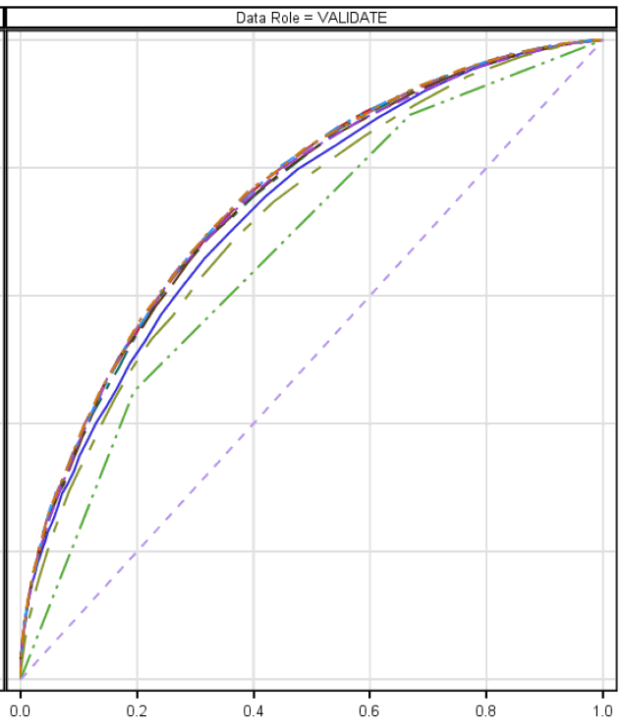
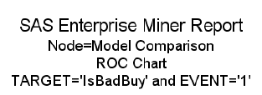
Sensitivity
Best Model:
Ensemble (3, 10, 30, & 50 HUs)
AUC = 0.756
1 - Specificity
Notes:
VALIDATION ROC
ROC shows very little difference between the other Neural Net Ensemble Models.
The best model, Ensemble(All) is virtually indistinguishable visually in ROC.
The severe and piecewise linear underperformance of the Gradient Boost model indicates that something may have been wrong with our implementation of that particular model.

Slide 11
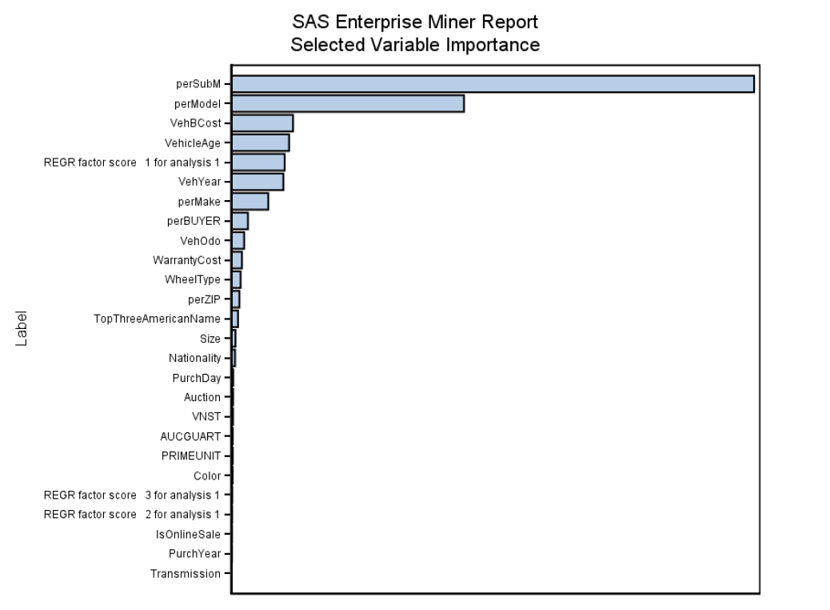
Notes:
VARIABLE IMPORTANCE
Overall, perSubM is the most important variable by far.
This shows that certain submodels are more likely to be “kicked” than others. This makes sense actually. Not all “Fords,” for example, are likely to be kicked. Rather, each manufacturer makes a range of models to appeal to different tastes for quality and different budgets. Certain submodels of any make are more likely to be a “lemon” or to be “kicked” back to auction because it did not sell.
The perturbed Model & SubModel explain almost everything. There are only four variables between these two and perMake: two related to price/cost (clearly an indicator of quality) and two related to the age of the car. VehBCost is the acquisition cost of the car, VehicleAge, VehYear are self-explanatory and the factor score 1 is main Principal Component of the MMR prices (which are specific for each Make, Model and SubModel of car).
Even though Neural Network models are highly nonlinear and difficult to explain, these are all variables that we would expect to see featured prominently in any model that claims to predict which cars are “lemons”. So we are confident that our model is robust and it should be fairly stable.

Slide 12
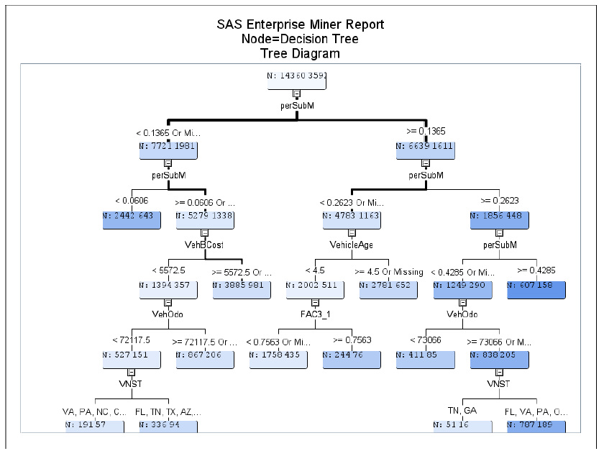
Notes:
MODEL INTERPRETATION
Surrogate Decision Tree
We fit a Decision Tree as surrogate model to explain the probability of being kicked by the Neural Net.
This slide shows an intermediate surrogate model that was current when we made a presentation to the class. It serves our purpose as the important variables have not changed much. (The next slide we show a current surrogate model that gets complex quickly and perhaps so quickly that it may defeat the purpose of illuminating what’s important.)
The darker (or lighter) the node the more (or less) likely the car is a “kick”.
The most important variable, as noted previously, is perSubM (perturbed SubModel).
Next comes VehicleAge and VehBCost (the cost of acquisition).
Then comes the Odometer reading (mileage) and one of the MMR prices Principal Components.
This one simple tree one can shed light on how the model makes its predictions.
But the real power of a model built in Enterprise Miner or other software like it is in making specific predictions for every car a dealer like Carvana is considering—so that they may more effectively avoid buying lemons.

Slide 13
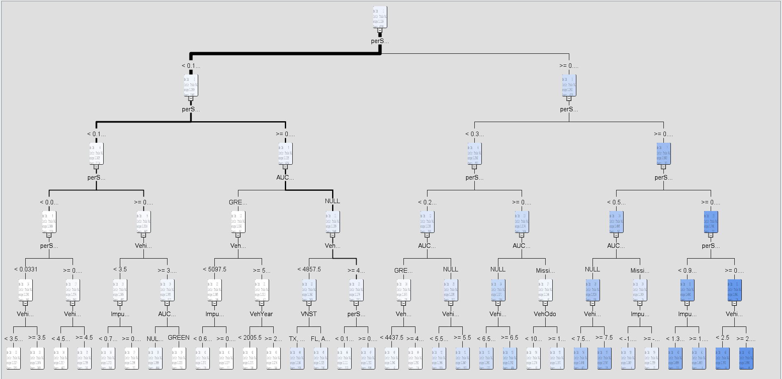
Notes:
MODEL INTERPRETATION
Surrogate Decision Tree
This slide shows a current surrogate model that does not shed much light. But still it shows that the first second and third splits are dominated by the perturbed SubModel variable.
It appears that the darker (or lighter) the node the more homogeneous the leaf. From this vantage point the tree shows much darker nodes to the right (where the probability of being a “kick” is high) and much lighter nodes to the left (where the odds are exactly the opposite). So the light blue nodes are the most mixed, the lighter nodes are the better cars to buy and the darker nodes are the higher risk cars.
Except as an exercise in seeing features that are more evident from far away, this tree is not fit to display.
Let us know if you would like any of our SPSS code, Enterprise Miner diagrams, reports or data.

Slide 14
Questions?
Notes:
QUESTIONS

