Slide 1
SRIOV
’16.06.24(수)
보라매NOC

Slide 2
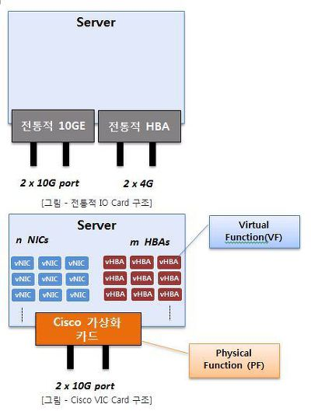
SRIOV 개념
SR-IOV 는 PCI-SIG(Special Interest Group) 표준기반의 PIC 카드를 가상화 시키는 기술 한 뿌리(Physical)를 가지지만 줄기는 가상화를 통해 논리적으로 여러 개의 vNIC(네트웍 카드) 생성
Term | Definition
PF | Physical Function. This is the physical Ethernet controller that supports SR-IOV.
VF | Virtual Function. This is a virtual PCIe device created from a physical Ethernet controller

Slide 3
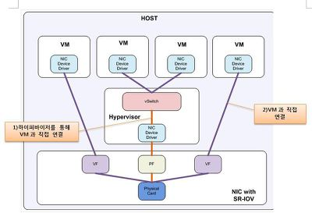
SRIOV 장점
(VF)가상 인터페이스(vNIC,vHBA)는 VM에 연결될 수도 있고, Hypervisor에 설정될 수도 있음
그러므로 SR-IOV는 Hypervisor Bypass(Pass through)는 아님
SR-IOV를 통해 VM을 VF에 직접 붙임으로서 Hypervisor Bypass를 할 수 있는 발판을 제공해 주긴하지만 SR-IOV가 모두 Hypervisor Bypass 를 의미하지 않음
1)한곳에서 2개 VM이 붙어 있습니다. 하이퍼바이저가 1하나의 PF을 보고 있으므로 데이터 교환이 한번에 하나만 가능 메모리가 그것을 복사해서 VM1주고 VM2에게 복사하여 줍니다. – 복사에 따른 오버헤드 발생
2)의 경우 VF가 VM에 있는 물리주소로 직접 접근 메모리 복사가 없습니다 - VM 커널간 I/O가 이뤼진다.(오버헤드 줄어듬)
하이퍼바이저를 거치지 않으니 Host(VM)의 CPU 오버헤드가 줄어드는 장점이 있습니다

Slide 4
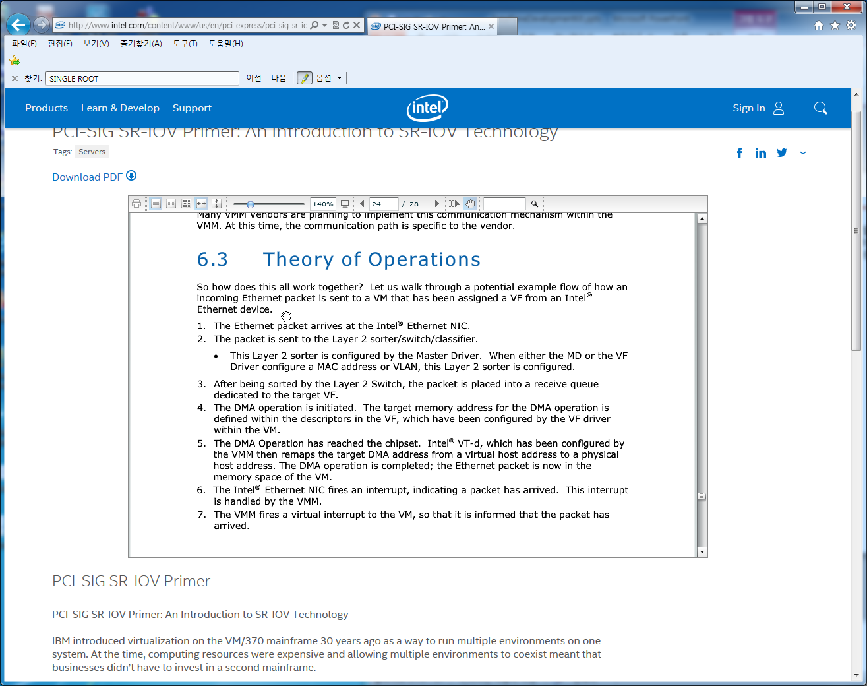
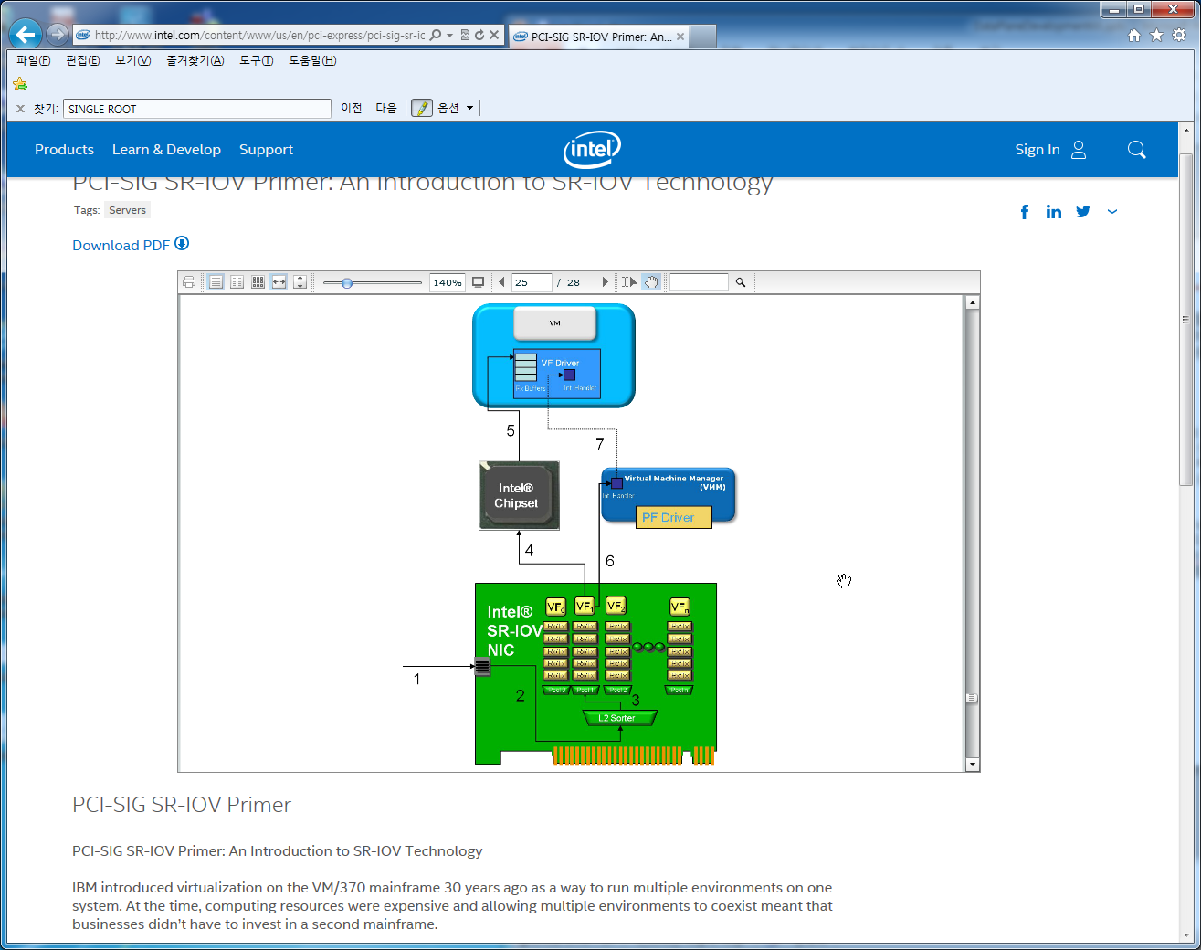
SRIOV 동작

Slide 5
SRIOV 구성-1
PF에서 7개의 VF 생성
# lspci
03:00.0 Ethernet controller: Intel Corporation 82576 Gigabit Network Connection (rev 01)
03:00.1 Ethernet controller: Intel Corporation 82576 Gigabit Network Connection (rev 01)
# modprobe igb [<option>=<VAL1>,<VAL2>,]
# lsmod |grep igb
igb 87592 0
dca 6708 1 igb
#modprobe -r igb
# modprobe igb max_vfs=7
# echo "options igb max_vfs=7" >>/etc/modprobe.d/igb.conf
# lspci | grep 82576
0b:00.0 Ethernet controller: Intel Corporation 82576 Gigabit Network Connection (rev 01)
0b:00.1 Ethernet controller: Intel Corporation 82576 Gigabit Network Connection(rev 01)
0b:10.0 Ethernet controller: Intel Corporation 82576 Virtual Function (rev 01)
0b:10.1 Ethernet controller: Intel Corporation 82576 Virtual Function (rev 01)
0b:10.2 Ethernet controller: Intel Corporation 82576 Virtual Function (rev 01)
0b:10.3 Ethernet controller: Intel Corporation 82576 Virtual Function (rev 01)
0b:10.4 Ethernet controller: Intel Corporation 82576 Virtual Function (rev 01)
0b:10.5 Ethernet controller: Intel Corporation 82576 Virtual Function (rev 01)
0b:10.6 Ethernet controller: Intel Corporation 82576 Virtual Function (rev 01)
0b:10.7 Ethernet controller: Intel Corporation 82576 Virtual Function (rev 01)
0b:11.0 Ethernet controller: Intel Corporation 82576 Virtual Function (rev 01)
0b:11.1 Ethernet controller: Intel Corporation 82576 Virtual Function (rev 01)
0b:11.2 Ethernet controller: Intel Corporation 82576 Virtual Function (rev 01)
0b:11.3 Ethernet controller: Intel Corporation 82576 Virtual Function (rev 01)
0b:11.4 Ethernet controller: Intel Corporation 82576 Virtual Function (rev 01)
0b:11.5 Ethernet controller: Intel Corporation 82576 Virtual Function (rev 01)

Slide 6
SRIOV 구성-2
PF 구성정보
# virsh nodedev-dumpxml pci_0000_0b_00_0
<device>
<name>pci_0000_0b_00_0</name>
<parent>pci_0000_00_01_0</parent>
<driver>
<name>igb</name>
</driver>
<capability type='pci'>
<domain>0</domain>
<bus>11</bus>
<slot>0</slot>
<function>0</function>
<product id='0x10c9'>82576 Gigabit Network Connection</product>
<vendor id='0x8086'>Intel Corporation</vendor>
</capability>
</device>
VF 구성정보
# virsh nodedev-dumpxml pci_0000_0b_10_0
<device>
<name>pci_0000_0b_10_0</name>
<parent>pci_0000_00_01_0</parent>
<driver>
<name>igbvf</name>
</driver>
<capability type='pci'>
<domain>0</domain>
<bus>11</bus>
<slot>16</slot>
<function>0</function>
<product id='0x10ca'>82576 Virtual Function</product>
<vendor id='0x8086'>Intel Corporation</vendor>
</capability>
</device>

Slide 7
SRIOV 구성-3
/tmp/new-interface.xml 파일로 저장
<interface type='hostdev' managed='yes'>
<source>
<address type='pci' domain='0' bus='11' slot='16' function='0'/>
</source>
</interface>
MyGUEST VM에 VF 디바이스 추가
virsh attach-device MyGuest /tmp/new-interface.xml --config

Slide 8
OPENSTACK SRIOV
SR-IOV생성 절차
1.Create Virtual Functions (Compute)
2.Whitelist PCI devices in nova-compute (Compute)
3.Configure neutron-server (Controller)
4.Configure nova-scheduler (Controller)
5.Enable neutron sriov-agent (Compute)
※ SRIOV-Agent는 Mitaka이전에는 선택사항이었고 Mitaka이후부터 필수가 됨
제약사항
•When using Quality of Service (QoS), max_burst_kbps (burst over max_kbps) is not supported
.•Security groups are not supported when using SR-IOV, thus, the firewall driver must be disabled. This can be done in the neutron.conf file.
•SR-IOV is not integrated into the OpenStack Dashboard (horizon). Users must use the CLI or API to configure SR-IOV interfaces.
•Live migration is not supported for instances with SR-IOV ports.
※ SR-IOV features may require a specific NIC driver version, depending on the vendor. Intel NICs, for example, require ixgbe version 4.4.6 or greater, and ixgbevf version 3.2.2 or greater.
SRIOV기능제공 주요 제조사
•Intel
•Mellanox
•QLogic

Slide 9
OPENSTACK SRIOV
1. Compute Virtual Functions
ㅇ BISO에서 VT-d를 Enable 설정
ㅇ /etc/default/grun 파일에 intel_iommu=on 설정후 reboot
ㅇ cat /sys/class/net/ens1f0/device/sriov_totalvfs로 최대 VF 설정가능 개수 확인
ㅇ echo ‘7’ > /sys/class/net/ens1f0/device/sriov_numvfs 로 VF 생성
영구설정하기 위해서 (/etc/rc.d/rc.local 파일에 echo ‘7’ > /sys/class/net/ens1f0/device/sriov_numvfs 추가)
ㅇ lspci | grep Ethernet으로 VF의 PCI주소가 생성되었는지 확인
ㅇ ip link show ens1f0
8: ens1f0 : <BROADCAST,MULTICAST,UP,LOWER_UP> mtu 1500 qdisc mq state UP mode DEFAULT qlen 1000
link/ether a0:36:9f:8f:3f:b8 brd ff:ff:ff:ff:ff:ff
vf 0 MAC 00:00:00:00:00:00, spoof checking on, link-state auto
vf 1 MAC 00:00:00:00:00:00, spoof checking on, link-state auto
vf 2 MAC 00:00:00:00:00:00, spoof checking on, link-state auto
vf 3 MAC 00:00:00:00:00:00, spoof checking on, link-state auto
vf 4 MAC 00:00:00:00:00:00, spoof checking on, link-state auto
vf 5 MAC 00:00:00:00:00:00, spoof checking on, link-state auto
vf 6 MAC 00:00:00:00:00:00, spoof checking on, link-state auto
vf 7 MAC 00:00:00:00:00:00, spoof checking on, link-state auto

Slide 10
OPENSTACK SRIOV
2. Whitelist PCI devices in nova-compute (Compute)
ㅇ /etc/nova/nova.conf파일에 설정
pci_passthrough_whitelist = { "devname": "eth3", "physical_network": "physnet2"}
또는
pci_passthrough_whitelist = { "address": "*:0a:00.*", "physical_network": "physnet2" }
ㅇ nova-compute 데몬 재기동
3. Configure neutron-server (Controller)
ㅇ /etc/neutron/plugins/ml2/ml2_conf.ini 파일에 설정
mechanism_drivers = openvswitch,sriovnicswitch
ㅇ neutron-server 데몬 재기동
--config-file /etc/neutron/neutron.conf
--config-file /etc/neutron/plugin.ini
--config-file /etc/neutron/plugins/ml2/ml2_conf_sriov.ini

Slide 11
OPENSTACK SRIOV
4.Configure nova-scheduler (Controller)
ㅇ /etc/nova/nova.conf파일에 설정
[DEFAULT]
scheduler_default_filters = RetryFilter, AvailabilityZoneFilter, RamFilter, ComputeFilter, ComputeCapabilitiesFilter, ImagePropertiesFilter, ServerGroupAntiAffinityFilter, ServerGroupAffinityFilter, PciPassthroughFilter
scheduler_available_filters = nova.scheduler.filters.all_filters
scheduler_available_filters = nova.scheduler.filters.pci_passthrough_filter.PciPassthroughFilter
ㅇ nova-scheduler 데몬 재기동
5.Enable neutron sriov-agent (Compute)
ㅇ /etc/neutron/plugins/sriov/sriov_agent.ini 파일에 설정
[securitygroup]
firewall_driver = neutron.agent.firewall.NoopFirewallDriver
[sriov_nic]
physical_device_mappings = physnet2:ensf10
exclude_devices =
ㅇ neutron-sriov-nic-agent \
--config-file /etc/neutron/neutron.conf \
--config-file /etc/neutron/plugins/ml2/sriov_agent.ini
ㅇ neutron sriov-agent 데몬 재기동

Slide 12
OPENSTACK SRIOV
6.Creating instances with SR-IOV ports (Controller)
ㅇ neutron net-show 로 net-id 확인
ㅇ neutron port-create $net_id --name sriov_port --binding:vnic_type direct 로 port 사전 생성
ㅇnova boot --flavor m1.large --image ubuntu_14.04 --nic port-id=$port_id test-sriov
7. SR-IOV with InfiniBand
1. Use InfiniBand enabled network adapters
2. Run InfiniBand subnet managers to enable InfiniBand fabric
3 Install the ebrctl utility on the compute nodes

