Slide 1
KVM Overview
Focusing on Network

Slide 2
Today
QEMU
KVM
KVM with virtio
KVM with virtio, vhost
Etc…

Slide 3
What is QEMU?
emulator
Dynamic translation을 통해서 다른 기반의 운영체제나 프로그램을 실행할 수 있다.
Dynamic translation : 실행 블록 단위만큼만 코드를 순차적으로 읽어서 대상 아키텍처에서 실행되는 코드로 변환한다.
virtualizer
guest code를 host CPU에서 직접 실행시킨다.
KVM을 지원하여 가상화를 할 수 있다.

Slide 4
Problems (Virtualize x86 architecture)
Binary translation is used to rewrite in terms of ring 3 instructions certain ring 0 instructions, such as POPF, that would otherwise fail silently or behave differently when executed above ring 0,[3][4]:3 making the classic trap-and-emulate virtualization impossible. (wiki)
특권 모드에 따라 명령어가 다름 (ring 0, 1, 2, 3)
trap 및 emulate 가상화가 불가능
CISC는 명령어가 너무 많다...

Slide 5
Solution
KVM을 통해 CPU 하드웨어 지원을 받아
guest code를 host cpu에서 직접 실행!

Slide 6
What is KVM?
Kernel Based Virtual Machine
Full Virtualization Solution, x86 하드웨어 지원
게스트 os의 수정이 필요 없다.
Kernel module (kvm.ko) 형태로 설치
기존 리눅스 운영체제의 대부분을 사용한다.
modified QEMU 필요
출처 : KVM 공식

Slide 7
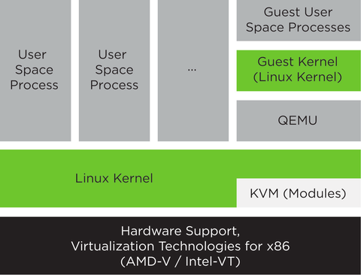
KVM Architecture
https://www.suse.com/documentation/sles-12/book_virt/data/sec_kvm_intro_arch.html

Slide 8
How To (QEMU - KVM)
QEMU userspace process uses kvm.ko driver to execute guest code
open("/dev/kvm")
ioctl(KVM_CREATE_VM)
ioctl(KVM_CREATE_VCPU)
for (;;) {
ioctl(KVM_RUN)
switch (exit_reason) {
case KVM_EXIT_IO: /* ... */
case KVM_EXIT_HLT: /* ... */
}
}

Slide 9
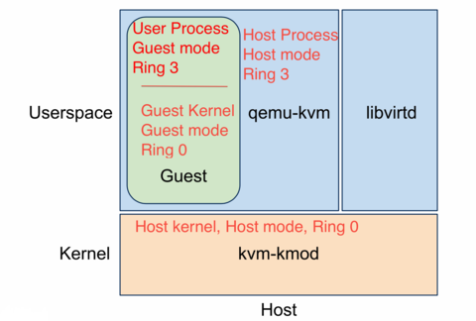
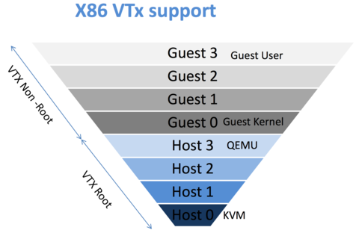
How To (privilege)
출처: http://www.cs.ucsb.edu/~rich/class/cs290-cloud/notes/Virtualization/virtualization.html

Slide 10
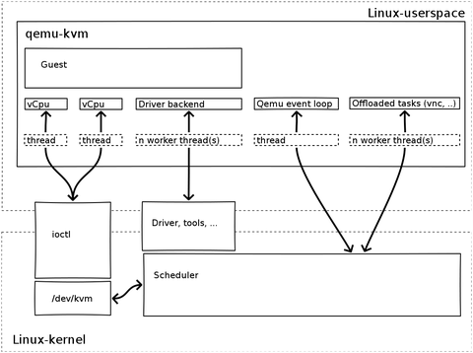
More More Detail
출처 : http://slides.com/braoru/kvm/fullscreen#/28

Slide 11
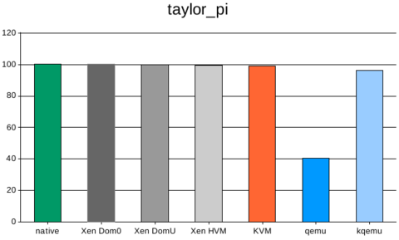
Benchmark
출처 : http://www.andrep.de/virtual/

Slide 12
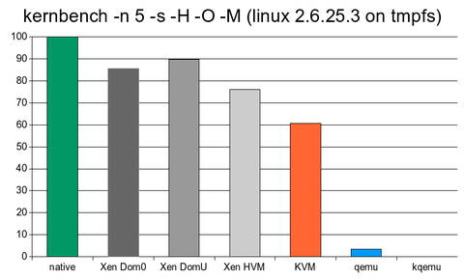
But I/O performance ?
출처 : http://www.andrep.de/virtual/

Slide 13
We need Tuning !!!
Virtio
Vhost_net
Others…

Slide 14
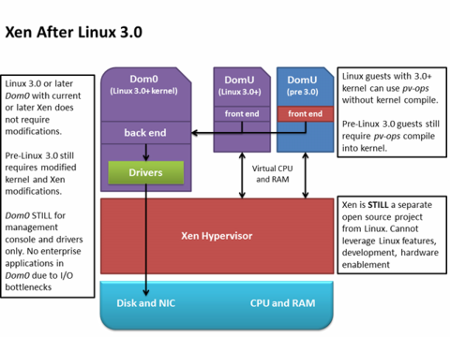
Paravirtualization
출처: http://www.chucknology.com/?p=15

Slide 15
What is Virtio
paravirtualization : network, disk operation
KVM or QEMU
virtio-compatible guest
libvirt
출처: http://wiki.libvirt.org/page/Virtio

Slide 16
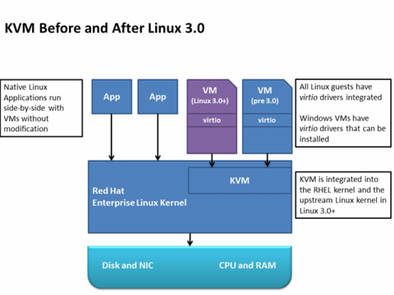
What is Virtio

Slide 17
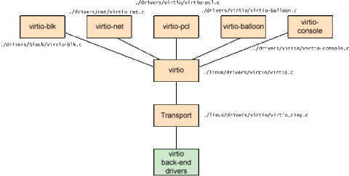
What is Virtio
-guest : /drivers/virtio
-qemu : /hw/virtio
-kernel : context switching
출처 : http://www.ibm.com/developerworks/library/l-virtio/

Slide 18
What is Vhost-net?
vhost-net module
virtio packet 처리를 user space (qemu process)에서 kernel (the vhost-net driver)로 옮김
better latency : 10% less than e1000
greater throughput : 8x normal virtio

Slide 19
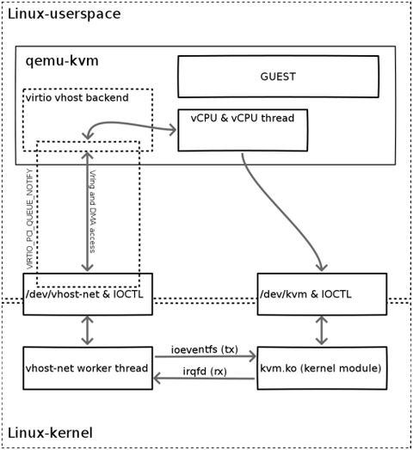
How to Vhost-net
- Guest : /drivers/virtio
- QEMU : hw/vhost.c, vhost_net.c
- kernel : driver/vhost/vhost.c, net.c, virt/kvm/eventfd.c
출처: http://slides.com/braoru/kvm/#/33

Slide 20
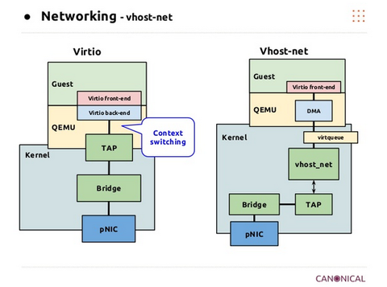
Virtio & vhost-net
guest : /drivers/virtio
qemu : /hw/virtio
kernel : context switching
Guest : /drivers/virtio
QEMU : hw/vhost.c, vhost_net.c
kernel
driver/vhost/vhost.c, net.c,
virt/kvm/eventfd.c

Slide 21
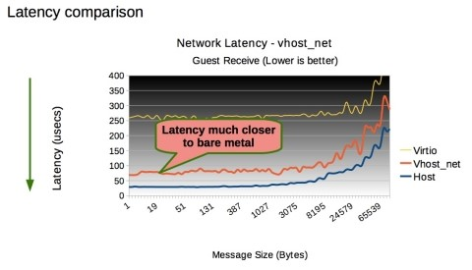
Performance vhost-net
출처: http://www.51gocloud.com/?p=402

Slide 22
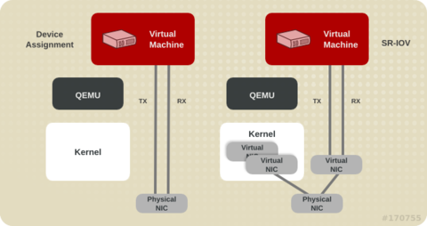
others

Slide 23
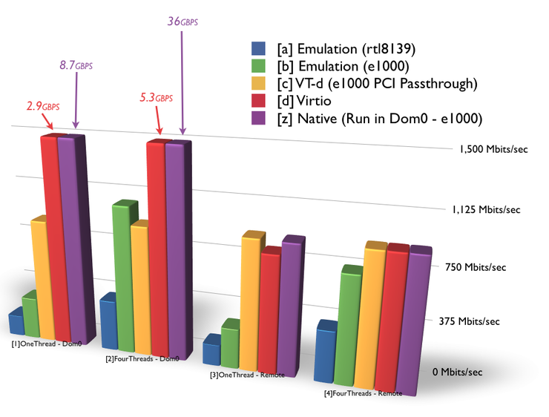
Performance
Network Speed Test (IPerf) in KVM (Virtio-net, emulated, vt-d)

Slide 24
Conclusion ?
KVM
KVM – virtio
KVM – virtio, vhost

Slide 25
Continue?
NEXT

