Slide 1
fuel
보라매NOC – 가상화WG

Slide 2
1. mirantis openstack
미란티스 openstakc 구성요소
• Mirantis OpenStack hardened packages
• Fuel for OpenStack
• Mirantis Support
Mirantis OpenStack hardened packages
These packages include the core OpenStack projects, updated with each stable release of OpenStack, and supporting a broad range of operating systems, hypervisors, and deployment topologies. Also included are:
Packages to ensure High Availability.
Fixes for defects reported by our customers that may not yet have been merged into the community source.
Mirantis-driven premium OpenStack projects such as Sahara (which provides a simple means to provision a Hadoop cluster on top of OpenStack) and Murano (an application catalog that can be used to publish apps and compose reliable environments out of them.)
Mirantis-certified partner plug-ins, drivers, and integrations.
Fuel for OpenStack
Fuel is a life cycle management application that deploys multipleOpenStack clouds from a single interface and then enables you to manage those clouds post deployment. You can add nodes, remove nodes, or even remove clouds, restoring those resources to the available resources pool. Fuel also eases the complexities of network and storage configurations through a simple-to-use graphical user experience. Baked into Fuel are:
Mirantis reference architectures that we have tested and certified to ensure that your deployed clouds are scalable, reliable, and production quality.
An open and flexible library that enables customers to make configuration changes that may be more advanced or focused than the default choices within Fuel. This library also empowers organizations to fold additional drivers or integrations into the deployed environment.
Mirantis OpenStack, by default, enables those features in the Fuel Project that Mirantis has certified and confirmed as production ready. However, it also includes some newer features that are marked as "experimental"; they are less-hardened but are integrated into the product for customers who can tolerate some risk. These experimental features can be enabled for Mirantis OpenStack any time after you have a running Fuel Master Node; see Enable Experimental Features.
Mirantis Support
Mirantis OpenStack offers a subscription to our world-class support with defined service level agreements based on the severity of your issue. For example, the premium support guarantees a one-hour response for severity 1 issues.

Slide 3
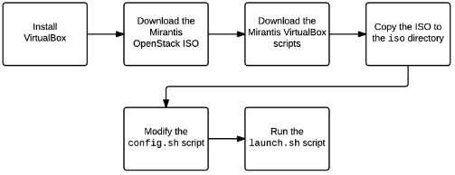
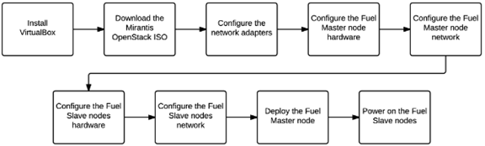
1. mirantis openstack
미란티스 openstakc 설치방법
Mirantis Openstack(MOS) 설치 2가지 방법 : Automated 설치, Manual 설치
1. Automated install : Mirantis VirtualBox Script 로 VM network/HW 자동 설정, 최신 MOS ISO image 필요, config.sh(Slave Node 조절)
2. Manual install : VM network/HW 직접 구성 후 직접 설치
자동설치
수동설치

Slide 4
1. mirantis openstack
미란티스 openstack 자동화 방법
PXE + TFTP를 이용한 OS Provisioning
Fuel이 설치된 서버는 Cobbler를 이용해 PXE 서버 역할을 한다. 동일 네트워크에서 OpenStack이 설치될 깡통(어떤 OS도 설치되지 않은) 서버를 PXE로 부팅시키면, Fuel로부터 기본적인 리눅스 이미지를 가져와 부팅을 진행하게된다. 이 후, OS Provision 과정에 따라 노드의 실제 디스크에 Ubuntu OS를 자동으로 설치하게된다.
Puppet을 통한 OpenStack Deploy
OS Provision 이 후, 각 노드들은 Puppet 배포/설정 자동화 스크립트를 시작하여 OpenStack 구성 요소를 설치하고 설정 또한 진행하게 된다. 자동으로 진행되기 때문에 배포가 끝날 때까지 느긋하게 기다려주면 된다.
OSTF를 이용한 설치 이후 테스트
OpenStack 배포가 완료되고나서 제대로 설치되고 잘 작동하는지 검증이 필요하다. 이 또한 미리 만들어져있는 테스트 스크립트를 통해 기능들을 점검하게 된다

