Slide 1
helion
보라매NOC – 가상화WG

Slide 2
1. helion
helion 기술
HLM
Helion OpenStack 4.0은 OpenStack 클라우드의 지속적인 라이프 사이클 작업을 설치하고 수행하는 프로세스를 단순화하고 가속화하는 라이프 사이클 관리 도구를 제공합니다.. 라이프 사이클 관리 도구는 OpenStack 소프트웨어를 배포하고 구성하는 데 사용할 수있는 오픈 소스 자동화 엔진을 사용합니다.
Ansible
HPE는 HPE Helion OpenStack 4.0을 설치, 구성, 유지 관리 및 업데이트하기 위해 Playbooks이라고하는 일련의 Apps 스크립트를 만들었습니다. 이 플레이 북이 모여 Helion Lifecycle Manager를 구성
HPE Helion OpenStack 4.0을 설치하는 동안 컴퓨팅, 네트워킹, 오케스트레이션, 저장소, ID 등과 같은 핵심 OpenStack 서비스는 기본적으로 자동으로 설치됩니다. 이러한 서비스는 통합되어 즉시 사용할 수 있습니다. HPE Helion OpenStack 라이프 사이클 관리자는 각 서비스를 개별적으로 구성하고 상호 작용을 구성하는 대신 통합 작업을 수행하는 스크립트를 제공합니다.
Cobbler
Cobbler는 프로비저닝, DNS 및 DHCP 관리, 패키지 업데이트, 전원 관리, 구성 관리 오케스트레이션 등을 지원할 수 있습니다.
Helion OpenStack은이를 달성하기 위해 Cobbler, IPMI 및 baremetal Ansible 플레이 북을 사용합니다. Cobbler는 전개 될 때 서버 모델에 지정된 baremetal 정보를 사용합니다. 베어 메탈 / PXE 설치 네트워크의 각 노드에 대해 지정된 MAC 및 IP 주소가 Cobbler에로드됩니다. Cobbler가 구성되면 Baremetal PlayBook을 사용하여 프로비저닝중인 각 서버를 다시 이미지 할 수 있습니다. 각 서버는 PXE를 사용하여 OS 및 보안 인증서를 제공하는 Cobbler 설치 프로그램으로 부팅합니다. 그런 다음 서버는 내부 하드 디스크의 새 OS 이미지로 재부팅되고 최종 설치 단계에 들어갑니다.
Configuration Processor
구성 프로세서는 YAML 파일에 설명 된 입력 모델을 읽고 유효성을 검사합니다. 이 정보와 HPE Helion OpenStack이 제공하는 서비스 정의 및 현재 배포에 대한 모든 영구 상태 정보를 결합한 다음 Asible Playbook에서 클라우드를 배포하는 데 사용되는 데이터를 생성합니다. 또한 구성에 대한 세부 정보를 제공하는 일련의 정보 파일을 생성합니다.
구성 프로세서가 성공적으로 실행되면 staging area가 만들어지고 최종 배포에 필요한 플레이 북 및 구성 파일로 채워집니다

Slide 3
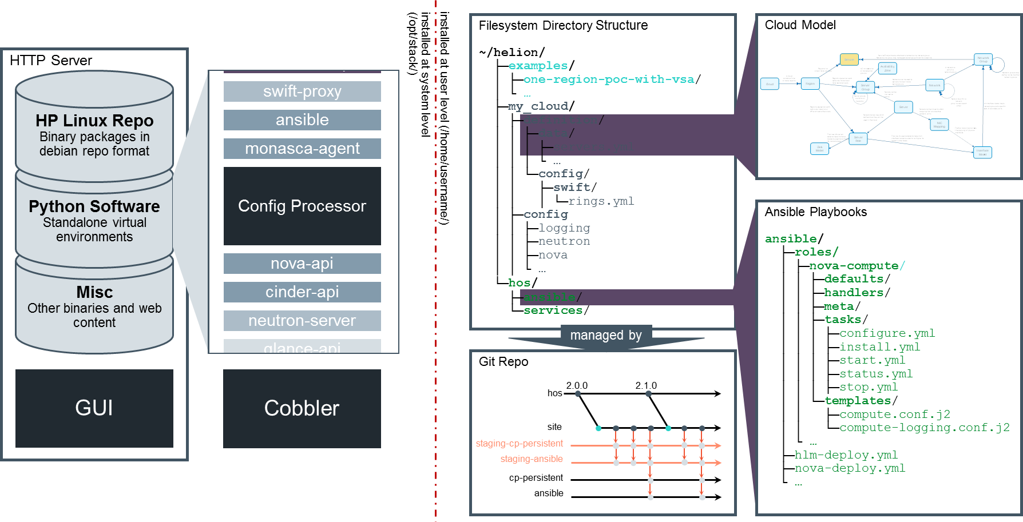
1. helion
Architecture

Slide 4
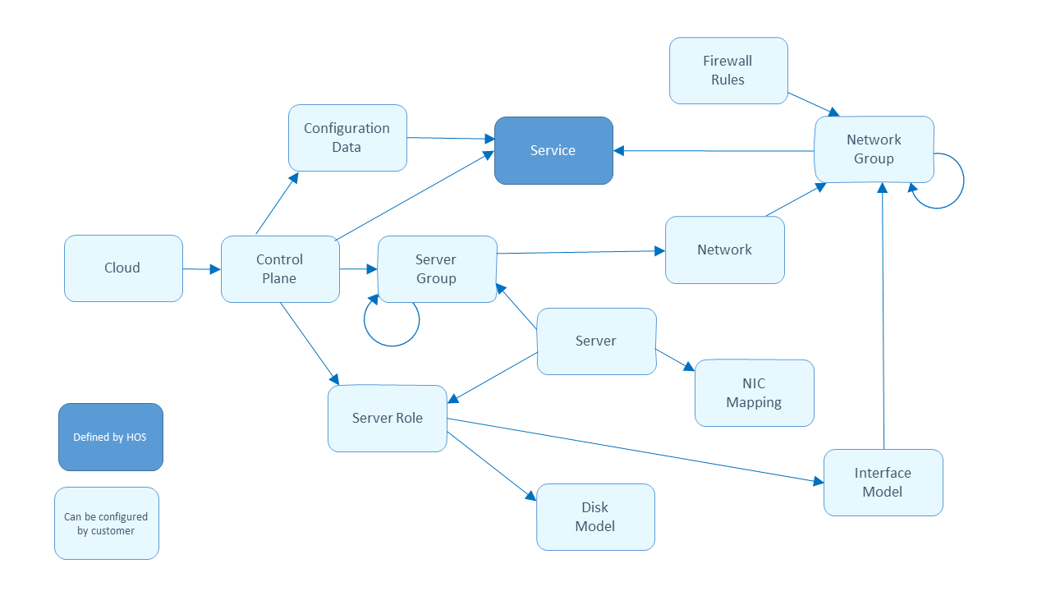
1. helion
Cloud input model
YAML 파일로 표현된 구성 객체들 (그림은 구성 객체들간의 관계)
~/helion/my_cloud/definition에 정의됨
NIC Device Family
NIC Device Type
cpu model
volume groups
memory model
device groups

Slide 5
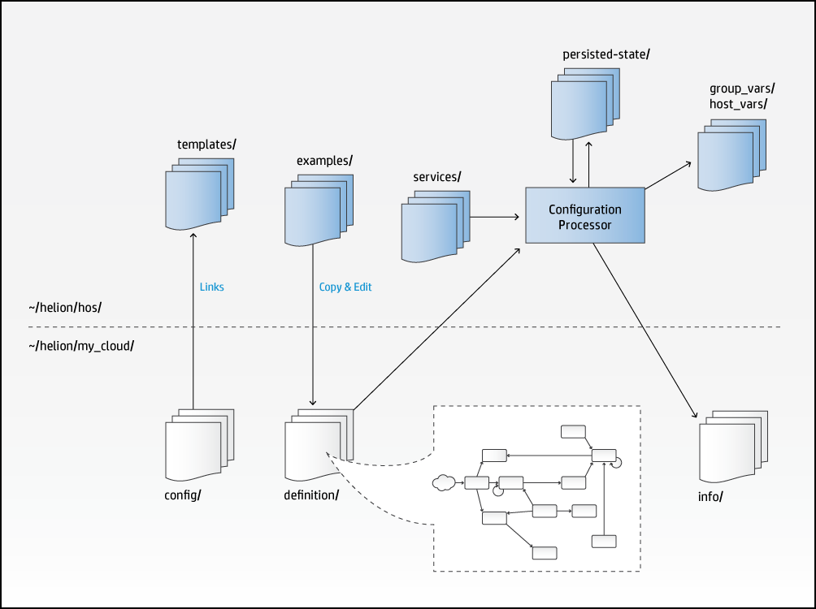
1. helion
Configuration processor
YAML 파일로 표현된 input model을 읽고 검증
클라우드를 배포하고 구성하는 데 필요한 모든 데이터를 생성 할뿐만 아니라 결과 구성에 대한 세부 정보를 제공하는 많은 정보 파일도 생성합니다. 이러한 파일은 첫 번째 구성 프로세서가 실행 된 후
~/helion/my_cloud/info에서 찾을 수 있습니다. 이 디렉토리는 구성 프로세서가 실행될 때마다 다시 빌드됩니다. input model YAML을 수정후 ansible-playbook -i hosts/localhost config-processor-run.yml로 configuration을 설정완료 하여야 배포가능

Slide 6
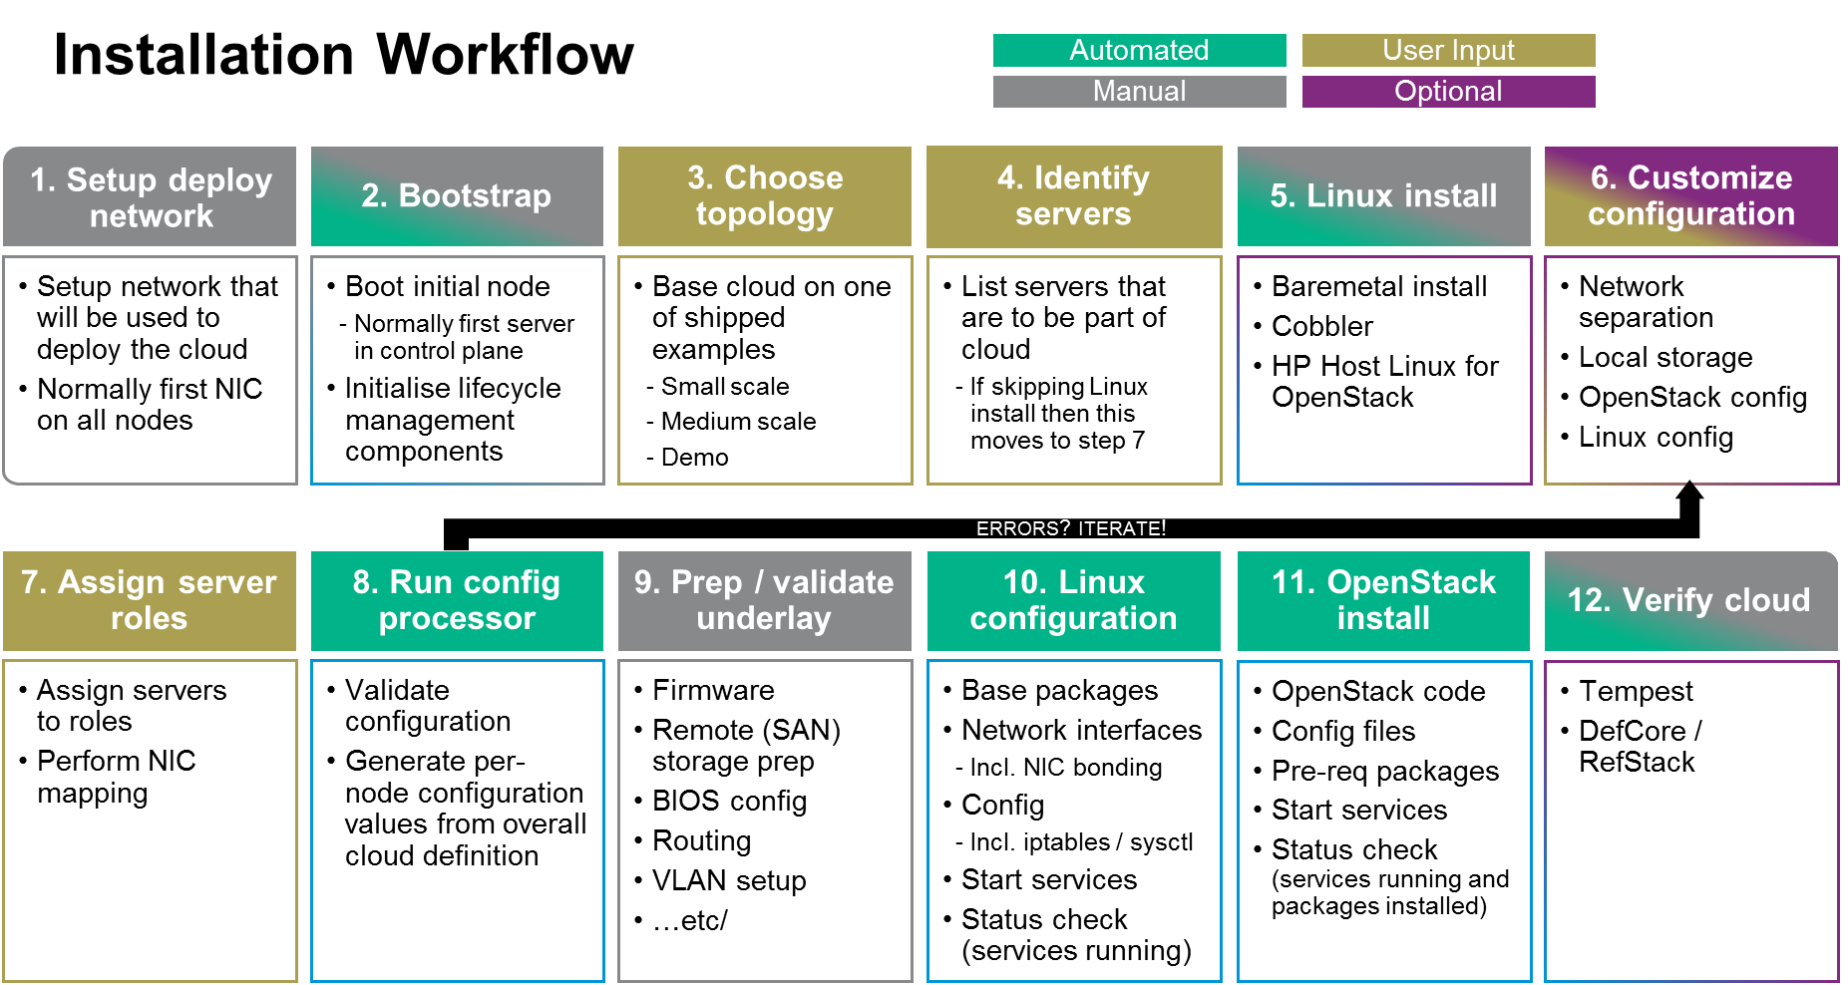
1. helion
설치절차

Slide 7
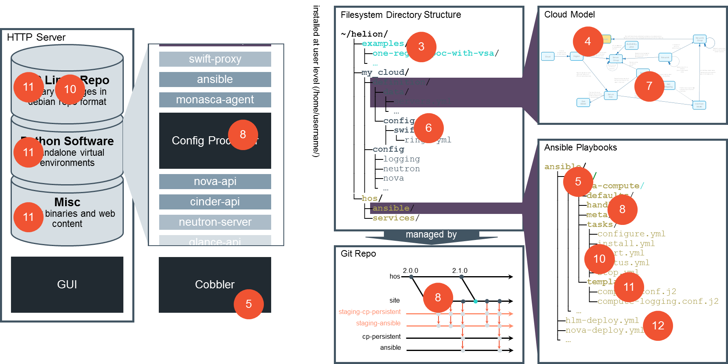
1. helion
설치절차

Slide 8
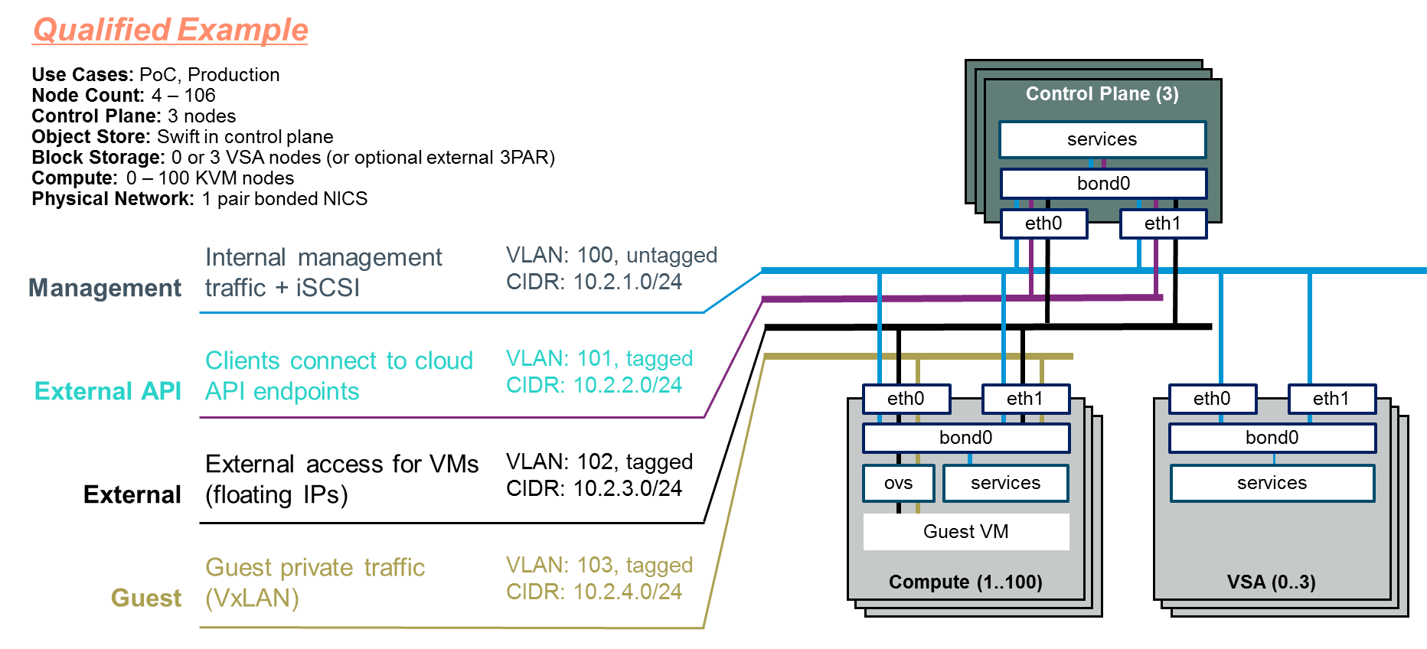
1. helion
Entry Scale Cloud with KVM

Slide 9
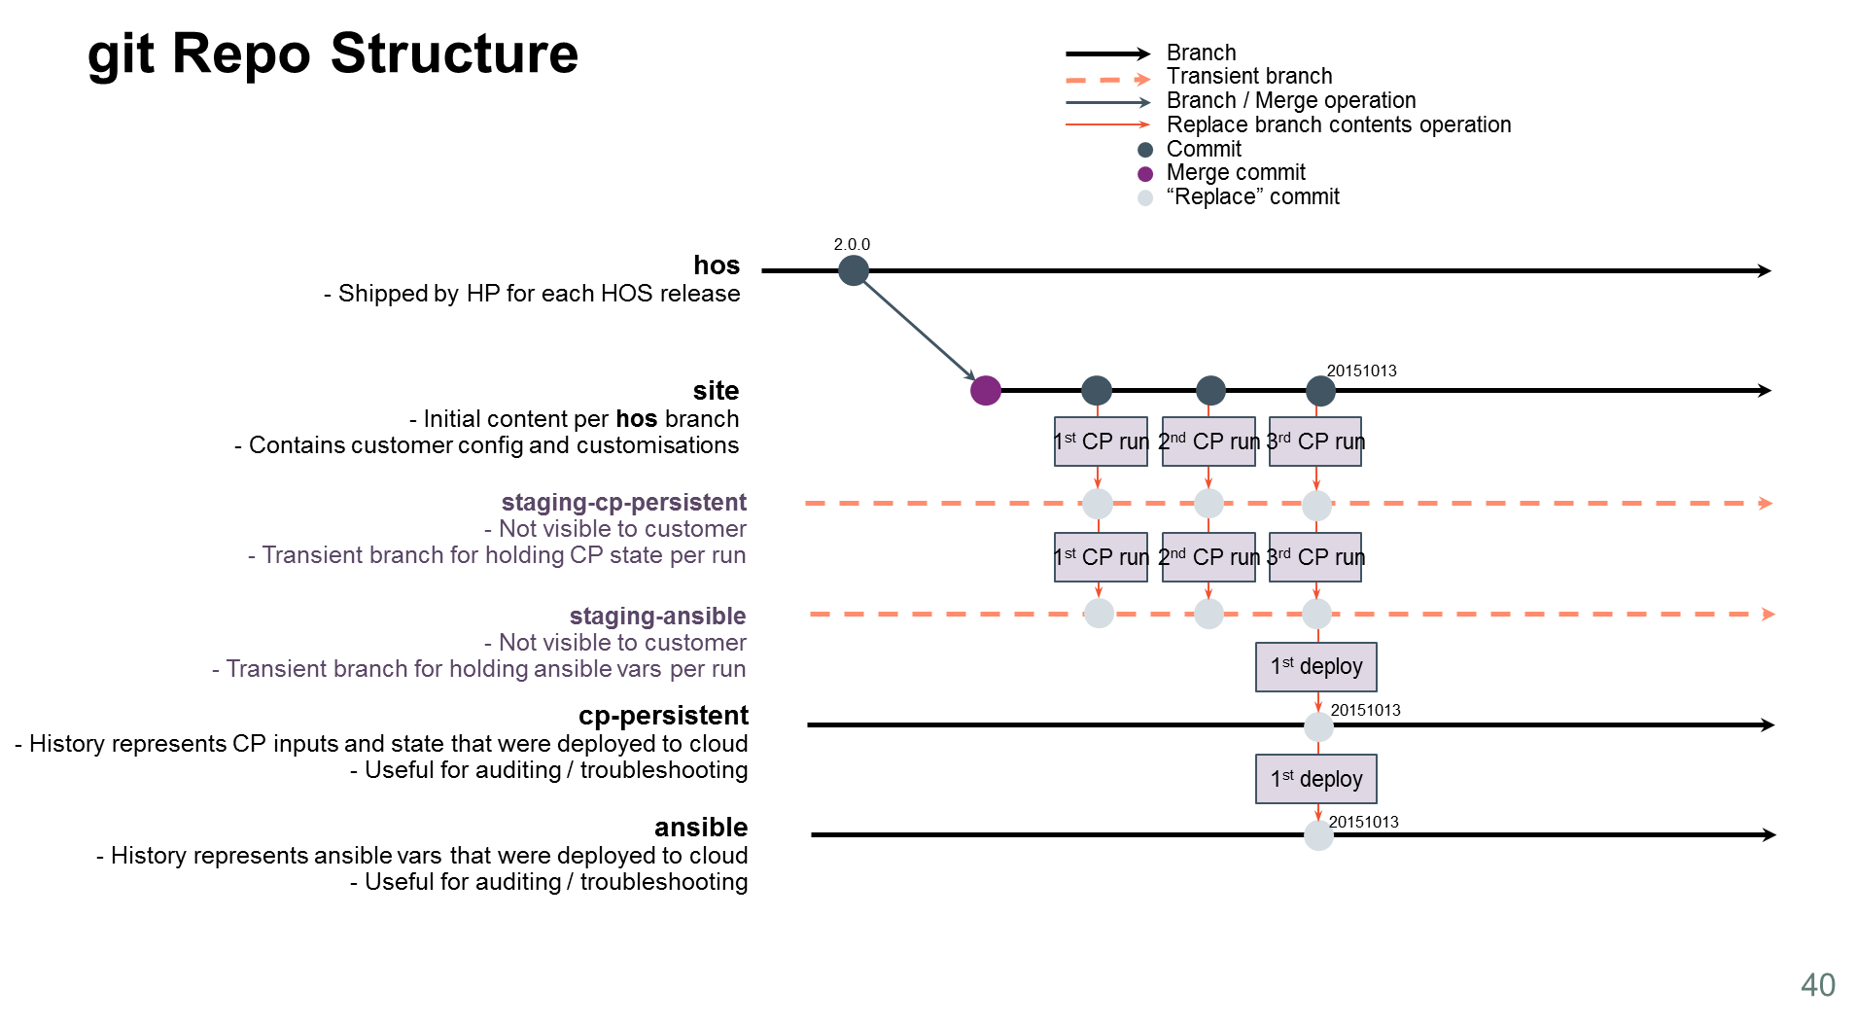
1. helion
git 구조

Slide 10
1. helion
git 배포
HPE Helion OpenStack 4.0을 처음 사용하는 시스템에서는 라이프 사이클 관리자가 ~ / helion 아래에있는 git 저장소를 준비합니다. 라이프 사이클 매니저 프로비저닝은 hlm-init-deployer 스크립트를 자동으로 실행합니다. 이것은 anonymous-playbook -i hosts / localhost git-00-initialise.yml을 호출합니다.
결과적으로 ~ / helion 디렉토리는 git repo로 초기화됩니다 (비어있는 경우). 그것은 4개의 branch로 초기화
hos | 이 디렉토리는 ~/hellion 디렉토리 내용에 대응하는 upstream source를 갖고 있습니다. HPE에서 다운로드한 모든 source code를 release한 것입니다. 즉, end user에 의해 customization되지 않은 것입니다.
site | 이 디렉토리는 host의 copy본으로서 당신의 configuration 변경분을 반영합니다.
ansible | 이 디렉토리는 Configuration Process에 의해 생성된 변수가 정의되어 있습니다. 그리고 어떤 서버가 어떤 역할을 수행하는지verb_hosts 파일에 포함되어 있습니다. 이러한 준비된 deployment playbook은 이 output을 수행하고 ~/scratch 디렉토리에 ansible playbook이 다양한 변수와 함께 포함되어 있습니다. 또한 main deployment playbook이 정상적으로 수행되었는지 ~/scratch/ansible/next/hos/ansible 에 들어있습니다.
cp-persistent | 이 디렉토리는 CP(Configuration Processor)를 유지하는데 필요한 지속상태를 포함하고 있습니다. 이 상태는 거의 ip주소 할당과 특정 서버 role 할당입니다. 일부 operation 절차가 이곳에 포함되어 있을 수 있습니다. (예를 들어 용도 변경을 위한 서비스 retiring)
staging-ansible | 가장 최근 commit이 ansible branch에 추가됩니다.
staging-cp-persistent | 가장 최근 commit이 cp-persistent에 추가됩니다.

Slide 11
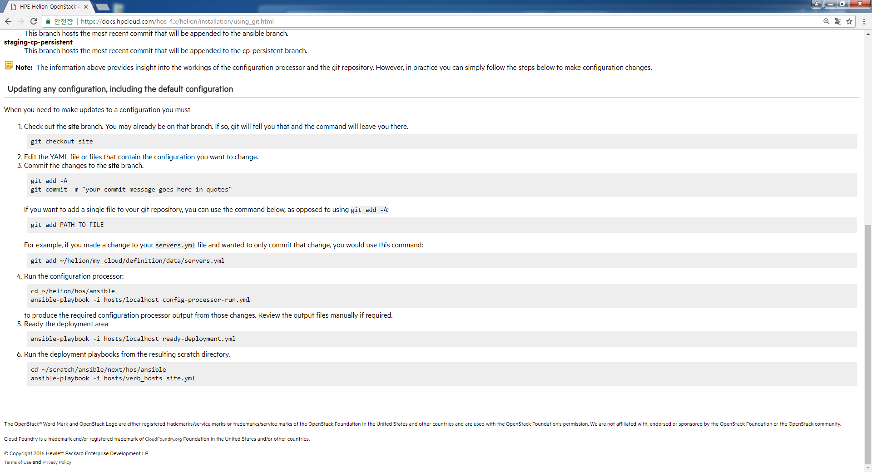
1. helion
GIT 명령어 사용

Slide 12
1. helion
Cloud Configuration
Key | Value Description
name | An administrator-defined name for the cloud
hostname-data (optional) | Provides control over some parts of the generated names (see Name Generation) Consists of two values: host-prefix - default is to use the cloud name (above) member-prefix - default is "-m"
ntp-servers (optional) | A list of external NTP servers your cloud has access to. If specified by name then the names need to be resolvable via the external DNS nameservers you specify in the next section. All servers running the "ntp-server" component will be configured to use these external NTP servers.
dns-settings (optional) | DNS configuration data that will be applied to all servers. See example configuration for a full list of values.
smtp-settings (optional) | SMTP client configuration data that will be applied to all servers. See example configurations for a full list of values.
firewall-settings (optional) | Used to enable/disable the firewall feature and to enable/disable logging of dropped packets. The default is to have the firewall enabled.
audit-settings (optional) | Used to enable/disable the production of audit data from services.The default is to have audit disabled for all services.
product:
version: 2
cloud:
name: entry-scale-kvm-vsa
hostname-data:
host-prefix: helion
member-prefix: -m
ntp-servers:
- "ntp-server1"
# dns resolving configuration for your site
dns-settings:
nameservers:
- name-server1
firewall-settings:
enable: true
# log dropped packets
logging: true
audit-settings:
audit-dir: /var/audit
default: disabled
enabled-services:
- keystone

Slide 13
1. helion
2. Control Plane
Key | Value Description
name | This name identifies the control plane. This value is used to persist server allocations (see Persisted Data) and cannot be changed once servers have been allocated.
control-plane-prefix (optional) | The control-plane-prefix is used as part of the hostname (see Name Generation). If not specified, the control plane name is used.
region-name | This name identifies the Keystone region within which services in the control plane will be registered.
common-service-components (optional) | This lists a set of service components that run on all servers in the control plane (clusters and resource pools)
failure-zones (optional) | A list of server-group names that servers for this control plane will be allocated from. If no failure-zones are specified, only servers not associated with a server-group will be used. (see Server Groups and Failure Zones for a description of server-groups as failure zones.)
configuration-data (optional) | A list of configuration data settings to be used for services in this control plane (see Configuration Data)
clusters | A list of clusters for this control plane (see Clusters).
resources | A list of resource groups for this control plane (see Resources).
product:
version: 2
control-planes:
- name: control-plane-1
control-plane-prefix: cp1
region-name: region1
failure-zones:
- AZ1
- AZ2
- AZ3
configuration-data:
- NEUTRON-CONFIG-CP1
- OCTAVIA-CONFIG-CP1
common-service-components:
- logging-producer
- monasca-agent
- freezer-agent
- stunnel
- lifecycle-manager-target
clusters:
- name: cluster1
cluster-prefix: c1
server-role: CONTROLLER-ROLE
member-count: 3
allocation-policy: strict
service-components:
- lifecycle-manager
- ntp-server
- swift-ring-builder
- mysql
- ip-cluster
resources:
- name: compute
resource-prefix: comp
server-role: COMPUTE-ROLE
allocation-policy: any
min-count: 0
service-components:
- ntp-client
- nova-compute
- nova-compute-kvm
- neutron-l3-agent

Slide 14
1. helion
3. Configuration data (control plane에 사용될 model content와 값)
product:
version: 2
configuration-data:
- name: NEUTRON-CONFIG-CP1
services:
- neutron
data:
neutron_provider_networks:
- name: OCTAVIA-MGMT-NET
provider:
- network_type: vlan
physical_network: physnet1
segmentation_id: 106
cidr: 172.30.1.0/24
no_gateway: True
enable_dhcp: True
allocation_pools:
- start: 172.30.1.10
end: 172.30.1.250
host_routes:
# route to MANAGEMENT-NET-1
- destination: 192.168.245.0/24
nexthop: 172.30.1.1
neutron_external_networks:
- name: ext-net
cidr: 172.31.0.0/24
gateway: 172.31.0.1
provider:
- network_type: vlan
physical_network: physnet1
segmentation_id: 107
allocation_pools:
- start: 172.31.0.2
end: 172.31.0.254
network-tags:
- network-group: MANAGEMENT
tags:
- neutron.networks.vxlan
- neutron.networks.vlan:
provider-physical-network: physnet1
- network-group: EXTERNAL-VM
tags:
- neutron.l3_agent.external_network_bridge

Slide 15
1. helion
3. Server Groups
product:
version: 2
- name: CLOUD
server-groups:
- AZ1
- AZ2
- AZ3
networks:
- EXTERNAL-API-NET
- EXTERNAL-VM-NET
- GUEST-NET
- MANAGEMENT-NET
#
# Create a group for each failure zone
#
- name: AZ1
server-groups:
- RACK1
- name: AZ2
server-groups:
- RACK2
- name: AZ3
server-groups:
- RACK3
#
# Create a group for each rack
#
- name: RACK1
Key | Value Description
name | An administrator-defined name for the server group. The name is used to link server-groups together and to identify server-groups to be used as failure zones in a control-plane. (see Control Plane)
server-groups (optional) | A list of server-group names that are nested below this group in the hierarchy. Each server group can only be listed in one other server group (i.e. in a strict tree topology).
networks (optional) | A list of network names (see Networks). See Server Groups and Networks for a description of how networks are matched to servers via server groups.

Slide 16
1. helion
Key | Value Description
name | The name of this network. The network name may be used in a server-group definition (see Server Groups) to specify a particular network from within a network-group to be associated with a set of servers.
network-group | The name of the associated network group.
vlanid (optional) | The IEEE 802.1Q VLAN Identifier, a value in the range 1 through 4094. A vlanid must be specified when tagged-vlan is true.
tagged-vlan (optional) | May be set to “true” or “false”. If true, packets for this network carry the vlanid in the packet header; such packets are referred to as VLAN-tagged frames in IEEE 802.1Q.
cidr (optional) | The IP subnet associated with this network.
addresses (optional) | A list of IP addresses or IP address ranges (specified as <start addr>-<end addr> from which server addresses may be allocated. The default value is the first host address within the CIDR (e.g. the .1 address). The addresses parameter provides more flexibility than the start-address and end-address parameters and so is the preferred means of specifying this data.
start-address (optional) (deprecated) | An IP address within the CIDR which will be used as the start of the range of IP addresses from which server addresses may be allocated. The default value is the first host address within the CIDR (e.g. the .1 address). Important: This parameter is deprecated in favor of the new addresses parameter. This parameter may be removed in a future release.
end-address (optional) (deprecated) | An IP address within the CIDR which will be used as the end of the range of IP addresses from which server addresses may be allocated. The default value is the last host address within the CIDR (e.g. the .254 address of a /24). Important: This parameter is deprecated in favor of the new addresses parameter. This parameter may be removed in a future release.
gateway-ip (optional) | The IP address of the gateway for this network. Gateway addresses must be specified if the associated network-group provides routes.
4. Networks
product:
version: 2
networks:
- name: NET_EXTERNAL_VM
vlanid: 102
tagged-vlan: true
network-group: EXTERNAL_VM
- name: NET_GUEST
vlanid: 103
tagged-vlan: true
cidr: 10.1.1.0/24
gateway-ip: 10.1.1.1
network-group: GUEST
- name: NET_MGMT
vlanid: 100
tagged-vlan: false
cidr: 10.2.1.0/24
addresses:
- 10.2.1.10-10.2.1.20
- 10.2.1.24
- 10.2.1.30-10.2.1.36
gateway-ip: 10.2.1.1
network-group: MGMT

Slide 17
1. helion
3. Servers
Key | Value Description
id | An administrator-defined identifier for the server. IDs must be unique and are used to track server allocations. (see Persisted Data).
ip-addr | The IP address is used by the configuration processor to install and configure the service components on this server. This IP address must be within the range of a network defined in this model. When the servers file is being used for operating system installation, this IP address will be assigned to the node by the installation process, and the associated network must be an untagged VLAN.
hostname (optional) | The value to use for the hostname of the server. If specified this will be used to set the hostname value of the server which will in turn be reflected in systems such as Nova, Monasca, etc. If not specified the hostname will be derived based on where the server is used and the network defined to provide hostnames.
role | Identifies the server-role of the server. (see Server Roles for a description of server roles)
nic-mapping | Name of the nic-mappings entry to apply to this server. (see NIC Mappings)
server-group (optional) | Identifies the server-groups entry that this server belongs to. (see Server Groups)
boot-from-san (optional) | Must be set to true is the server needs to be configured to boot from SAN storage. Default is False
fcoe-interfaces (optional) | A list of network devices that will be used for accessing FCoE storage. This is only needed for devices that present as native FCoE, not devices such as Emulex which present as a FC device.
ansible-options (optional) | A string of additional variables to be set when defining the server as a host in Ansible. For example, ansible_ssh_port=5986
mac-addr (optional) | Needed when the servers file is being used for operating system installation. This identifies the MAC address on the server that will be used to network install the operating system.
distro-id (optional) | The name of the cobbler server profile to be used when the servers file is used for operating system installation. Supported values are: hlinux-x86_64 (default) rhel72-x86_64 rhel72-x86_64-multipath Important: RHEL is only supported for KVM compute hosts. Note that you need to add a -multipath suffix to the distro-id value when using multipath with RHEL.
kopt-extras (optional) | Provides additional command line arguments to be passed to the booting network kernel. For example, vga=769 sets the video mode for the install to low resolution which can be useful for remote console users.
ilo-ip (optional) | Needed when the servers file is being used for operating system installation. This provides the IP address of the power management (e.g. IPMI, iLO) subsystem.
ilo-user (optional) | Needed when the servers file is being used for operating system installation. This provides the user name of the power management (e.g. ipmi-ip, iLO) subsystem.
ilo-password (optional) | Needed when the servers file is being used for operating system installation. This provides the user password of the power management (e.g. ipmi-ip, iLO) subsystem.
ilo-extras (optional) | Needed when the servers file is being used for operating system installation. Additional options to pass to ipmitool. For example, this may be required if the servers require additional IPMI addressing parameters.
moonshot (optional) | Provides the node identifier for HPE Moonshot servers, e.g. c4n1 where c4 is the cartridge and n1 is node 1.
product:
version: 2
baremetal:
subnet: 192.168.10.0
netmask: 255.255.255.0
servers:
- id: controller1
ip-addr: 192.168.10.3
role: CONTROLLER-ROLE
server-group: RACK1
nic-mapping: HP-DL360-4PORT
mac-addr: b2:72:8d:ac:7c:6f
ilo-ip: 192.168.9.3
ilo-password: password
ilo-user: admin
- id: controller2
ip-addr: 192.168.10.4
role: CONTROLLER-ROLE
server-group: RACK2
nic-mapping: HP-DL360-4PORT
mac-addr: 8a:8e:64:55:43:76
ilo-ip: 192.168.9.4
ilo-password: password
ilo-user: admin

Slide 18
1. helion
4. NIC Mappings
Key | Value Description
logical-name | The network device name that will be associated with the device at the specified bus-address. The logical-name specified here can be used as a device name in network interface model definitions. (see Interface Models)
type | The type of port. HPE Helion OpenStack 4.0 supports "simple-port" and "multi-port". Use "simple-port" if your device has a unique bus-address. Use "multi-port" if your hardware requires a "port-num" attribute to identify a single port on a multi-port device. An examples of such a device is: Mellanox Technologies MT26438 [ConnectX VPI PCIe 2.0 5GT/s - IB QDR / 10GigE Virtualization+]
bus-address | PCI bus address of the port. Enclose the bus address in quotation marks so yaml does not misinterpret the embedded colon (:) characters. See Pre-Install Checklist - Information for nic_mappings.yml for details on how to determine this value.
port-attributes (required if type is multi-port) | Provides a list of attributes for the physical port. The current implementation supports only one attribute, "port-num". Multi-port devices share a bus-address. Use the "port-num" attribute to identify which physical port on the multi-port device to map. See Pre-Install Checklist - Information for nic_mappings.yml for details on how to determine this value.
nic-device-type (optional) | Specifies the PCI vendor ID and device ID of the port in the format of <vendor_id>:<device_id>, for example, 8086:10fbs.
product:
version: 2
nic-mappings:
- name: HP-DL360-4PORT
physical-ports:
- logical-name: hed1
type: simple-port
bus-address: "0000:07:00.0"
- logical-name: hed2
type: simple-port
bus-address: "0000:08:00.0"
nic-device-type: '8086:10fb'
- logical-name: hed3
type: multi-port
bus-address: "0000:09:00.0"
port-attributes:
port-num: 0
- logical-name: hed4
type: multi-port
bus-address: "0000:09:00.0"
port-attributes:
port-num: 1

Slide 19
1. helion
3. Server Roles (disk+ interface, memory+ cpu role 정의)
product:
version: 2
server-roles:
- name: CONTROLLER-ROLE
interface-model: CONTROLLER-INTERFACES
disk-model: CONTROLLER-DISKS
- name: COMPUTE-ROLE
interface-model: COMPUTE-INTERFACES
disk-model: COMPUTE-DISKS
memory-model: COMPUTE-MEMORY
cpu-model: COMPUTE-CPU
- name: VSA-ROLE
interface-model: VSA-INTERFACES
disk-model: VSA-DISKS
Key | Value Description
name | An administrator-defined name for the role.
interface-model | The name of the interface-model to be used for this server-role. Different server-roles can use the same interface-model.
disk-model | The name of the disk-model to use for this server-role. Different server-roles can use the same disk-model.
memory-model (optional) | The name of the memory-model to use for this server-role. Different server-roles can use the same memory-model.
cpu-model (optional) | The name of the cpu-model to use for this server-role. Different server-roles can use the same cpu-model.

Slide 20
1. helion
4. Disk Models (volume groups+ device groups)
product:
version: 2
disk-models:
- name: VSA-DISKS
volume-groups:
- ...
device-groups:
- ...
volume-groups:
- name: hlm-vg
physical-volumes:
- /dev/sda_root
logical-volumes:
- name: root
size: 35%
fstype: ext4
mount: /
- name: log
size: 50%
mount: /var/log
fstype: ext4
mkfs-opts: -O large_file
- ...
- name: vg-comp
physical-volumes:
- /dev/sdb
logical-volumes:
- name: compute
size: 95%
mount: /var/lib/nova
fstype: ext4
mkfs-opts: -O large_file
device-groups:
- name: vsa-data
consumer:
name: vsa
usage: data
devices:
- name: /dev/sdc
- name: vsa-cache
consumer:
name: vsa
usage: adaptive-optimization
devices:
- name: /dev/sdb

Slide 21
1. helion
4. Memory Models (hugepage 설정)
Key | Value Description
name | The name of the memory-model that is referenced from one or more server-roles.
default-huge-page-size (optional) | The default page size that will be used is specified when allocating huge pages. If not specified, the default is set by the operating system.
huge-pages | A list of huge page definitions (see below).
memory-models:
- name: COMPUTE-MEMORY-NUMA
default-huge-page-size: 2M
huge-pages:
- size: 2M
count: 5
numa-node: 0
- size: 2M
count: 5
numa-node: 1
- size: 1G
count: 3
- size: 2M
count: 6
Key | Value Description
size | The page size in kilobytes, megabytes, or gigabytes specified as nX where: nis an integer greater than zeroXis one of "K", "M" or "G"
count | The number of pages of this size to create (must be greater than zero).
numa-node (optional) | If specified the pages will be created in the memory associated with this numa node. If not specified the pages are distributed across numa nodes by the operating system.

Slide 22
1. helion
4. Cpu Models (cpu 할당 설정)
product:
version: 2
cpu-models:
- name: COMPUTE-CPU
assignments:
- components:
- nova-compute-kvm
cpu:
- processor-ids: 0-1,3,5-7
role: vm
- components:
- openvswitch
cpu:
- processor-ids: 4,12
isolate: False
role: eal
- processor-ids: 2,10
role: pmd
Key | Value Description
processor-ids | A list of CPU IDs as seen by the operating system.
isolate (optional) | A boolean value which indicates if the CPUs are to be isolated from the general kernel SMP balancing and scheduling algorithms. The specified processor IDs will be configured in the Linux kernel isolcpus parameter. The default value is True.
role | A role within the component for which the CPUs will be used.
Component | Role | Description
nova-compute-kvm | vm | The specified processor IDs will be configured in the Nova vcpu_pin_set option.
openvswitch | eal | The specified processor IDs will be configured in the Open vSwitch DPDK EAL -c (coremask) option. Refer to the DPDK documentation for details.
 | pmd | The specified processor IDs will be configured in the Open vSwitch pmd-cpu-mask option. Refer to the Open vSwitch documentation and the ovs-vswitchd.conf.db man page for details.

Slide 23
1. helion
4. Interface Models (network interface bond와 networkgroup mapping)
product:
version: 2
interface-models:
- name: INTERFACE_SET_CONTROLLER
network-interfaces:
- name: BONDED_INTERFACE
device:
name: bond0
bond-data:
provider: linux
devices:
- name: hed3
- name: hed4
options:
mode: active-backup
miimon: 200
primary: hed3
network-groups:
- EXTERNAL_API
- EXTERNAL_VM
- GUEST
- name: UNBONDED_INTERFACE
device:
name: hed0
network-groups:
- MGMT
fcoe-interfaces:
- name: FCOE_DEVICES
devices:
- eth7
- eth8
- name: INTERFACE_SET_DPDK
network-interfaces:
- name: BONDED_DPDK_INTERFACE
device:
name: bond0
bond-data:
provider: openvswitch
devices:
- name: dpdk0
- name: dpdk1
options:
mode: active-backup
network-groups:
- GUEST
- name: UNBONDED_DPDK_INTERFACE
device:
name: dpdk2
network-groups:
- PHYSNET2
dpdk-devices:
- devices:
- name: dpdk0
- name: dpdk1
- name: dpdk2
driver: igb_uio
components:
- openvswitch
eal-options:
- name: socket-mem
value: 1024,0
- name: n
value: 2
component-options:
- name: n-dpdk-rxqs
value: 64

Slide 24
1. helion
5. Network Groups (network topology 정의)
product:
version: 2
network-groups:
- name: EXTERNAL-API
hostname-suffix: extapi
load-balancers:
- provider: ip-cluster
name: extlb
external-name:
tls-components:
- default
roles:
- public
cert-file: my-public-helion-cert
- name: EXTERNAL-VM
tags:
- neutron.l3_agent.external_network_bridge
- name: GUEST
hostname-suffix: guest
tags:
- neutron.networks.vxlan
- name: MANAGEMENT
hostname-suffix: mgmt
hostname: true
component-endpoints:
- default
routes:
- default
load-balancers:
- provider: ip-cluster
name: lb
components:
- default
roles:
- internal
- admin
tags:
- neutron.networks.vlan:
provider-physical-network: physnet1

Slide 25
1. helion 설치
사전조건
BIOS and iLO Settings
ㅇ Setup the iLO Advanced license in the iLO configuratio
ㅇ Verify the Date and Time settings in the BIOS
ㅇ Ensure that Wake-on-LAN is disabled in the BIOS
ㅇ Ensure that the NIC port to be used for PXE installation has PXE enabled in the BIOS
ㅇ Ensure that all other NIC ports have PXE disabled in the BIOS
ㅇ Ensure all hardware in the server not directly used by Helion is disable
Lifecycle Manager
ㅇ Disk Requirement: Single 8GB disk needed per the Minimum Hardware Requirements
ㅇ Set up the Deployer using the hLinux ISO
ㅇ Ensure your local DNS nameserver is placed into your /etc/resolv.conf file
ㅇ Install and configure NTP for your environment
ㅇ Ensure your NTP server(s) is placed into your /etc/ntp.conf file
ㅇ NTP time source:

Slide 26
1. helion 설치
LIFECYCLE MANAGER
가. Set up the Lifecycle Manager
Sign in and download the product and signature files at the link below:
  Software Entitlement Portal
You can verify the download was complete via the signature verification process outlined here.
Boot your lifecycle manager from the ISO contained in the download.
Enter "install" to start installation.Note: "install" is all lower case
Select the language. Note that only the English language selection is currently supported.
Select the location.
Select the keyboard layout.
Select the primary network interface, if prompted:
  Assign IP address, subnet mask, and default gateway
Create new account:
  Enter a username.
  Enter a password.
  Enter time zone
나. Configure and Run the Lifecycle Manager
sudo mount HelionOpenStack-4.0.iso /media/cdrom
tar xvf /media/cdrom/hos/hos-4.0.0-20161014T020249Z.tar
~/hos-4.0.0/hos-init.bash
~/helion/ Top level directory
~/helion/examples/ Directory contains the config input files of the example clouds
~/helion/my_cloud/definition/ Directory contains the config input files
~/helion/my_cloud/config/ Directory contains .j2 files which are symlinks to the ~/helion/hos/ansible directory
~/helion/hos/ Directory contains files used by the installer
다. Configure Your Environment
cp -r ~/helion/examples/mid-scale-kvm-vsa/* ~/helion/my_cloud/definition/
~/helion/my_cloud/definition directory 환경파일 수정
cd ~/helion/hos/ansible
git add -A
git commit -m "My config or other commit message"

Slide 27
1. helion 설치
LIFECYCLE MANAGER
라. Provision Your Baremetal Nodes
Part One: Deploy Cobbler
cd ~/helion/my_cloud/definition
servers.yml을 사용하여 Cobbler로 provisioning (This sets each node to netboot-enabled: true )
cd ~/helion/hos/ansible
ansible-playbook -i hosts/localhost bm-power-status.yml
cd ~/helion/hos/ansible
ansible-playbook -i hosts/localhost cobbler-deploy.yml
Part Two: Image the Nodes
sudo cobbler system find --netboot-enabled=1 -> netboot가 설정된 node를 확인해줌
cd ~/helion/hos/ansible
ansible-playbook -i hosts/localhost bm-reimage.yml [-e nodelist=node1,node2,node3]
Run the Configuration Processor
cd ~/helion/hos/ansible
ansible-playbook -i hosts/localhost config-processor-run.yml
Configuring TLS
Deploy the Cloud
cd ~/helion/hos/ansible
ansible-playbook -i hosts/localhost ready-deployment.yml
cd ~/scratch/ansible/next/hos/ansible
ansible-playbook -i hosts/verb_hosts site.yml

