Slide 1
OVS
보라매NOC – 가상화WG

Slide 2
목차
1. OVS 개념 (ovs->openflow->sdn->networkslicing)
2. OVS Features
3. OVS 구조
4. OVS 동작방식
5. OVS 설치
6. OVS 설정
7. OVS 구성사례

Slide 3
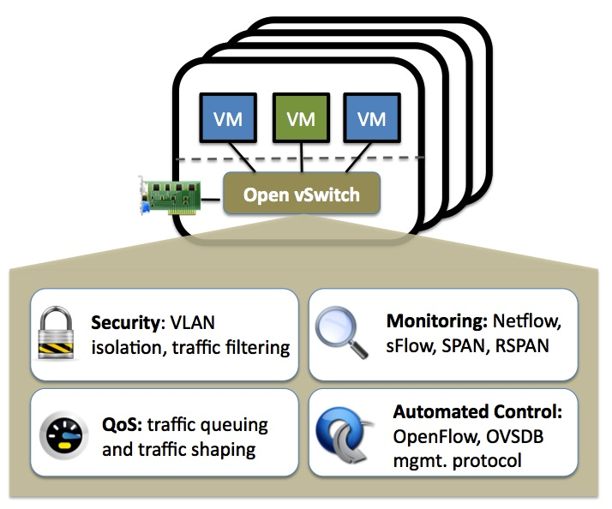
1. OVS
OVS (Open vSwitch)
- 오픈소스 아파치2.0 라이센스 기반의 multilayer Virtual Switch
- OpenFlow을 지원하는 SDN 스위치로 사용가능며 프로그래밍적으로 네트워크 확장가능
- VMware의 Distributed Switch와 유사하게 분산스위치 기능제공
- 표준 프로토콜(NetFlow, sFlow, IPFIX, RSPAN, CLI, LACP, 802.1ag)을 지원
OVSDB 프로토콜 지원(OVS의 설정값을 저장한 DB관리 프로토콜)
리눅스 커널 3.3에 default로 포함됨
Notes:
L2,L3,L4를 모두 지원한다. Linux bridge는 L2만 지원

Slide 4
2. OVS Features
OVS 지원 Features
Visibility into inter-VM communication via NetFlow, sFlow(R), IPFIX, SPAN, RSPAN, and GRE-tunneled mirrors
LACP (IEEE 802.1AX-2008)
Standard 802.1Q VLAN model with trunking
Multicast snooping
IETF Auto-Attach SPBM and rudimentary required LLDP support
BFD and 802.1ag link monitoring
STP (IEEE 802.1D-1998) and RSTP (IEEE 802.1D-2004)
Fine-grained QoS control
Support for HFSC qdisc
Per VM interface traffic policing
NIC bonding with source-MAC load balancing, active backup, and L4 hashing
OpenFlow protocol support (including many extensions for virtualization)
IPv6 support
Multiple tunneling protocols (GRE, VXLAN, STT, and Geneve, with IPsec support)
Remote configuration protocol with C and Python bindings
Kernel and user-space forwarding engine options
Multi-table forwarding pipeline with flow-caching engine
Forwarding layer abstraction to ease porting to new software and hardware platforms

Slide 5
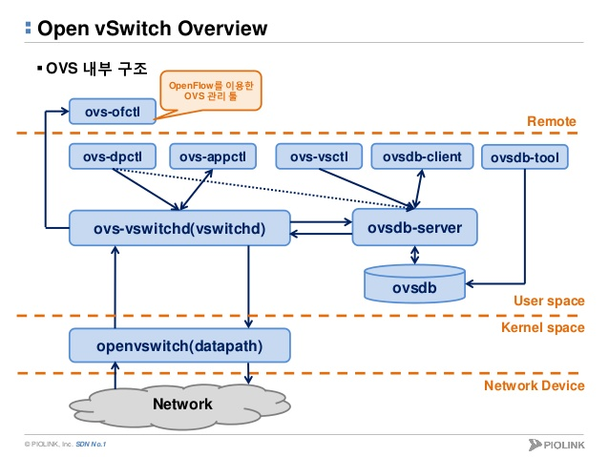
3. OVS 구조
OVS 구조
- Remote, User space, Kernerl space로 나뉨
- User space는 다시 ovs-vswitchd, ovsdb-server, 관리 tool(dpctl,appctl,vsctl 등)로 나뉨
- ps –ef | grep openvswitch로 확인시 ovs-vswitchd, ovsdb-server 데몬 동작
- /etc/sysconfig/openvswitch 가 설정파일
3
1
2
Notes:
1번은 프로세스 데몬
2번은 db서버
3번은 툴들임

Slide 6
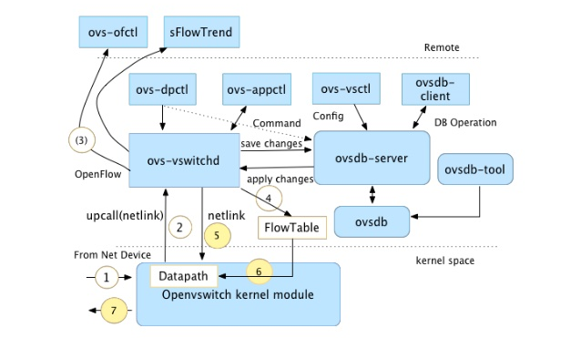
3-1. OVS 구조
ovs-vswitchd
- ovs main 데몬이며 netlink protocol을 통해 kernel module과 통신
- ovsdb-server의 Database에 스위치 구성변경을 요청하고 결과를 받음
- 외부 Controller와 OpenFlow 정보를 주고받음

Slide 7
3-2. OVS 구조
ovsdb-server
- ovs database 서버역할
- ovsdb-client, ovsdb-tool에 database 관리
- 기본DB는 /etc/openvswitch.conf.db , 기본스키마는 /usr/share/openvswitch/vswitch.ovsschema
- DB,TABLE.COLUMN( JSON Type으로 표현)
Table | Purpose
Open_vSwitch | Open vSwitch configuration
Bridge | Bridge configuration
Port | Port configuration
Interface | One physical network device in a Port
Flow_Table | OpenFlow table configuration
QoS | Quality of Service configuration
Queue | QoS output queue
Mirror | Port mirroring
Controller | OpenFlow controller configuration
Manager | OVSDB management connection
NetFlow | NetFlow configuration
SSL | SSL configuration
sFlow | sFlow configuration

Slide 8
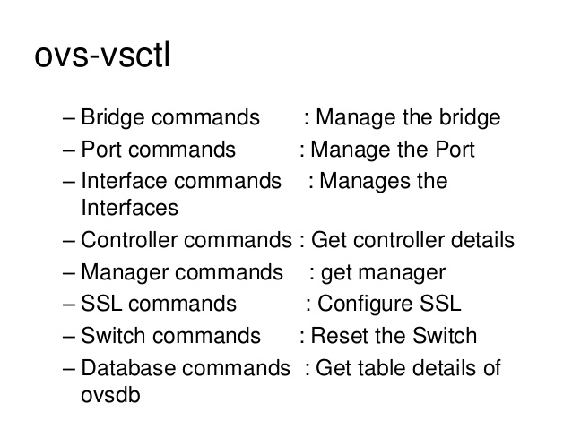
3-3. OVS 구조
관리 Tool
- ovs-ofctl : Open Flow 스위치를 모니터링하고 관리하는 command line tool
- ovs-appctl : 동작중인 ovs 데몬을 configuration하는 utility
- ovs-dpctl : ovs의 datapaths를 생성,삭제,수정하는 utility
- ovsdb-clinet : ovsdb-server와 접속할수 있는 client program
- ovsdb-tool : ovsdb 관리하는 utilty
- ovs-vsctl : ovsdb Database에 쿼리하고 구성하는 utility

Slide 9
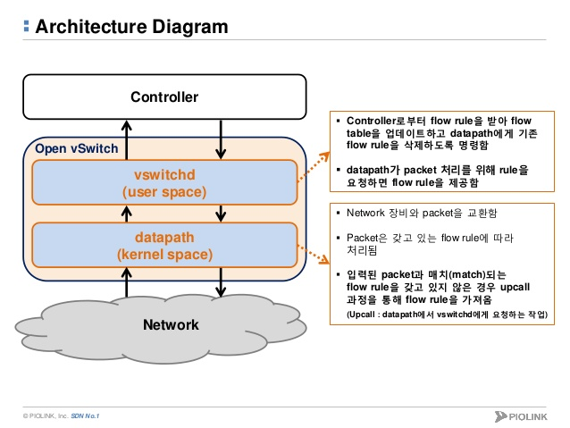
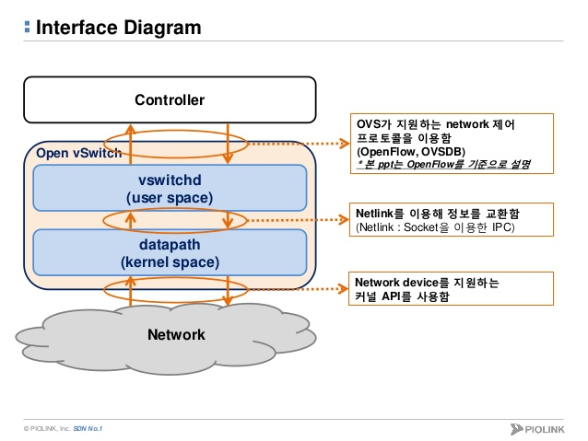
4-1. OVS 동작방식
OVS 동작방식
- datapath의 packet처리는 flow rule base로 동작함
- packet에 매칭되는 flow rule 없는 경우 userspace로 부터 제공받음
- userspace도 flow rule없는 경우 Controller로부터 받아 flow table을 업데이함
Flow table

Slide 10
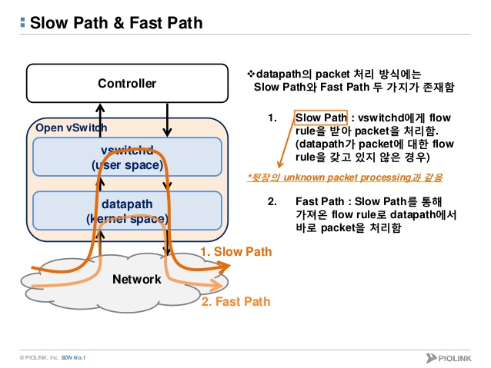
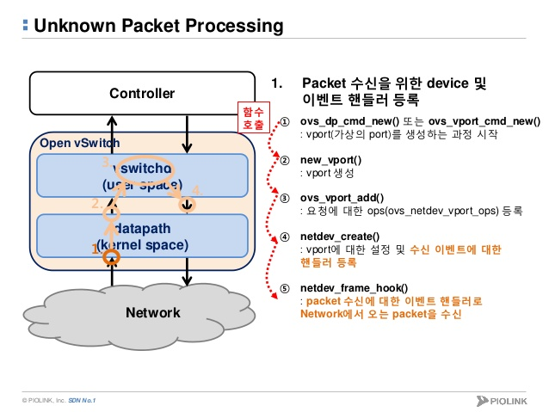
4-2. OVS 동작방식
OVS 동작방식
- datapath의 packet 처리방식에는 Slow path와 Fast path 두가지 방식이 있음
- Slow path는 매칭되는 flow rule이 없어 userspace에 받아서 packet을 처리
- Fast path는 매칭되는 flow rule을 알고 있으므로 datapath에서 바로 처리

Slide 11
5-1. OVS 설치 (Source 설치)
OVS 설치 (Centos 7 기준)
① 필수패키지 설치
yum install wget gcc make python-devel openssl-devel kernel-devel graphviz kernel-devug-devel autoconf automake rpm-build-redhat-rpm-config libtool
② 최신 ovs설치 tar파일 다운로드
wget http://openvswitch.org/releases/openvswitch-2.4.0.tar.gz
③ RPM sources directory로 tar파일 복사
cp openvswitch-x.y.z.tar.gz $HOME/rpmbuild/SOURCES
④ 압축해제 및 디렉토리 이동
tar xzf openvswitch-x.y.z.tar.gz
cd openvswitch-x.y.z
⑤ userpace rpm 파일 생성
rpmbuild –bb rhel/openvswitch.spec
⑥ kernel module rpm 파일 생성
rpmbuild –bb rhel/openvswitch-kmod-rhel6.spec
⑦ rpm 파일 설치
# rpm –ivh /root/rpmbuild/RPMS/x86_64/kmod-openvswitch-2.3.1-1.e17.x86_64.rpm
# rpm –ivh /root/rpmbuild/RPMS/x86_64/openvswitch-2.3.1-1.e17.x86_64.rpm
# rpm –ivh /root/rpmbuild/RPMS/x86_64/openvswitch-debuginfo-2.3.1-1.e17.x86_64.rpm
⑧ 모듈설치 여부 확인
# lsmod | grep openvswitch
openvswitch 80138 0
gre 13808 1 openvswitch
vxlan 37584 2 mlx4_en,openvswitch
libcrc32c 12644 2 xfs,openvswitch
Notes:
Rpm 파일 서치에서 맨 처음이 kernel space. 아래 두개가 user space에 생김
80138 0 에서 0은 몇번 사용되었냐. 다른 모듈에 의해…
2 2 는 2번 사용되었다 이런 내용임

Slide 12
5-2. OVS 설치 (YUM 설치)
OVS 설치 (YUM)
① 필수패키지 설치
yum install wget gcc make python-devel openssl-devel kernel-devel graphviz kernel-devug-devel autoconf automake rpm-build-redhat-rpm-config libtool
② OpenStack Rdo 프로젝트의 저장소를 이용하면 쉽게 설치
yum install yum install -y http://rdo.fedorapeople.org/rdo-release.rpm
③ YUM 설치
yum install openvswitch -y
④ 데몬기동
systemctl enable openvswitch
systemctl start openvswitchcd openvswitch-x.y.z
⑤ userpace rpm 파일 생성
# lsmod | grep openvswitch
openvswitch 80138 0
gre 13808 1 openvswitch
vxlan 37584 2 mlx4_en,openvswitch
libcrc32c 12644 2 xfs,openvswitch
OVS 설치 (RPM)
① wget [http://cbs.centos.org/kojifiles/packages/openvswitch/2.3.1/2.el7/x86_64/openvswitch-2.3.1-2.el7.x86_64.rpm http://cbs.centos.org/kojifiles/packages/openvswitch/2.3.1/2.el7/x86_64/openvswitch-2.3.1-2.el7.x86_64.rpm]
② rpm -ivh openvswitch-2.3.1-2.el7.x86_64.rpm

Slide 13
6. OVS 기본설정
VM
ETH
OVS (Open vSwitch) 설정
① br-tun 구성
- ovs-vsctl add-bro br-tun
- ifconfig ens33559296 0 (영구적 파일설정 필요)
- ovs-vsctl add-port br-tun eno33559296
- ifconfig br-tun 172.18.213.65 netmansk 255.255.255.0 (영구적 파일설정 필요)
- ovs-vsctl add-port br-tun patch이름 --set interface patch이름 type=patch options:peer=상태편patch
② br-int 구성
- ovs-vsctl add-bro br-int
- ovs-vsctl add-port br-int patch이름 --set interface patch이름 type=patch options:peer=상태편patch
③ veth 케이블 구성
- ip link add name veth0 type veth peer name veth1
- ovs-vsctl add-port br-int veth0
- ovs-vsctl add-port br-tun veth1
- ip link set veth0 up && ip link set veth1 up
④ ovs-vsctl show 확인
TAP
BR-INT
BR-TUN
ENO

Slide 14
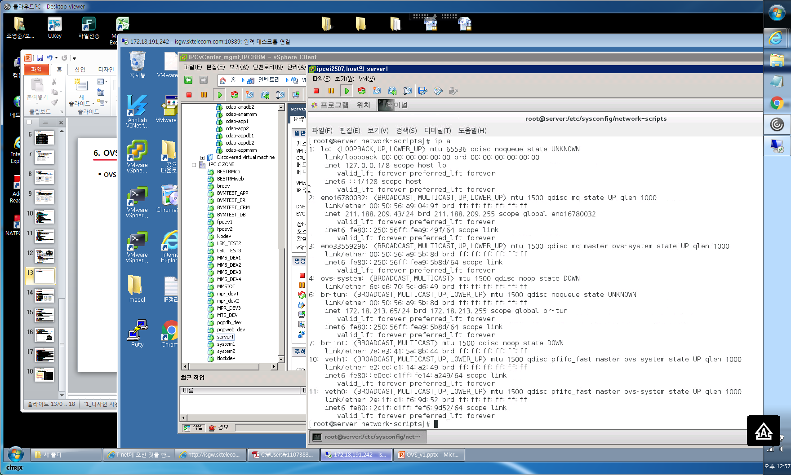
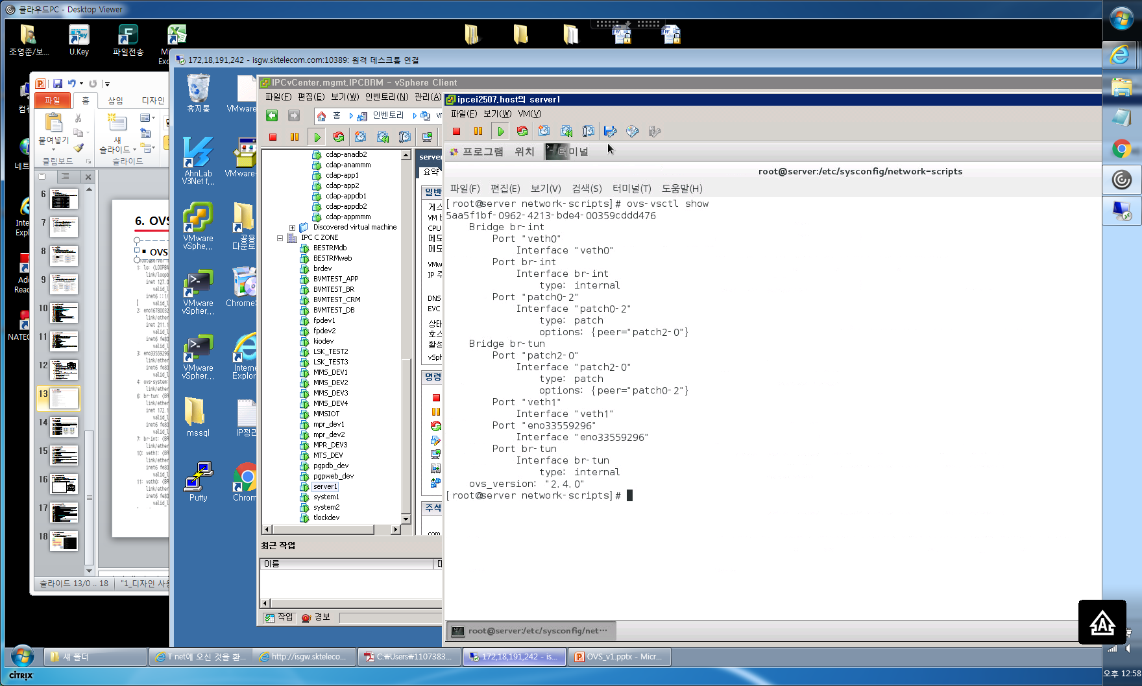
6. OVS 기본설정
OVS (Open vSwitch) 설정확인

Slide 15
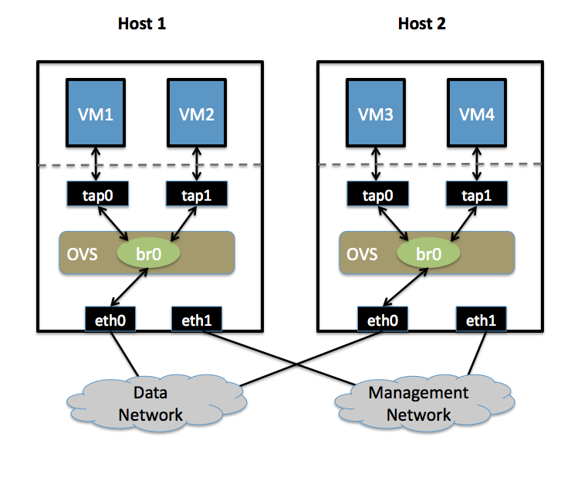
6-1. OVS VLAN설정
OVS VLAN 설정
1. Create an OVS bridge:
- ovs-vsctl add-br br0
2. Add eth0 to the bridge (by default, all OVS ports are VLAN trunks, so eth0 will pass all VLANs):
ovs-vsctl add-port br0 eth0
Note that when you add eth0 to the OVS bridge, any IP addresses that might have been assigned to eth0 stop working. IP address assigned to eth0 should be migrated to a different interface before adding eth0 to the OVS bridge. This is the reason for the separate management connection via eth1.
3. Add VM1 as an "access port" on VLAN 100. This means that traffic coming into OVS from VM1 will be untagged and considered part of VLAN 100:
ovs-vsctl add-port br0 tap0 tag=100
4. Add VM2 on VLAN 200.
ovs-vsctl add-port br0 tap1 tag=200
5. Repeat these steps on Host 2:
Setup a bridge with eth0 as a VLAN trunk:
ovs-vsctl add-br br0 ovs-vsctl add-port br0 eth0
Add VM3 to VLAN 100:
ovs-vsctl add-port br0 tap0 tag=100
Add VM4 to VLAN 200:
ovs-vsctl add-port br0 tap1 tag=200

Slide 16
6-2. OVS GRE Tunnel설정
OVS GRE Tunnel 설정
1.Create an OVS bridge:
ovs-vsctl add-br br0
Note that you will not add eth0 to the OVS bridge.
2. Start (launch) VM1 and VM2 on Host1. If the VMs are not automatically attached to OVS, add them to the OVS bridge you just created (the commands below assume tap0 is for VM1 and tap1 is for VM2):
ovs-vsctl add-port br0 tap0 ovs-vsctl add-port br0 tap1
3. Add a port for the GRE tunnel:
ovs-vsctl add-port br0 gre0 -- set interface gre0 type=gre options:remote_ip=<IP address of eth0 on Host2>
4.Create a mirrored configuration on Host2 using the same basic steps:
Create an OVS bridge, but do not add any physical interfaces to the bridge:
ovs-vsctl add-br br0
5.Launch VM3 and VM4 on Host2, adding them to the OVS bridge if needed (again, tap0 is assumed to be for VM3 and tap1 is assumed to be for VM4):
ovs-vsctl add-port br0 tap0 ovs-vsctl add-port br0 tap1
6.Create the GRE tunnel on Host2, this time using the IP address for eth0 on Host1 when specifying the remote_ip option:
ovs-vsctl add-port br0 gre0 -- set interface gre0 type=gre options:remote_ip=<IP address of eth0 on Host1>

Slide 17
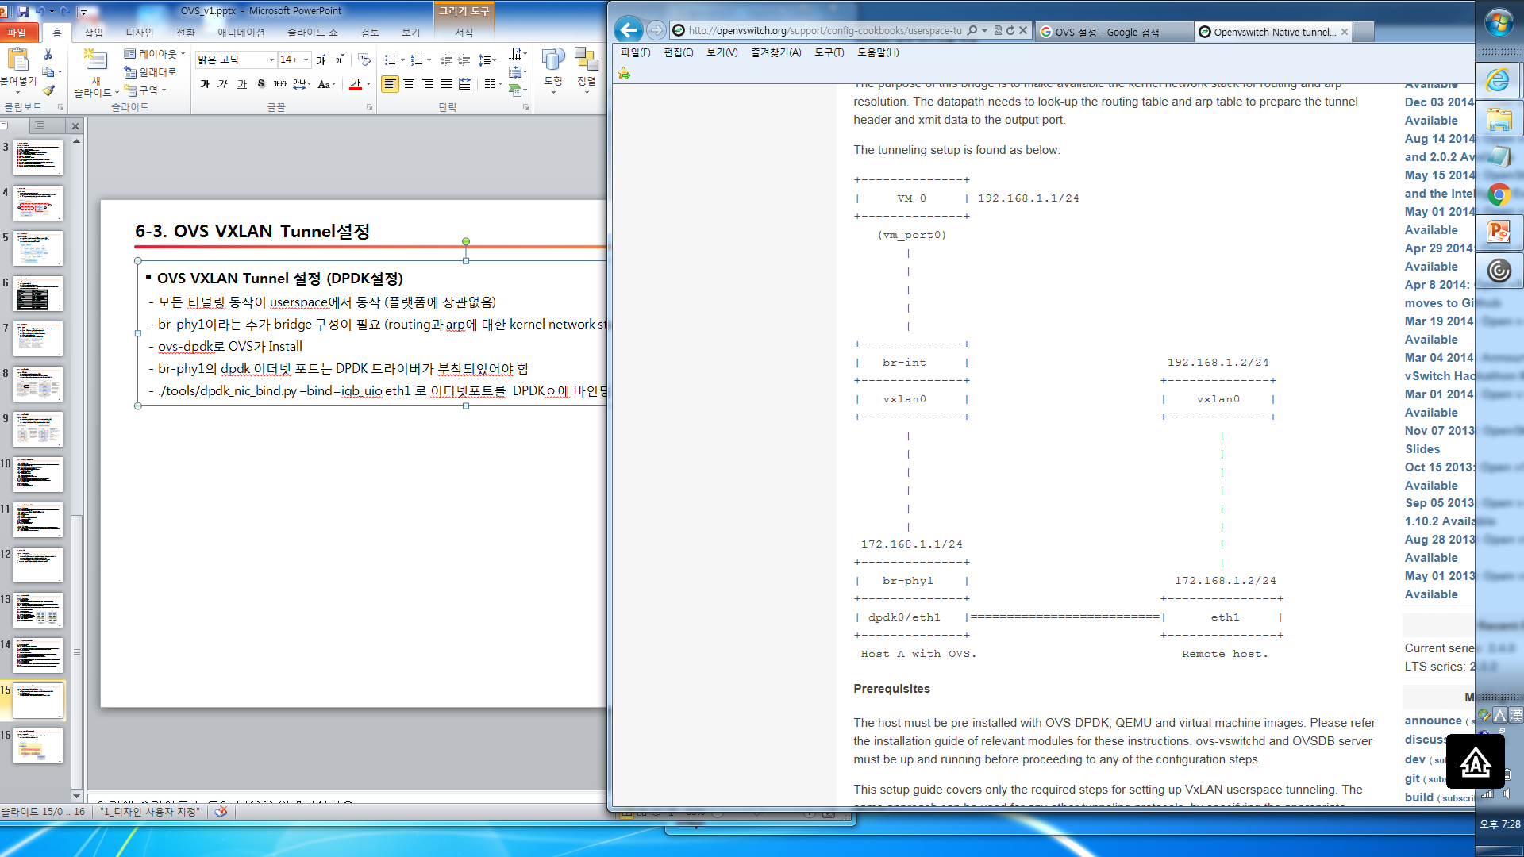
6-3. OVS VXLAN Tunnel설정
OVS VXLAN Tunnel 설정 (DPDK설정)
- 모든 터널링 동작이 userspace에서 동작 (플랫폼에 상관없음)
- br-phy1이라는 추가 bridge 구성이 필요 (routing과 arp에 대한 kernel network stack을 사용)
- ovs-dpdk로 OVS가 Install
- br-phy1의 dpdk 이더넷 포트는 DPDK 드라이버가 부착되있어야 함
- ./tools/dpdk_nic_bind.py –bind=igb_uio eth1 로 이더넷포트를 DPDK에 바인딩

Slide 18
6-4. OVS VXLAN Tunnel설정
OVS VXLAN Tunnel 설정 (DPDK설정)
the “br-int” bridge as below,
HOST-A$ ovs-vsctl –may-exist add-br br-int – set Bridge br-int datapath_type=netdev – br-set-external-id br-int bridge-id br-int – set bridge br-int fail-mode=standalone
Add the VM interface to the “br-int”.
HOST-A$ ovs-vsctl add-port br-int vm_port0 – set Interface vm_port0 type=dpdkvhostuser
[“vm_port0” is the vhost-user interface name for the VM0. This interface name must be used while qemu starting the virtual machine.]
Start the VM(VM-0) using vhost-user network backend. The vhost-user interface name is “vm_port0”.
Set the Ip address 192.168.1.1 to the VM interface. Run the following command inside the VM to set the Ip address.
VM-0$ ip addr add 192.168.1.1/24 dev eth0
[“eth0” is the interface inside VM. It’s possible to set the ip address using“ifconfig” command as “ifconfig eth0 192.168.1.1/24”. Please use either one command to set the ip address.]
Attach the VxLAN tunnel interface to the “br-int“ bridge.
HOST-A$ ovs-vsctl add-port br-int vxlan0 – set interface vxlan0 type=vxlan options:remote_ip=172.168.1.2
[“172.168.1.2” is the remote tunnel end point address, On remote host this will be 172.168.1.1.]
Create the “br-phy1” bridge for attaching the physical interface.
HOST-A$ ovs-vsctl –may-exist add-br br-phy1 – set Bridge br-phy1 datapath_type=netdev – br-set-external-id br-phy1 bridge-id br-phy1 – set bridge br-phy1 fail-mode=standalone other_config:hwaddr=”<mac address of eth1 interface>“
[“eth1” is the physical interface on the host, Assign mac address of “eth1”to the “br-phy1”.]
The physical port “eth1” can operate either as a kernel network interface or a DPDK interface. Depending on the operating mode, attach “eth1”to the “br-phy1” bridge as follows.
Use step-7 if “eth1” is managed by kernel driver. Please follow step-8 rather than this step in case “eth1” is a DPDK Interface.This step will cause to loose the connectivity through “eth1” (refer configuration problems in FAQ for more details) for a while. The connectivity can be restored by moving the IP address to the “br-phy1” internal interface. The following command-set will do that,
HOST-A$ ovs-vsctl –timeout 10 add-port br-phy1 eth1
HOST-A$ ip addr add 172.168.1.1/24 dev br-phy1
HOST-A$ ip link set br-phy1 up
HOST-A$ ip addr flush dev eth1 2>/dev/null
HOST-A$ ip link set eth1 up
HOST-A$ iptables –F
Steps for attaching “eth1” to “br-phy1” is slightly different in case“eth1” is a DPDK interface. DPDK interfaces are not managed by the kernel, so the port details are not visible on any “ip” commands.
HOST-A$ ovs-vsctl –timeout 10 add-port br-phy1 dpdk0 – set Interface dpdk0 type=dpdk
HOST-A$ ip addr add 172.168.1.1/24 dev br-phy1
HOST-A$ ip link set br-phy1 up
HOST-A$ iptables –F
[“eth1” is mapped to DPDK port “dpdk0”. DPDK driver assign port names that starts with “dpdk”]

Slide 19
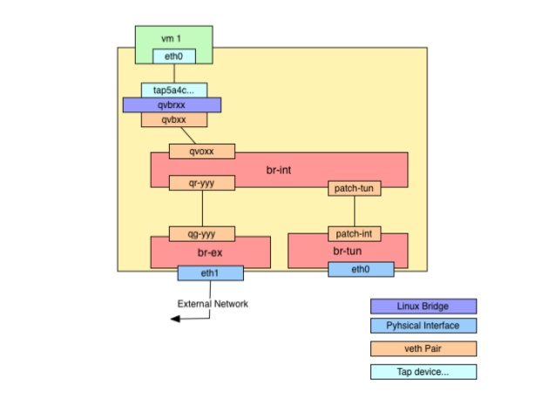
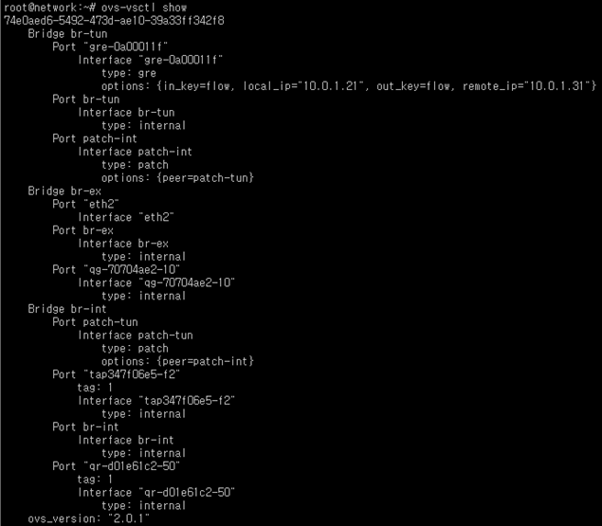
7. OVS 구성사례 (Openstack)
OVS (Openstack)
- br-int(내부 ovs스위치), br-ex,br-tun(외부 ovs스위치)로 구성
- packstack 설치시 기본 스위치로 ovs 설치

