Slide 1
OpenFlow실습
보라매NOC - 가상화WG

Slide 2
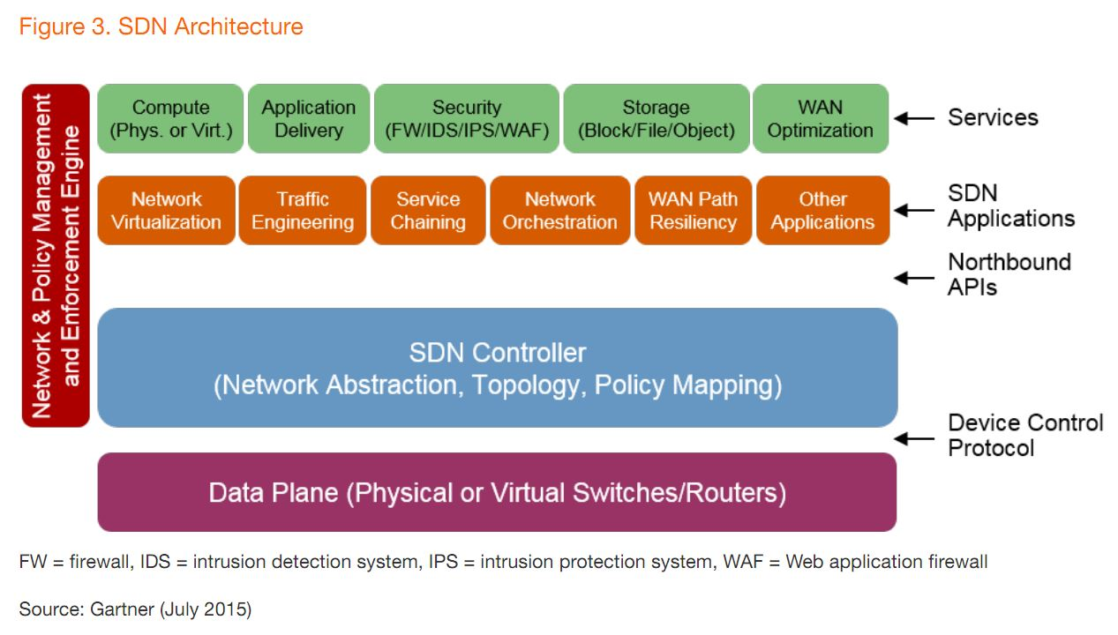
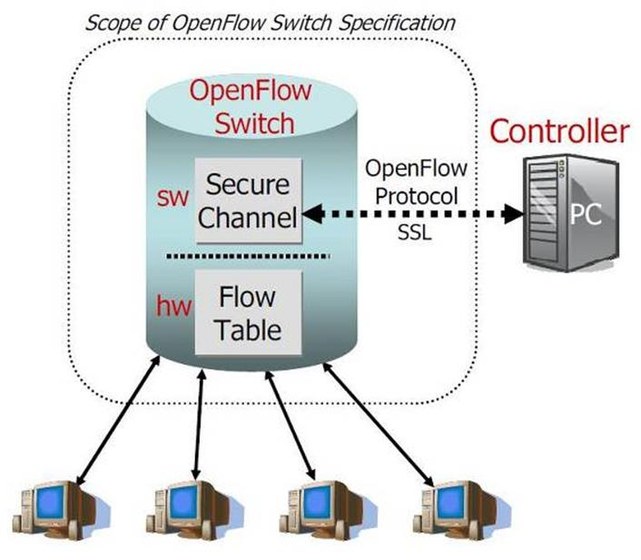
1. SDN
SDN (Software Define Networking)
• 소프트웨어로 네트워크를 정의한다. 하드웨어 중심에서 소프트웨어 중심으로 기술이 천이
• 그 방법은 네트워크 장비의 제어부와 데이터를 분리하여 컨트롤러에 의한 제어/접근을 하는 것
• 주요 구성요소는 SDN 스위치, SDN 컨트롤러, 사우스바운드 인터페이스, 노스바운드 인터페이스로 구성
OpenFlow
네트워크 장비의 패킷 포워딩 기능과 컨트롤러 기능을 표준 인터페이스로 분리하여 OpenFlow 규격을 만듬
네트워크 개방성을 제공하는 기술로, SDN의 가장 중요한 기술

Slide 3
2-1. OpenFlow
OpenFlow 동작방식
- Controller : Switch로부터 패킷 유입 시 정책이나 혹은 미리 설정된 알고리즘에 의해 Flow Table 전송
Switch : Controller에게 받은 Flow Table을 등록하고 유입되는 패킷을 Rule에 의해 매칭되는 패킷은 Next Hop으로 포워딩 혹은 Drop. Rule에 포함되어 있지 않은 패킷은 Controller에게 Packet IN질의
Flow Table 구성요소
조건(Match fields) : 입력된 패킷의 일치여부를 판단하는 패킷헤더,입력포트 ,메타데이터 정보
처리(Actions) : 패킷을 어떻게 처리할지 알려주는 명령이나 액션의 집합
통계(Counters) : 카운터, 특정 플로우의 통계

Slide 4
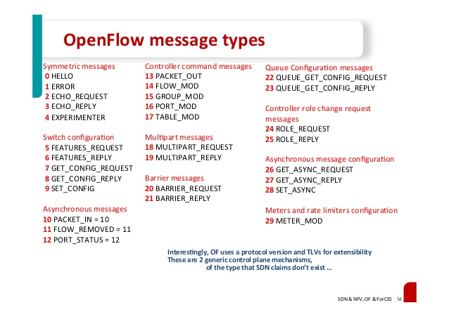
2-2. OpenFlow
OpenFlow 프로토콜 메세지 타입
컨트롤러와 스위치 : 스위치에서 시작돼 스위치의 상태를 직접관리하거나 조사하기 위함
(기능요청, 스위치 설정, 상태 수정,상태읽기, 패킷전송, 배리어)
대칭 메세지 : 스위치나 컨트롤러 중 하나가 시작하고 상대방의 동의를 구하지 않고 보냄
( Hello, Echo, Vendor 메세지)
비대칭 메세지 : 스위치가 시작하고 네트워크 이벤트와 스위치 상태변화,에러를 컨트롤러에게 전달
( 패킷인, 플로우 제거, 포트상태, 에러)

Slide 5
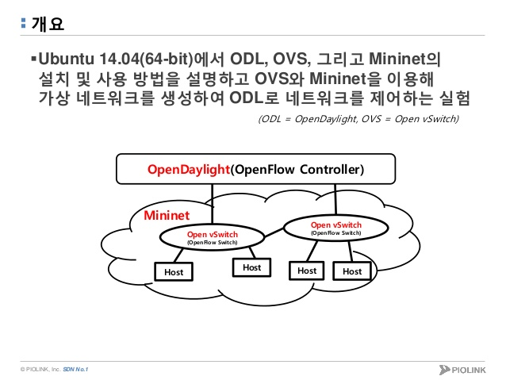
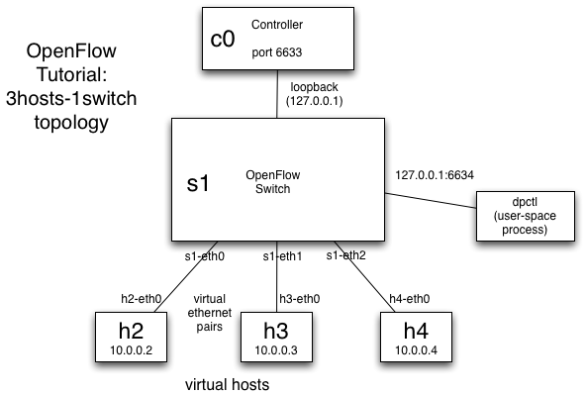
2-3. OpenFlow
OpenFlow TEST 구성
- 가상 호스트와 스위치는 Mininet으로 구성
- OpenFlow Controller는 외부에 OpenDayLight로 구성

Slide 6
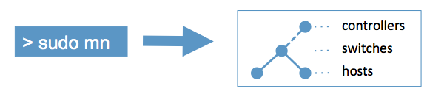
3. Mininet 이란
Mininet 이란?
- Mininet은 네트워크 에뮬레이터 프로그램
- Mininet 은 single 서버에서 virtual OpenFlow network (controller, switches, hosts, and links) 생성
- Python 프로그래맹을 통한 가상 네트워크 구성 지원

Slide 7
3-1. Controller
Controller 이란?
- OpenFlow 스위치와 통신하며 flow-table을 내려줌
- Controller는 Switch와 같은 머신에 있을수 도 있고 외부(사설망, 인터넷)상에 존재할수도 있음
Mininet 내부 Controller를 제공
- mn –controller ref (참조 컨트롤러)
- mn –controller ovsc (ovs 컨트롤러)
- mn –controller NOX (NOX 컨트롤러)

Slide 8
3-2. Mininet 설치
Mininet 설치방법
Option 1: Mininet VM Installation (easy, recommended)
Option 2: Native Installation from Source
Option 3: Installation from Packages
Option 4. Upgrading an existing Mininet Installation
Mininet 설치 (YUM)
① repo 설정
[root@webserver01 yum.repos.d]# cat naulinux.repo
[naulinux]
name=NauLinux Extras
baseurl=http://downloads.naulinux.ru/pub/NauLinux/6.5/$basearch/Extras/RPMS/
enabled=1
gpgcheck=1
gpgkey=http://downloads.naulinux.ru/pub/NauLinux/RPM-GPG-KEY-linux-ink
② yum install mininet

Slide 9
3-3. Mininet 설치확인
Mininet 설치확인
cho@ubuntu:/etc/init.d$ sudo mn --test pingall
*** Creating network
*** Adding controller
*** Adding hosts:
h1 h2
*** Adding switches:
s1
*** Adding links:
(h1, s1) (h2, s1)
*** Configuring hosts
h1 h2
*** Starting controller
*** Starting 1 switches
s1
*** Ping: testing ping reachability
h1 -> h2
h2 -> h1
*** Results: 0% dropped (2/2 received)
*** Stopping 1 switches
s1 ..
*** Stopping 2 hosts
h1 h2
*** Stopping 1 controllers
c0
*** Done
completed in 1.390 seconds

Slide 10
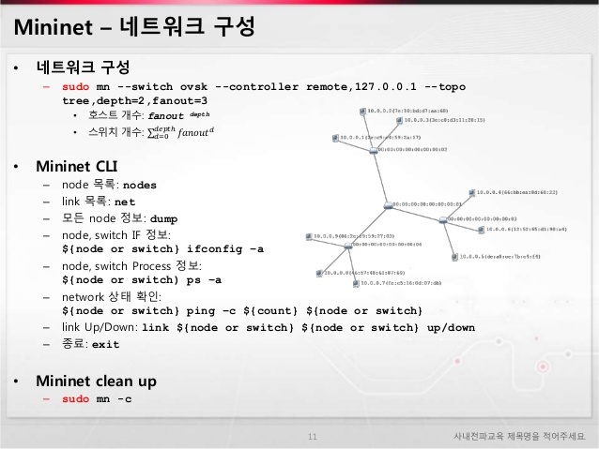
3-4. Mininet 명령어
Mininet 명령어
mininet> nodes
available nodes are:
c0 h1 h2 h3 s1
mininet> dump
<Host h1: h1-eth0:10.0.0.1 pid=20294>
<Host h2: h2-eth0:10.0.0.2 pid=20295>
<Host h3: h3-eth0:10.0.0.3 pid=20296>
<OVSSwitch s1: lo:127.0.0.1,s1-eth1:None,s1-eth2:None,s1-eth3:None pid=20299>
<RemoteController c0: 127.0.0.1:6633 pid=20287>
mininet> h1 ifconfig -a
h1-eth0 Link encap:Ethernet HWaddr a6:ab:89:30:3b:2f
inet addr:10.0.0.1 Bcast:10.255.255.255 Mask:255.0.0.0
inet6 addr: fe80::a4ab:89ff:fe30:3b2f/64 Scope:Link
UP BROADCAST RUNNING MULTICAST MTU:1500 Metric:1
RX packets:30 errors:0 dropped:0 overruns:0 frame:0
TX packets:9 errors:0 dropped:0 overruns:0 carrier:0
collisions:0 txqueuelen:1000
RX bytes:5120 (5.1 KB) TX bytes:738 (738.0 B)
mininet> h1 ps -a
PID TTY TIME CMD
19240 pts/0 00:00:00 sudo
19241 pts/0 00:00:09 wireshark
19260 pts/0 00:00:00 dbus-launch
20282 pts/8 00:00:00 sudo
20283 pts/8 00:00:00 mn

Slide 11
3-5. Mininet 명령어
Mininet 명령어
mininet> pingall
*** Ping: testing ping reachability
h1 -> h2 h3
h2 -> h1 h3
h3 -> h1 h2
*** Results: 0% dropped (6/6 received)
mininet> xterm h2
mininet> iperf (대역폭 측정 명령어)
*** Iperf: testing TCP bandwidth between h1 and h3
*** Results: ['5.42 Gbits/sec', '5.43 Gbits/sec']

Slide 12
3-6. Mininet dpctl
Mininet dptcl
mininet> h1 ping h2
PING 10.0.0.2 (10.0.0.2) 56(84) bytes of data.
From 10.0.0.1 icmp_seq=1 Destination Host Unreachable
From 10.0.0.1 icmp_seq=2 Destination Host Unreachable
From 10.0.0.1 icmp_seq=3 Destination Host Unreachable
^C
--- 10.0.0.2 ping statistics ---
4 packets transmitted, 0 received, +3 errors, 100% packet loss, time 3000ms
mininet> dpctl add-flow in_port=1,actions=output:2
*** s1 ------------------------------------------------------------------------
mininet> dpctl add-flow in_port=2,actions=output:1
*** s1 ------------------------------------------------------------------------
mininet> h1 ping h2
PING 10.0.0.2 (10.0.0.2) 56(84) bytes of data.
64 bytes from 10.0.0.2: icmp_seq=1 ttl=64 time=0.727 ms
64 bytes from 10.0.0.2: icmp_seq=2 ttl=64 time=0.135 ms
^C
--- 10.0.0.2 ping statistics ---
2 packets transmitted, 2 received, 0% packet loss, time 1001ms
rtt min/avg/max/mdev = 0.135/0.431/0.727/0.296 ms
mininet> dpctl dump-flows
*** s1 ------------------------------------------------------------------------
NXST_FLOW reply (xid=0x4):
cookie=0x0, duration=20.793s, table=0, n_packets=4, n_bytes=280, idle_age=7, in_port=1 actions=output:2
cookie=0x0, duration=15.602s, table=0, n_packets=4, n_bytes=280, idle_age=7, in_port=2 actions=output:1

Slide 13
4. Controller(Pox)
Controller(Pox)
① cho@ubuntu:~/pox$ sudo mn --topo single,3 --mac --switch ovsk --controller remote
*** Creating network
*** Adding controller
Unable to contact the remote controller at 127.0.0.1:6633
*** Adding hosts:
h1 h2 h3
*** Adding switches:
s1
*** Adding links:
(h1, s1) (h2, s1) (h3, s1)
*** Configuring hosts
h1 h2 h3
*** Starting controller
*** Starting 1 switches
s1
*** Starting CLI:
② git clone http://github.com/noxrepo/pox
cd pox
cho@ubuntu:~/pox$ ./pox.py forwarding.l2_learning
POX 0.2.0 (carp) / Copyright 2011-2013 James McCauley, et al.
INFO:core:POX 0.2.0 (carp) is up.
INFO:openflow.of_01:[00-00-00-00-00-01 1] connected
③ mininet> h1 ping h3
PING 10.0.0.3 (10.0.0.3) 56(84) bytes of data.
64 bytes from 10.0.0.3: icmp_seq=1 ttl=64 time=32.6 ms
root@ubuntu:/pox/pox/forwarding# pwd
/pox/pox/forwarding
root@ubuntu:/pox/pox/forwarding# ll
total 108
drwxrwxr-x 2 cho cho 4096 Feb 16 17:56 ./
drwxrwxr-x 15 cho cho 4096 Feb 16 17:56 ../
-rw-rw-r-- 1 cho cho 1092 Feb 16 17:51 hub.py
-rw-rw-r-- 1 cho cho 651 Feb 16 17:51 __init__.py
-rw-rw-r-- 1 cho cho 214 Feb 16 17:56 __init__.pyc
-rw-rw-r-- 1 cho cho 4426 Feb 16 17:51 l2_flowvisor.py
-rw-rw-r-- 1 cho cho 6692 Feb 16 17:51 l2_learning.py
-rw-rw-r-- 1 cho cho 6309 Feb 16 17:56 l2_learning.py
-rw-rw-r-- 1 cho cho 15558 Feb 16 17:51 l2_multi.py
-rw-rw-r-- 1 cho cho 4324 Feb 16 17:51 l2_nx.py
-rw-rw-r-- 1 cho cho 2105 Feb 16 17:51 l2_nx_self_learning.py
-rw-rw-r-- 1 cho cho 2882 Feb 16 17:51 l2_pairs.py
-rw-rw-r-- 1 cho cho 12330 Feb 16 17:51 l3_learning.py
-rw-rw-r-- 1 cho cho 14102 Feb 16 17:51 topo_proactive.py

Slide 14
5. Controller(Floodlight)
Controller(Floodlight)
Ubuntu 10.04 (Natty) or higher.
Install JDK and Ant by running “sudo apt-get install build-essential default-jdk ant python-dev eclipse”
② $ git clone git://github.com/floodlight/floodlight.git
$ cd floodlight
$ git checkout stable $ ant;
$ sudo mkdir /var/lib/floodlight
$ sudo chmod 777 /var/lib/floodlight
③ $ java -jar target/floodlight.jar
④ sudo mn --controller=remote --ip=<controller ip> --port=<openFlowPort 6633 by default> --switch ovsk

Slide 15
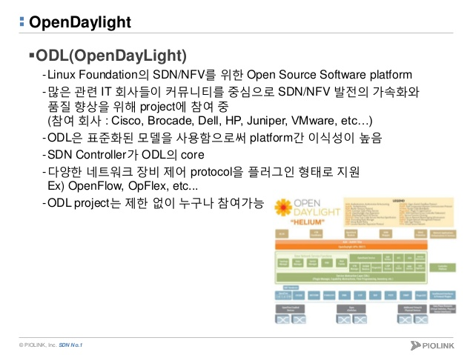
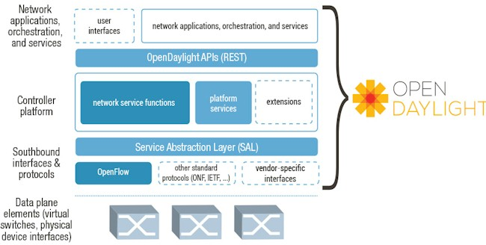
6. Opendaylight
Opendaylight
Opendaylight 구조

Slide 16
6-1. Controller(ODL –zip파일로 설치)
Controller(ODL)
apt-get update
apt-get install maven git openjdk-7-jre
② vi ~/.bashrc
export M2_HOME=/usr/local/apache-maven/apache-maven-3.3.3
export MAVEN_OPTS="-Xms256m -Xmx512m" # Very important to put the "m" on the end
export JAVA_HOME=/usr/lib/jvm/java-7-openjdk-amd64 # This matches sudo update-alternatives --config java
source ~/.bashrc
③ git clone https://git.opendaylight.org/gerrit/integration/distribution
curl https://raw.githubusercontent.com/opendaylight/odlparent/master/settings.xml --create-dirs -o ~/.m2/settings.xml
cd distribution
mvn clean install –DskipTests
distribution-karaf-0.3.3-Lithium-SR3.zip
unzip distribution-karaf-0.3.3-Lithium-SR3.zip
bin/karaf
karaf> feature:install odl-dlux-core odl-dlux-yangui odl-dlux-yangvisualizer odl-dlux-node
http://localhost:8181/index.html
Login : admin/admin (Default 계정)
opendaylight-user@root>feature:install odl-dlux-core (web화면)
opendaylight-user@root>feature:install odl-dlux-yangui
opendaylight-user@root>feature:install odl-dlux-yangvisualizer
opendaylight-user@root>feature:install odl-dlux-node
opendaylight-user@root>feature:install odl-l2switch-switch-ui

Slide 17
6-2. Controller(ODL)
Some handy commands
Command | Description
la | Shows all installed bundles
service:list | Shows the active OSGi services. This list is quite long. Here it is quite handy that you can use unix pipes like "ls | grep admin"
exports | Shows exported packages and bundles providing them. This helps to find out where a package may come from.
feature:list | Shows which features are installed and can be installed.
features:install webconsole | Install features (a list of bundles and other features). Using the above command we install the Karaf webconsole. It can be reached at http://localhost:8181/system/console . Log in with karaf/karaf and take some time to see what it has to offer.
log:tail | Show the log. Use ctrl-c to go back to Console
Ctrl-d | Exit the console. If this is the main console karaf will also be stopped.

Slide 18
6-3. Controller(ODL)
Controller(ODL)
cho@ubuntu:~/pox$ sudo mn --controller=remote,ip=192.168.17.131,port=6633 --switch ovsk --topo tree,2
*** Creating network
*** Adding controller
*** Adding hosts:
h1 h2 h3 h4
*** Adding switches:
s1 s2 s3
*** Adding links:
(h1, s2) (h2, s2) (h3, s3) (h4, s3) (s1, s2) (s1, s3)
*** Configuring hosts
h1 h2 h3 h4
*** Starting controller
*** Starting 3 switches
s1 s2 s3
*** Starting CLI:
mininet> nodes
available nodes are:
c0 h1 h2 h3 h4 s1 s2 s3
mininet> dump
<Host h1: h1-eth0:10.0.0.1 pid=17304>
<Host h2: h2-eth0:10.0.0.2 pid=17305>
<Host h3: h3-eth0:10.0.0.3 pid=17306>
<Host h4: h4-eth0:10.0.0.4 pid=17307>
<OVSSwitch s1: lo:127.0.0.1,s1-eth1:None,s1-eth2:None pid=17310>
<OVSSwitch s2: lo:127.0.0.1,s2-eth1:None,s2-eth2:None,s2-eth3:None pid=17315>
<OVSSwitch s3: lo:127.0.0.1,s3-eth1:None,s3-eth2:None,s3-eth3:None pid=17320>
<RemoteController c0: 192.168.17.131:6633 pid=17297>

Slide 19
6-4. Controller(ODL )
Controller(ODL)
mininet> dpctl dump-flows
*** s1 ------------------------------------------------------------------------
NXST_FLOW reply (xid=0x4):
cookie=0x2b00000000000001, duration=470.727s, table=0, n_packets=188, n_bytes=28842, idle_age=3, priority=2,in_port=1 actions=output:2
cookie=0x2b00000000000000, duration=470.727s, table=0, n_packets=188, n_bytes=29098, idle_age=3, priority=2,in_port=2 actions=output:1
mininet> pingall
*** Ping: testing ping reachability
h1 -> h2 h3 h4
h2 -> h1 h3 h4
h3 -> h1 h2 h4
h4 -> h1 h2 h3
*** Results: 0% dropped (12/12 received)

Slide 20
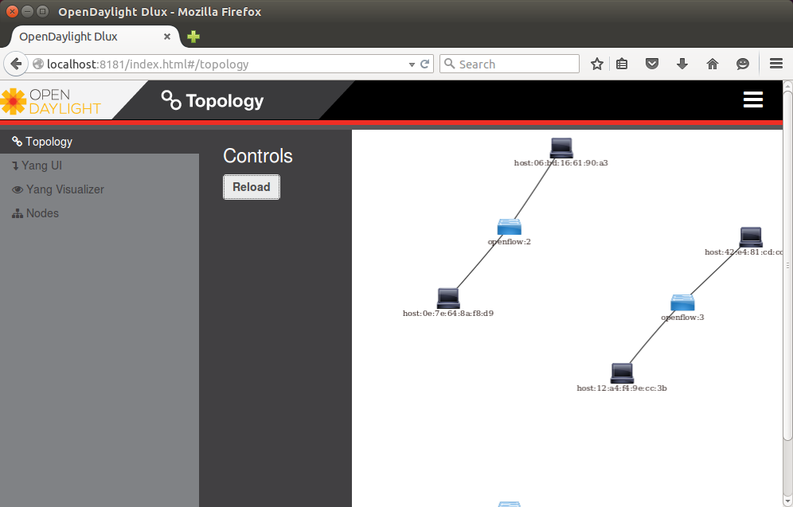
6-5. Controller(ODL)
Controller(ODL)
- localhost:8181 (admin/admin)

Slide 21
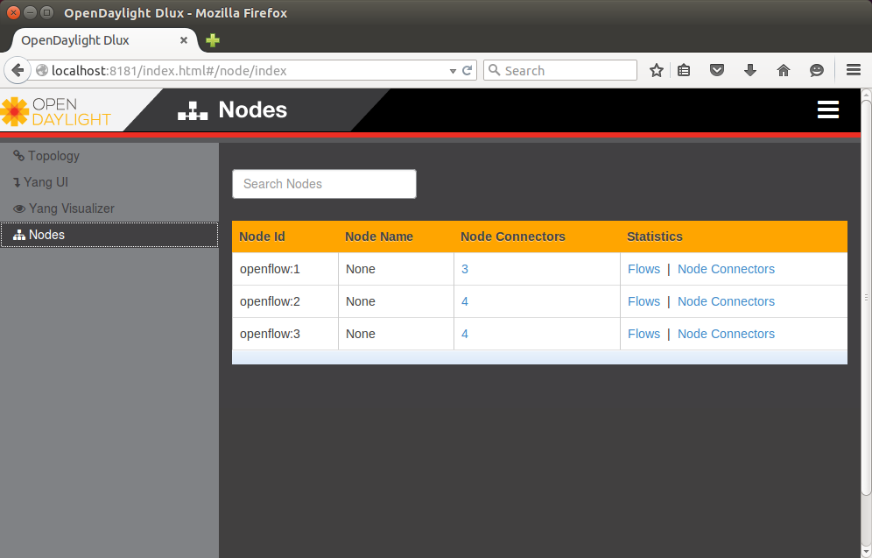
6-5. Controller(ODL)
Controller(ODL)

Slide 22
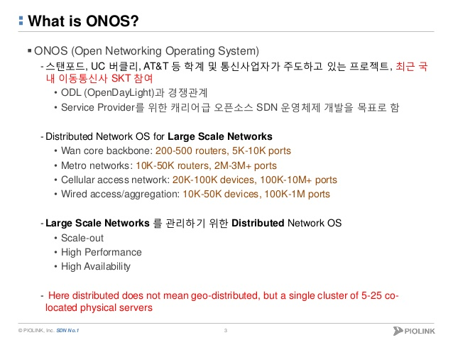
7-1. onos
onos

Slide 23
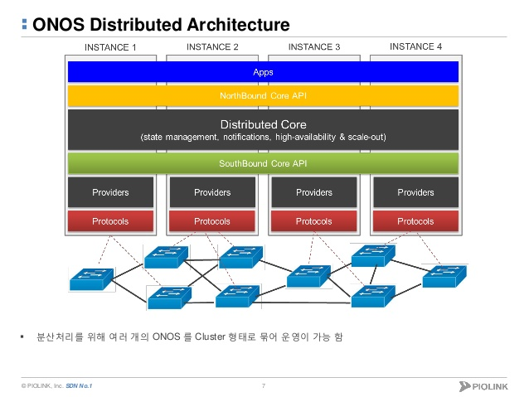
7-2. onos
onos 분산구조

Slide 24
7-3. onos 설치방법
Controller(onos)
source 코드 컴파일 방법
바이너리 파일(tar.gz, zip 파일) 압축해제
docker 활용하여 설치
튜토리얼 VM(OVF파일)
Name | VERSION | Dates | Notes | About the name | Presentation | Related Press
Kingfisher | 1.10.0 | May 31, 2017 FF: May 12, 2017
Junco | 1.9.0 | Feb. 28, 2017 FF: Feb. 10, 2017 | Release Content | About the bird
Ibis | 1.8.0 | Dec. 2, 2016 | Release Content | About the bird
Hummingbird | 1.7.0 | Aug. 31, 2016 | Feature Summary | About the bird | pptx | Press
Goldeneye | 1.6.0 | Jun. 10, 2016 | Release Notes | About the bird | pptx | Press
Falcon | 1.5.0 | Mar. 10, 2016 | Release Notes | About the bird | pptx | Press
Emu | 1.4.0 | Dec. 16, 2015 | Release Notes | About the bird | pptx | Press
Drake | 1.3.0 | Sept. 18, 2015 | Release Notes | About the bird | pptx | Press
Cardinal | 1.2.2 | Sept. 1, 2015 | Release Notes | About the bird (Stanford "Cardinal" refers to the color, NOT the bird)
 | 1.2.1 | June 25, 2015 | Release Notes
 | 1.2.0 | June 5, 2015 | Release Notes |  |  | Press
Blackbird | 1.1.0 | Mar. 17, 2015 | Release Notes | About the bird The legendary Blackbird Jet In honor of Beatles |  | Press
Avocet | 1.0.1 | Jan 21st, 2015 | Release Notes | About the bird
 | 1.0.0 | Dec 5th, 2014 | Release Notes

Slide 25
7-4. onos설치 (source 설치)
Controller(onos)
karaf, maven 설치
build:~$ cd; mkdir Downloads Applications
build:~$ cd Downloads
build:~$wget http://archive.apache.org/dist/karaf/3.0.5/apache-karaf-3.0.5.tar.gz
build:~$wget http://archive.apache.org/dist/maven/maven-3/3.3.9/binaries/apache-maven-3.3.9-bin.tar.gz
build:~$ tar -zxvf apache-karaf-3.0.5.tar.gz -C ../Applications/
build:~$ tar -zxvf apache-maven-3.3.9-bin.tar.gz -C ../Applications/
oracle java 8버젼 설치
build:~$ sudo apt-get install software-properties-common –y
build:~$ sudo add-apt-repository ppa:webupd8team/java –y
build:~$ sudo apt-get update
build:~$ sudo apt-get install oracle-java8-installer oracle-java8-set-default –y
$ export JAVA_HOME=/usr/lib/jvm/java-8-oracle
③ 환셜설정 및 컴파일
git clone https://gerrit.onosproject.org/onos
cd onos
$ export ONOS_ROOT=~/onos
$ source $ONOS_ROOT/tools/dev/bash_profile
$ cd ~/onos
$ mvn clean install (30분 소요)
$ export ONOS_IP=127.0.0.1 (또는 인터페이스 ip 설정)
$ export ONOS_APPS=drivers,openflow,proxyarp,mobility,fwd
ok clean <- 동작

Slide 26
7-5. onos 기본명령어
Controller(onos)
onos> help onos
COMMANDS
onos:add-flows Installs a flow rules onos:add-host-intent Installs host-to-host connectivity intent onos:add-multi-to-single-intent Installs point-to-point connectivity intent onos:add-node Adds a new controller cluster node
onos:add-optical-intent Installs optical connectivity intent
onos> list -> 현재 모듈의 상태확인
START LEVEL 100 , List Threshold: 50
ID | State | Lvl | Version | Name------------------------------------------------------------------------------
156 | Active | 80 | 1.1.0.SNAPSHOT | onos-core-common
157 | Active | 80 | 1.1.0.SNAPSHOT | onos-core-dist
158 | Active | 80 | 1.1.0.SNAPSHOT | onos-core-serializers
159 | Active | 80 | 1.1.0.SNAPSHOT | onlab-netty
168 | Active | 80 | 1.1.0.SNAPSHOT | onos-app-proxyarp onos> stop onos-app-proxyarp
onos> start onos-app-proxyarp
onos> feature:install onos-gui <-> onos> feature:uninstall onos-gui
onos> apps –a –s 현재 app 의 상태확인
onos> app deactivate org.onosproject.fwd < -> app activate org.onosproject.fwd
apps –a –s | wc –l -> 7
feature:list –i | wc –l ->31
list | wc –l -> 95

Slide 27
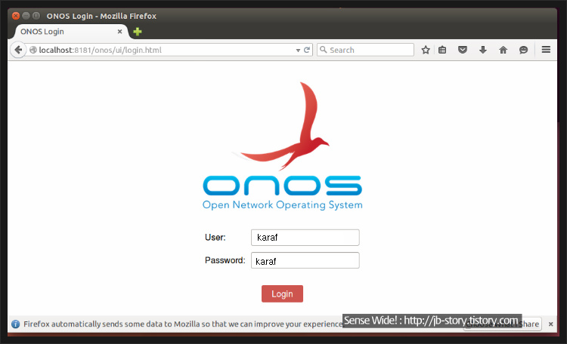
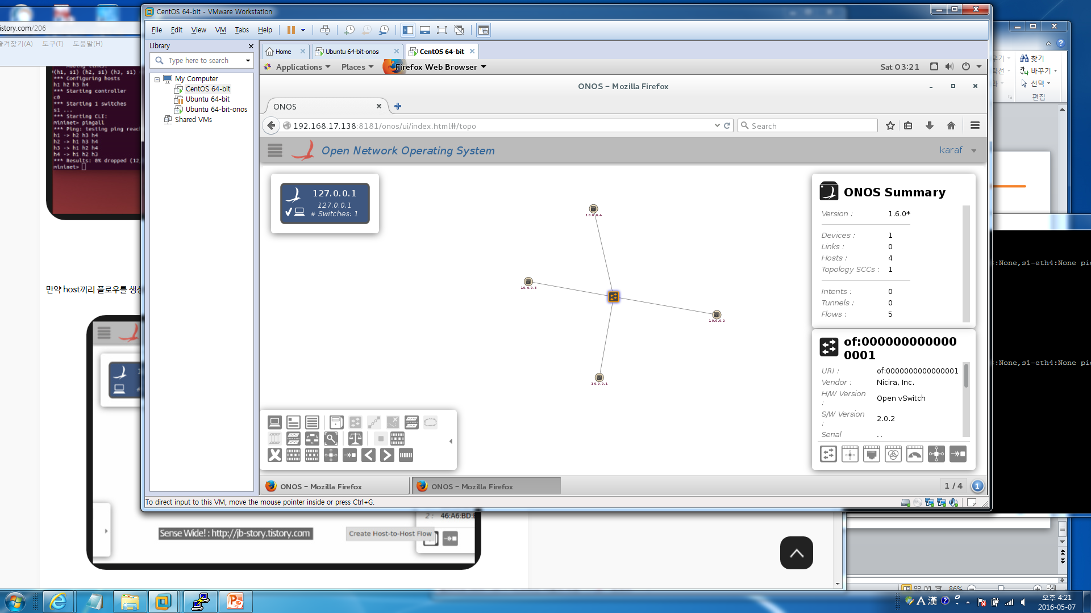
7-6. onos gui
Controller(onos)
http://localhost:8181/onos/ui 로 접속
/를 누르면 화면옵션 설정이 나옴

Slide 28
7-7. onos mininet 연동
Controller(onos)
root@ubuntu:~/mininet# mn --topo=single,3 --controller=remote,127.0.0.1
mn ---switch=ovsk,protocols=OpenFlow13 –-controller=remote,ip=192.168.99.100,port=32779 (openflow 1.3 버젼 연동시)
mininet> pingall
*** Ping: testing ping reachability
h1 -> h2 h3
h2 -> h1 h3
h3 -> h1 h2
*** Results: 0% dropped (6/6 received)
mininet> dpctl dump-flows
*** s1 ------------------------------------------------------------------------
NXST_FLOW reply (xid=0x4):
cookie=0x10000190260d7, duration=50.209s, table=0, n_packets=0, n_bytes=0, idle_age=50, priority=40000,dl_type=0x88cc actions=CONTROLLER:65535
cookie=0x10000adc87f7a, duration=50.209s, table=0, n_packets=6, n_bytes=588, idle_age=19, priority=5,ip actions=CONTROLLER:65535
cookie=0x100006a526acd, duration=50.209s, table=0, n_packets=0, n_bytes=0, idle_age=50, priority=40000,dl_type=0x8942 actions=CONTROLLER:65535
cookie=0x10000c42e0660, duration=50.209s, table=0, n_packets=8, n_bytes=336, idle_age=14, priority=40000,arp actions=CONTROLLER:65535
cookie=0x10000f1040206, duration=50.209s, table=0, n_packets=0, n_bytes=0, idle_age=50, priority=5,arp actions=CONTROLLER:65535
onos> devices -> sdn 스위치
onos> nodes -> controller
onos> hosts -> hosts
onos> masters -> 클러스터 구성인 경우 마스터 상태
onos> flows -> devices에 내려준 flow들
onos> paths src dst → src에서 dst까지 cost값
onos> intents → 의도적으로 path를 만든 intent 경로

Slide 29
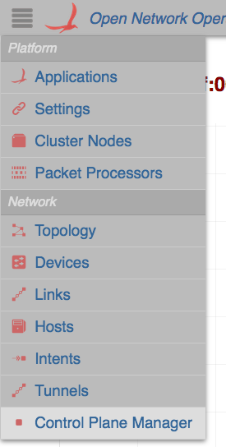
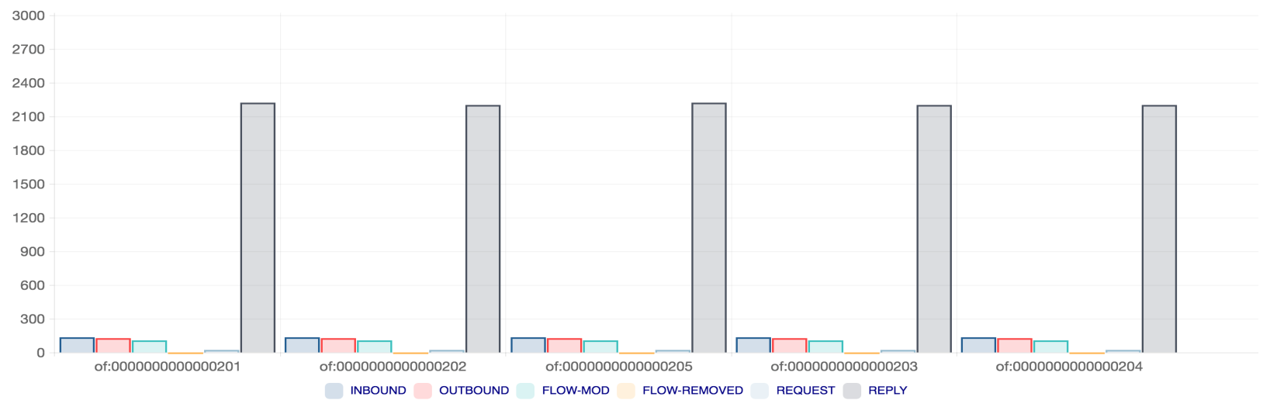
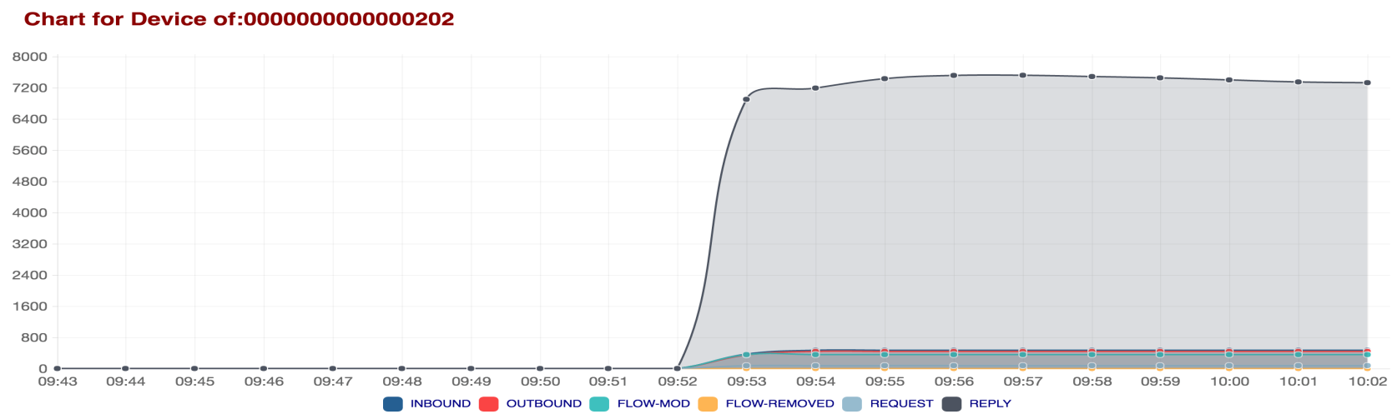
7-8. onos 모니터링
Controller(onos)
onos > app activate org.onosproject.cpman
onos > cpman-stats-list <node_ip> control_message <device_id>

