Slide 1
InfluxDB
보라매NOC – 가상화WG

Slide 2
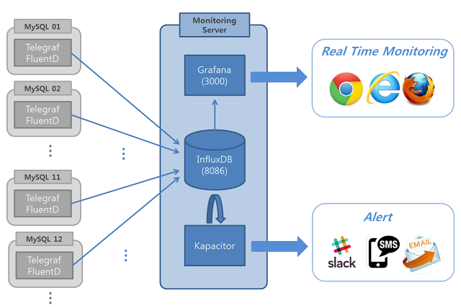
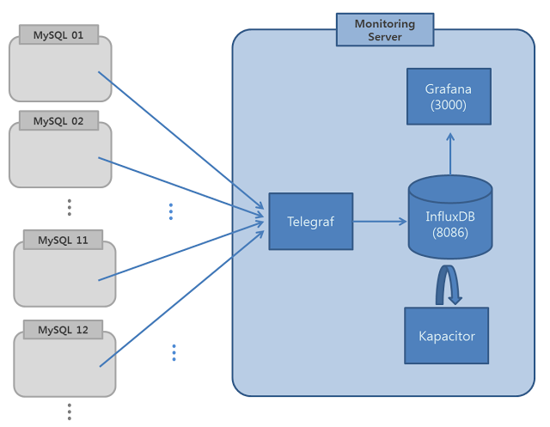
1. InfluxDB
구성방법
가. agent에서 push하는 방식과
나. 모니터링 서버에서 get하는 방식

Slide 3
1. InfluxDB
What is InfluxDB ?
InfluxDB는 시계열(Time-series) 데이터를 저장하는 데이터저장소 입니다.
시계열 데이터란 시간의 흐름에 따라 저장하는 데이터로서 서버, DB, 네트웍, 스토리지와 같은 IT인프라 모니터링을 위한 각종 데이터들, 서비스 반응을 확인하기위한 각종 지표들(동시접속자, PV 등), 요즘 뜨고 있는 IOT기기들의 각종 수집 데이터들, 다이어트를 위해 매일 기록하는 내 몸무게 등등 활용 목적에 따라 무척 다양할 수 있습니다.
시계열DB는 이러한 시계열 데이터들을 효율적으로 저장할 목적으로 사용되며 Grafana 같은 대쉬보드 툴과 연계하여 모니터링 용도로 주로 사용됩니다.

Slide 4
1. InfluxDB 설치
InfluxDB 사전요구 사항
TCP port 8086 is used for client-server communication over InfluxDB’s HTTP API
TCP port 8088 is used for the RPC service for backup and restore
InfluxDB uses a host’s local time in UTC to assign timestamps
2. InfluxDB 설치
yum install influxdb
systemctl start influxd
3. InfluxDB 설정 (/etc/influxdb/influxdb.conf에서 수정후 restart)
[root@glusterfs ~]# influxd config
Merging with configuration at: /etc/influxdb/influxdb.conf
reporting-disabled = false
bind-address = ":8088"
[meta]
dir = "/var/lib/influxdb/meta"
retention-autocreate = true
logging-enabled = true
[data]
dir = "/var/lib/influxdb/data"
wal-dir = "/var/lib/influxdb/wal"
query-log-enabled = true
cache-max-memory-size = 1073741824
cache-snapshot-memory-size = 26214400
cache-snapshot-write-cold-duration = "10m0s"
compact-full-write-cold-duration = "4h0m0s"
max-series-per-database = 1000000
max-values-per-tag = 100000
trace-logging-enabled = false
[coordinator]
write-timeout = "10s"
max-concurrent-queries = 0
query-timeout = "0s"
log-queries-after = "0s"
max-select-point = 0
max-select-series = 0
max-select-buckets = 0
[retention]
enabled = true
check-interval = "30m0s"
[shard-precreation]
enabled = true
check-interval = "10m0s"
advance-period = "30m0s"
[admin]
enabled = true
bind-address = ":8083"
https-enabled = false
https-certificate = "/etc/ssl/influxdb.pem"
[monitor]
store-enabled = true
store-database = "_internal"
store-interval = "10s"
[subscriber]
enabled = true
http-timeout = "30s"
insecure-skip-verify = false
ca-certs = ""
write-concurrency = 40
write-buffer-size = 1000
[http]
enabled = true
bind-address = ":8086"
auth-enabled = false
log-enabled = true
write-tracing = false
pprof-enabled = true
https-enabled = false
https-certificate = "/etc/ssl/influxdb.pem"
https-private-key = ""
max-row-limit = 0
max-connection-limit = 0
shared-secret = ""
realm = "InfluxDB"
unix-socket-enabled = false
bind-socket = "/var/run/influxdb.sock"
[[graphite]]
enabled = false
bind-address = ":2003"
database = "graphite"
retention-policy = ""
protocol = "tcp"
batch-size = 5000
batch-pending = 10
batch-timeout = "1s"
consistency-level = "one"
separator = "."
udp-read-buffer = 0
[[collectd]]
enabled = false
bind-address = ":25826"
database = "collectd"
retention-policy = ""
batch-size = 5000
batch-pending = 10
batch-timeout = "10s"
read-buffer = 0
typesdb = "/usr/share/collectd/types.db"
security-level = "none"
auth-file = "/etc/collectd/auth_file"
[[opentsdb]]
enabled = false
bind-address = ":4242"
database = "opentsdb"
retention-policy = ""
consistency-level = "one"
tls-enabled = false
certificate = "/etc/ssl/influxdb.pem"
batch-size = 1000
batch-pending = 5
batch-timeout = "1s"
log-point-errors = true
[[udp]]
enabled = false
bind-address = ":8089"
database = "udp"
retention-policy = ""
batch-size = 5000
batch-pending = 10
read-buffer = 0
batch-timeout = "1s"
precision = ""
[continuous_queries]
log-enabled = true
enabled = true
run-interval = "1s"

Slide 5
1. InfluxDB 서버설치
InfluxDB 접속
[root@glusterfs ~]# influx -precision rfc3339
Connected to http://localhost:8086 version 1.2.4
InfluxDB shell version: 1.2.4
> create database mydb
> show databases
name: databases
name
----
_internal
mydb
> use mydb;
Using database mydb
> INSERT cpu,host=serverA,region=us_west value=0.64
> SELECT "host", "region", "value" FROM "cpu"
name: cpu
time host region value
---- ---- ------ -----
2017-06-10T10:27:30.242543468Z serverA us_west 0.64
2017-06-11T08:27:42.891601453Z serverA us_west 0.64
> INSERT temperature,machine=unit42,type=assembly external=25,internal=37
> SELECT * FROM "temperature"
name: temperature
time external internal machine type
---- -------- -------- ------- ----
2017-06-10T10:31:13.124590403Z 25 37 unit42 assembly
2017-06-11T08:30:28.031139782Z 25 37 unit42 assembly
> SELECT * FROM /.*/ LIMIT 2
name: cpu
time external host internal machine region type value
---- -------- ---- -------- ------- ------ ---- -----
2017-06-10T10:27:30.242543468Z serverA us_west 0.64
2017-06-11T08:27:42.891601453Z serverA us_west 0.64
name: temperature
time external host internal machine region type value
---- -------- ---- -------- ------- ------ ---- -----
2017-06-10T10:31:13.124590403Z 25 37 unit42 assembly
2017-06-11T08:30:28.031139782Z 25 37 unit42 assembly

Slide 6
1. InfluxDB 서버설치
InfluxDB 접속
[root@glusterfs ~]# influx -precision rfc3339
Connected to http://localhost:8086 version 1.2.4
InfluxDB shell version: 1.2.4
> create database mydb
> show databases
name: databases
name
----
_internal
mydb
> use mydb;
Using database mydb
> INSERT cpu,host=serverA,region=us_west value=0.64
> SELECT "host", "region", "value" FROM "cpu"
name: cpu
time host region value
---- ---- ------ -----
2017-06-10T10:27:30.242543468Z serverA us_west 0.64
2017-06-11T08:27:42.891601453Z serverA us_west 0.64
> INSERT temperature,machine=unit42,type=assembly external=25,internal=37
> SELECT * FROM "temperature"
name: temperature
time external internal machine type
---- -------- -------- ------- ----
2017-06-10T10:31:13.124590403Z 25 37 unit42 assembly
2017-06-11T08:30:28.031139782Z 25 37 unit42 assembly
> SELECT * FROM /.*/ LIMIT 2
name: cpu
time external host internal machine region type value
---- -------- ---- -------- ------- ------ ---- -----
2017-06-10T10:27:30.242543468Z serverA us_west 0.64
2017-06-11T08:27:42.891601453Z serverA us_west 0.64
name: temperature
time external host internal machine region type value
---- -------- ---- -------- ------- ------ ---- -----
2017-06-10T10:31:13.124590403Z 25 37 unit42 assembly
2017-06-11T08:30:28.031139782Z 25 37 unit42 assembly

Slide 7
1. InfluxDB
What is Telegraf ?
Telegraf를 선택한 이유는 InfluxDB와 마찬가지로 Go언어로 개발되어 설치가 매우 간편하고 다양한 종류의 수집/저장 플러그인을 간단한 설정으로 사용 가능하기 때문입니다
플러그인은 Input/Output Plugin 으로 구분되는데 Input Plugin은 수집하는 대상을 의미하며 여기서는 system 및 mysql을 모니터링 대상으로 수집합니다.
Output Plugin은 수집한 데이터를 저장하는 Plugin으로서 주로 InfluxDB나 Graphite 같은 시계열DB가 될 수 있고 일반 파일이나 Kafka같은 메시징 시스템이 될 수도 있습니다

Slide 8
1. InfluxDB 설치
1. Telegraf 설치
wget https://dl.influxdata.com/telegraf/releases/telegraf-1.3.1-1.x86_64.rpm
yum localinstall telegraf-1.3.1-1.x86_64.rpm
2. Telegraf 설정 (/etc/telegraf/telegraf.conf에서 수정후 restart)
[root@glusterfs ~]# $ cd /etc/telegraf
$ telegraf -sample-config -input-filter cpu:disk:kernel:mem:net:netstat:system:mysql -output-filter influxdb > telegraf.conf
[agent]
interval = "1s"
round_interval = true
metric_batch_size = 1000
metric_buffer_limit = 10000
collection_jitter = "0s"
flush_interval = "5s"
flush_jitter = "0s"
debug = false
quiet = false
hostname = "mytest1"
omit_hostname = false
[[outputs.influxdb]]
urls = ["http://influxdb:8086"] # required
database = "telegraf" # required
precision = "s"
retention_policy = "default"
write_consistency = "any"
timeout = "5s"
[[inputs.mysql]]
servers = ["telegraf:p@$$w0rd@tcp(127.0.0.1:3306)/"]
## the limits for metrics form perf_events_statements
perf_events_statements_digest_text_limit = 120
perf_events_statements_limit = 250
perf_events_statements_time_limit = 86400
#
## if the list is empty, then metrics are gathered from all databasee tables
table_schema_databases = [ ]
#
## gather metrics from INFORMATION_SCHEMA.TABLES for databases provided above list
gather_table_schema = false
#
## gather thread state counts from INFORMATION_SCHEMA.PROCESSLIST
gather_process_list = false
#
## gather auto_increment columns and max values from information schema
gather_info_schema_auto_inc = false
#
## gather metrics from SHOW SLAVE STATUS command output
gather_slave_status = true
#
## gather metrics from SHOW BINARY LOGS command output
gather_binary_logs = false
#
## gather metrics from PERFORMANCE_SCHEMA.TABLE_IO_WAITS_SUMMART_BY_TABLE
gather_table_io_waits = false
#
## gather metrics from PERFORMANCE_SCHEMA.TABLE_LOCK_WAITS
gather_table_lock_waits = false
#
## gather metrics from PERFORMANCE_SCHEMA.TABLE_IO_WAITS_SUMMART_BY_INDEX_USAGE
gather_index_io_waits = false
#
## gather metrics from PERFORMANCE_SCHEMA.EVENT_WAITS
gather_event_waits = false
#
## gather metrics from PERFORMANCE_SCHEMA.FILE_SUMMARY_BY_EVENT_NAME
gather_file_events_stats = false
#
## gather metrics from PERFORMANCE_SCHEMA.EVENTS_STATEMENTS_SUMMARY_BY_DIGEST
gather_perf_events_statements = false
#
## Some queries we may want to run less often (such as SHOW GLOBAL VARIABLES)
interval_slow = "30m"

Slide 9
1. InfluxDB 서버설치
Telegraf에서 수집한 데이타 확인
[> show databases;
name: databases
name
----
_internal
mydb
telegraf
> show measurements
name: measurements
name
----
cpu
disk
kernel
mem
mysql
mysql_info_schema
mysql_users
mysql_variables
net
netstat
system
> show tag keys from mysql
name: mysql
tagKey
------
host
server
> show tag values from mysql with key=host
name: mysql
key value
--- -----
host glusterfs
> show field keys from mysql
name: mysql
fieldKey fieldType
-------- ---------
aborted_clients integer
aborted_connects integer
access_denied_errors integer
> select uptime form mysql;
ERR: error parsing query: found form, expected FROM at line 1, char 15
> select uptime from mysql;
name: mysql
time uptime
---- ------
1497345660000000000 3305
1497345670000000000 3315
1497345680000000000 3325
1497345690000000000 3335
1497345700000000000 3345
1497345710000000000 3355
1497345720000000000 3365

Slide 10
1. InfluxDB
What is Grafana ?
Grafana는 3.0으로 업데이트 되면서 큰 변화가 있었는데 grafana.net 이라는 플랫폼 형태로 서비스가 진화한 것입니다. 그동안 사용자들이 열열히 요구하던 파이차트와 히스토그램 같은 다양한 panel 및 ElasticSearch, CloudWatch, Prometheus 와 같은 data source 를 플러그인 형태로 grafana.net 에서 제공하는데 필요하면 다운 받아 설치하여 사용할 수 있습니다. 뿐만 아니라 app 이라는 형태로 특정 용도에 맞게 제작된 대시보드들을 공유하고 다운받아 사용할 수도 있습니다

Slide 11
1. InfluxDB 설치
1. Grafana 설치
wget https://s3-us-west-2.amazonaws.com/grafana-releases/release/grafana-4.3.1-1.x86_64.rpm
yum install initscripts fontconfig
rpm -Uvh grafana-4.3.1-1.x86_64.rpm
yum install fontconfig
yum install freetype*
yum install urw-fonts
influx
> create user choga88 with password 'cho123' with all privileges;
> show users
user admin
---- -----
choga88 true
2. Grafana 환경변수 설정 (/etc/sysconfig/grafana-server)
Grafana 설정 (/etc/grafana/grafana.ini)
systemctl start grafana-server.service

Slide 12
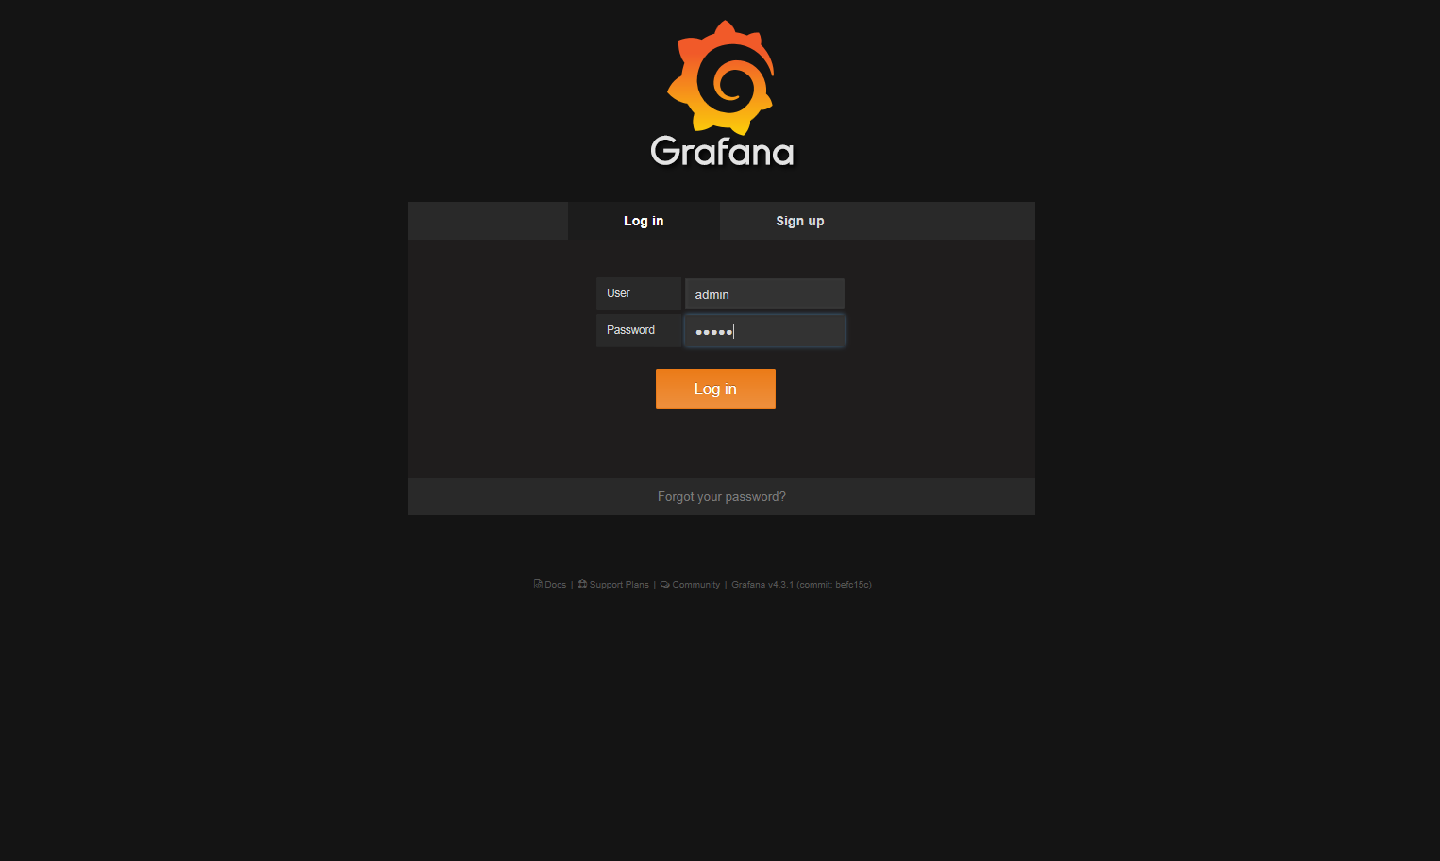
1. InfluxDB 설치
Grafana 접속 (http://ip:3000)
admin/admin접속

Slide 13
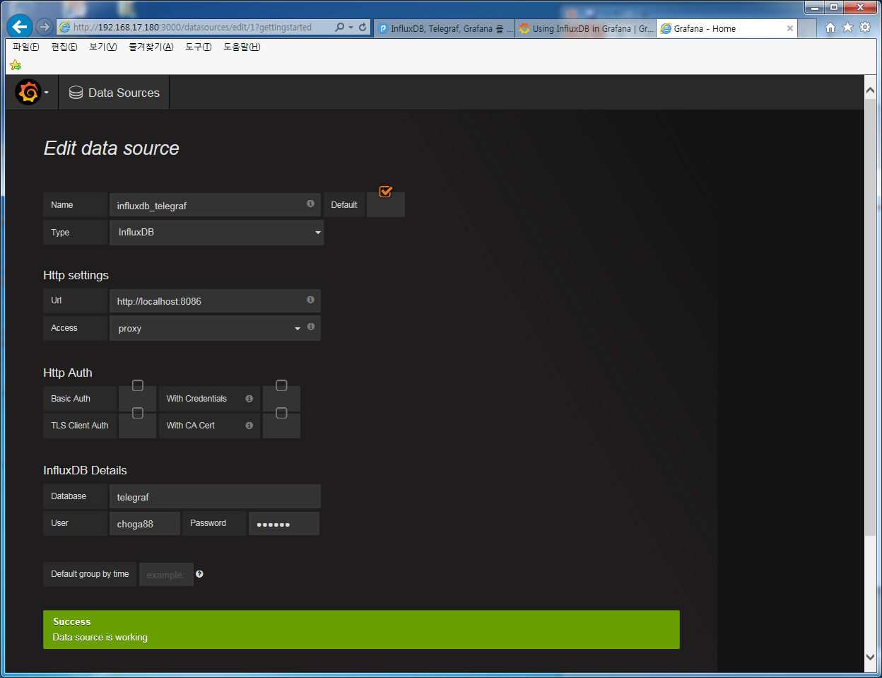
1. InfluxDB 설치
Grafana data source 추가 (influxdb를 source로 추가)
Success가 나오면 소스연동 성공

Slide 14
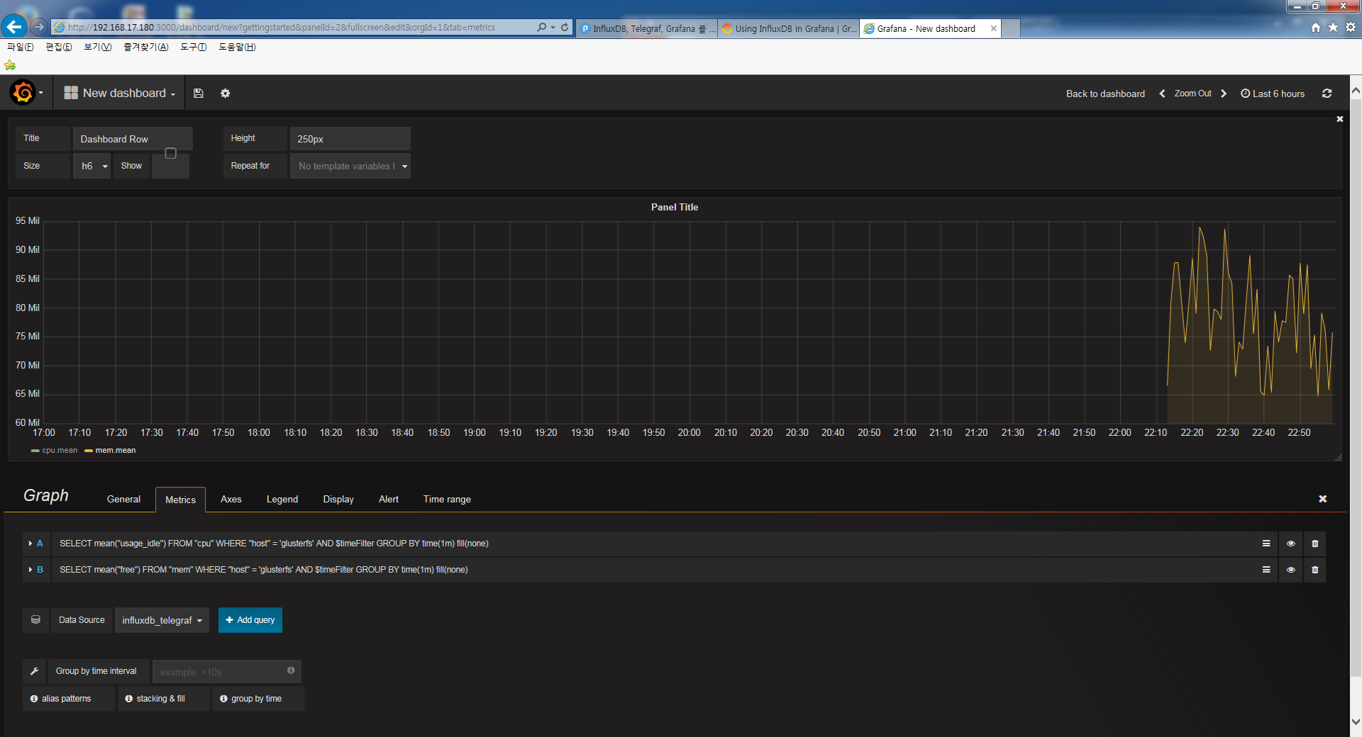
1. InfluxDB 설치
Grafana Dashboard추가

