Slide 1
redis
보라매NOC – 가상화WG

Slide 2
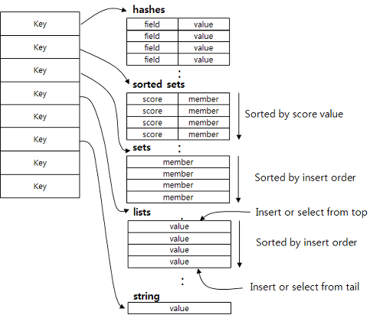
1. redis란
1. redis 란
Redis는 "REmote DIctionary System"의 약자로 메모리 기반의 Key/Value Store 이다.
Cassandra나 HBase와 같이 NoSQL DBMS로 분류되기도 하고, memcached와 같은 In memory 솔루션으로 분리되기도 한다.
성능은 memcached에 버금가면서 다양한 데이타 구조체를 지원함으로써 Message Queue, Shared memory, Remote Dictionary 용도로도 사용될 수 있으며, 이런 이유로 인스탄트그램, 네이버 재팬의 LINE 메신져 서비스, StackOverflow,Blizzard,digg 등 여러 소셜 서비스에 널리 사용되고 있다.
2. redis 데이타 구조
Value가 일반적인 string 뿐만 아니라, set,list,hash와 같은 집합형 데이타 구조를 지원한다.
저장된 데이타에 대한 연산이나 추가 작업 가능하다. (합집합,교집합,RANGE QUERY 등)
set은 일종의 집합, sorted set은 오름차순으로 정렬된 집합, hash는 키 기반의 테이블, list는 일종의 링크드 리스트 와 같은 특성을 지니고 있다.

Slide 3
1. redis 설치
redis 설치
und3r@sungwook redis]$ wget http://download.redis.io/releases/redis-3.0.1.tar.gz
--2015-05-27 16:01:34-- http://download.redis.io/releases/redis-3.0.1.tar.gz
Resolving download.redis.io... 109.74.203.151
Connecting to download.redis.io|109.74.203.151|:80... connected.
HTTP request sent, awaiting response... 200 OK
Length: 1358190 (1.3M) [application/x-gzip]
Saving to: “redis-3.0.1.tar.gz”
100%[======================================================================>] 1,358,190 498K/s in 2.7s
2015-05-27 16:01:38 (498 KB/s) - “redis-3.0.1.tar.gz” saved [1358190/1358190]
[und3r@sungwook redis]$ tar xzf redis-3.0.1.tar.gz
[und3r@sungwook redis]$ cd redis-3.0.1
[und3r@sungwook redis-3.0.1]$ make; make install

Slide 4
1. redis 기동
redis 기동방법
가. ./install_server.sh를 실행하면서 port등을 설정
나. /etc/init.d/redis_port번호 start/stop/status
다. redis-server로 기동하면 default 설정으로 기동됨
2. redis config/log정보
ㅇ /etc/redis/port번호.conf 파일에 저장됨
ㅇ vi /etc/redis/port번호.conf 에서
requirepass password 부분을 수정
ㅇ /var/log/redis_port번호.log 에서 확인
3. redis cli 사용
ㅇ redis-cli –p port번호 –a 비밀번호
[und3r@sungwook utils]$ redis-cli
127.0.0.1:6379> set myKey myValue
OK
127.0.0.1:6379> get myKey
"myValue"
127.0.0.1:6379>

Slide 5
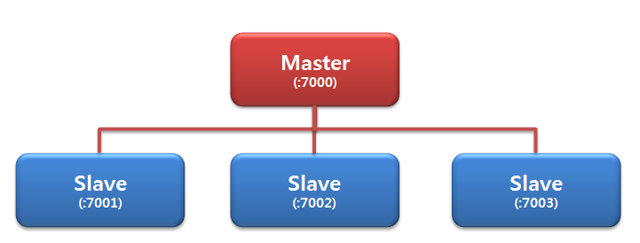
1. redis replication-1
redis replication (7000, 7001, 7002, 7003 생성)
und3r@sungwook utils]$ sudo ./install_server.sh
Welcome to the redis service installer
This script will help you easily set up a running redis server
Please select the redis port for this instance: [6379] 7000
Please select the redis config file name [/etc/redis/7000.conf]
Selected default - /etc/redis/7000.conf
Please select the redis log file name [/var/log/redis_7000.log]
Selected default - /var/log/redis_7000.log
Please select the data directory for this instance [/var/lib/redis/7000]
Selected default - /var/lib/redis/7000
Please select the redis executable path [] /usr/local/bin/redis-server
Selected config:
Port : 7000
Config file : /etc/redis/7000.conf
Log file : /var/log/redis_7000.log
Data dir : /var/lib/redis/7000
Executable : /usr/local/bin/redis-server
Cli Executable : /usr/local/bin/redis-cli
Is this ok? Then press ENTER to go on or Ctrl-C to abort.
Copied /tmp/7000.conf => /etc/init.d/redis_7000
Installing service...
Successfully added to chkconfig!
Successfully added to runlevels 345!
Starting Redis server...
Installation successful!
[und3r@sungwook utils]$

Slide 6
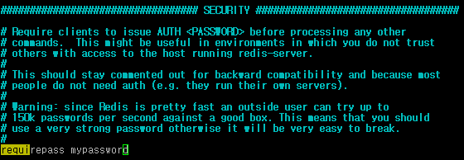
1. redis replication-2
redis replication
ㅇ master 설정 (7000)
ㅇ slave 설정 (7000,7001,7002,7003)
# slaveof <masterip> <masterport>
slaveof 127.0.0.1 7000
# masterauth <master-password>
masterauth mypassword
repl-ping-slave-period 10
repl-timeout 60

Slide 7
1. redis replication-3
redis replication 상태확인
root@webserver01 Desktop]# redis-cli -p 7000 –a cho123
127.0.0.1:7001> info replication
# Replication
role:master
connected_slaves:3
slave0:ip=127.0.0.1,port=7001,state=online,offset=5878,lag=1
slave1:ip=127.0.0.1,port=7002,state=online,offset=5892,lag=0
slave2:ip=127.0.0.1,port=7003,state=online,offset=5878,lag=0
master_repl_offset:5892
repl_backlog_active:1
repl_backlog_size:1048576
repl_backlog_first_byte_offset:2
repl_backlog_histlen:5891

Slide 8
1. redis sentinel-1
redis sentinel
sentinel을 통해 자동으로
master,slave 상태관리
sentinel.conf 파일에 기본설정
port 23629
sentinek monitor mymaster 127.0.0.1 7000 1
sentinel auth-pass mymaster cho123
Sentinel
(23629)

Slide 9
1. redis sentinel-2
redis sentinel
ㅇ 7000번이 master 임을 확인
[root@webserver01 redis-3.0.1]# redis-cli -p 7000 -a cho123
127.0.0.1:7000> info replication
# Replication
role:master
connected_slaves:3
slave0:ip=127.0.0.1,port=7003,state=online,offset=3001003,lag=0
slave1:ip=127.0.0.1,port=7001,state=online,offset=3001003,lag=1
slave2:ip=127.0.0.1,port=7002,state=online,offset=3001003,lag=0
master_repl_offset:3001003
repl_backlog_active:1
repl_backlog_size:1048576
repl_backlog_first_byte_offset:1952428
repl_backlog_histlen:1048576
ㅇ 7000번이 master stop
[root@webserver01 redis-3.0.1]# /etc/init.d/redis_7000 stop
Stopping ...
Redis stopped
ㅇ sentinel 로그에서 master의 변동사항 확인
root@webserver01 utils]# cat /var/log/sentinel.log | grep switch
9358:X 31 May 18:57:05.598 # +switch-master mymaster 127.0.0.1 7000 127.0.0.1 7003
9358:X 01 Jun 02:16:56.383 # +switch-master mymaster 127.0.0.1 7003 127.0.0.1 7000
9358:X 14 Jun 23:32:20.078 # +switch-master mymaster 127.0.0.1 7000 127.0.0.1 7002
ㅇ 7002번이 master 임을 확인
[root@webserver01 redis-3.0.1]# redis-cli -p 7002 -a cho123
127.0.0.1:7002> info replication
# Replication
role:master
connected_slaves:2
slave0:ip=127.0.0.1,port=7001,state=online,offset=3832,lag=2
slave1:ip=127.0.0.1,port=7003,state=online,offset=3832,lag=1
master_repl_offset:3832
repl_backlog_active:1
repl_backlog_size:1048576
repl_backlog_first_byte_offset:2
repl_backlog_histlen:3831

Slide 10
1. redis sentinel-3
redis sentinel
ㅇ 7000번이 master start
[root@webserver01 redis-3.0.1]# /etc/init.d/redis_7000 start
Starting Redis server...
ㅇ 7000번 slave동작 확인
[root@webserver01 redis-3.0.1]# redis-cli -p 7000 -a cho123
127.0.0.1:7000> info replication
# Replication
role:slave
master_host:127.0.0.1
master_port:7002
master_link_status:up
master_last_io_seconds_ago:1
master_sync_in_progress:0
slave_repl_offset:8475
slave_priority:100
slave_read_only:1
connected_slaves:0
master_repl_offset:0
repl_backlog_active:0
repl_backlog_size:1048576
repl_backlog_first_byte_offset:0
repl_backlog_histlen:0
2. redis sentinel 동작원리
sentinel process가 /etc/7000.conf파일의 master설정인 slaveof를 변경
[root@webserver01 utils]# cat /etc/redis/7000.conf | grep slaveof
slaveof 127.0.0.1 7002
[root@webserver01 utils]# cat /etc/redis/7001.conf | grep slaveof
slaveof 127.0.0.1 7002
[root@webserver01 utils]# cat /etc/redis/7003.conf | grep slaveof
slaveof 127.0.0.1 7002
[root@webserver01 utils]# cat /etc/redis/7002.conf | grep slaveof

