Slide 1
zabbix
보라매NOC – 가상화WG

Slide 2
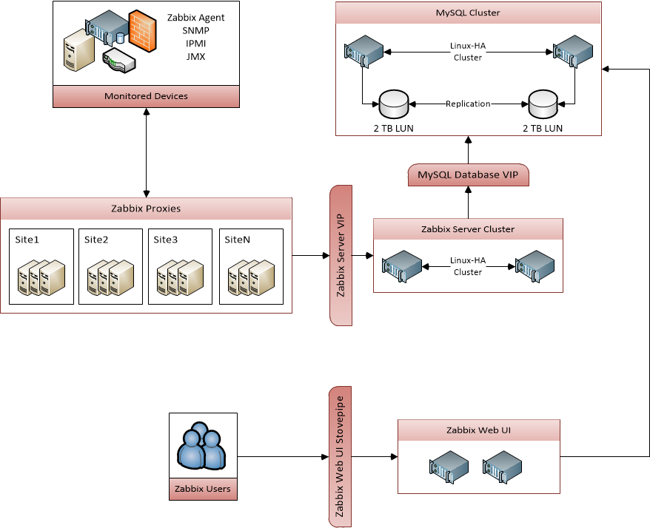
1. zabbix
zabbix 란
Zabbix is an enterprise-class open source distributed free monitoring solution
2. zabbix 특징
availability and performance checks
support for SNMP (both trapping and polling), IPMI, JMX, VMware monitoring
custom checks
gathering desired data at custom intervals
performed by server/proxy and by agents
3. zabbix 데이타 수집방식
In a passive check the agent responds to a data request. Zabbix server (or proxy) asks for data, for example, CPU load, and Zabbix agent sends back the result.
Active checks require more complex processing. The agent must first retrieve a list of items from Zabbix server for independent processing. Then it will periodically send new values to the server

Slide 3
1. zabbix 용어
zabbix 용어
host
- a networked device that you want to monitor, with IP/DNS.
host group
- a logical grouping of hosts; it may contain hosts and templates. Hosts and templates within a host group are not in any way linked to each other. Host groups are used when assigning access rights to hosts for different user groups.
item
- a particular piece of data that you want to receive off of a host, a metric of data.
trigger
- a logical expression that defines a problem threshold and is used to “evaluate” data received in items
When received data are above the threshold, triggers go from 'Ok' into a 'Problem' state. When received data are below the threshold, triggers stay in/return to an 'Ok' state.
event
- a single occurrence of something that deserves attention such as a trigger changing state or a discovery/agent auto-registration taking place
problem
- a trigger that is in “Problem” state
action
- a predefined means of reacting to an event.
An action consists of operations (e.g. sending a notification) and conditions (when the operation is carried out)
escalation
- a custom scenario for executing operations within an action; a sequence of sending notifications/executing remote commands
media
- a means of delivering notifications; delivery channel
notification
- a message about some event sent to a user via the chosen media channel
remote command
- a pre-defined command that is automatically executed on a monitored host upon some condition
template
- a set of entities (items, triggers, graphs, screens, applications, low-level discovery rules, web scenarios) ready to be applied to one or several hosts
The job of templates is to speed up the deployment of monitoring tasks on a host; also to make it easier to apply mass changes to monitoring tasks. Templates are linked directly to individual hosts.
application
- a grouping of items in a logical group
web scenario
- one or several HTTP requests to check the availability of a web site
frontend
- the web interface provided with Zabbix
Zabbix API
- Zabbix API allows you to use the JSON RPC protocol to create, update and fetch Zabbix objects (like hosts, items, graphs and others) or perform any other custom tasks
Zabbix server
- a central process of Zabbix software that performs monitoring, interacts with Zabbix proxies and agents, calculates triggers, sends notifications; a central repository of data
Zabbix agent
- a process deployed on monitoring targets to actively monitor local resources and applications
Zabbix proxy
- a process that may collect data on behalf of Zabbix server, taking some processing load off of the server

Slide 4
1. zabbix 서버설치
zabbix 설치방법
Install it from the distribution packages
Download the latest source archive and compile it yourself
Install it from the containers
Download the virtual appliance
2. zabbix repo 등록
rpm -ivh http://repo.zabbix.com/zabbix/3.2/rhel/7/x86_64/zabbix-release-3.2-1.el7.noarch.rpm
3. mairadb/httpd 사전설치
yum install mairadb-server maridb
systemctl start/enable mariadb
mysql_secure_installation
systemc enable mariadb
systemctl start/enable httpd
setenforce 0

Slide 5
1. zabbix 서버설치
zabbix 설치
yum install zabbix-server-mysql zabbix-web-mysql
mysql -uroot –p cho123
mysql> create database zabbix character set utf8 collate utf8_bin;
mysql> create user zabbix@localhost identified by ‘cho123’;
mysql> grant all privileges on zabbix.* to zabbix@localhost;
mysql> quit;
zcat /usr/share/doc/zabbix-server-mysql-3.2.6/create.sql.gz | mysql -uzabbix -p zabbix
cho123
2. zabbix database config
vi /etc/zabbix/zabbix_server.conf
DBHost=localhost
DBName=zabbix
DBUser=zabbix
DBPassword=cho123
# systemctl start zabbix-server
# systemctl enable zabbix-server
vi /etc/httpd/conf.d/zabbix.conf
php_value max_execution_time 300
php_value memory_limit 128M
php_value post_max_size 16M
php_value upload_max_filesize 2M
php_value max_input_time 300
php_value always_populate_raw_post_data -1
php_value date.timezone Asia/Tokyo → 주석제거 해야함
# systemctl restart httpd

Slide 6
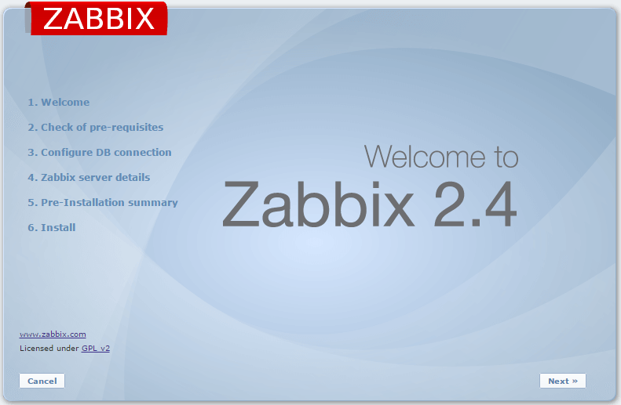
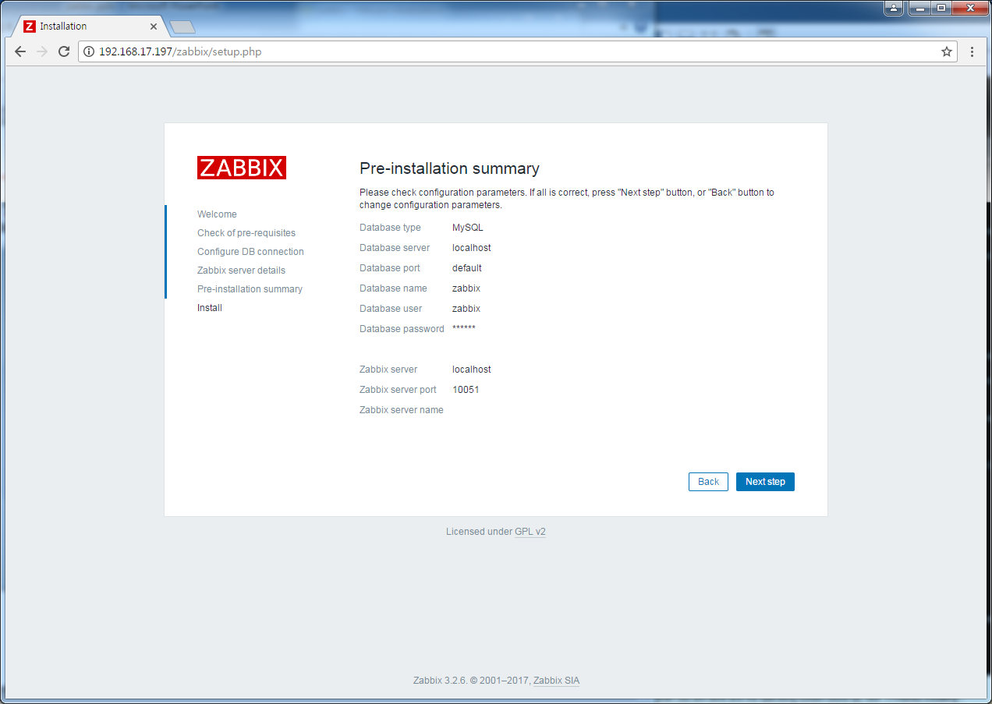
1. zabbix 서버설치
zabbix frontend 웹서버 환경 구성
http://localhost/zabbix

Slide 7
1. zabbix agent설치
1. zabbix repo 등록
#rpm -ivh http://repo.zabbix.com/zabbix/3.2/rhel/7/x86_64/zabbix-release-3.2-1.el7.noarch.rpm
2. zabbix agent설치
#yum install zabbix-agent
#systemctl start/enable zabbix-agent
#vi /etc/zabbix/zabbix_agent.conf
Server=서버IP
#systemctl restart zabbix-agent

Slide 8
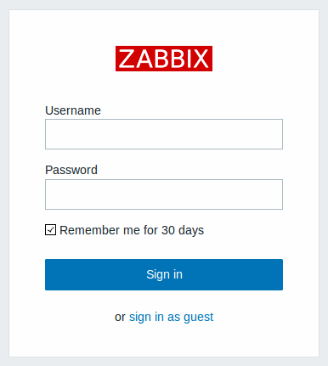
1. zabbix 서버구성
로그인
Admin
zabbix
2. 구성순서
가. Host 생성
나. Host의 Item 생성
다. Host의 Item의 그래프 생성
라. Host의 Item의 트리거 생성
마. Host의 Item의 트리거 Action 생성

Slide 9
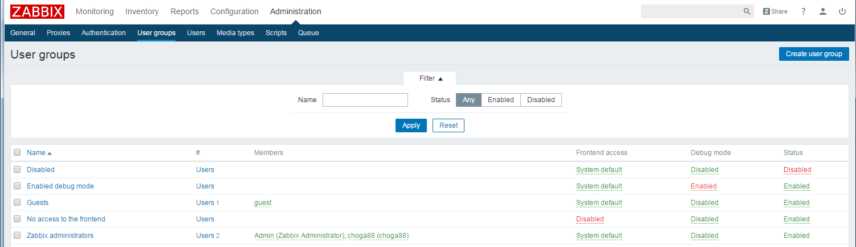
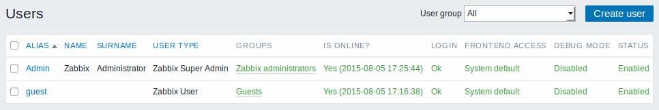
1. zabbix 서버구성
1. 사용자 그룹 생성 (Administrations->user groups)
1. 사용자 생성 (Administrations->users)
※ In Zabbix, access rights to hosts are assigned to user groups, not individual users

Slide 10
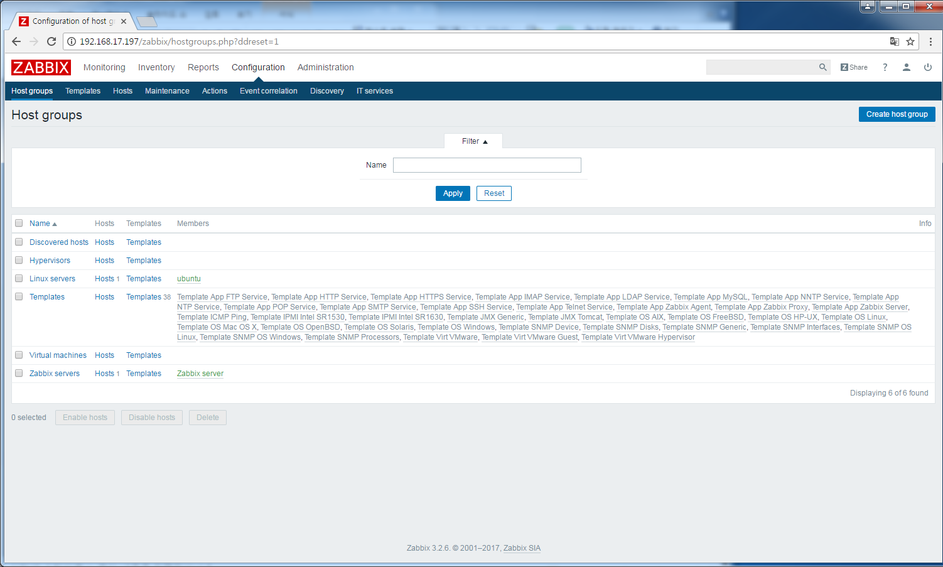
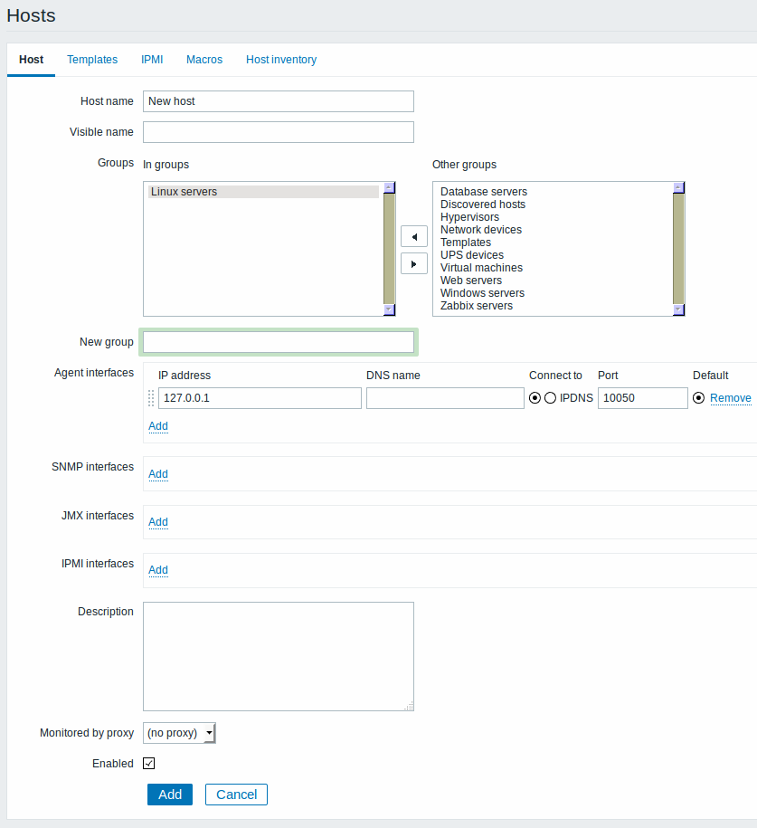
1. zabbix 서버구성
1. 호스트 그룹 추가 (Configuration->host grups)
호스트 추가 (Configuration->hosts)
-템플릿을 연결하면 모든 항목(application,item,trigger,graphs)이 상속됨
※ All access permissions are assigned to host groups, not individual hosts.
That is why a host must belong to at least one group

Slide 11
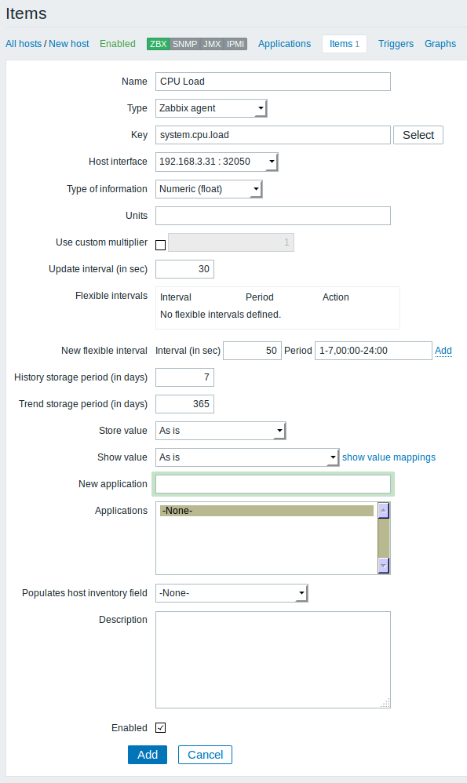
1. zabbix 서버구성
Item 추가 (Configuration->host->item)
- 호스트로 부터 수집할 데이터 구성

Slide 12
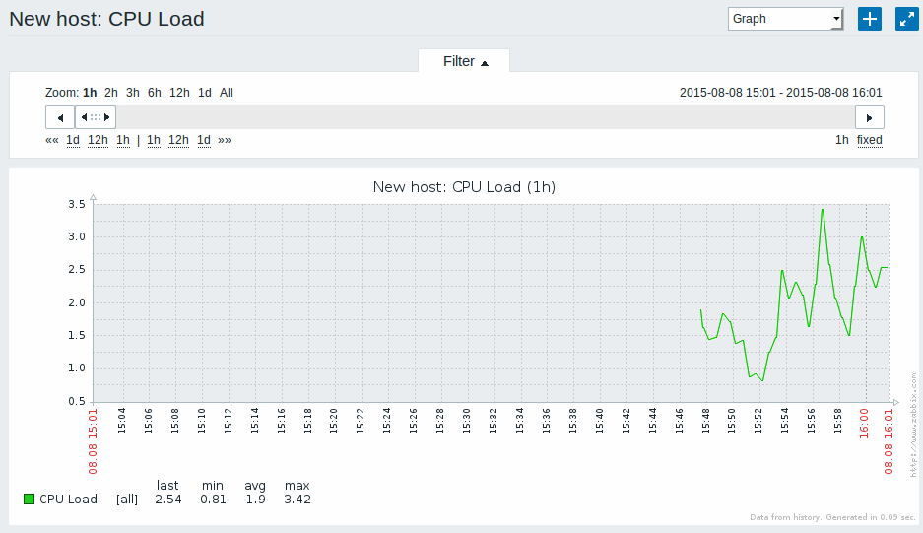
1. zabbix 서버구성
Graph 추가 (Configuration->host->graphs)
- 수집된 Item의 그래프

Slide 13
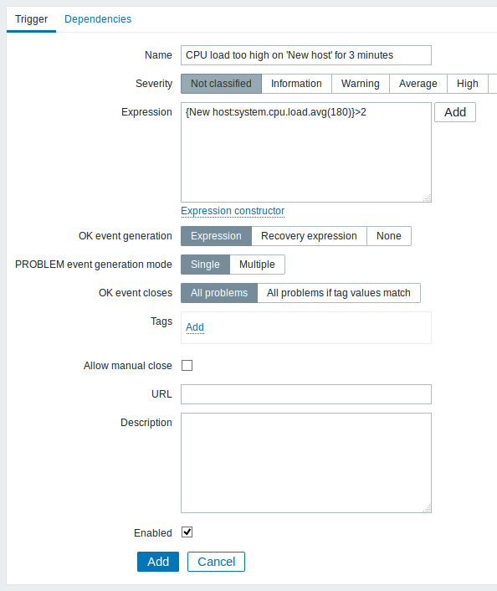
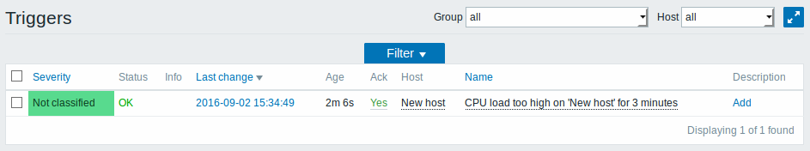
1. zabbix 서버구성
trigger 추가 (Configuration->host->triggers)
지정값을 초과하였을때 정상으로 돌아왔을때 trigger됨
※ 정상 : 그린색 ‘OK’
비정상: 빨간색 ‘PROBLEM’

Slide 14
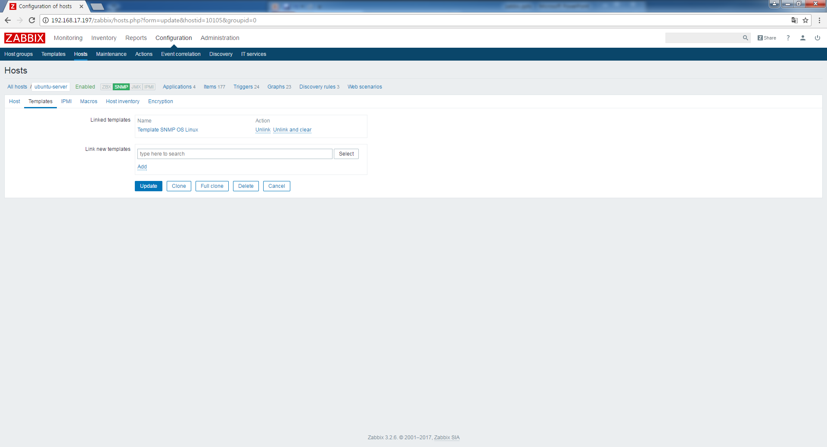
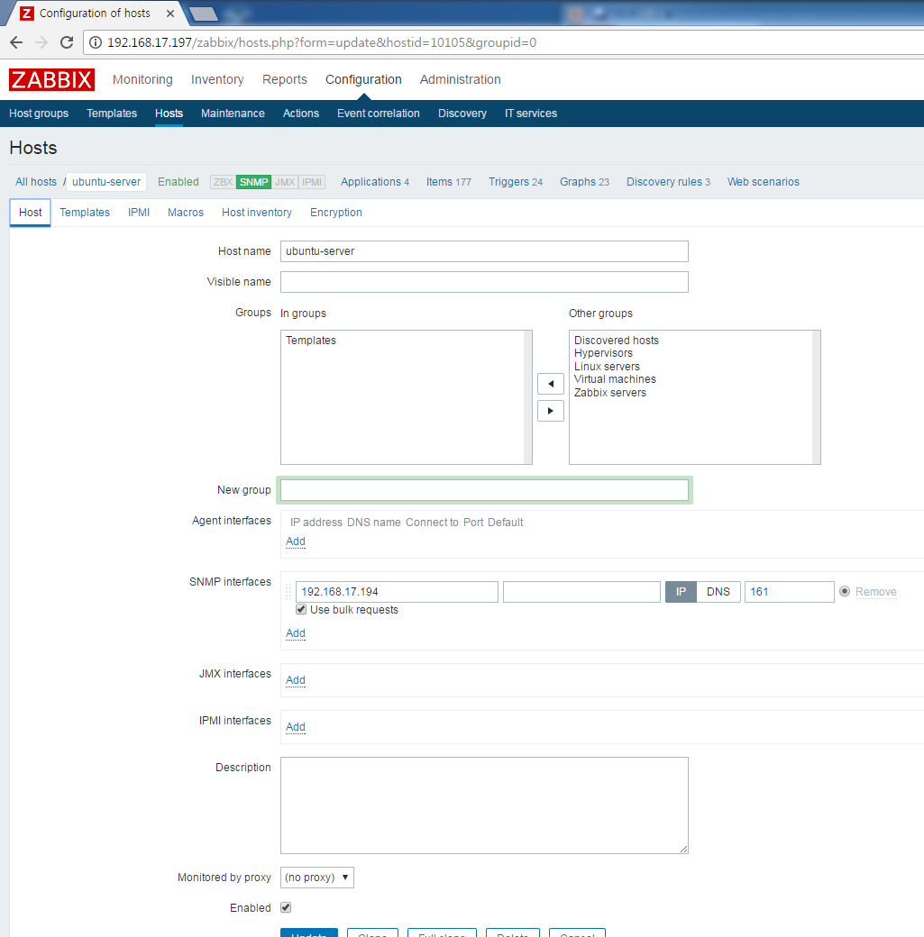
1. zabbix 서버 SNMP Template
호스트 추가시 그룹을 Template선택
SNMP interface 선택
2. SNMP에 맞는 Template선택후 ADD->UPDATE

Slide 15
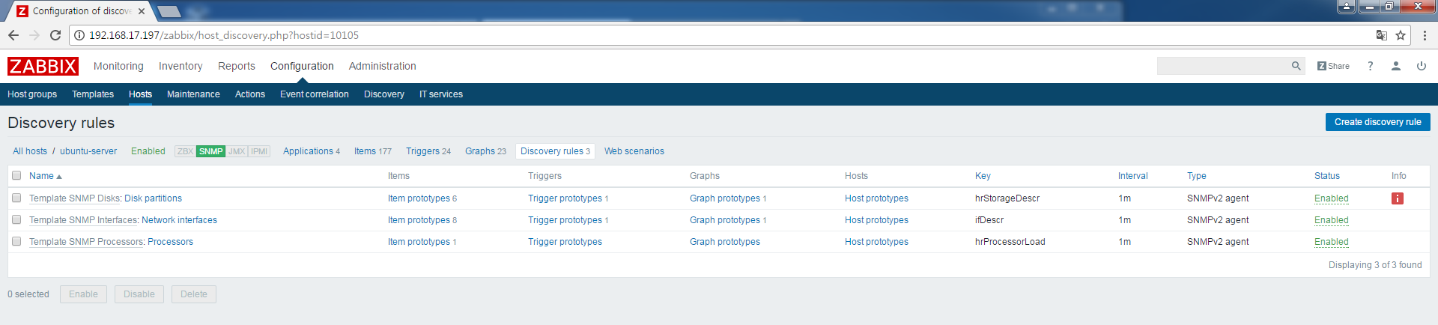
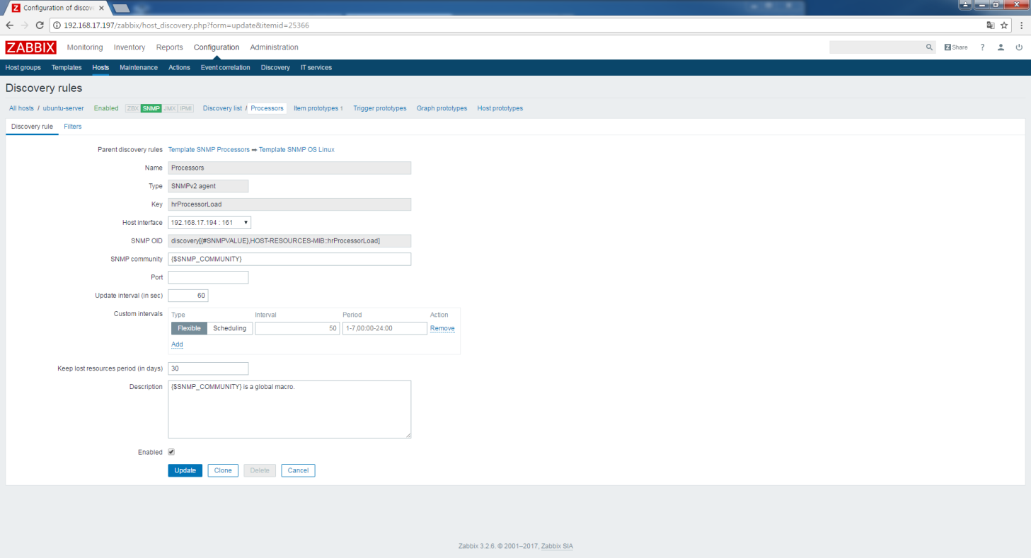
1. zabbix 서버 SNMP Template
1. Discovery Rule 선택
2. Discovery Rule에서 Update interval 3600->60초 변경

Slide 16
1. zabbix 서버 Agent Template
호스트 추가시 그룹을 Template선택
Agent interface 선택
2. OS 에 맞는 Template선택후 ADD->UPDATE

Slide 17
1. zabbix 서버 Agent Template
1. Discovery Rule 선택
2. Discovery Rule에서 Update interval 3600->60초 변경

Slide 18
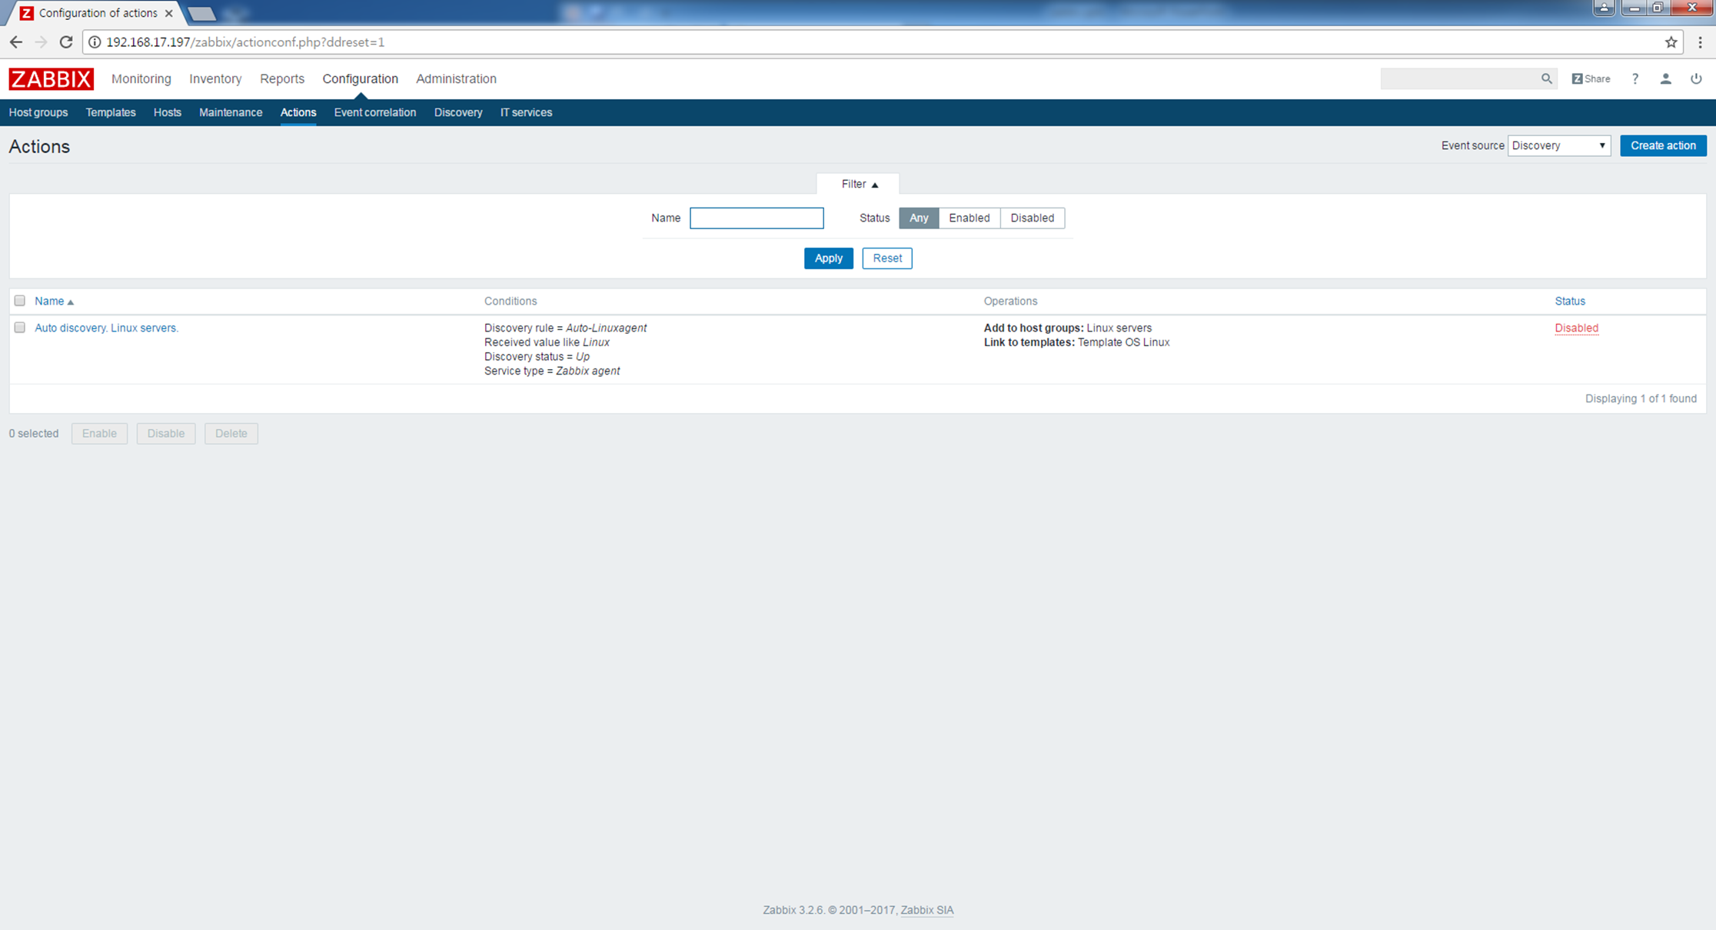
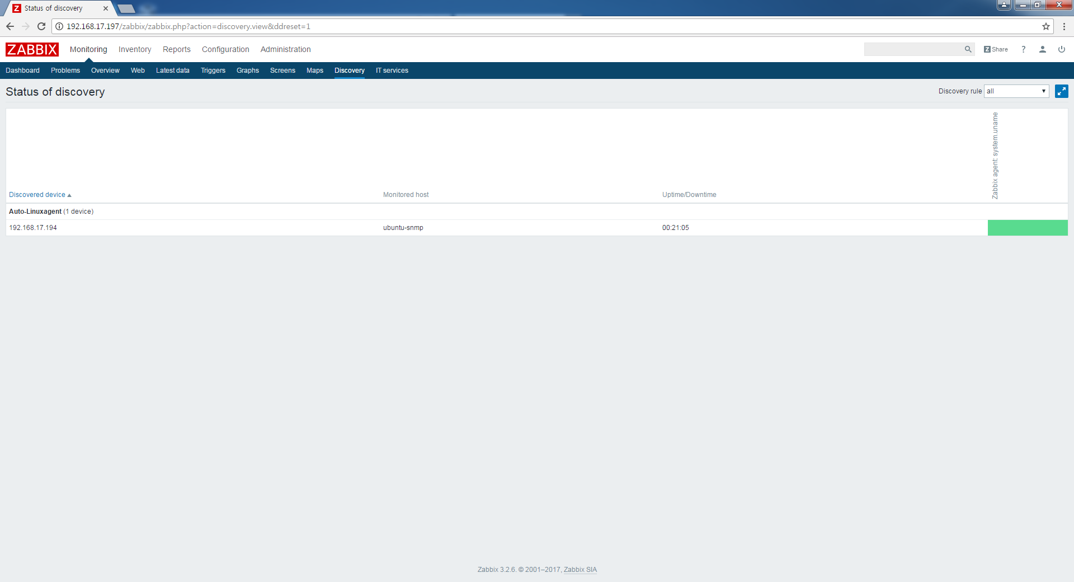
1. zabbix 서버 Auto Discovery
Configuration->Actions선택 (Event souce->Discovery선택)
Conditions조건을 만족하면 Operation동작으로 Auto Discovery 동작
2. Monitoring-> Discovery에서 등록된 서버확인

Slide 19
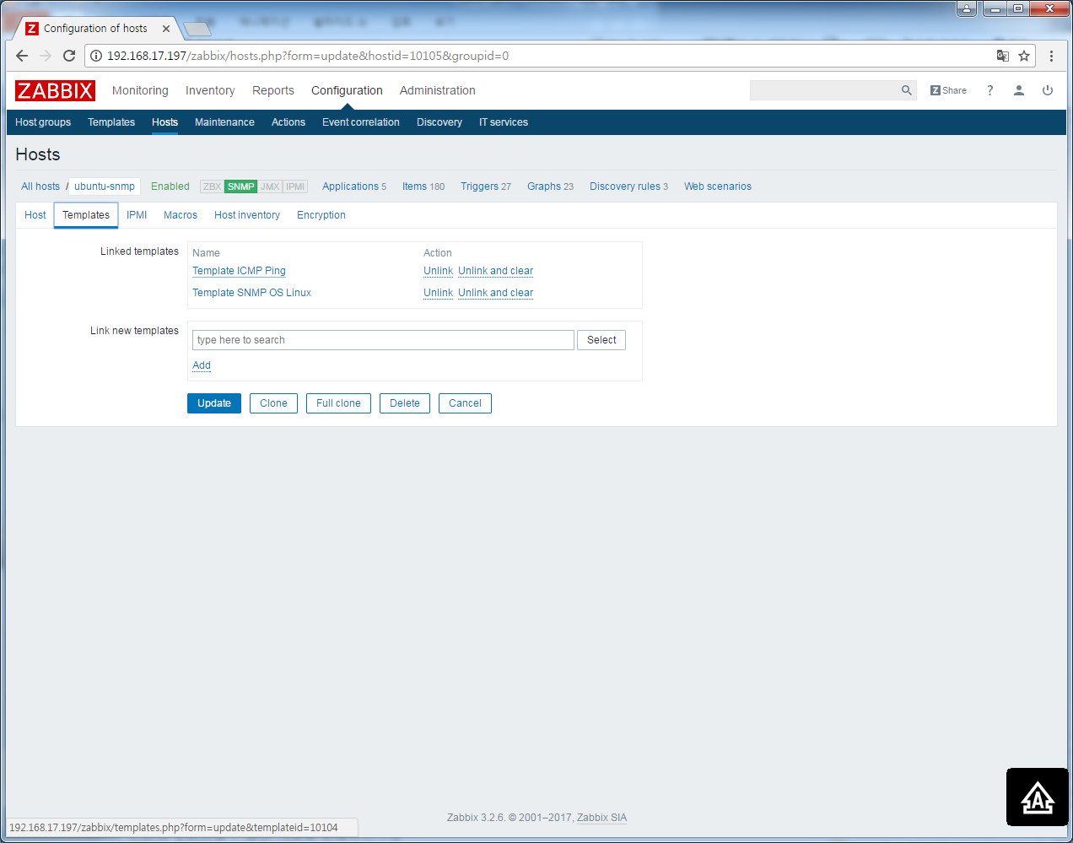
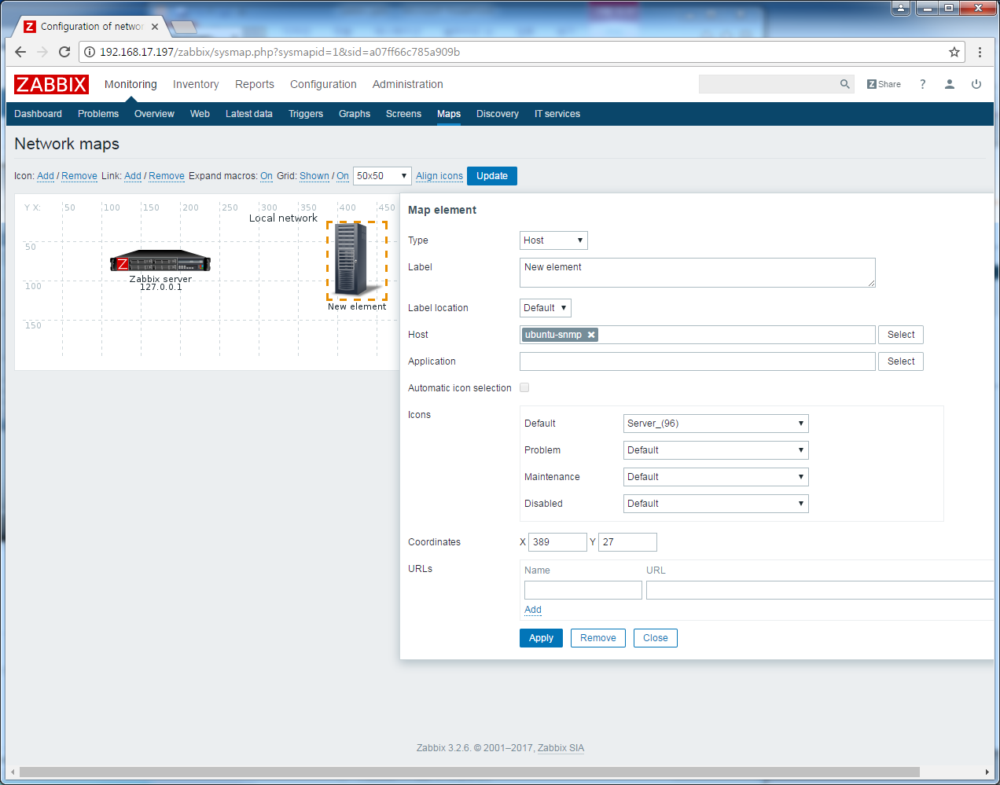
1. zabbix 서버 모니터링
1. Hosts에 Template ICMP Ping추가
2. Monitoring->Maps

Slide 20
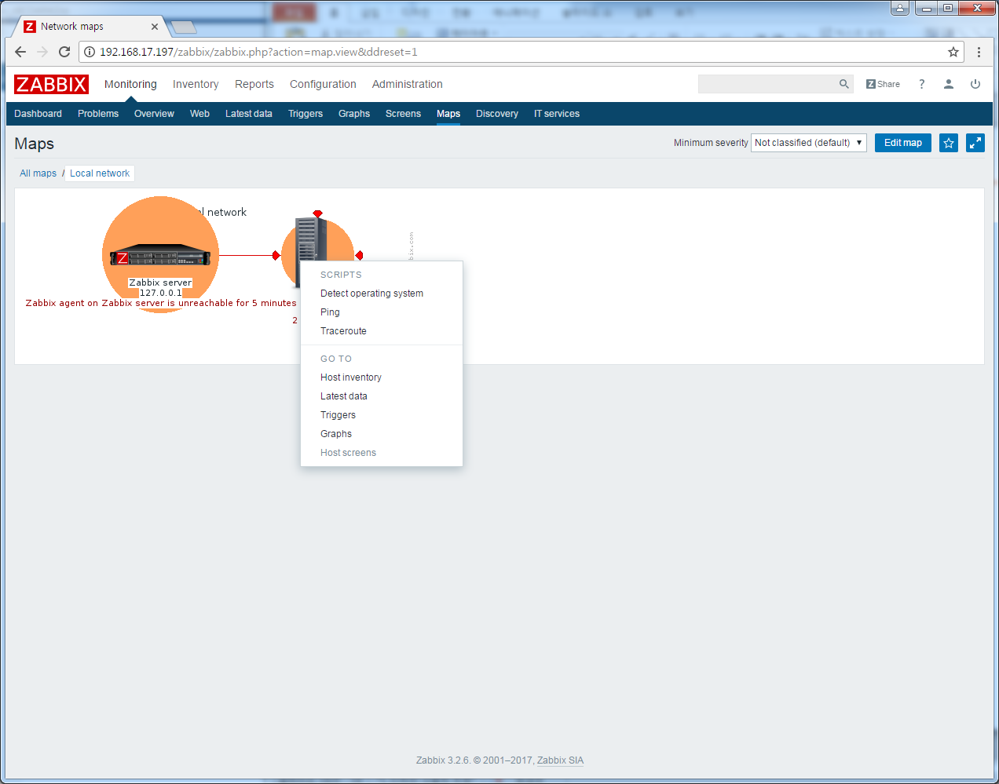
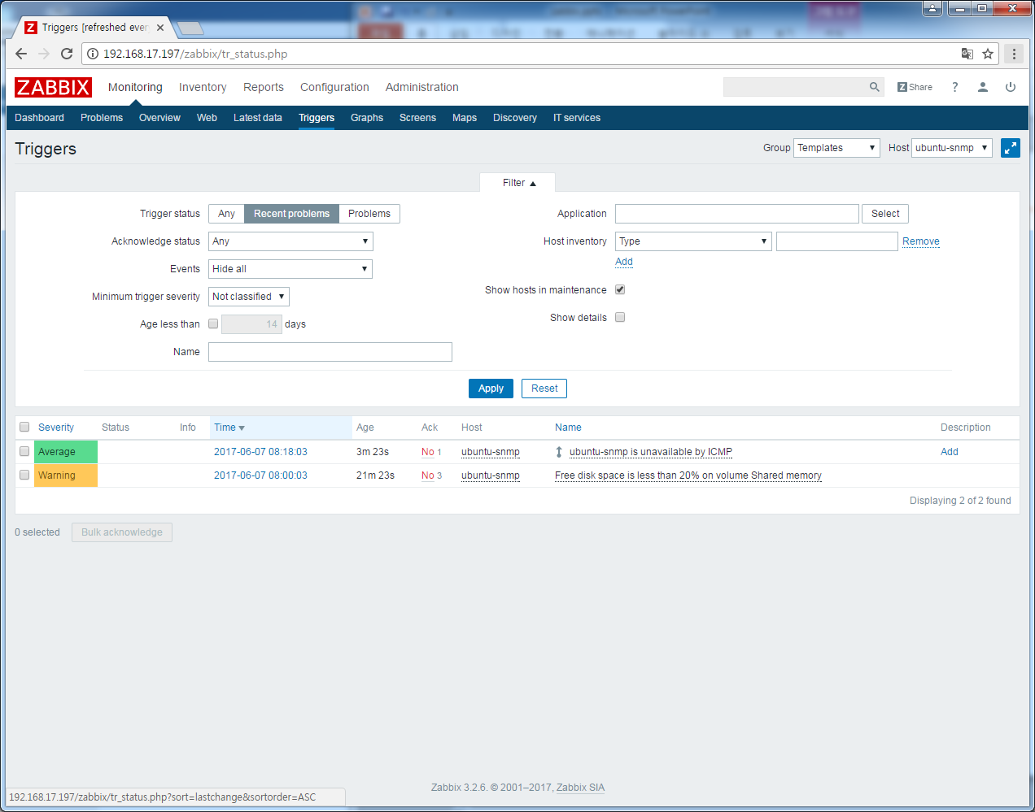
1. zabbix 서버 모니터링
1. Monitoring->Maps->Triggers

Slide 21
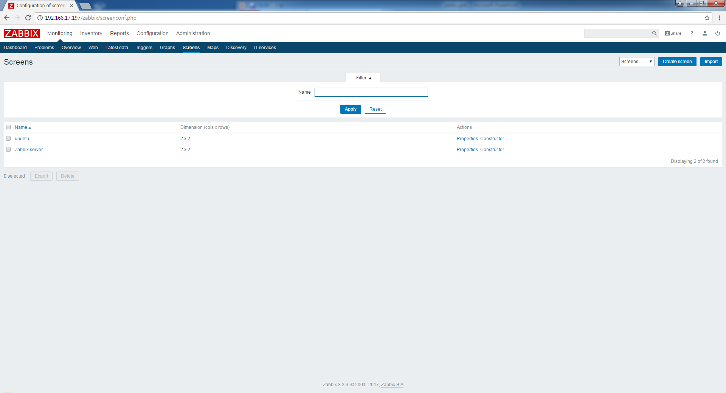
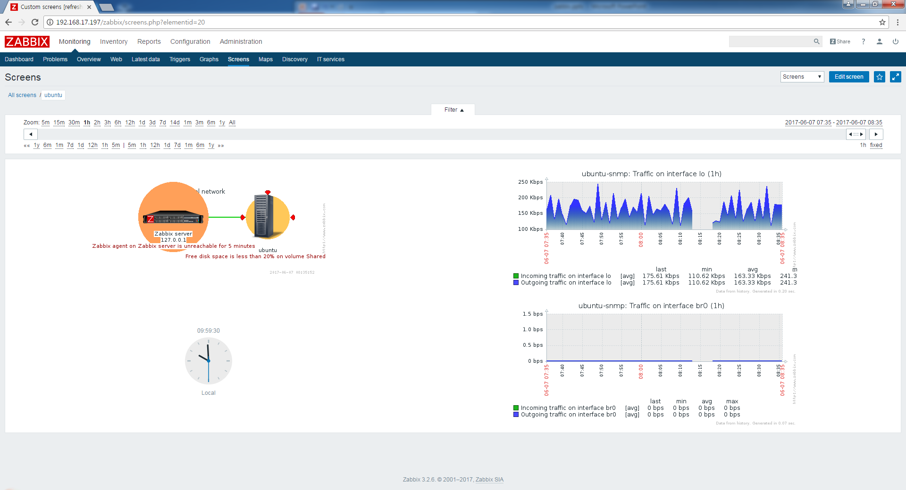
1. zabbix 서버 모니터링
1. Monitoring->Screen

Slide 22
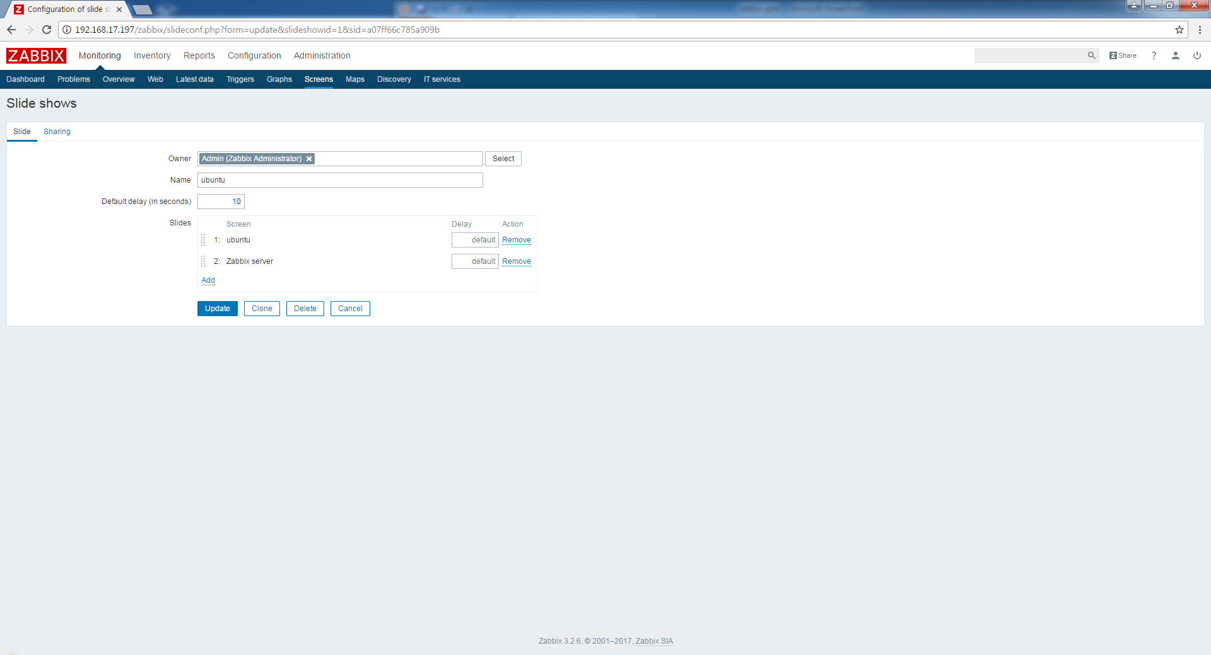
1. zabbix 서버 모니터링
1. Monitoring->Screen->Slide shows

Slide 23
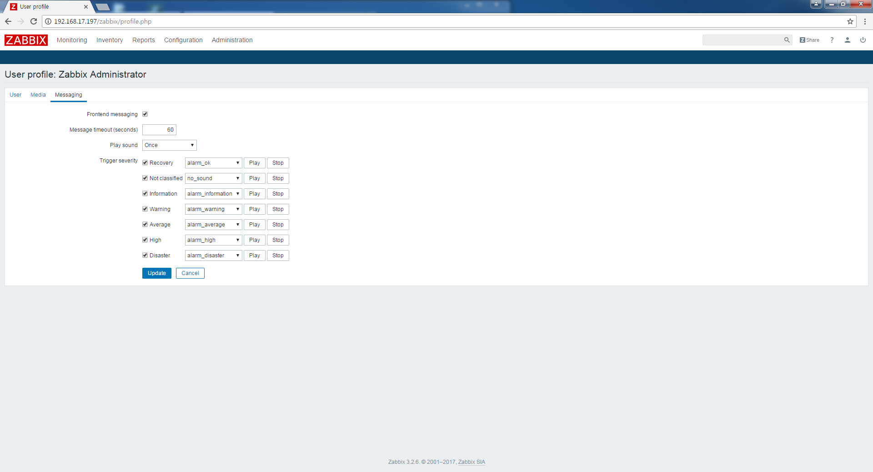
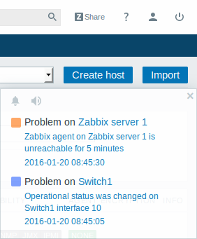
1. zabbix 서버 모니터링(사운드)
1. User profile->Messaging

