Slide 1
ATTESTLOCK · CREDITCOIN DEFI
Credit without
moving collateral
NO VALID PROOF
0
credit lines
Lock mock USDC on Sepolia.
Prove the receipt. Borrow on Creditcoin.
Attestcoin is the gate,
not a decorative oracle.
BUIDL CTC 2026 FALL
Notes:
[Sources]
- https://dorahacks.io/hackathon/buidl-ctc-2026-fall/detail (hackathon context; accessed 2026-09-03)
- https://github.com/choguun/AttestLock-Agent (product implementation; accessed 2026-09-03)
[/Sources]

Slide 2
PROBLEM → PRODUCT
Cross-chain credit has a reporting problem
TODAY
ATTESTLOCK
A bridge, oracle signer, or operator says collateral exists.
Creditcoin verifies the exact successful escrow receipt.
The reporting layer becomes part of the solvency boundary.
The asset stays on Sepolia. The line opens only after BlockProver succeeds.
02
Notes:
[Sources]
- https://docs.attestcoin.org/ (cross-chain proof model; accessed 2026-09-03)
- https://github.com/choguun/AttestLock-Agent/blob/main/docs/THREAT_MODEL.md (system boundary; accessed 2026-09-03)
[/Sources]

Slide 3
PROOF ARCHITECTURE
One proof opens one bounded line
01
02
03
04
Lock
→
Attest
→
Verify
→
Borrow
Sepolia vault emits
CollateralLocked
Wait for height;
build official proof
0x0FD2 + exact
receipt/event policy
ASC opens 50%;
user signs the draw
The worker relays proof. It cannot manufacture credit.
03
Notes:
[Sources]
- https://github.com/gluwa/attestcoin-protocol-examples (official proof ABI and dependencies; accessed 2026-09-03)
- https://docs.attestcoin.org/ (BlockProver and Proof Builder; accessed 2026-09-03)
- https://github.com/choguun/AttestLock-Agent/blob/main/docs/ATTESTCOIN.md (implemented flow; accessed 2026-09-03)
[/Sources]

Slide 4
FAIL-CLOSED CONTROLS
The safest line is the one that never opens
0
Receipt
Origin
status = 1
chainKey = 1
Event
Economics
invalid proofs
become credit
exact vault + token
≥100 mUSDC · 8d cover
Replay
Funds
query ID + lock ID
borrower signature
A junk transaction is a product demo, not just a unit test.
04
Notes:
[Sources]
- https://github.com/choguun/AttestLock-Agent/blob/main/contracts/src/creditcoin/AttestLockASC.sol (destination checks; accessed 2026-09-03)
- https://github.com/choguun/AttestLock-Agent/blob/main/contracts/src/creditcoin/CreditPool.sol (borrow authorization; accessed 2026-09-03)
[/Sources]

Slide 5
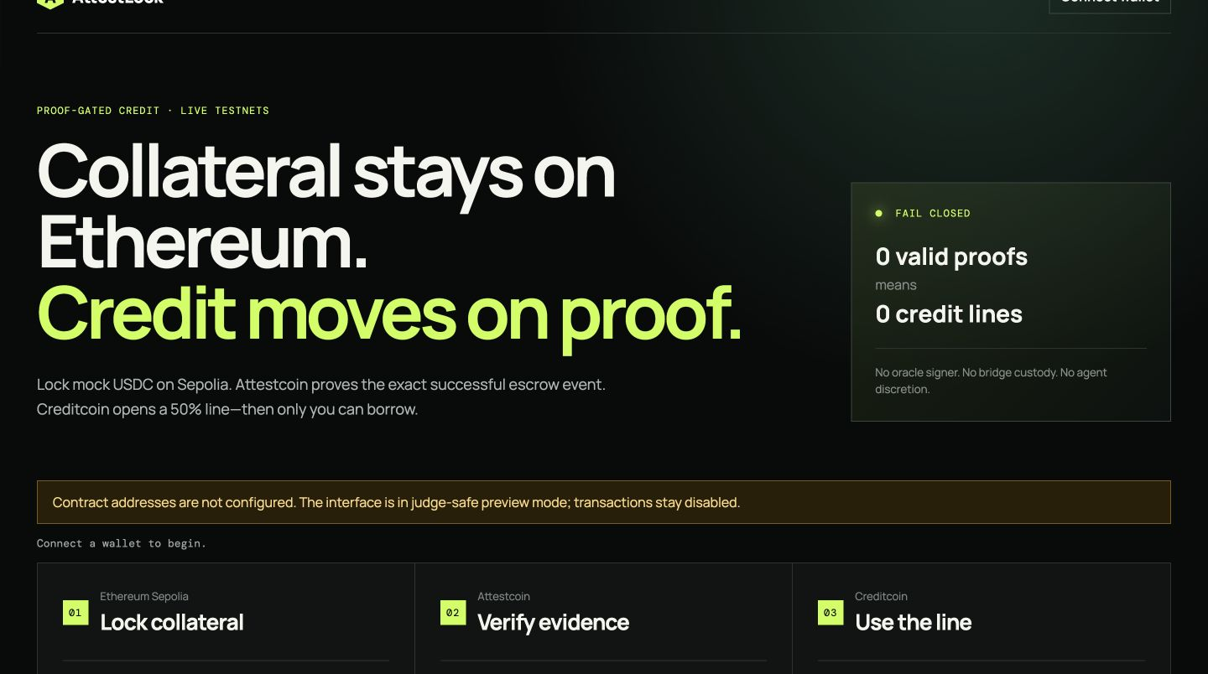
EXECUTION PROOF
Evidence is separated from what still needs gas
VERIFIED NOW
56
verified automated paths
54 unit + contract tests · 2 browser paths
94.29% line coverage · ChainInfo readiness
LIVE GATE
Verified addresses · native proof · wallet draw
Negative txs · public videos
05
Notes:
[Sources]
- https://attestlock-web-production.up.railway.app (hosted preview; accessed 2026-09-04)
- https://github.com/choguun/AttestLock-Agent/actions (automated verification surface; accessed 2026-09-04)
- https://github.com/choguun/AttestLock-Agent/blob/main/docs/EVIDENCE.md (live evidence gate; accessed 2026-09-04)
[/Sources]

Slide 6
MARKET → CREDITCOIN ECOSYSTEM
Risk teams first.
Proof-gated credit for Creditcoin.
TARGET
DISTRIBUTE
EXPAND
Lenders + risk teams
5-minute onboarding
Reusable profile
Escrow facts
without bridging
API + event schema
Integration checklist
Proof-opened footprint
Release + defaults next
Solo builder · contracts, worker, web
github.com/choguun/AttestLock-Agent
Notes:
[Sources]
- https://github.com/choguun/AttestLock-Agent/blob/main/docs/MARKET.md (target user and ecosystem value; accessed 2026-09-04)
- https://github.com/choguun/AttestLock-Agent/blob/main/docs/ONBOARDING.md (five-minute integration path; accessed 2026-09-04)
- https://github.com/choguun/AttestLock-Agent/blob/main/docs/COMPETITIVE.md (primary-source competitor matrix; accessed 2026-09-04)
- https://creditcoin.org/Credal (Creditcoin credit infrastructure strategy; accessed 2026-09-04)
[/Sources]

