Slide 1
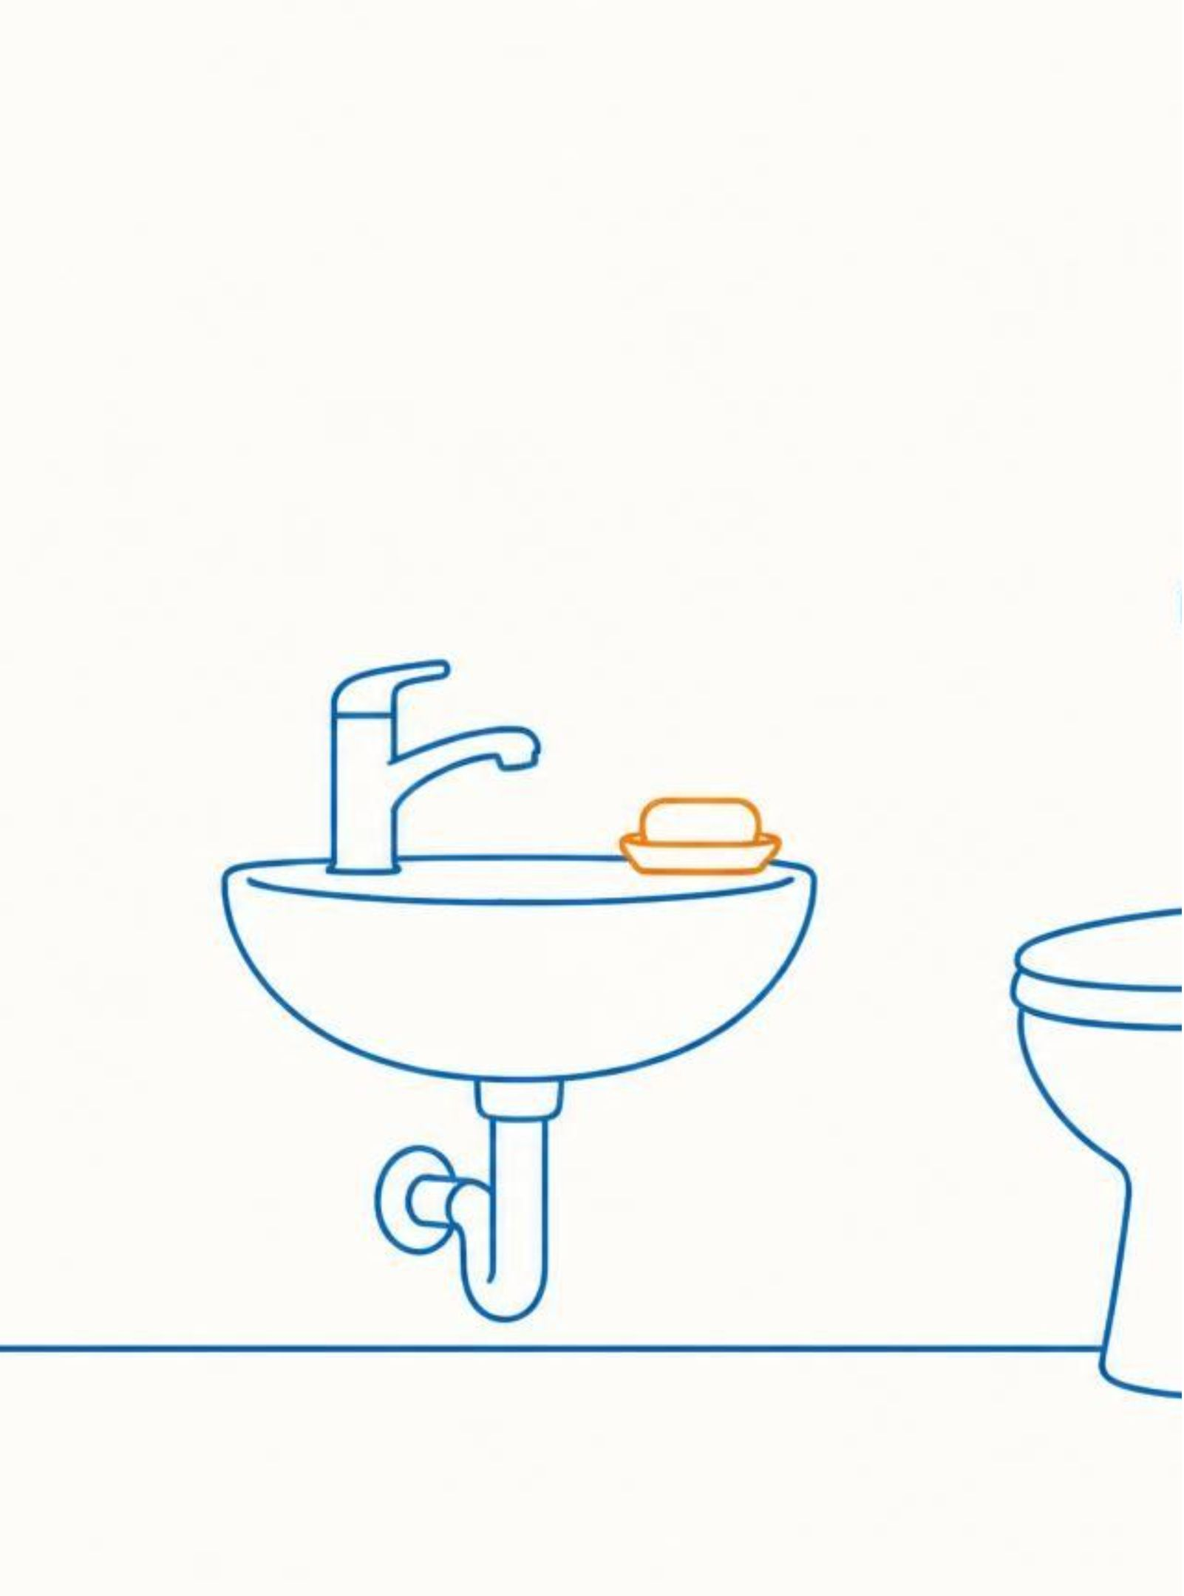
SDG 6 · EVERYDAY ACTION
CLEAN WATER
AND SANITATION
Safe water, safe toilets, and clean habits protect everyone.

Slide 2
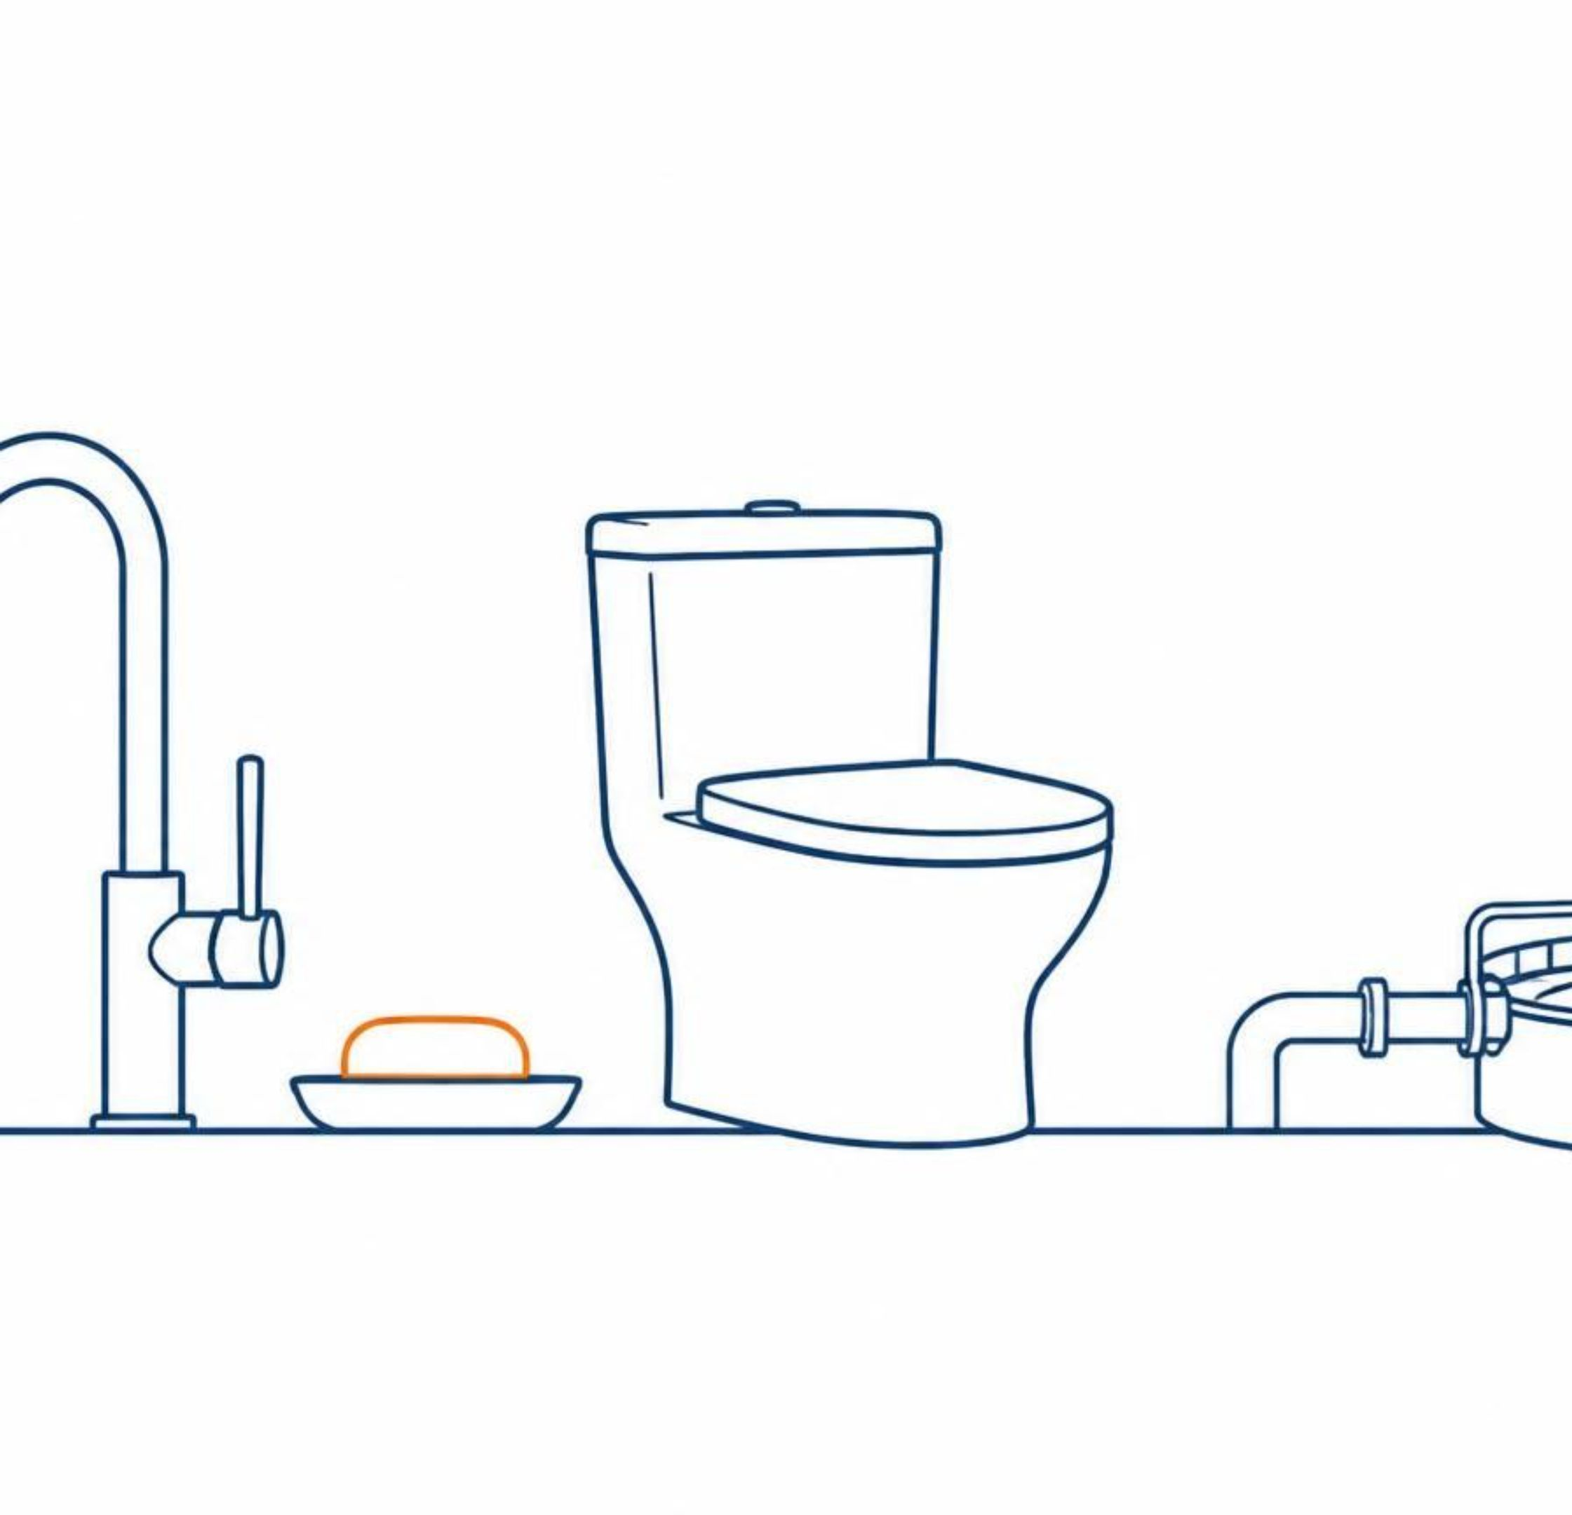
SAFE WATER AND
SANITATION PROTECT HEALTH
Clean water: Safe drinking water helps people stay healthy.
Sanitation: Safe toilets, wastewater treatment, and handwashing help prevent disease.
Global goal: United Nations Goal 6 calls for water and sanitation for all by 2030.

Slide 3
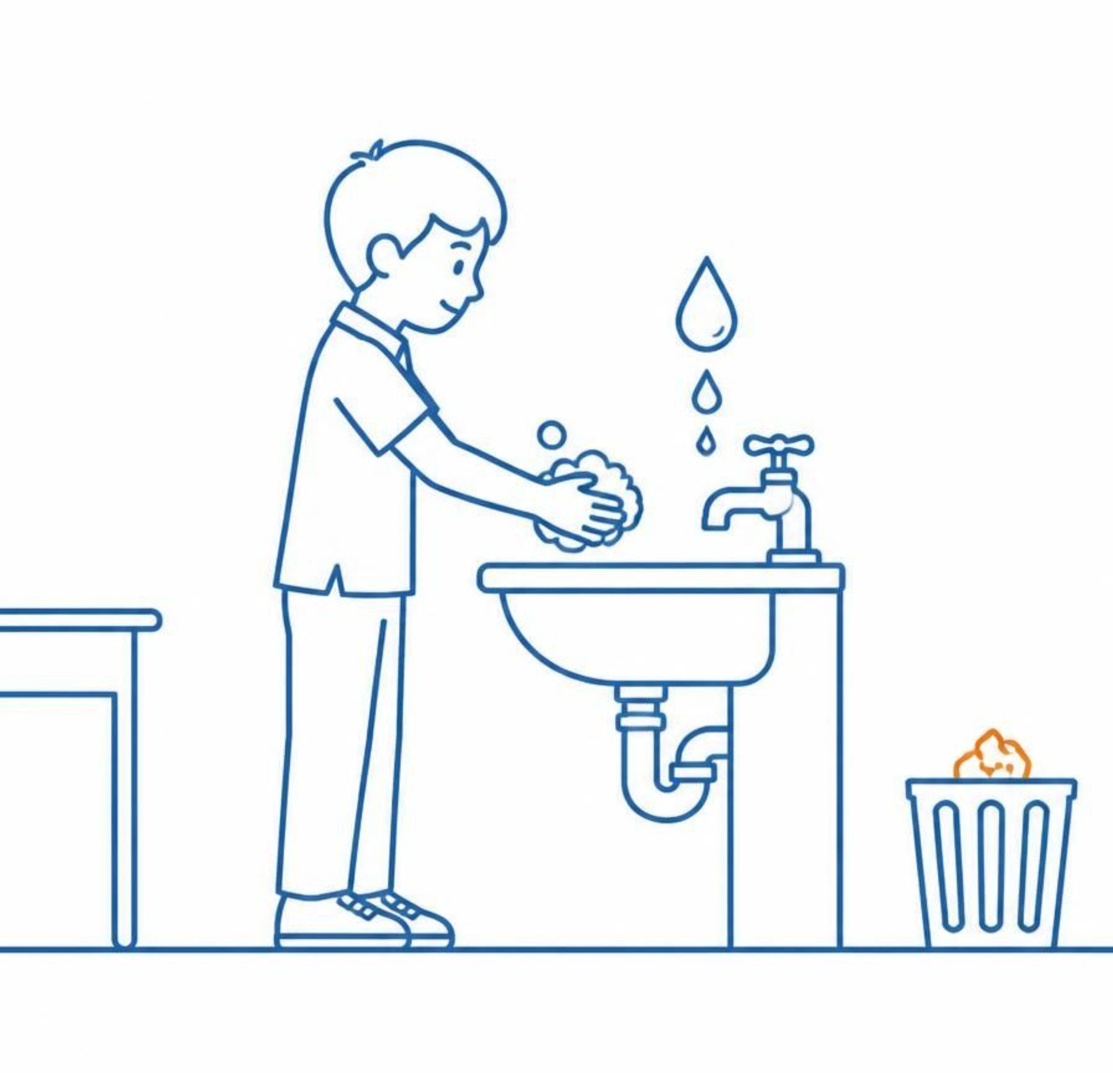
SMALL ACTIONS
MAKE A DIFFERENCE
Wash hands with soap and water.
Do not throw trash or chemicals into rivers, lakes, or drains.
Use only the water you need and report leaks.
Keep toilets clean and use them safely.
Clean water is everyone’s responsibility.

