Slide 1

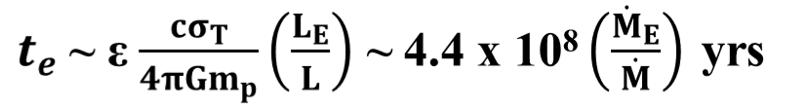
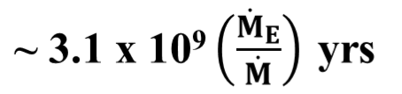





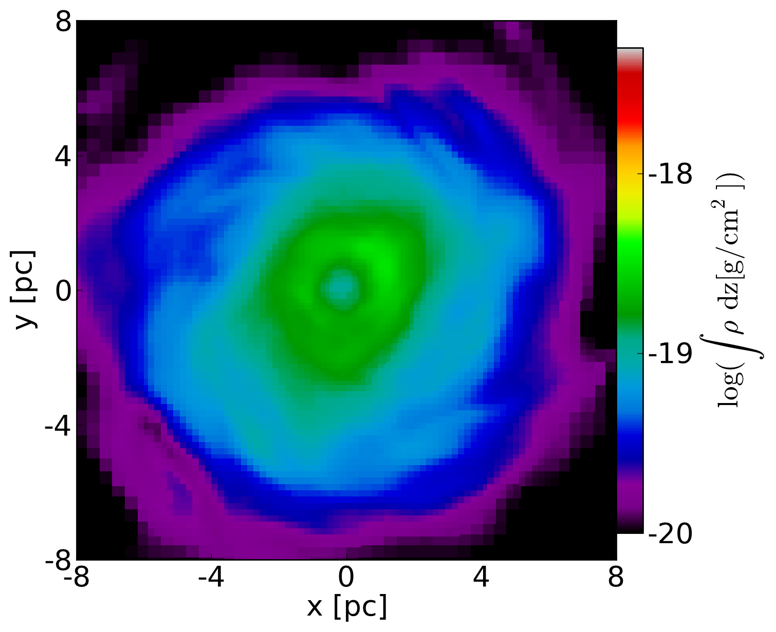
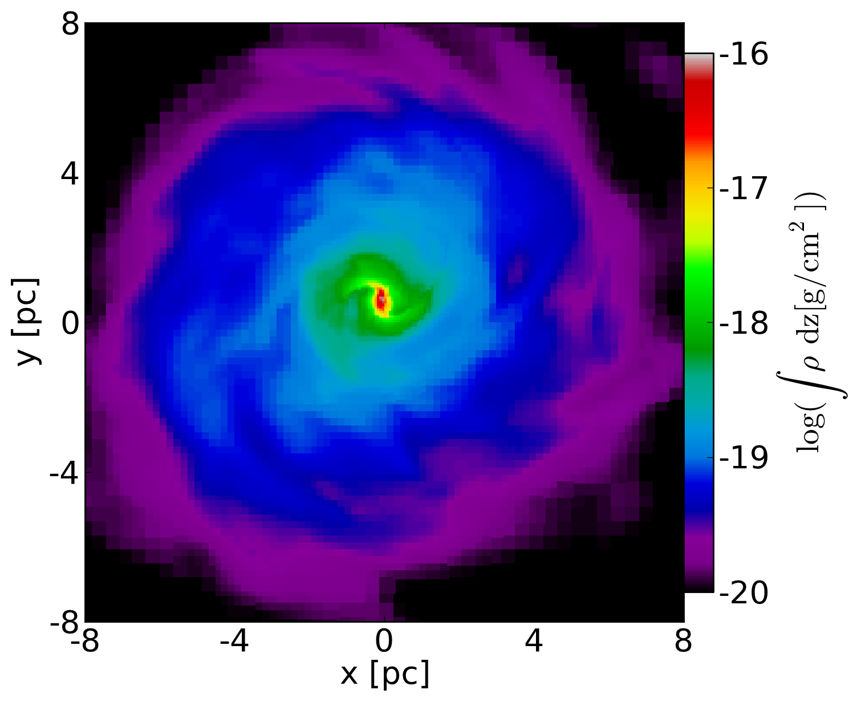


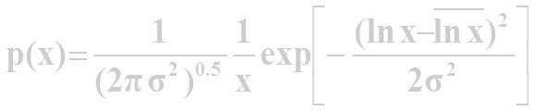




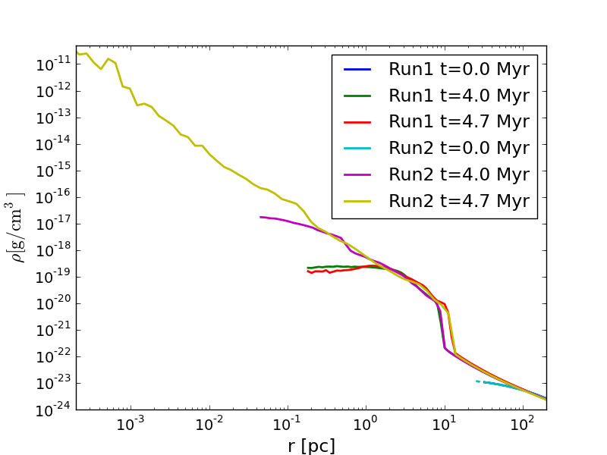
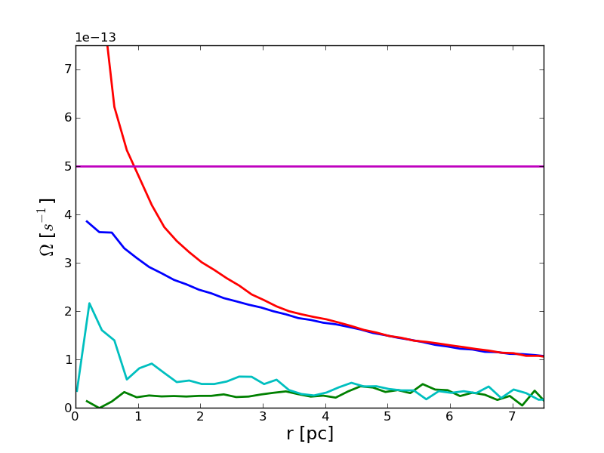
EARLY SUPERMASSIVE BLACK HOLES FROM A DIRECT COLLAPSE
Jun-Hwan Choi & Isaac Shlosman (University of Kentucky @ Lexington)
FROM POP III STARS
MONOLITHIC (DIRECT) COLLAPSE
Population III stars: M* ~ 10²⁻³M can lead to
SMBH seeds: M* ~10²M (Bromm & Loeb 2003)
If primodial gas → cooling floor
can collapse into DM halo of
T_{gas} ~10⁴K
T_{vir} > T_{gas} ~10⁴K
M_{vir} > 10⁸ M
(Begelman et al. 2006; Wise et al. 2008; Regan & Haehnelt 2009)
PITFALLS with POP III SEEDS
PITFALLS with a direct collapse to SMBHs
Pop III SMBH Seeds:
Growth by accretion/mergers from z > 20 to z~6 → to >10⁹ M
e-fold time :
(Salpeter 1964)
growth time to ~10⁹M :
Too long !! → QSOs are already observed at z~7 (<0.8Gyr)
Also, additional difficulties:
too frequent mergers lead to BH slingshot and ejection from mini-haloes
Also: BH accretion growth is limited by feedback + accretion cutoff
On the positive side:
Easy to grow by accretion/mergers from z~12-20 to z~6
From ~ 10⁶⁻⁷ M to >10⁹ M
But the gas collapse is expected to lead fragmentation and to an associated star formation, because M_{gas} > M_{J}
How to avoid fragmentation in the collapsing gas?
→ Not enough leftovers from star formation for the SMBH
Less mergers!
TURBULENCE DRIVEN by NESTED BARS CASCADE
Numerical experiments with collapsing spheres
(Begelman & Shlosman 2009
Shlosman et al. 1989,1990)
Enzo AMR simulation – Refined by Gas Density w/ non-equilibrium atomic cooling (Abel et al. 1997)
Dark Matter Halo
  Isolated isothermal sphere
  M_{vir} = 10⁸M with R_{vir} ~ 1.3 kpc
Isothermal gas sphere with 100 pc core:
  f_{gas}~0.16 and initial gas temperature is ~30,000K
  Solid body rotation in the gas core; flat rotation curve outside the gas core, assuming halo λ~0.05.
Two runs, differ only in the size of the flat density core of the DM halo:
  Run1 : ~ 2 pc DM core
  Run2: ~ 0.4 pc DM core
Gravitational collapse
Supersonic virial turbulence
J barrier
Turbulence decays
Choi & Shlosman (in prep.)
Spontaneous symmetry breaking
→ Gaseous bar
Run1
Run2
Supersonic turbulence requires continuous driving
→ nested bars cascade
Gravitational collapse resumes
Density lognormal probability distribution function (Padoan & Nordlund 2002):
where
The fraction of starforming masses f_{J} over t_{ff}:
for M ≥ 3
Mach number
Density projections for the face-on view of the gas disk forming from a collapsing sphere at t=4.7 Myr → just before the gas disk in the Run2 exhibits a runaway collapse at the center. The right panel shows that the gas disk in the Run2 forms a nested bars cascade (Shlosman et al 1989) which drives a strong mass inflow. While the gas disk in the Run2 undergoes a runaway collapse, the gas disk in the Run1 maintains its profile steady for more than 10 Myr. Both gas disks are intermittently turbulent as also noted in Regan & Haehnelt 2009, Levine et al. 2008, Wise et al. 2008.
Two alternatives in direct collapse to SMBH
Angular momentum is unimportant
→ No preferential channel of energy release (Begelman et al. 2006)
Photon trapping
→ Formation of a single accreting massive object in pressure equilibrium
→ Quasistar
→ Thermonuclear reactions
Neutrini-cooled core collapse
SMBH seed ~ 10⁴M
Angular momentum cascade dominates (Begelman & Shlosman 2009)
→ Defines preferential channel of energy release
(both mechanical and radiation)
No early photon trapping
→ Formation of a single accreting massive object supported by rotation in R and pressure in z
→ Self-gravitating ‘torus/disk’
Efficient dynamical instabilities
Possibility to circumvent thermonuclear
reactions
Runaway collapse
SMBH seed ~ 10⁶⁻⁷ M
Gas density profiles for the Run1 and Run2. The initial gas density profiles are identical. Owing to deeper DM potential, the gas disk in the Run2 has steeper mass distribution (see the profiles at t=4.0 Myr). At t=4.7 Myr, the Run2 shows a runaway collapse (strong mass inflow) driven by the nested bars, while the Run1 disk shows a marginal evolution from t=4.0 Myr to t=4.7 Myr. The critical difference is that the central density gradient is steeper in the Run2 disk.
Take away
SMBH seeds from Pop III star remnant model have
serious shortcomings.
To form SMBH seeds from direct collapse, it is
necessary to remove angular momentum while
suppressing fragmentation.
SMBH seeds with > 10⁶M can form via nested
bars cascade which drives supersonic turbulence.
Numerical simulations demonstrate that such
runaway collapse is triggered when the central
density gradient is sufficiently high.
References
Abel, T., Anninos, P., Zhang, Y., & Norman, M. L. 1997, New
Astronomy, 2, 181
Begelman, M. C., & Shlosman, I. 2009, ApJ, 702, 5L
Begelman, M. C., Volonteri, M., & Rees, M. J. 2006, MNRAS,
370, 289
Bromm, V., & Loeb, A. 2003, ApJ, 596, 34
Choi, J.-H., & Shlosman, I. in preparation
Levine, R., Gnedin, N. Y., Hamilton, A. J. S., & Kravtsov, A. V.
2008, ApJ, 678, 154
Regan, J. A., & Haehnelt, M. G. 2009, MNRAS, 396, 343
Salpeter, E. E. 1964, ApJ, 140, 797
Shlosman, I., Frank, J., & Begelman, M. C. 1989, Nature, 338, 45
Wise, J. H., Turk, M. J., & Abel, T. 2008, ApJ, 682, 745
Run2: Ω
Run2: Ω_{bar}
Rotation velocity profiles for the gas disks at t=4.7Myr.
In the Run2, Ω−κ/2 lies always below the bar pattern speed Ω_{bar}. Hence, no inner Lindblad resonance (ILR), that prevents the runaway collapse, exists here. The double ILR which exists in the Run1 (not shown here) prevents the bar instability from developing. Thus in the Run1, the disk remains stable and the inflow is quenched.
Run1: Ω
Run2: Ω−κ/2
Run1: Ω−κ/2
Turbulence driven by nested bars damps fragmentation and supports strong mass inflow → a runaway collapse that can produce massive SMBH seeds
Notes:
02/09/12

