Slide 1
JungSeok Food(Jangsung)
Supplier info
1) Business career
√ 2017y ~
2) 25y sales revenue
√ Packaged meat: 15 billion won
√ Part meat: 30 billion won
3) 25y total GMV
√ 14 billion won
6) Diversity of Packaging Types
☑ Pouch
☑ Top sealing
☑ MAP
☐ Skin
☐ Multivac
4) Operate Cate(total 34 SKU)
√ Pork(Chilled) / 33 SKU
√ Pork(Frozen) / 1 SKU
5) Other OEM
√ Cacao
7) Capacity
√ 3 t / day (66 t / month)
- Pork/Beef 3 t
√ Full capa – 4.5 t /d
√ Spare capa – 1.5 t /d
8) raw material standards(Fresh condition)
√ Pork(Chilled), 8/15d – 53.3%
√ Pork(Frozen), 129/300d – 43%
- Avg. slaughter ~ FC : 48.1%
9) raw material supply control
√ Deboning
- Use of self-deboning mate : 70 %
- Market purchase : 30 %

Slide 2
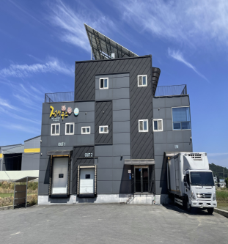
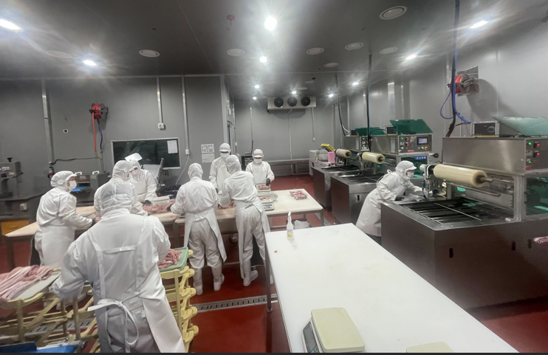
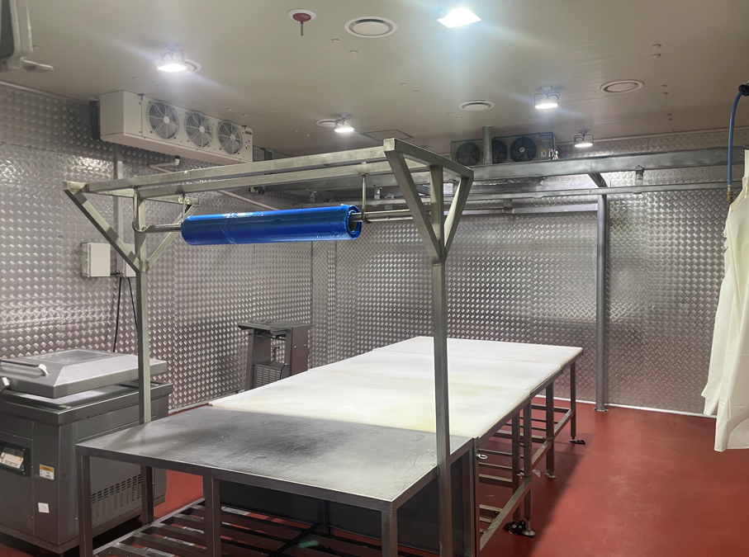
JungSeok Food(Jangsung)
Supplier info

Slide 3
JungSeok Food(Naju)
Supplier info
1) Business career
√ 2019y ~
2) 25y sales revenue
√ Packaged meat: 57 billion won
3) 25y total GMV
√ 3 billion won
4) Operate Cate(total 26 SKU)
√ Domestic Pork(Chilled) / 16 SKU
√ Domestic Pork(Chilled) / 2 SKU
√ Domestic Pork(Chilled) / 4 SKU
√ Domestic Beef(Frozen) / 4 SKU
5) Other OEM
√ Cacao
√ Mokwoocheon
√ Dongwon HomeFood
6) Diversity of Packaging Types
☑ Pouch
☑ Top sealing
☑ MAP
☑ Skin
☑ Multivac
7) Capacity
√ 5 t / day (110 t / month)
- Pork: 1.2 t /d
- Beef: 3.7 t /d
√ Full capa – 6 t /d
√ Spare capa – 1 t /d
8) raw material standards(Fresh condition)
√ Domestic Pork(Chilled), 7/15d – 46.6%
√ Domestic Pork(Chilled), 29.8/300d – 9.9%
√ Domestic Pork(Chilled), 17.8/23d – 77.4%
√ Domestic Beef(Frozen), 68.9/180d – 38.2%
- Avg. slaughter ~ FC : 43%
9) raw material supply control
√ Deboning
→ Beef
- Use of self-deboning mate : 10 %
- Market purchase : 90 %
→ Pork
- Use of self-deboning mate : 70 %
- Market purchase : 30 %

Slide 4
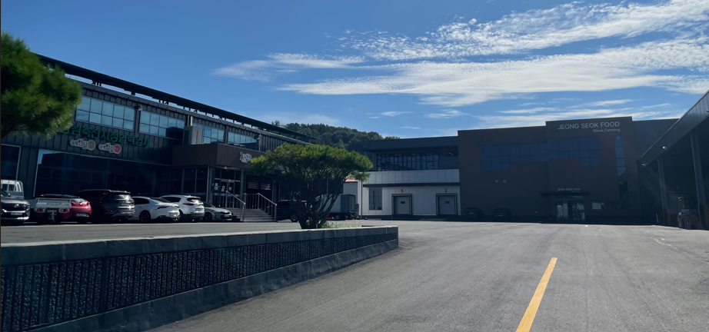
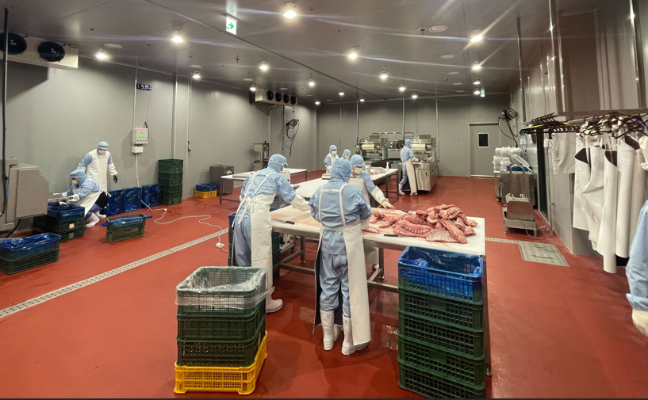
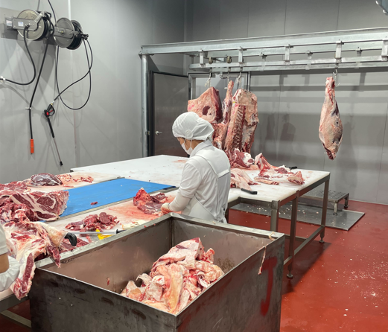
JungSeok Food(Naju)
Supplier info

Slide 5
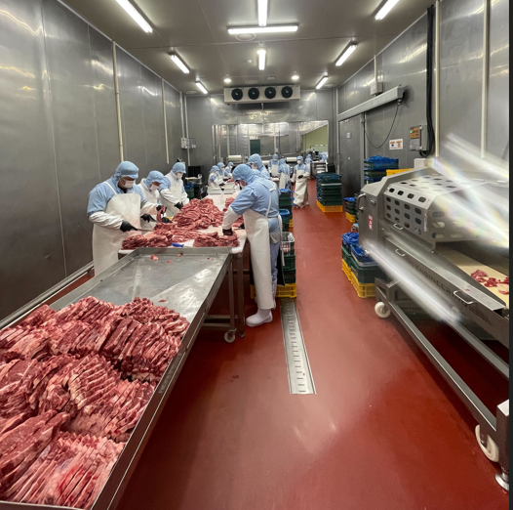
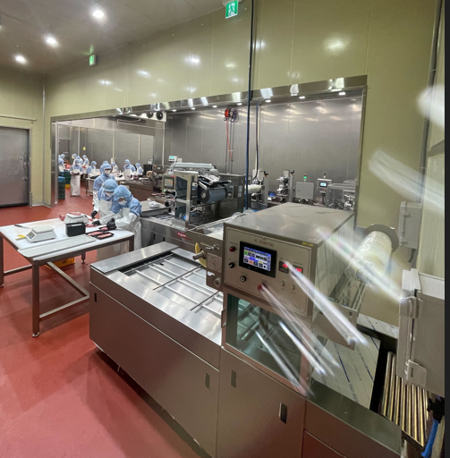
JungSeok Food(Naju)
Supplier info

Slide 6
Winners Food
Supplier info
1) Business career
√ 2020y ~
2) 25y sales revenue
√ Packaged meat: 15 billion won
√ Seasoned meat: 15 billion won
3) 25y total GMV
√ 22 billion won
- Code: Winners Food + Seoul-well Food
+ Winners Food-The Fresh
4) Operate Cate(total 42 SKU)
√ Domestic Pork(Chilled) / 4 SKU
√ Imported Pork(Chilled) / 7 SKU
√ Imported Beef(Chilled) / 12 SKU
√ Imported Beef(Frozen) / 3 SKU
√ Seasoned meat(Chilled) / 16 SKU
5) Other OEM
√ Gyunwoo food
√ E-mart(traders)
√Haesung Provision
√ CU
6) Diversity of Packaging Types
☑ Pouch
☑ Top sealing
☑ MAP
☑ Skin
☐ Multivac
7) Capacity
√ 15 t / day (330 t / month)
- Seasoned meat 5t, Pork 4t, Beef 6t
√ Full capa – 20 t /d
√ Spare capa – 5 t /d
8) raw material standards(Fresh condition)
√ Avg. slaughter ~ FC : 71.5%
- Domestic Pork(Chilled), 10.7/15d – 71%
- Imported Pork(Chilled), 41.8/45d – 93%
- Imported Beef(Chilled), 48.5/58d – 84%
- Imported Beef(Frozen), 206.7/365d – 57%
- Seasoned meat(Chilled)

Slide 7
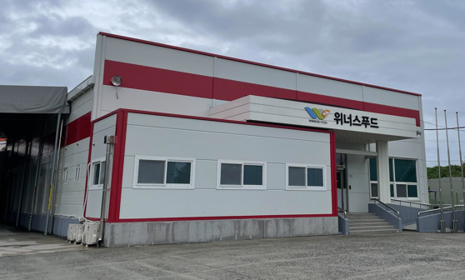
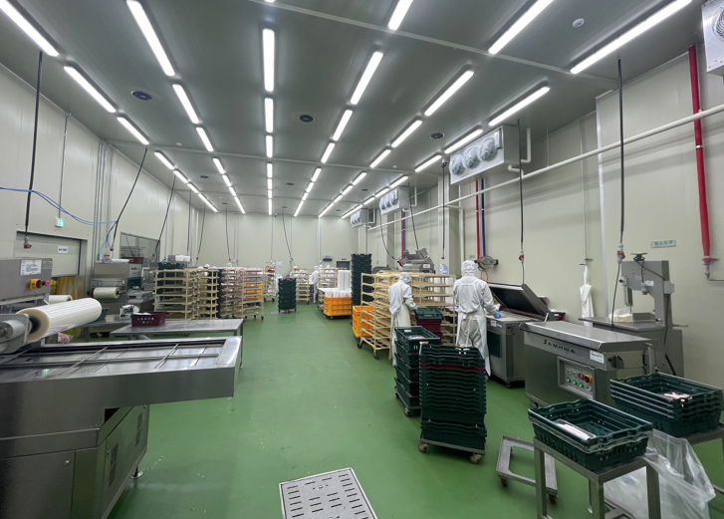
Winners Food
Supplier info

Slide 8
STF(Jincheon)
Supplier info
1) Business career
√ 2024y ~
2) 25y sales revenue
√ Packaged meat: 22 billion won
√ Seasoned meat: 8 billion won
3) 25y total GMV
√ 31 billion won
- Code: STF + The KL Farms + The KL Food
4) Operate Cate(total 56 SKU)
√ Domestic Pork(Frozen) / 4 SKU
√ Imported Pork(Frozen) / 20 SKU
√ Imported Beef(Frozen) / 20 SKU
√ Seasoned meat(Chilled) / 12 SKU
5) Other OEM
√ BaeMin(wonderful brothers)
√ Dongwon-Homefood
6) Diversity of Packaging Types
☑ Pouch
☑ Top sealing
☑ MAP
☐ Skin
☐ Multivac
7) Capacity
√ 10 t / day (220 t / month)
- Seasoned meat 2.5t, Pork/Beef 7t
√ Full capa – 15 t /d
√ Spare capa – 5 t
8) raw material standards(Fresh condition)
√ Avg. slaughter ~ FC : 33.3%
- Domestic Pork(Frozen), 24.4/300d – 8.1%
- Imported Pork(Frozen), 159.4/365d – 43.7%
- Imported Beef(Frozen), 175.2/365d – 48%
- Seasoned meat(Chilled)

Slide 9
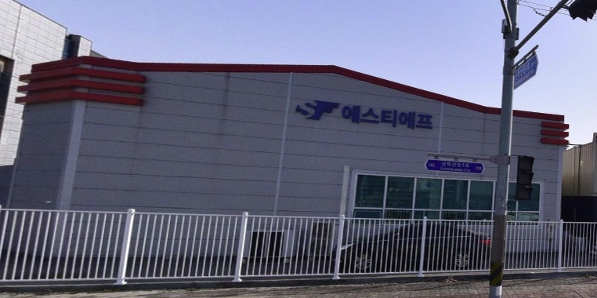
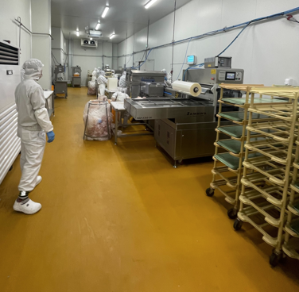
STF(JinChoen)
Supplier info

Slide 10
STF(Chungju)
Supplier info
1) Business career
√ 2025y ~
2) 25y sales revenue
√ Packaged meat: 6 billion won
3) 25y total GMV
√ 29 billion won
- Code: STF + The KL Farms
4) Operate Cate(total 44 SKU)
√ Domestic Pork(Frozen) / 4 SKU
√ Imported Pork(Frozen) / 20 SKU
√ Imported Beef(Frozen) / 20 SKU
5) Other OEM
√ CPLB only
6) Diversity of Packaging Types
☑ Pouch
☑ Top sealing
☑ MAP
☐ Skin
☐ Multivac
7) Capacity
√ 4 t / day (88 t / month)
- Pork/Beef 4t
√ Full capa – 10 t /d
√ Spare capa – 6 t /d
8) raw material standards(Fresh condition)
- Domestic Pork(Frozen), 24.4/300d – 8.1%
- Imported Pork(Frozen), 159.4/365d – 43.7%
- Imported Beef(Frozen), 175.2/365d – 48%
√ Avg. slaughter ~ FC : 33.3%

Slide 11
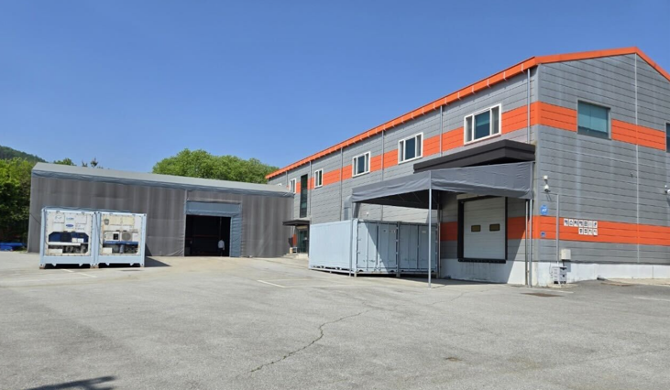
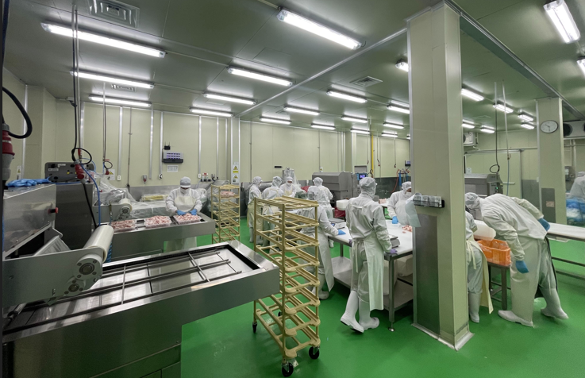
STF(Chungju)
Supplier info

Slide 12
Vendor Code
(Lee KyoLyeon)
Winners Food
Winners Food
Winners Food
-The Fresh
FC
STF
STF(Chungju)
The KL Farms
STF(Jincheon)
The KL Food
Seoul-Well Food
chilled meat supply

Slide 13
Dongwon HomeFood
Supplier info
1) Business career
√ 2021y ~
2) 25y sales revenue
√ Packaged meat: 41 billion won
√ Seasoned meat: 1 billion won
3) 25y total GMV
√ 14 billion won
5) Other OEM
√ CPLB only
6) Diversity of Packaging Types
☑ Pouch
☑ Top sealing
☑ MAP
☑ Skin
☑ Multivac
4) Operate Cate(total 18 SKU)
√ Imported Beef(Chilled) / 16 SKU
√ Imported Pork(Frozen) / 2 SKU
7) Capacity
√ 10 t / day (220 t / month)
- Pork/Beef 10t
√ Full capa – 20 t /d
√ Spare capa – 10 t /d
8) raw material standards(Fresh condition)
√ Imported Beef(Chilled), 44.5/58d – 76.7%
√ Imported Pork(Frozen) 219.5/365d – 60.1%
- Avg. slaughter ~ FC : 68.4%
9) raw material supply control
√ Importer
- Direct import : 70 %
- Market purchase : 30 %

Slide 14
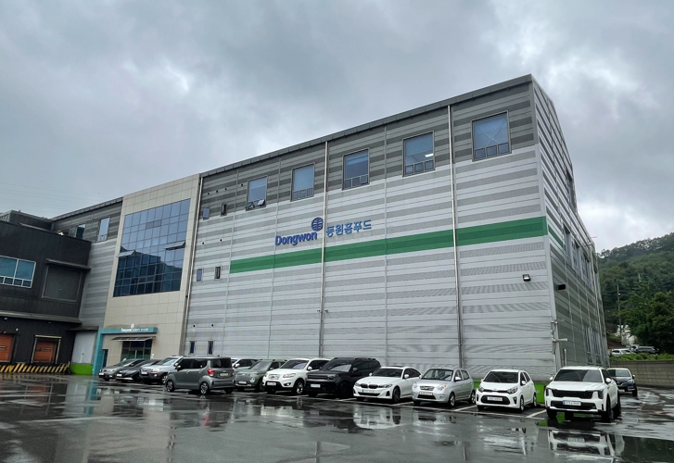
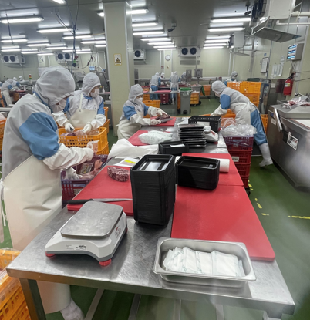
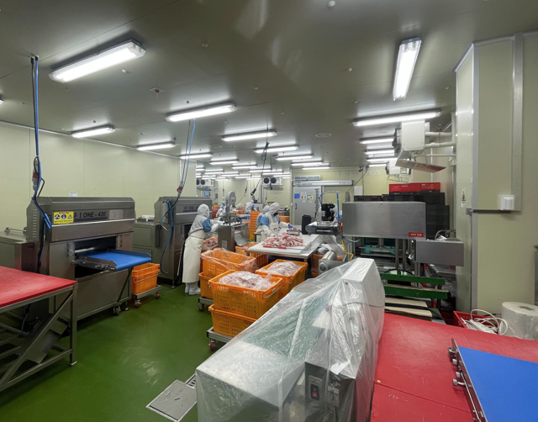
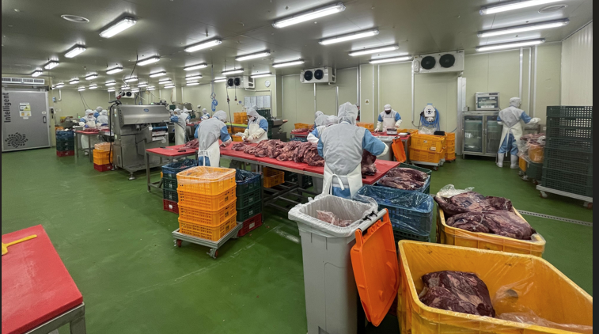
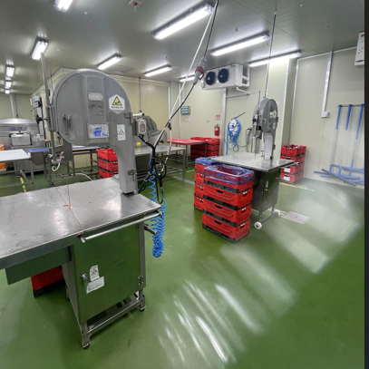
Donwon HomeFood
Supplier info

Slide 15
Code
Vendor
Manufacturing company
Lee KyoLyeon
chilled meat supply
Winners Food
Winners Food
-The Fresh
STF
The KL Farms
The KL Food
Seoul-Well Food
The KL Farms
The KL Farms
Seoul-Well Food
Winners Food
STF(Chungju, Jincheon)
STF(Jincheon)
Winners Food
√ Imported Beef(Frozen)
√ Seasoned meat(Chilled)
√ Domestic Pork(Chilled)
√ Imported Pork(Chilled)
√ Imported Beef(Chilled)
√ Imported Pork(Frozen)
√ Imported Beef(Frozen)
√ Domestic Pork(Frozen)
√ Imported Pork(Frozen)
√ Imported Beef(Frozen)
√ Seasoned meat(Chilled)
√ Imported Pork(Chilled)
√ Imported Beef(Chilled)

