Slide 1


프로젝트 진행
명지대학교 융합소프트웨어학부 교수
OMG-Korea Chair
최성운, Ph.D.

Slide 2
2023-01-04
진행
적용
BaseObject
Component
Application
ApplicationComponent
TestMain

Slide 3
Paradigm
Definition
A way of viewing the world
목적을 이루기 위해 creating a virtual world
예) 수학/물리/화학/음악/미술
Organization
현실 – 물질과 변화
System – Element/Operation
Programming Paradigm
Object-Oriented
Object/Message
Component-Based
Component/Interaction
Programming Language 종류
Procedural
Functional
Object-Oriented
Logic
a.add(b);

Slide 4
Object-Oriented vs. Component-Based Paradigm
Object-Oriented
Multiple Object Context Sharing
함수 호출 – Jump
Pointer 사용 가능
Loosely Encapsulated
Source Code/Binary
Interface
Programming Language Dependent
Compiled Unit
Link
Source Code Level에서 Compiler가 Link
Source Code Level Public Interface를 노출
Component-Based
Independent Context
Remote Interaction
RMI/Event
Data 는 공유 되지 않음
Encapsulated
Binary
Interface
Programming Language Independent
Standard Interface
Executable Unit
Link - Run-Time 환경에서 동적 Link
C1
I_C1
I_C1
C1
o1
o3
o2
o1
o2
o3

Slide 5
Interface Class
Specialization vs. Realization
Interface Class
Realized Class가 Interface 함수를 구현
표준화된 Interface 를 강제
동물
직원
MouseListener
사람
Serializable
황인종

Slide 6
Memory Manager - Variable
Data Structure
HIndexList - sorted, Ascending order
SlotList
Operation
New(), Delete();
Algorithm
New(100); => return 0
Hindex.next = 1
Head
Head
Head - 0
Hindex
Size = 64
slot
slot
Hindex0 - 0
Size = 128
0-1
1-2
2-x
Hindex
Size = 128
Hindex
Size = 256
Head
Head - 0
Hindex0 - 0
Size = 128
0-1

Slide 7
Memory Allocation
Memory Manager
New MemoryManager(totalSize, pMemoryAllocated);
1. MemoryManager 할당
2. Intialize에 정의된 Memory를 할당
Log/Exception
Slot의 구조
Data + pNext;
Memory Allocated
Memory Manager
MemoryEvent- Event
MemoryEvent- Exception
Slot
Slot

Slide 8
Operator new overloading
ClassName *pClassName = new ClassName();
void* operator new(size_t size) {
return allocate(size);
}
Char[10000] memoryAllocated;
ClassName *pClassName = new(&memoryAllocated) ClassName();
void* operator new(size_t size, char* pAllocated) {
pAllocated = size;
return pAllocated + sizeof(size_t);
}

Slide 9
Paging
Logical Address
Page Index + Offset
Operator ->/* overloading
Oversized
Undersized
Slot1 : 5 + 0
Slot2: 5 + 64
Free Page
Page1
Page2
Page3
Page5
Page7
Page5
Free Slot - 64
Slot1
Slot2
Slot3
Free Slot - 128

Slide 10
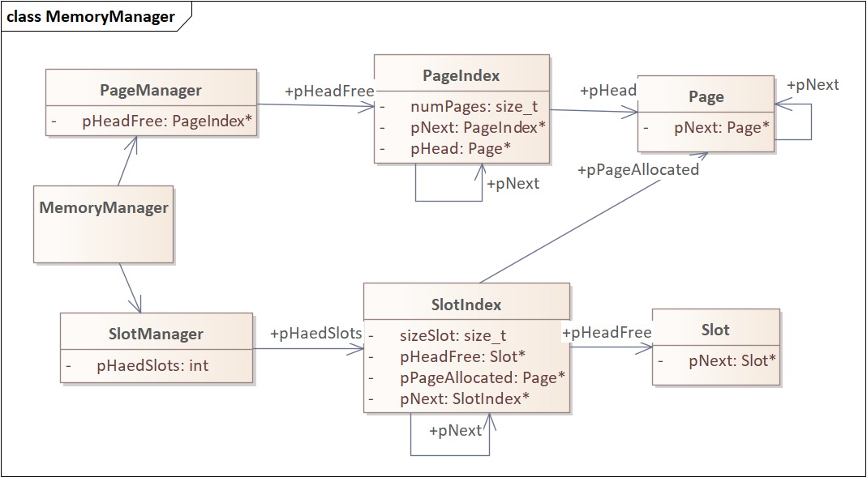
2023-01-14
Page Structure

Slide 11
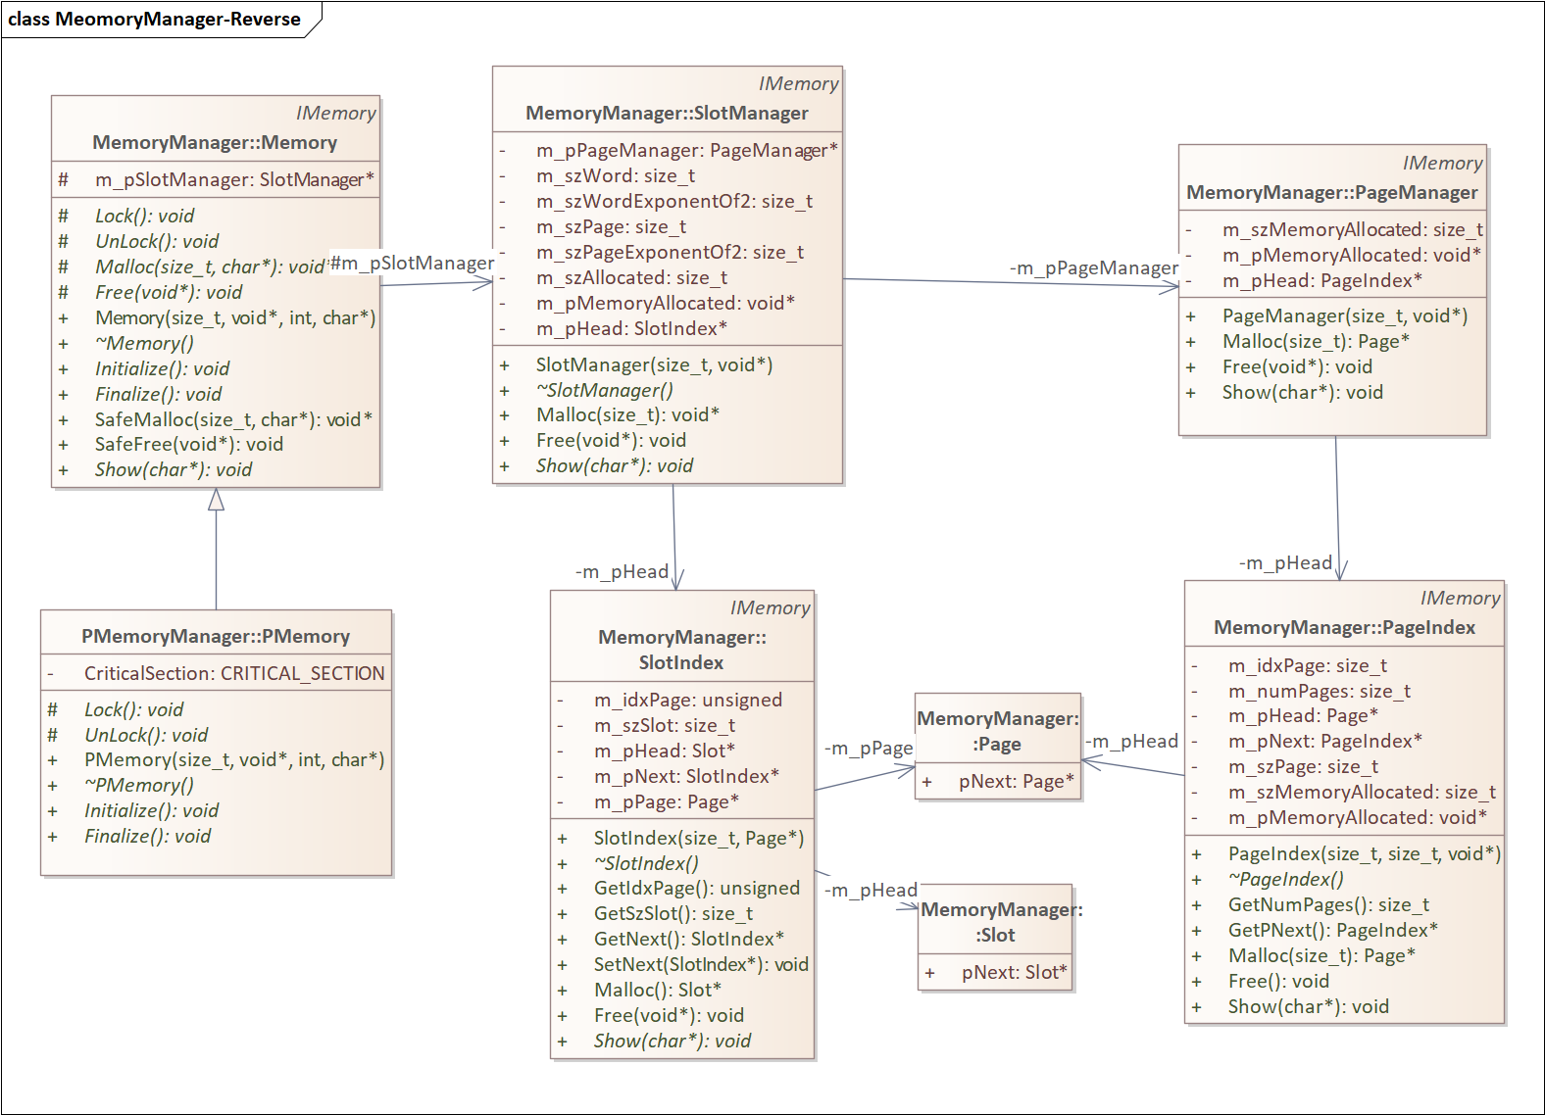

Slide 12
Page Manager
0
S
L
w
1
S
L
w
Head
Head
0
S
L
w
1
S
L
w
2
S
L
w
Head
Head
Head
0
S
L
w
1
S
L
w
2
S
L
w

Slide 13
Slot Allocation
Free
n
Head
n
n
n

Slide 14
Memory Manager
Overview
Dynamic
Relocatable – page mapping
Slot *pSlot
pSlot->
*pSlot
Separation of
System Memory
User Memory
IMemory
- new/delete
Page Manager
Page Index
Page
BaseObject
new/delete
->
Memory
pPageIndex
Slot Manager
Slot index
- index
- szSlot
Slot

Slide 15
Slot Index
Slot Index -> Multiple Page Index
Ex) Free Slot
Physical Address
2300 + 34
4500 + 23
Logical Address
0300 + (??) + 23
Slot Index : Page Index = 1:1
Page Index
- 23
Page Index
- 45
Page Index
- 31
Slot index
- lAdd
- szSlot
Slot
Logical Page No
03
Slot index
- lAdd
- szSlot
Slot index
- lAdd
- szSlot
Logical Page No
031
Logical Page No
032

Slide 16
Slot Index
SlotIndex List - pNext
Size in Ascending order
SlotIndex List – pSibling
Of the same size
Slots
Even Size
Page Index
szSlot <= szPage
szSlot > szPage
Slot index
Index
szSlot = 50
pPageIndex
Slot index
Index
szSlot = 100
pPageIndex
Slot index
Index
szSlot = 200
pPageIndex
pNext
pNext
pSibling
Slot index
Index
szSlot = 50
pPageIndex
pHead
Slot
pNext
Slot
pNext
Slot
Slot index
Index
szSlot = 50
pPageIndex
pPageIndex
Page Index
Slot index
Index
szSlot = 50
pPageIndex
pPageIndex
Page Index
pNext
Page Index
pNext
Page Index

Slide 17
SlotIndex Free

