Slide 1
Technology Presentation: Nodejs
Presented by SlackOverflow Representatives:
John Choi
Haoran Jiang
Mike McDaniel
Dominik Winecki
Notes:
Gain attention and Introduce team presenting
Gain attention- I want you to quickly think to yourselves about a scenario that some of you have may have had the pleasure to experience in life. Imagine you’re at a gas station or a grocery store and there is one person in front of you as you wait in line. Unexpectedly they remembered that they had forgotten to grab something and leave their things there as they go express shopping whilst leaving everyone in line to wait until their return to check out. There has to be a better way to handle the waiting like possibly having more than one cash register open or even something as simple as the cashier checkout out other customers while the hasty shopper is away.
There are multiple solutions to this scenario but now that I have your attention, my name is Mike McDaniel and John Choi, Randal Jian, and Dominik Winecki on the behalf of SlackOverflow team will be presenting our teams technology presentation covering node.js

Slide 2
Learning Objectives
Enabling Learning Objectives
Node.js architecture and what about it that makes it a popular tool and solution to industry problems
Advantages and disadvantages of node.js
Terminal Learning Objectives
Node.js history and usage in industry
Better understanding of how and why node.js is widely used in industry
Notes:
Elaborate on what ELO’s and TLO’s then describe expectations
Some of you may have never heard about enabling or terminal learning objectives before. The difference between the two being that enabling learning objectives are what we as a team expect the audience to be able to take information that we present and be able to answer a question based upon that information and is almost imperative to understand to accomplish the terminal learning objective. A Terminal learning objective is something that we as a team expect the audience will be able to take away from this presentation
Then read the slide

Slide 3
Overview
Node.js description and history
Node.js Architecture
V8 Chrome Engine and Node.js
Node.js in Industry and Advantages/Disadvantages
Node Package Manager
Deno and Other Solutions
Notes:
Sequence of events to occur based upon ordering of the list

Slide 4
What is Node.js?
Server-side platform built on Chrome’s JavaScript runtime
Node.js was created in 2009 by Ryan Dahl
Easily implements scalable network and server applications
Source: [1]
Notes:
Make mention of how the world wide web is about 32 years old and node.js being 11 years old so has been around for about ⅓ of the launch of the internet

Slide 5
What is Node.js?
Open source and cross platform
Works on macOS, Microsoft Windows, and Linux.
Provides rich JavaScript libraries to implement
Source: [1]

Slide 6
Some Features of Node.js
Asynchronous and event driven
Fast execution time
Single threaded and highly scalable
No buffering
Source: [1]
Notes:
Asynchronous and event driven-
All APIs of Node.js library are asynchronous, that is, non-blocking. It essentially means a Node.js based server never waits for an API to return data. The server moves to the next API after calling it and a notification mechanism of Events of Node.js helps the server to get a response from the previous API call.
Fast execution time-
Being built on Google Chrome's V8 JavaScript Engine, Node.js library is very fast in code execution.
Single threaded and highly scalable-
Node.js uses a single threaded model with event looping. Event mechanism helps the server to respond in a non-blocking way and makes the server highly scalable as opposed to traditional servers which create limited threads to handle requests. Node.js uses a single threaded program and the same program can provide service to a much larger number of requests than traditional servers like Apache HTTP Server.
No buffering-
Node.js applications never buffer any data. These applications simply output the data in chunks.
Source: [1]

Slide 7
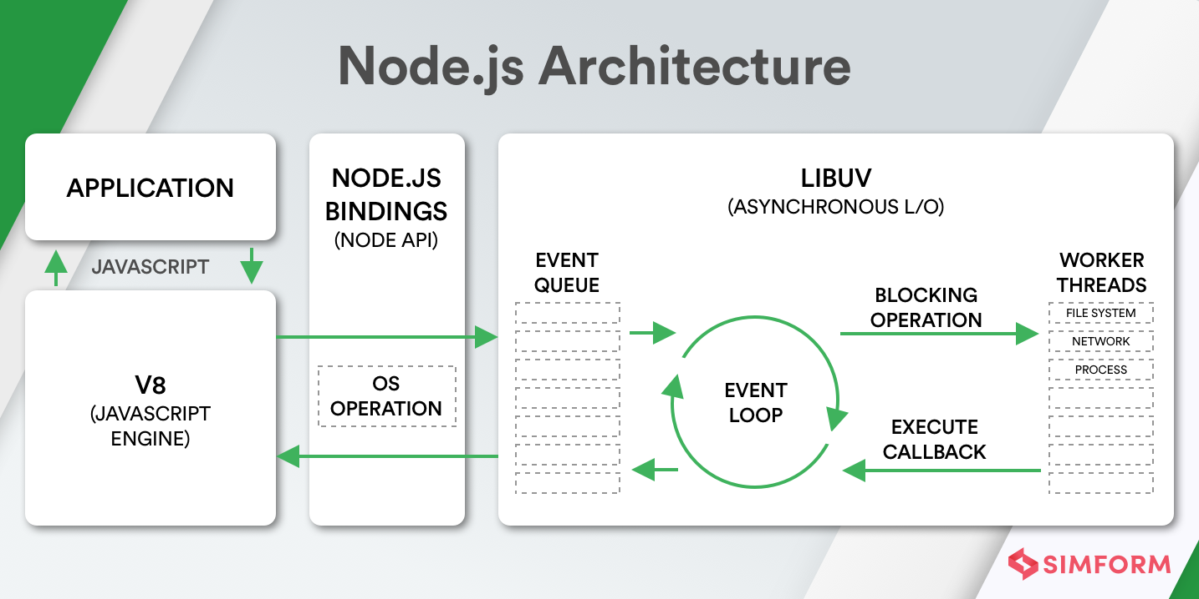
Node.js Architecture
Source: [2]
Notes:
Example of what Node.js architecture looks like under the hood

Slide 8
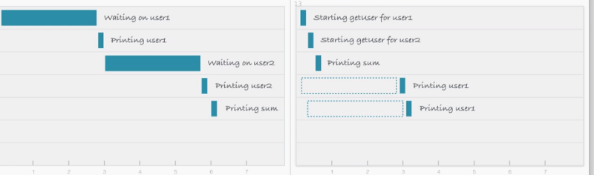
Node.js Architecture
Node.js implements non-blocking I/O
By using non-blocking I/O multiple concurrent jobs from different users can be accomplished with single threads because the node.js server can handle multiple requests
Source: [3]
Notes:
Example of multi threading and I/O blocking on left, single thread and non-I/O blocking on the right

Slide 9
Node.js Architecture
Node.js is event driven which means it can be asynchronous
Events can be handled in a plethora of ways using event emitters and event handlers
Single threaded event loop
Source: [2]
Notes:
Node.js runs over Google’s V8 Javascript engine, where web applications are event-based in an asynchronous manner. Node.js platform uses a “single-threaded event loop.”

Slide 10
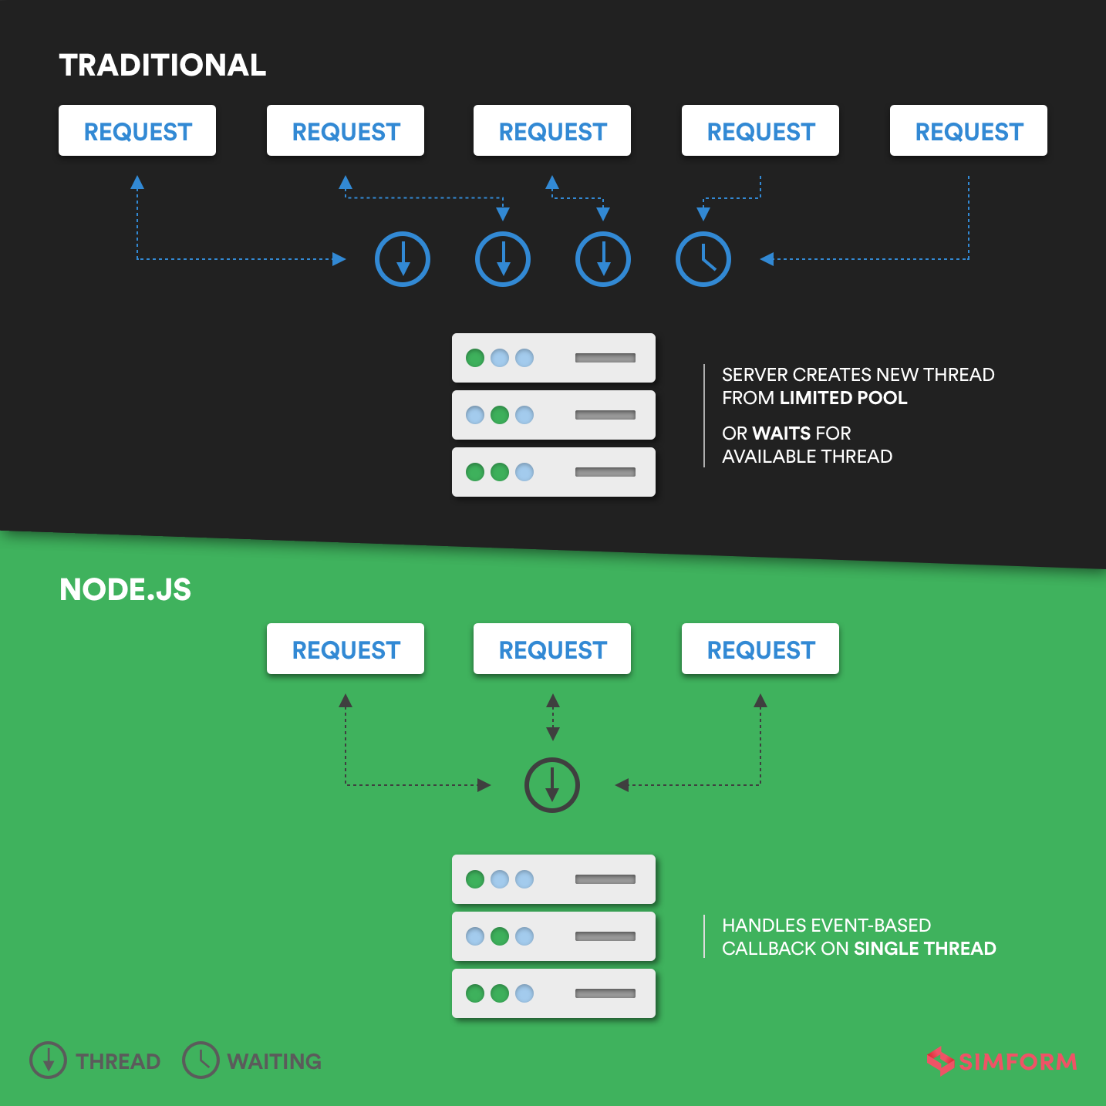
Node.js Architecture
Source: [2]
Notes:
Example of how threads were handled in a traditional vs node.js manner. By implementing the use of the server, we can handle single threads instead of multiple threads in the past.

Slide 11
Question For The Audience
Why do you think Node.JS is a competitive service compared to other services despite having only single thread to run everything?
Answer: Non-blocking I/O feature and event-loop handling
Notes:
Question should go in this slide
It should correspond with the Enabling learning objective defined in slide 2

Slide 12
V8 Engine
V8 Engine is an open-source JavaScript engine build using C++.V8 to Java script is more like Oracle JRE to Java
As a JavaScript engine, V8 was originally used in Google Chrome browser. It was released and open source with the first release of chrome. Now it has many other users besides chrome. Such as nodejs, Deno,etc.
Unlike the traditional “compile parse execute” process, V8 is more like a hybrid system. First, it interprets, and if necessary switch to a JIT.
Source: [9]

Slide 13
Ignition Interpreter
Although V8 engine has lots of advantages, however, the code is initially compiled by a baseline compiler, which generate non-optimized machine code. What’s more, even if the code is only executed only once, the JITed machine code can consume a significant amount of memory.
Based on this, Ignition was designed to reduce the memory footprint of mobile devices. Previously, code generated by the full CodeGen benchmark compiler takes up almost one-third of Chrome browser's heap memory. This leaves little memory space for the actual data of the application
Source: [10]

Slide 14
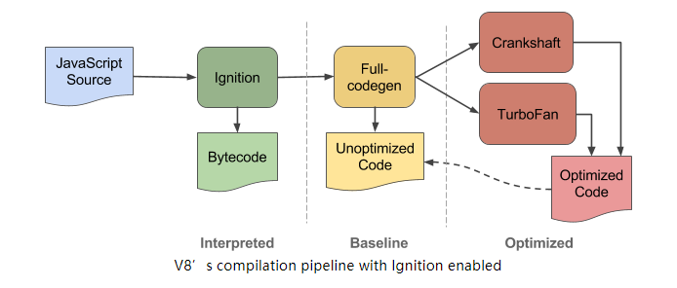
Ignition Interpreter Using TurboFan
TurboFan is a new optimizing compiler, that “creates optimal interaction with the V8 runtime engine and other generated code”.
“The Ignition interpreter uses TurboFan’s low-level, architecture-independent macro-assembly instructions to generate bytecode handlers for each opcode.”
Turbofan compiles instructions into the target architecture, in which low-level instruction selection and machine register allocation are performed.
Source: [10]

Slide 15
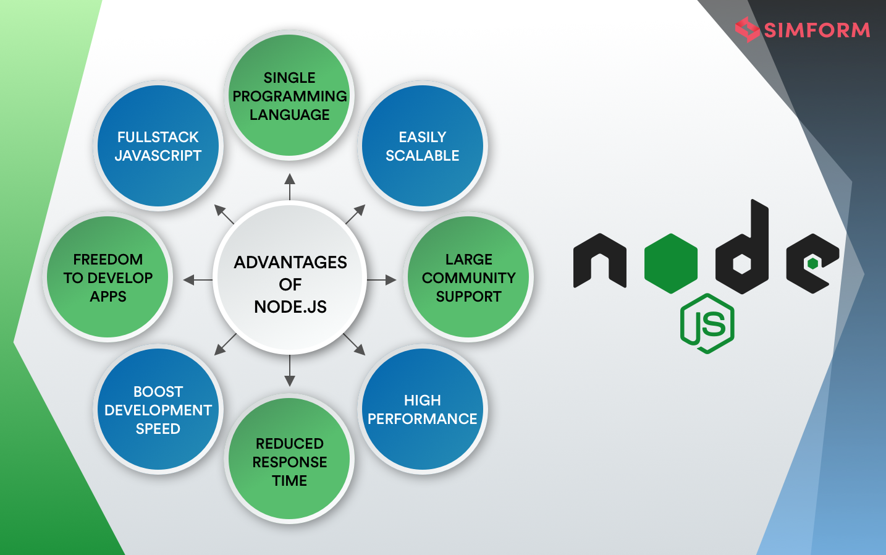
Node.js advantages
Source:[2]
Notes:
Scalability: Node.js applications are easily scalable, vertically and horizontal. While vertical scaling lets you add more resources to the current nodes, horizontal scaling enables you to add new nodes quicker.
High Performance: Node.js runs on Google V8 JS engine that complies with Javascript code directly into the machine code. This makes it resource efficient as well as accelerates the framework’s speed. In fact, Google themselves invest heavily in their search engine to consistently improve their performance.
Large Community Support: Established in 2015, Node.js Foundation is an impressive group of founders from leading enterprises such as IBM, Microsoft, Fidelity, and SAP.
Boosts Development Speed: Node.js allows you developers to accelerate the web app development process with its lightweight and varied tools.
Freedom to Develop Apps: Developers working with Node.js get the freedom to develop cross-platform apps.
Single Programming Language: Node.js offers a cocktail of similar languages on front-end and back-end Javascript.
Contribution to Fullstack & MEANstack: Node.js has proven its potential and is a part of a robust tech stack with Javascript being the undisputed leader amongst leading programming languages
Rich Ecosystem: When it comes to the simplicity and richness of Node.js, npm is the only word that comes to your mind. Did you know? npm has 836,000 libraries

Slide 16
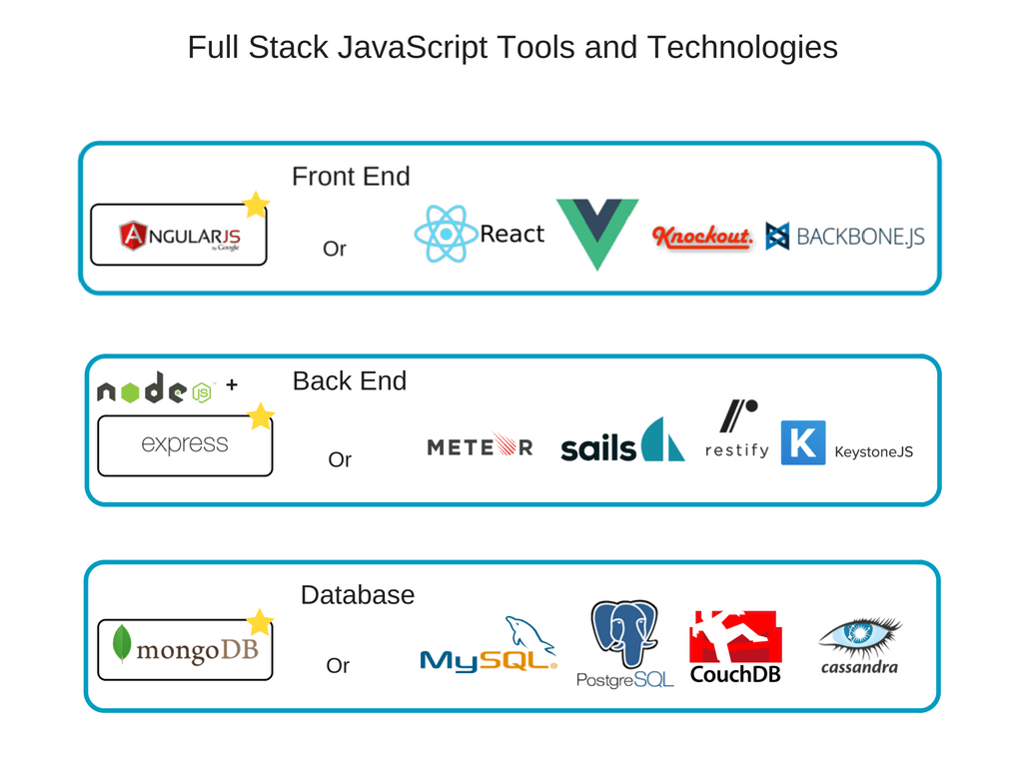
Node.js Advantages
Source: [4]
Notes:
Example of the flexibility of node.js because of the ability to program a full stack. This can lead to a robust solution for a multitude of problems say something bad about mongoDB

Slide 17
Node.js Used Heavily in Industry
The Node.js foundation claimed in 2015 that 98% of fortune 500 companies use Node regularly [5]
Netflix, Uber, and LinkedIn have used node.js to improve user performance [4]
Notes:
Netflix: With over 130 million subscribers and one billion hours of weekly data streaming, Netflix was looking for a scalable solution that could enable it to handle multiple requests simultaneously. They also built a Single page application that significantly decreased its start-up time. This resulted in an overall reduction of the start-up time– from 40 min to under 60 seconds.
LinkedIn: Back in 2016, LinkedIn had around 63 million members out of which 59% interacted with their mobile app. To handle the increase in users, LinkedIn picked Node.js that enabled it to boost their performance by 20x times in some cases. What’s more, they were able to reduce servers from 30 to 3, lower memory overhead, and draw their focus on application development instead of troubleshooting.
Uber:
Uber is one of those first 3 companies who dived into Node.js in the full production stage. It required a high-speed and scalable application, but at the same time a cross-platform tech solution that could manage a colossal amount of requests. They needed a tech solution that could match multiple riders to their drivers in fractions of seconds.

Slide 18
Node.js Disadvantages
Bottlenecks occur with heavy CPU computation
“Callback Hell” issues, since node.js is asynchronous in nature, the developer is responsible for dealing with each callback and lack of standardization can make code hard to read
Immature tooling, the Node Package Manager contains many open source repositories that offer unique solutions to problems but a problem arises as not all libraries work well with others
Source: [4]

Slide 19
Question For The Audience
Can you think of some advantages and disadvantages to using node.js?
Advantages
IO Scalability
High Performance
Large Community Support
Boosts Development Speed
Freedom to Develop Apps
Single Programming Language
Contribution to Fullstack
Rich Ecosystem with NPM
Source: [2]
Disadvantages
Bottlenecks with heavy CPU computation
“Callback Hell”
Immature tooling
Source: [4]
Notes:
Quickly reiterate points from lecture earlier

Slide 20
Node Package Manager
NPM is the world's largest JavaScript software registry, and the world's largest software registry of any language
Has automatic package vulnerability disclosure
Good tooling and security relative to its size and number of dependencies
Source: [6]
Notes:
Registering to share code would be a necessity to help curb the submission of malicious code in a open-sourced platform

Slide 21
The Modern Alternative: Deno
By the same creator as NodeJS
Sandboxed by default
Bindings written in memory-safe language Rust
Import over HTTP approach
Top-level-await support
Closely follows mainline V8
Full TypeScript support (including dependencies!)
Source: [7]
Notes:
Registering to share code would be a necessity to help curb the submission of malicious code in a open-sourced platform

Slide 22
Non-JavaScript Alternatives
Go
Made by Google
Write blocking-looking code that runs like async code*
Handles 100k+ goroutines/”threads” at once
Compiled, C-like speed (Since it shares a creator with C)
Python
Large async ecosystem, really similar to Node
Massively used in industry webapps
Java/Kotlin
Massive community, long history
C#/ASP
Microsoft’s offering
Quite good coroutines
Ruby and PHP
Losing popularity, unnecessary complexity, but alternatives nonetheless
Notes:
Registering to share code would be a necessity to help curb the submission of malicious code in a open-sourced platform

Slide 23
Summary
Node.js description and history
Node.js Architecture
V8 Chrome Engine and Node.js
Node.js in Industry and Advantages/Disadvantages
Node Package Manager
Deno and Other Solutions

Slide 24
Conclusion
Node.js is still extremely popular and heavily used in industry today
NPM is massive and node.js has a robust community of followers
There are alternative platforms that accomplish the same tasks in a more secure manner more efficiently
Frankenstein's Monster?

Slide 25
Questions?

Slide 26
Sources
https://www.tutorialspoint.com/nodejs/nodejs_introduction.htm [1]
https://www.simform.com/what-is-node-js [2]
https://www.freecodecamp.org/news/what-exactly-is-node-js-ae36e97449f5/ [3]
https://www.altexsoft.com/blog/engineering/the-good-and-the-bad-of-node-js-web-app-development/ [4]
https://nodejs.org/en/blog/announcements/foundation-advances-growth/#:~:text=With%20Node.,and%20Uber%20are%20using%20Node. [5]
https://docs.npmjs.com/about-npm [6]
Source: https://deno.land [7]
https://www.infoq.com/news/2019/03/rust-npm-performance/ [8]
https://en.wikipedia.org/wiki/V8_(JavaScript_engine)#Usage [9]
https://v8.dev/blog/ignition-interpreter[10]

