Slide 1

CU your music curation.

Slide 2
1.Why?
2.How?
3.Detail
CU your music curation.

Slide 3
Why?
CU your music curation.

Slide 4
음악 추천 서비스 = Curation
내가 좋아하는 음악과
비슷한 음악은 어떤 것이 있을까?
“ “
CU your music curation.

Slide 5
How?
CU your music curation.

Slide 6
“User”
+
“Music”
+
“Like”
+
“Music Player”
CU your music curation.

Slide 7
Detail
CU your music curation.

Slide 8
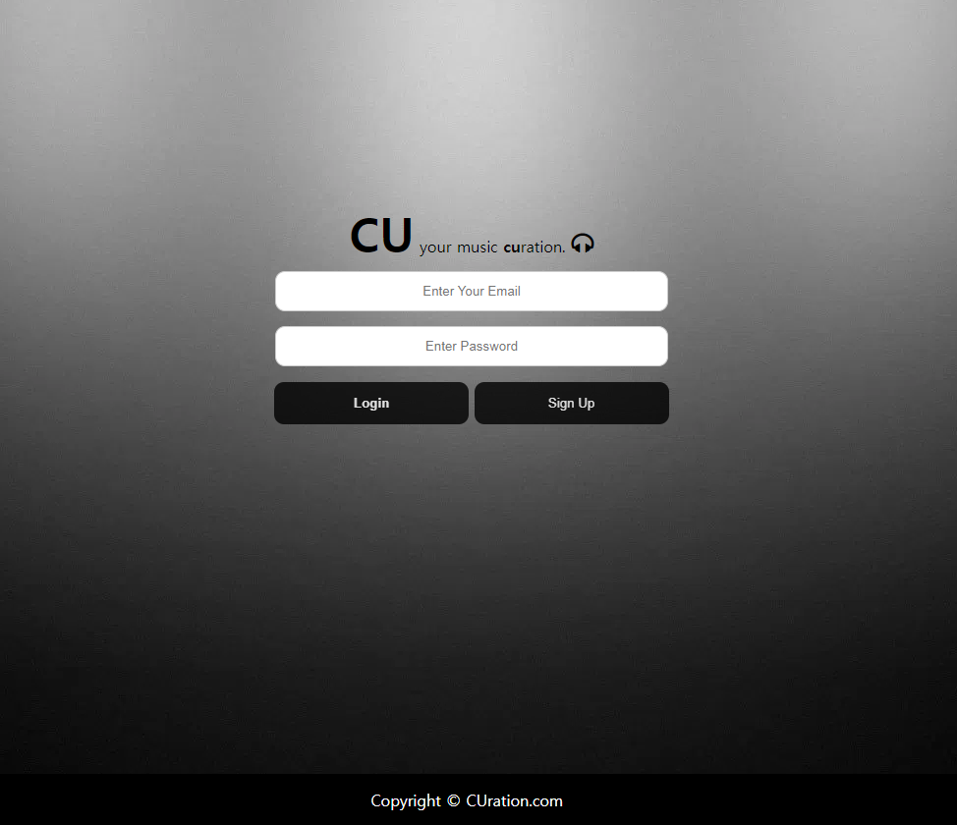
[그림 1 – 로그인]
CU your music curation.

Slide 9
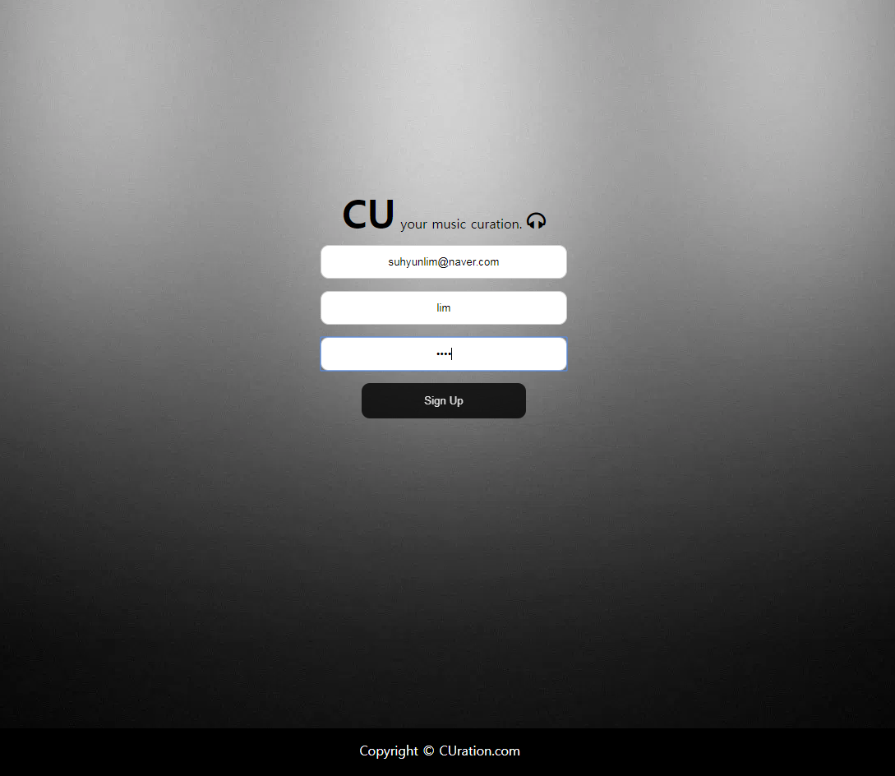
[그림 2 – 회원가입]
CU your music curation.

Slide 10
Let’s CU !
CU your music curation.

