Slide 1
Capstone Project : Recipe Recommender
Presented by Bosu Choi

Slide 2
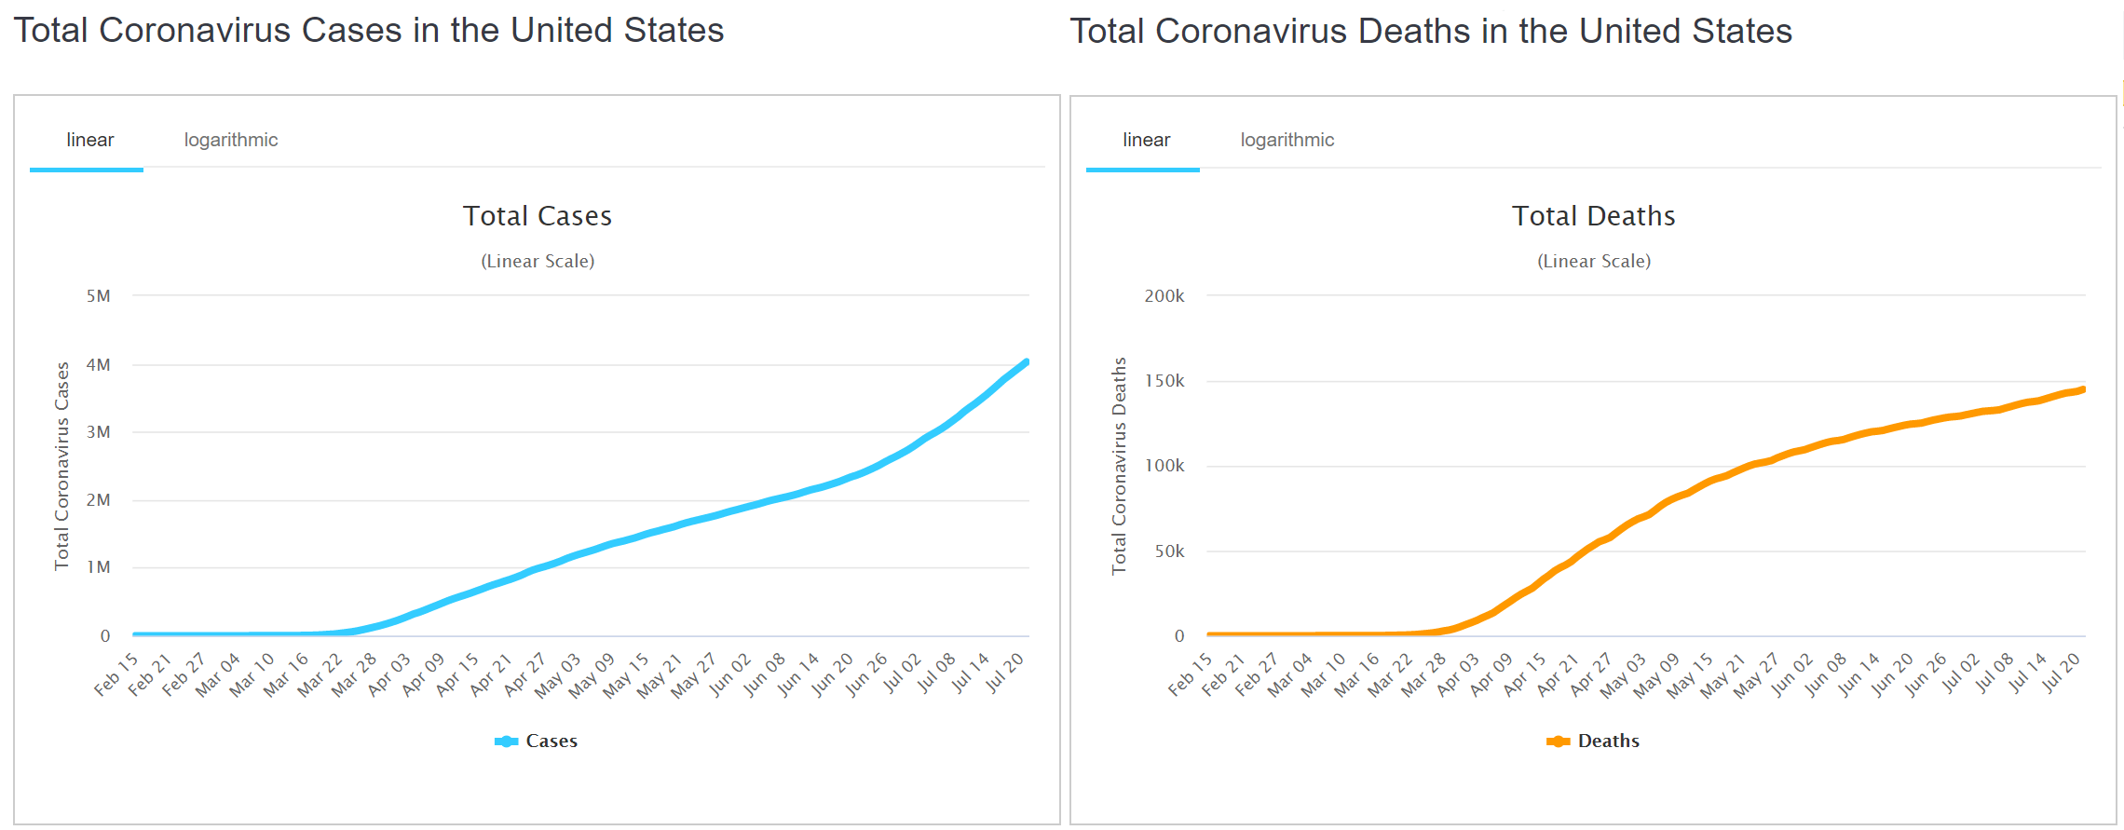
COVID-19 and Life Changes
worldometers.info/coronavirus/

Slide 3
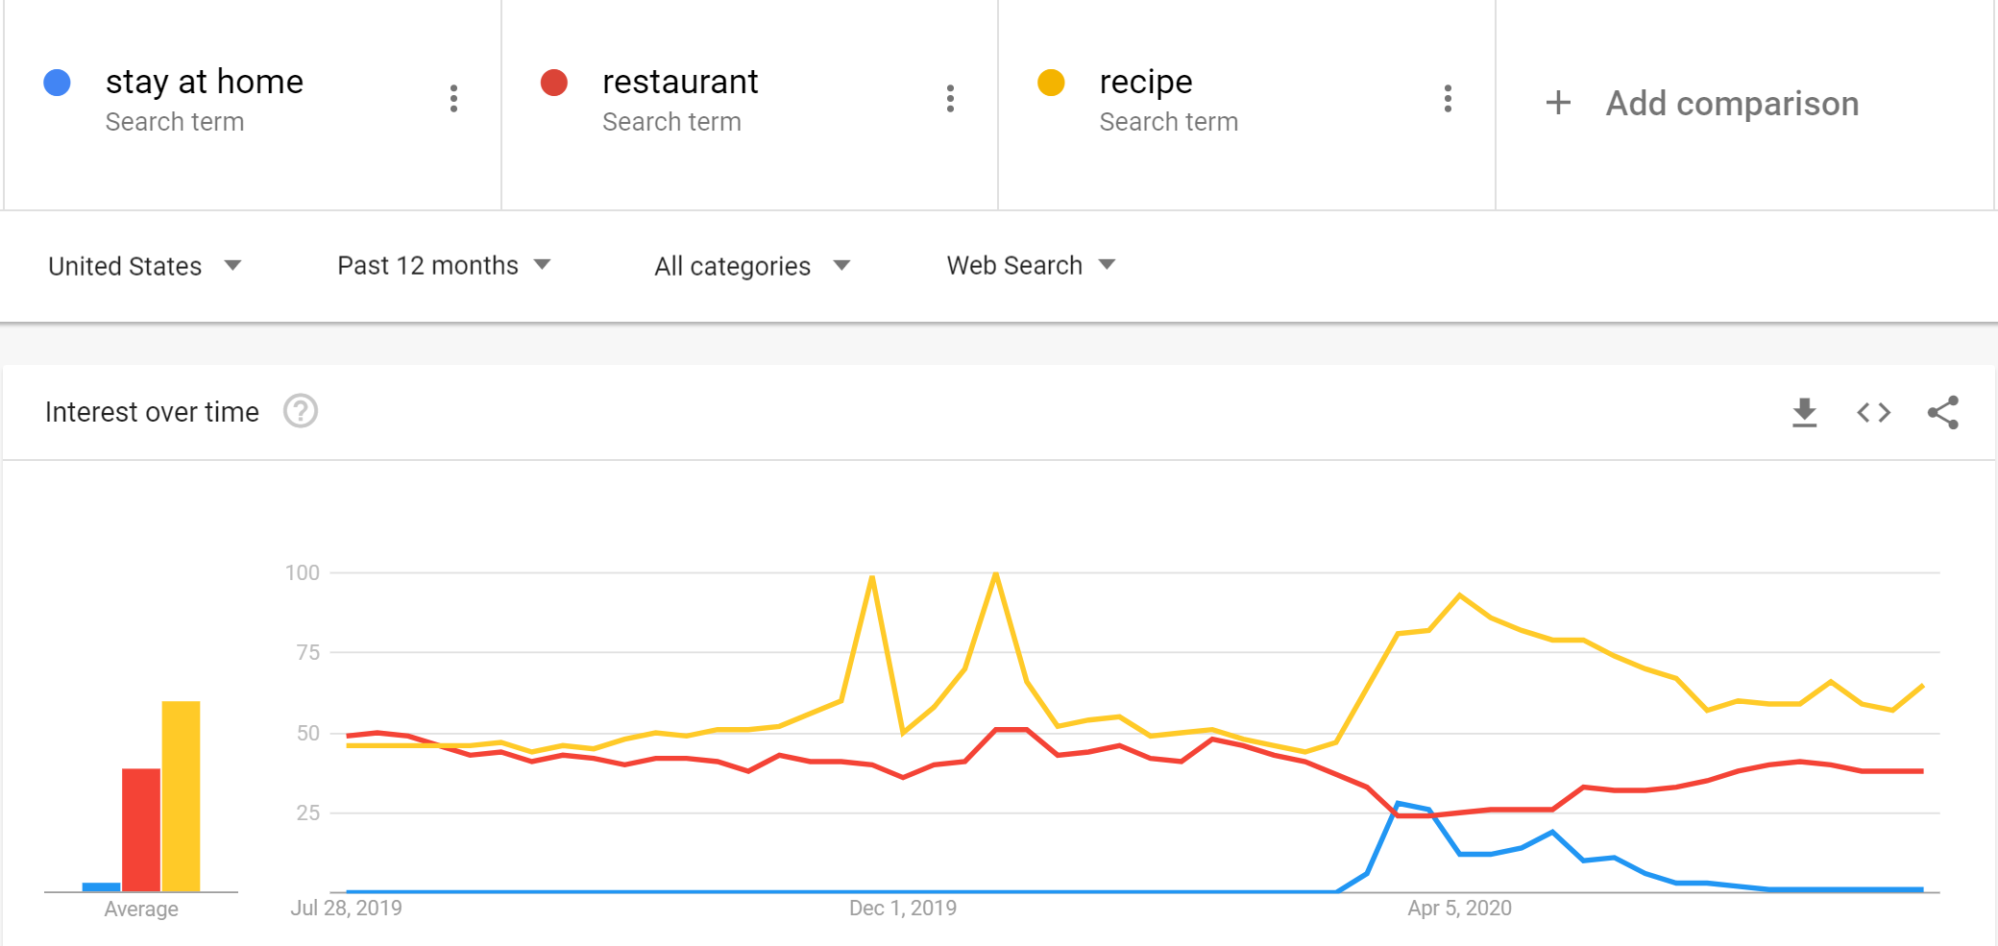
Google Trends

Slide 4
Recipes and Recommendation System
57K recipes from allrecipes.com
Each recipe contains name, ingredients, quantity, unit, and directions
Ingredient-based personalized recipe recommendation
Inputs from a user : dietary restriction, ingredient preference, list of ingredients in the fridge
Main goal : recommending recipes which use more of the ingredients in common and use less of extra ingredients using a customized similarity metric
Additionally, suggest everyday ingredients which are often used/ paired

Slide 5
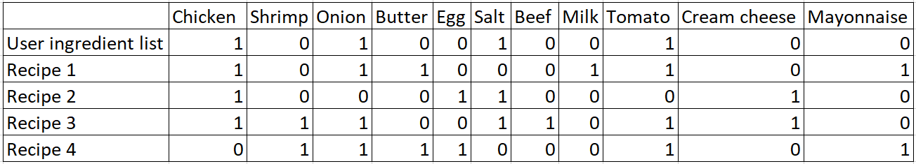

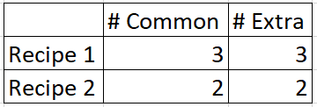
Recommendation Idea
↓
Exclude!
↑
maximize
↑
minimize

Slide 6
Business Ideas
More people are expected to be interested in cooking since COVID-19.
Recipe recommender based on various preferences will be useful for people.
Especially suggesting simple recipes that users can afford efficiently and economically.
It can be combined with grocery delivery, meal prep services, smart refrigerators, etc.

Slide 7
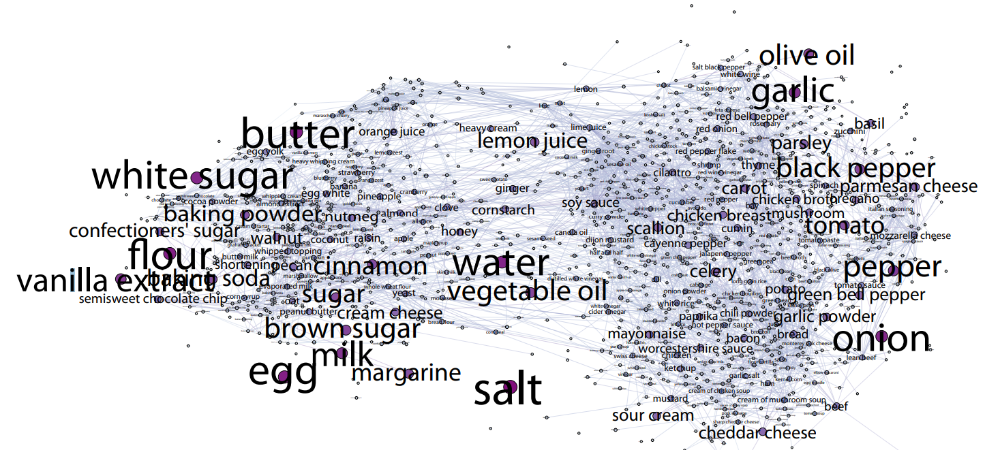
Additional Suggestion
Chun-Yuen Teng et al. 2012. Recipe recommendation using ingredient networks. In Proceedings of the 4th Annual ACM Web Science Conference (WebSci ’12). Association for Computing Machinery, New York, NY, USA, 298–307.

Slide 8
Capstone Project : Recipe Recommender
Bosu Choi
Notes:
Hi, I’m Bosu Choi. I’m gonna talk about my capstone project in Data Incubator which is to build a recipe recommedation app

Slide 9
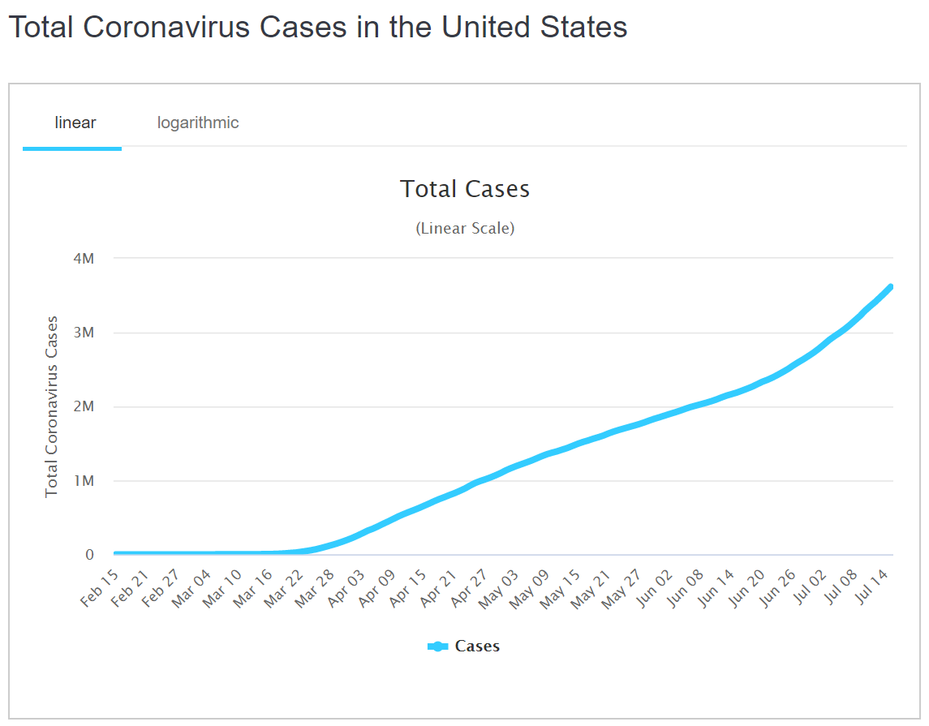
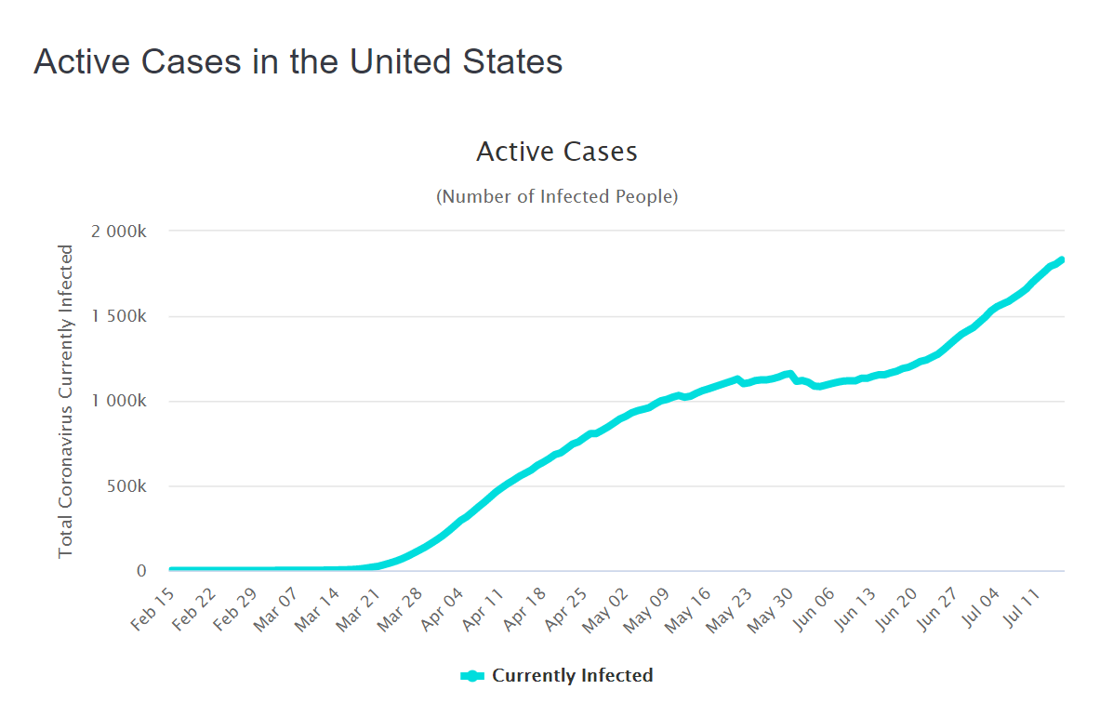
COVID 19 and Life Changes
https://www.worldometers.info/

Slide 10
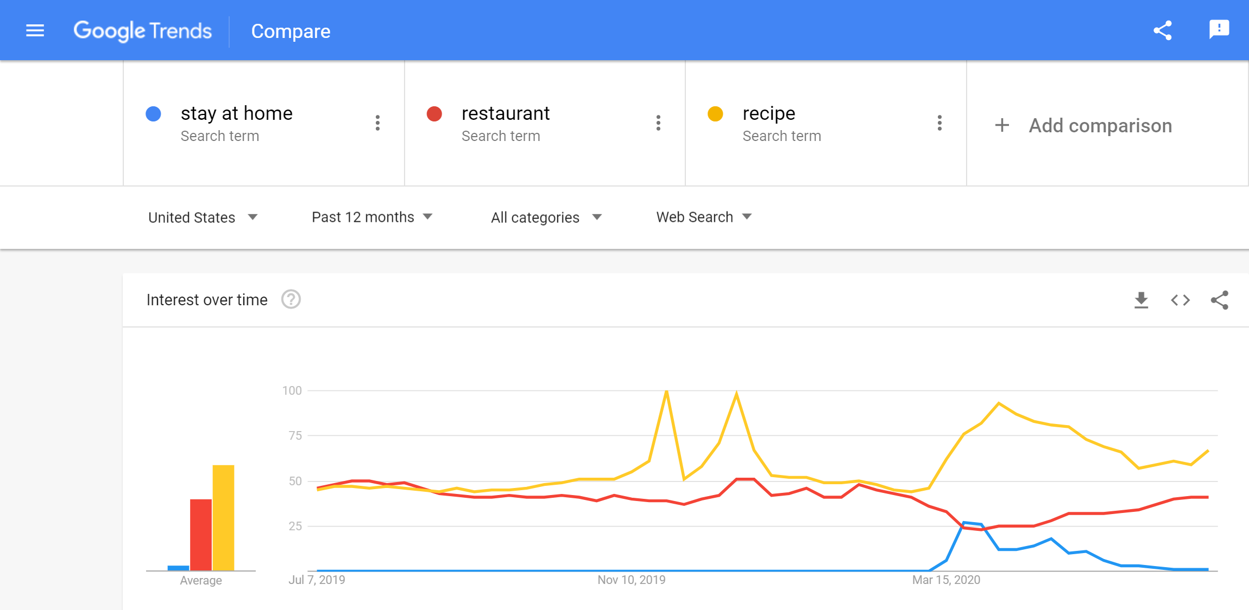

Slide 11
Ingredients for the Project
40000 recipes scraped from allrecipes.com
13000 ingredients
User’s inputs : List of ingredients in the fridge, food restriction/preference
Recommend recipes which use more of the existing ingredients and use less of extra ingredients
Sieving the recipe database by food preference/restriction
Main goal : maximizing the # of common ingredients between ingredient list of a user and a recipe as well as minimizing the # of extra ingredients to buy

Slide 12
Business Ideas
More people are expected to be interested in cooking.
Recipe recommender based on various preferences will be useful for people.
Especially suggesting simple recipes that users can afford their cooking economically.
Popular websites can accommodate more advertisements.
It can be combined with online/offline grocery delivery/to-go service, meal prep, smart refrigerator.
Notes:
The last slide includes my take home messages.
More people are getting interested in cooking as the social distancing continues.
So recipe recommender based on various preferences will be useful for people.
Especially, I am interested in recommending a recipe that benefit users financially.
On the other hand, companies with this recommender can make profit through the online advertisement
and grocery stores with delivery or to-go service can accommodate this recommender to draw more customers.
Also companies already with nice and clean recipe database can accelerate the progress of this project.
This is all for my presentation and thank you for your attention.

Slide 13
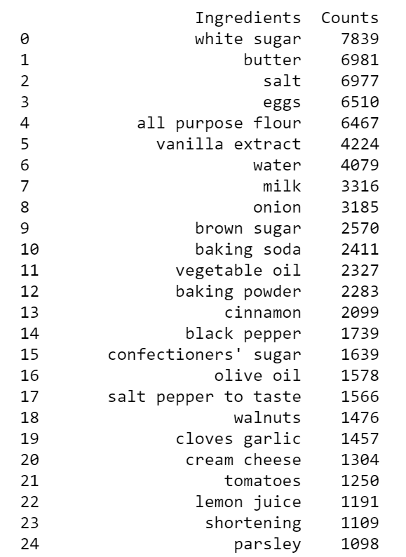
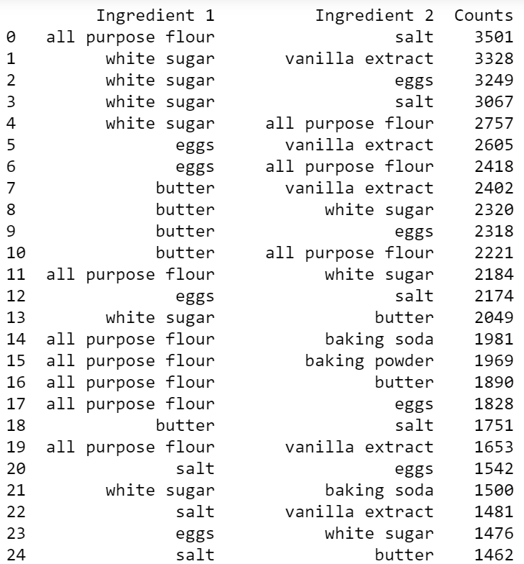
Best pairs and most used ingredients

Slide 14
Ingredients for the Project
Database of Recipes
Recommendation algorithm
Inputs from user
Scraping from online recipes available publicly
Database including
Title
Directions
Ingredients
Quantity
Unit
Etc.
Build a cost function depending on variables of interest
Intersection of user’s ingredient list and ingredients of each recipe
Dietary restriction
Food preference
Etc.
Optimization tool
List of ingredients in user’s fridge
Dietary restrictions of user
Food preference
Etc.
Notes:
In the fourth slide, there are 3 pieces required to complete my project.
Firstly, I need to build a database of recipes scraped from the internet.
Secondly, for an actual recommendation algorithm, I need to determine a cost function depending on different variables.
One specific condition I consider is
to recommend a recipe that helps people to use up the ingredients in their fridge quickly,
So that people can benefit financially from this recommender.
At last, we needs inputs from users about the ingredients in their fridge, their dietary restrictions, etc.

Slide 15
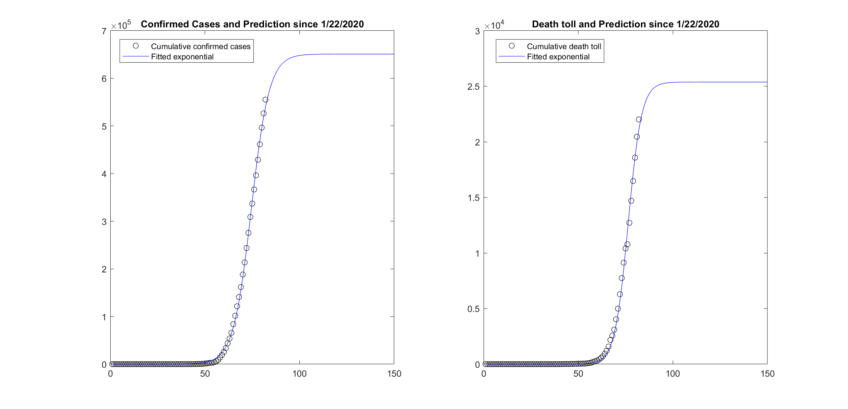
Coronavirus Changes Our Life!
Confirmed cases and death toll in US are soaring.
Hard to predict when the pandemic is over.
Social distancing is ongoing. Until when?
Vaccine is a year away at least.
Our life may change in the long term.
Data source : https://github.com/CSSEGISandData/COVID-19/tree/master/
Notes:
Please look at the second slide.
The motivation of my project started from coronavirus pandemic.
Probably some of you are checking the confirmed cases and death toll in US every day, trying to predict the future.
It is hard to make a prediction with all this uncertainty but by checking people’s interest in the google trends,
I could see some of the topics that people are now interested in.

Slide 16
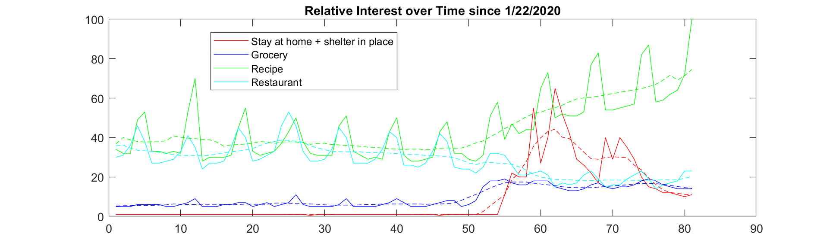
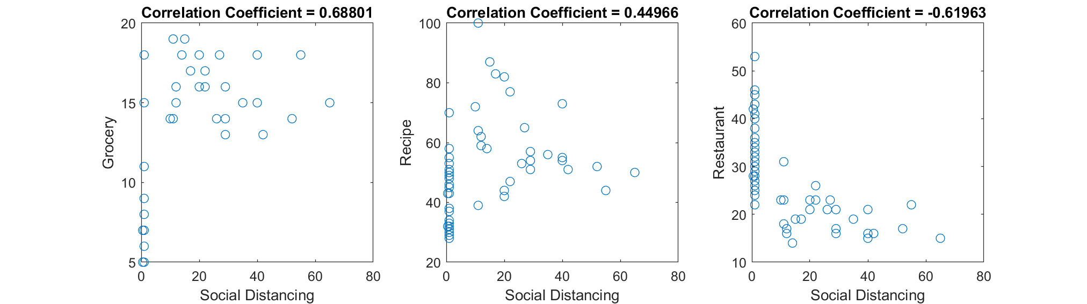
Coronavirus and Cooking at Home
As people stay at home, the interest in groceries and cooking recipes increases, and the interest in restaurants decreases.
Why don’t we recommend recipes that people are specifically looking for? (ex. Recipe that uses up most of ingredients in my fridge)
Data source : Google Trends
Notes:
In the third slide’s top figure, we can see that as people’s interest in social distancing
including stay at home and shelter in place increases,
the interest in grocery and recipe increases whereas the interest in restaurant decreases.
To see this trend more clearly, I plotted the 7day averages in dotted lines.
Also I checked the correlation coefficients in the 3 bottom plots,
seeing the relatively strong positive correlation of social distancing with grocery and recipe
whereas restaurant has strong negative correlation with social distancing.
So, this exploratory analysis gave me the inspiration of my project about the recipe recommender.

