Slide 1
Last Update: 22 March 2023
2D Heterostructure Preparation
Jae-hoon Ji

Slide 2
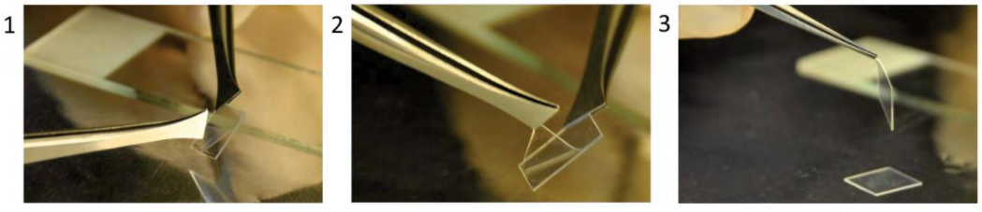
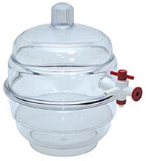
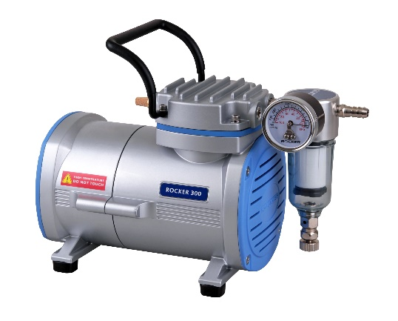
Stamp Preparation
A. Prepare PDMS stamp
Material ($ 120)
PDMS material - Sylgard 184 (Dow Corning, USA), $ 45
PPC material - Propylene carbonate (Sigma-Aldrich, CAS 25511-85-7) $ 75
Equipment ($ 306, used for releasing bubbles inside PDMS to reduce surface roughness)
Vacuum Desiccator (Southern Labwaer) $ 56
Oil free vacuum pump (Rocker) $ 250
Notes:
PDMS : http://krayden.com/buy/sylgard-184-0-5kg-1-1lb-kit-dc4019862.html
PPC :
Decicator : https://www.southernlabware.com/desiccator-vacuum-white-base-polypropylene-base-polycarbonate-top-150mm-id-with-desiccator-plate.html?utm_source=google_shopping&gclid=Cj0KCQjw9afOBRDWARIsAJW4nvzYr4h-BtITvePlwzbIugTqrmuoJ-pTIiQByEkG8hFvHZmoUXL6PHUaAmWEEALw_wcB

Slide 3
Stamp Preparation
A. Prepare PDMS stamp
PDMS preparation
Prepare the pre-polymer base without bubble (Under vacuum condition for 0.5 hour)
Mix pre-polymer base and cross linking curing agent (10:1~15:1)
Pour the mixed solution in the container
Bubble releasing (Under vacuum condition for 1 hour)
Cure the solution for 4 hour, 4 C
If the surface of the stamp is not clean enough => Plasma treating
PPC preparation
Coat the surface of the stamp
Notes:
PDMS : http://krayden.com/buy/sylgard-184-0-5kg-1-1lb-kit-dc4019862.html
Decicator : https://www.southernlabware.com/desiccator-vacuum-white-base-polypropylene-base-polycarbonate-top-150mm-id-with-desiccator-plate.html?utm_source=google_shopping&gclid=Cj0KCQjw9afOBRDWARIsAJW4nvzYr4h-BtITvePlwzbIugTqrmuoJ-pTIiQByEkG8hFvHZmoUXL6PHUaAmWEEALw_wcB

Slide 4
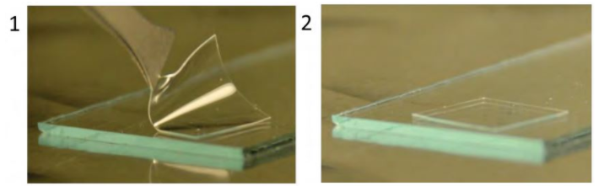
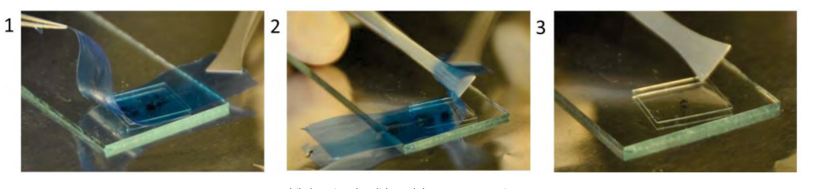
Stamp Preparation
B. Attach the stamp on the glass
C. Transfer TMDC flakes on the stamp

Slide 5
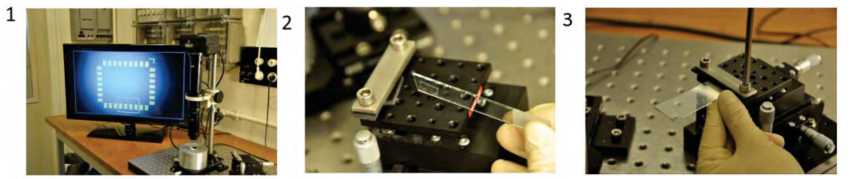
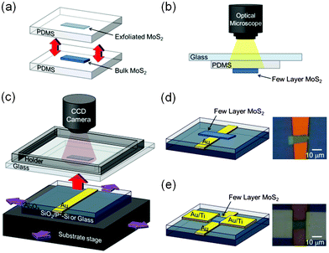
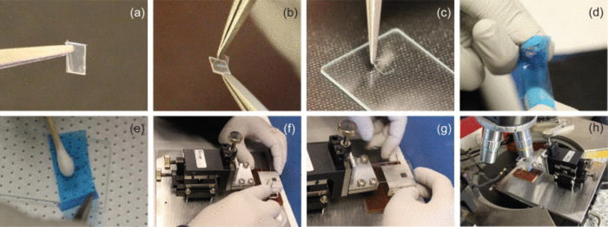
Transfer method using micromanipulator
D. Transfer TMDC flakes on the substrate using micromanipulator and optical camera

Slide 6
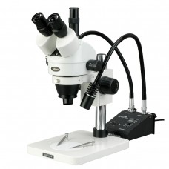
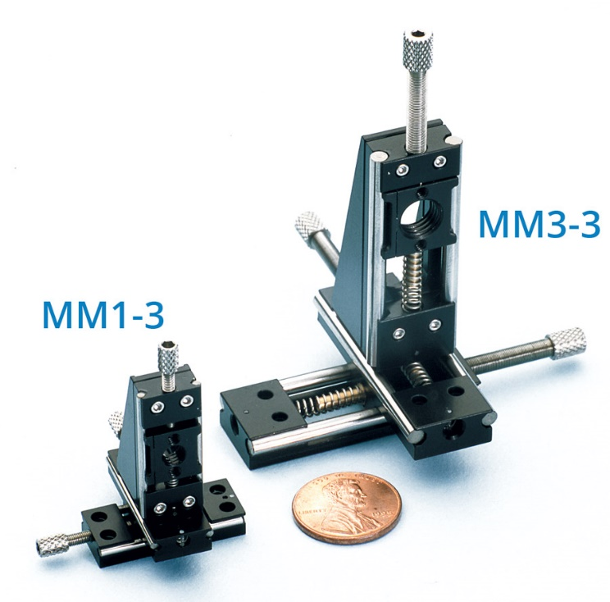
Transfer Equipment
up to 225x magnification
Have to find fairly large flakes
Ask the provider whether we can get more high magnification range.
Optical scope (AMScope, $850)
Micropositioner
Notes:
Scope : http://www.amscope.com/7x-90x-trinocular-zoom-stereo-microscope-on-boom-stand-with-144-led-light-and-18mp-usb3-0-camera.html?gclid=Cj0KCQjw9afOBRDWARIsAJW4nvyNQYLYxoyIWiQxWOS04OzJBqW6D-N8FV6KV7zZvumBdEHxY1nMkgUaAgIkEALw_wcB

Slide 7
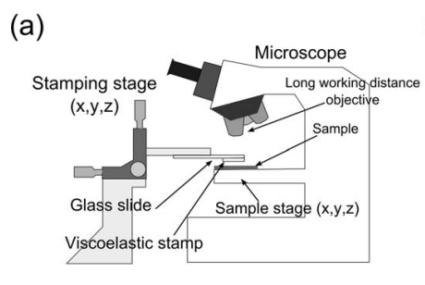
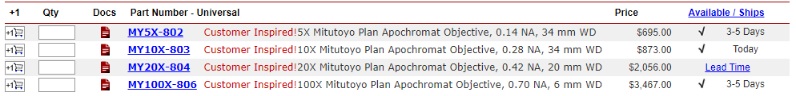
Transfer Equipment
(a) Using Long Working Distance Objective
Objective – too expensive
Micropositioner
Notes:
Micropositioner https://www.wpiinc.com/products/laboratory-supplies/make-selection-miniature-micropositioner-three-axes/
http://www.signatone.com/products/micropositioners/s725.asp
Objective https://www.thorlabs.com/newgrouppage9.cfm?objectgroup_id=9922

