Slide 1
Pikachu Volleyball Agent

Slide 2
Framework
Game
Simplified
With
Serpentai
Pynput
Controller
Win32api
Read address
Get state
Agent
Select action
trajectory
Reward
function
DQN
training

Slide 3
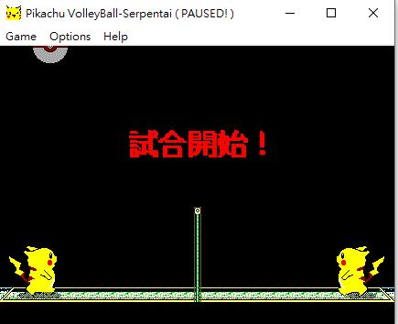
Define state
A sub state : [36,244,396,244,56,0]
ball (x,y)
(56,0)
Player2 (x,y)
(36,244)
Player1 (x,y)
(396,244)

Slide 4
Define state
vector : [0,0,0,0,0,0]
vector = sub state - sub state before 0.1 sec
We will know speed feature with vector

Slide 5
Define state
Key pressed : [0,0,0,0]
Left is pressed : 0/1
Right is pressed : 0/1
Up is presseed : 0/1
Down is pressed : 0/1
We will know the action we take before

Slide 6
Define state
State : [
36,244,396,244, 56, 0 // sub state
0, 0, 0, 0, 0, 0 // vector
0, 0, 0, 0 // key pressed
]
p.s. Need normalization in future

Slide 7
Define action
0 : release all key
1 : left
2 : right
3 : up
4 : down
5 : power

Slide 8
Define reward
ball_y == player_y : 5 / 152 *
( 152 - |ball_y - player_y|)
// if ball is on the top of player
// give some reward
over the net : 50 points
win the game : 100 points
loss the game : -50 points
discount : 0.8

Slide 9
Reward function
get trajectory first :
[[state, action]…] // a game record
Then calculate reward with definition
And push the reward to replay memory
[state1, action, state2, reward]
See example in github trajectory sample

Slide 10
Get state
We found the initial value of palyer’s (x,y), ball’s (x,y), and flag with cheat engine
Read memory with win32api
More memory details in github design_model.txt

Slide 11
Control
Use pynput to control
Fail to control agent with writing memory.

Slide 12
Agent model
Use DNN 16 -> 10 -> 10 -> 6
Use DQN for training

Slide 13
Something awkward
Because cheat engine controlling failure. We can’t do parallelization with open subprocess directly. There is an other way to make parallelization : Use Xvfb open lots of virtual monitor in Linux. We need to do more things to deal with it.
Run game on linux (Wine can make it)
Find new api to read memory (replace win32api)
Xvfb virtual monitor
Apex-DQN

Slide 14
To Do
State normalization (not urgent)
Reward function (working)
Auto starting new game (working)
Test 1st version : DQN version
Run game on linux (Wine)
Find linux api for reading memory (working)
Parallelization (Xvfb + Apex)
Test 2nd version : Apex-DQN version

Slide 15
Summary
If we can’t find the solution of reading memory in Linux. We’ll do A3C and give up Ape-X DQN.

