Slide 1

Open-API development
Choijilbuu.b
Automation Engineer

Slide 2
Agenda
How it works
How can I integrate with it
Documentation guide

Slide 3
How it works
Features
Log management –
Token : JWT Token,
HTTP BEARER
Policy check method
User Management
Support PostGre Database
DB_gateway : t_credentials_api
Db_ticketing_system: t_operation_log_api
Run on Docker Container

Slide 4
How can I integrate with it
Available APIs:
Login
Admin access - Support CRUD,
Create_token
SendMML.SE2900
SendMML.MSoftX
Requirement:
Create user
Send request to Automation team
Network access
Send request to IT team
Our Gateway server
10.21.60.68
Port 8080

Slide 5
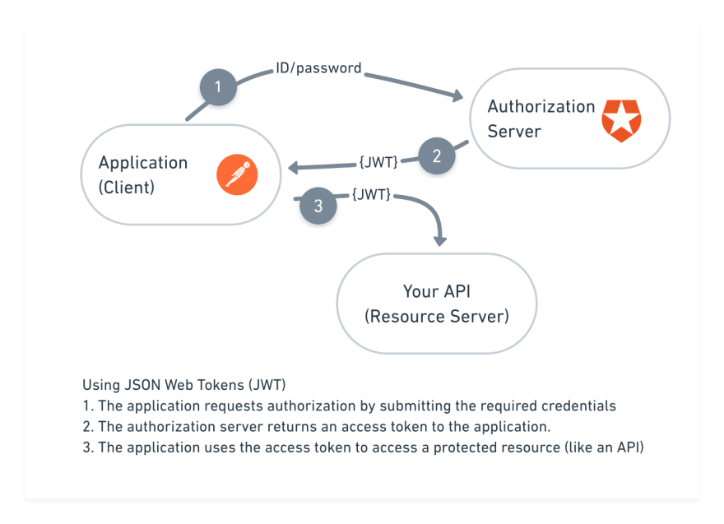
Documentation guide
JWT TOKEN validate
Word Documentation file
Postman collection
see more

Slide 6
THANKS

