Slide 1
Statistical computing and data analysis using R Data in R
Sebastian Duchene
University of Sydney

Slide 2









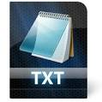

Slide 3


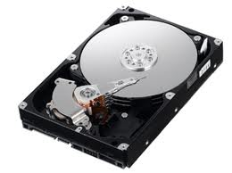
The working directory
?

Slide 4
Paths

Slide 5
Paths
In Unix systems (mac or linux):
~/path/to/file
In Windows
\path\to\file

Slide 6
Basic text files and tables
Comma separated values (csv)
Tab delimited text (txt)
Space delimited (txt)
Microsoft Office Excel files (xlsx)
(xlsx package extension)

Slide 7
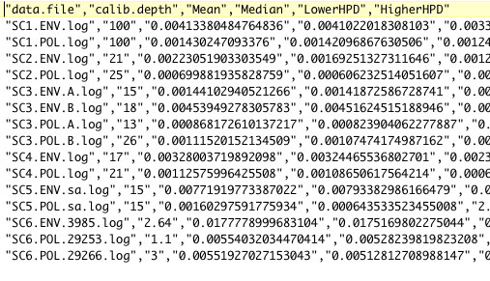
Comma separated values

Slide 8
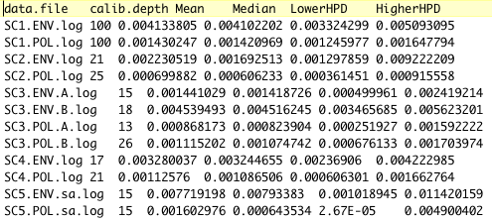
Tab or space delimited text

Slide 9
Tutorial 5
Set and find the working directory (WD) in R
Reading and write text from the WD (readLines)
Read and write CSV files from the WD (read.table)

