Slide 1
Predicting Chronic Kidney Disease

Slide 2
Chronic Kidney Disease (CKD)
Slowly increased loss of kidney function
Starts asymptomatically and only symptomatic at later stages when slowing or halting of CKD progression is difficult
Avoidable outcomes
Lower mortality due to increased risk of cardiovascular disease
Kidney failure leads to decreased quality of life regardless of treatment options (transplant or dialysis)
Early intervention can prevent adverse outcomes

Slide 3
Problem Statement
To use patient data to predict CKD diagnosis

Slide 4
Basic Overview of Dataset
Data covering different medical conditions related to CKD
Creatinine levels
Blood pressure (diastolic and systolic)
Hemoglobin levels
Glucose levels
Low-density lipoprotein (LDL-c) level
Medications
Basic demographics
Eventual CKD diagnosis

Slide 5
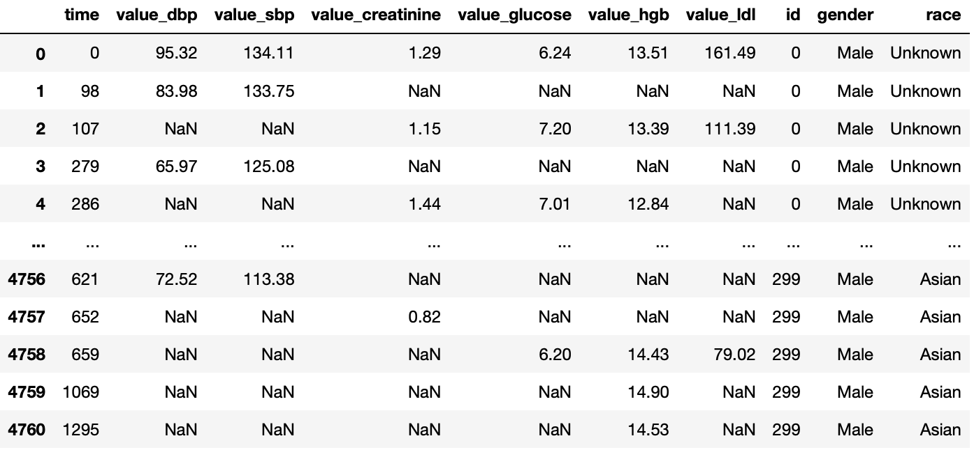
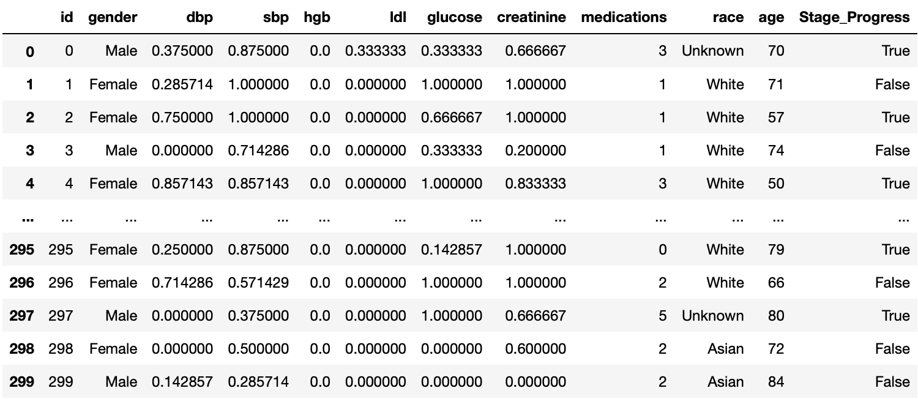
Feature Engineering
Objective: Keep things simple
Clinicians want explainable models, hence most of the feature engineering reduce complexity and improve understandability
Data was manipulated into a simple single table form

Slide 6
Feature Engineering Steps
Blood pressure, creatinine, glucose, hemoglobin, and LDL levels were first merge together into one long form data table
Some observations:
Some independent variables were taken at different time points for each individual person
Possibility that some measurements were not taken in a clinical setting
To further simplify the data, the number of out-of-range aka unhealthy measurements for each of the above independent variables was calculated as a ratio of number of total measurements taken
This gives an indication of how many and how chronic the risk factors a patient has.

Slide 7
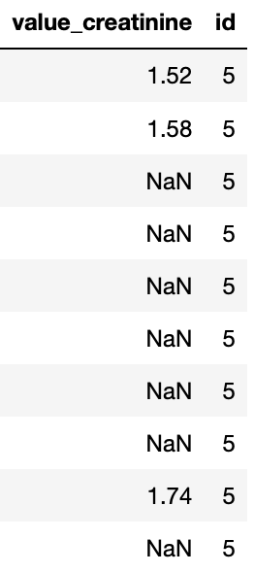
Feature Engineering Steps
Patient ID #5’s creatinine levels
Ratio of unhealthy measurements =
Number of unhealthy instances / Total number of instances
3/3 = 1
A creatinine level of > 1.0 mg/dl for females and > 1.2 mg/dl for males is considered abnormal

Slide 8
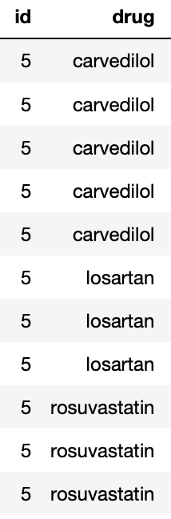
Feature Engineering Steps
As a measure of number of CKD related conditions treated, total number of unique medications per patient was calculated
List of medications
Number of Unique Medications for Patient ID #5
=
3

Slide 9
Data Preparation
In order to get the dataset ready for machine learning, the following steps were done
Changing binary independent variables into numerical variables (1 or 0)
Gender
CKD stage progress
One –hot encoding for race (categorical data)
‘Dummy’ encoding scheme so each category becomes a binary independent variable

Slide 10
Machine Learning
Several methods of machine learning was trialed
Random Forest
Ada Boosted Decision tree
Ada Boosted Random Forest
Without feature selection
With feature selection

