Slide 1
Predicting Chronic Kidney Disease

Slide 2
Chronic Kidney Disease (CKD)
Slowly increased loss of kidney function
Starts asymptomatically and only symptomatic at later stages when slowing or halting of CKD progression is difficult
Avoidable outcomes
Lower mortality due to increased risk of cardiovascular disease
Kidney failure leads to decreased quality of life regardless of treatment options (transplant or dialysis)
Early intervention can prevent adverse outcomes

Slide 3
Problem Statement
To use patient data to predict CKD diagnosis

Slide 4
Basic Overview of Dataset
Data covering different medical conditions related to CKD
Creatinine levels
Blood pressure (diastolic and systolic)
Hemoglobin levels
Glucose levels
Low-density lipoprotein (LDL-c) level
Medications
Basic demographics
Eventual CKD diagnosis

Slide 5
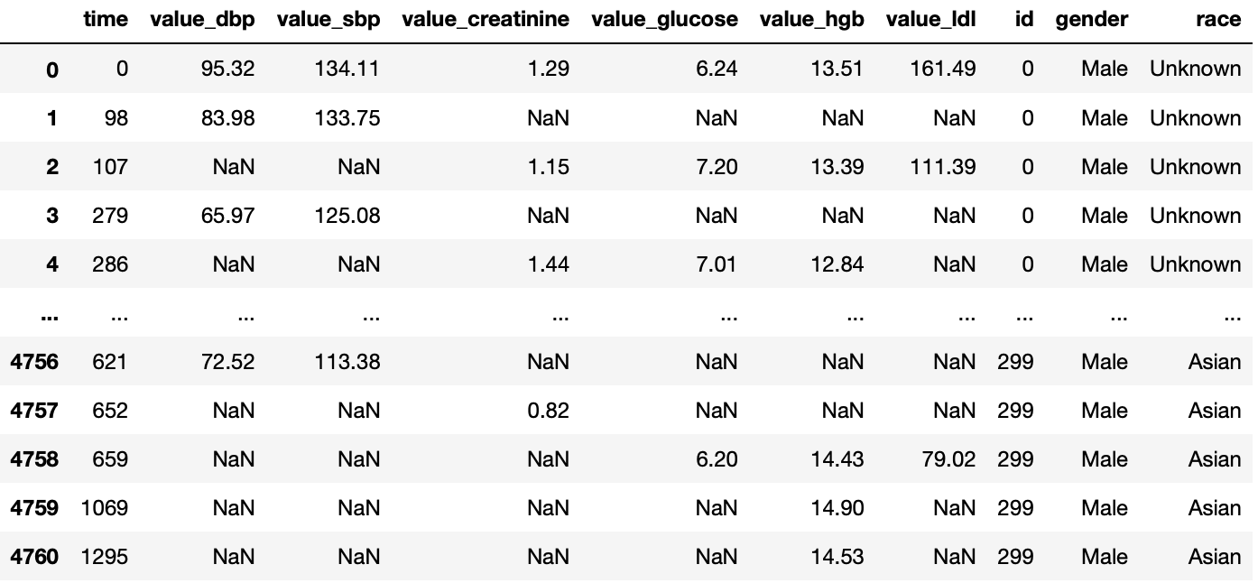
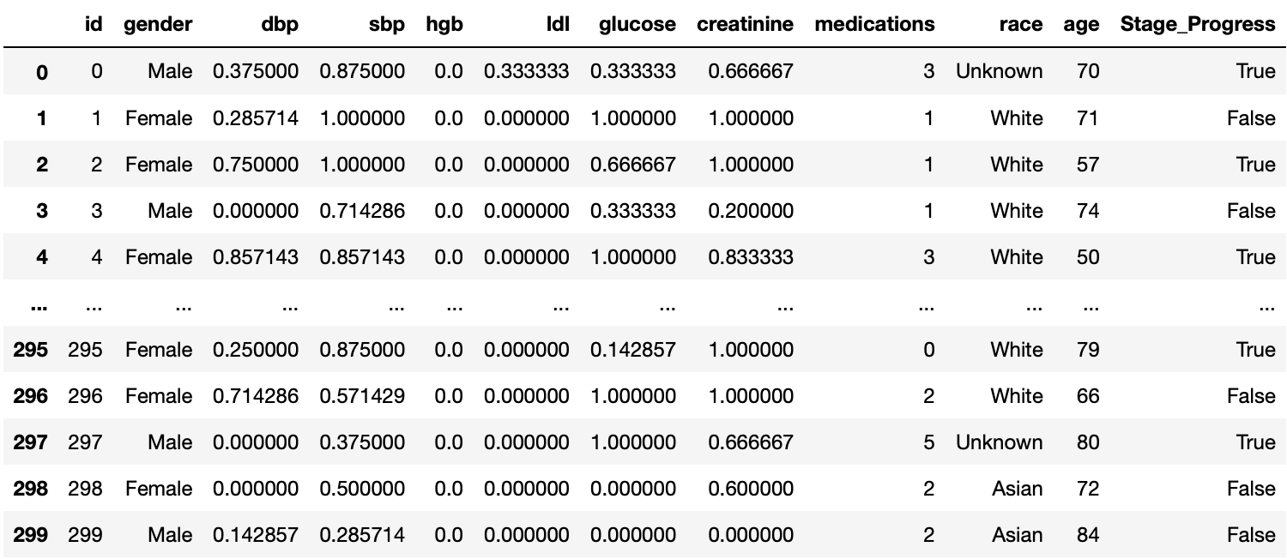
Feature Engineering
Objective: Keep things simple
Clinicians want explainable models, hence most of the feature engineering reduce complexity and improve understandability
Data was manipulated into a simple single table form

Slide 6
Feature Engineering Steps
Blood pressure, creatinine, glucose, hemoglobin, and LDL levels were first merge together into one long form data table
Some observations:
Some independent variables were taken at different time points for each individual person
Possibility that some measurements were not taken in a clinical setting
To further simplify the data, the number of out-of-range aka unhealthy measurements for each of the above independent variables was calculated as a ratio of number of total measurements taken
This gives an indication of how many and how chronic the risk factors a patient has.

Slide 7
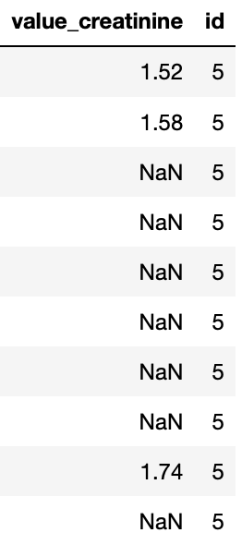
Feature Engineering Steps
Patient ID #5’s creatinine levels
Ratio of unhealthy measurements =
Number of unhealthy instances / Total number of instances
3/3 = 1
A creatinine level of > 1.0 mg/dl for females and > 1.2 mg/dl for males is considered abnormal

Slide 8
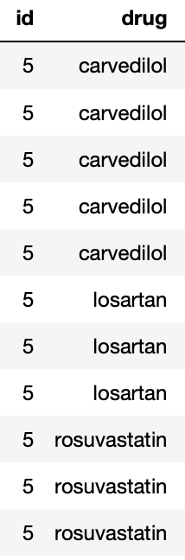
Feature Engineering Steps
As a measure of number of CKD related conditions treated, total number of unique medications per patient was calculated
List of medications
Number of Unique Medications for Patient ID #5
=
3

Slide 9
Data Preparation
In order to get the dataset ready for machine learning, the following steps were done
Changing binary independent variables into numerical variables (1 or 0)
Gender
CKD stage progress
One –hot encoding for race (categorical data)
‘Dummy’ encoding scheme so each category becomes a binary independent variable

Slide 10
Machine Learning
Several methods of machine learning was trialed
Random Forest
Ada Boosted Decision tree
Ada Boosted Random Forest
Without feature selection
With feature selection
All are ensemble methods
Data does not to be scaled
Helps to aggregate weak models through bagging or boosting to create a stronger model

Slide 11
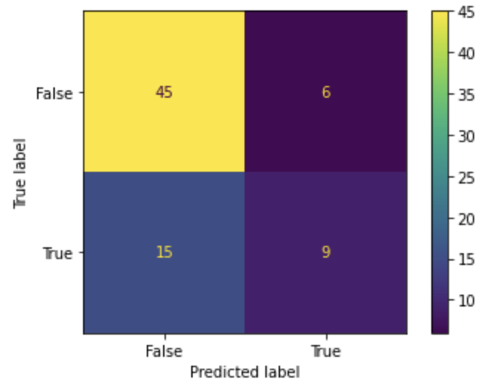
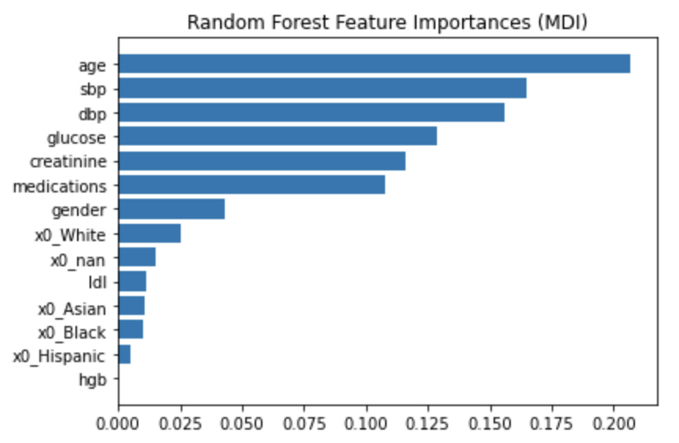
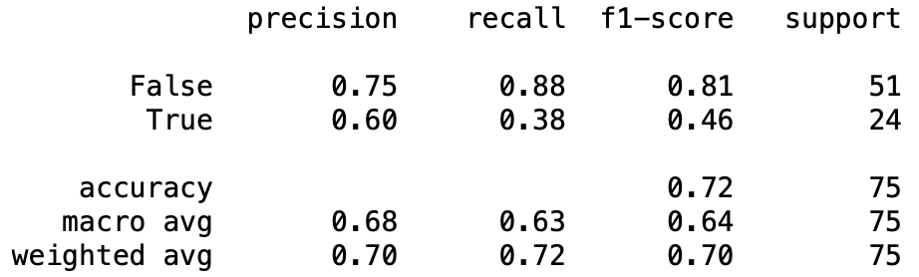
Random Forest: Results
ROCAUC score: 0.629
Accuracy score: 0.72
F1 score: 0.461
RF train accuracy: 1.000
RF test accuracy: 0.720

Slide 12
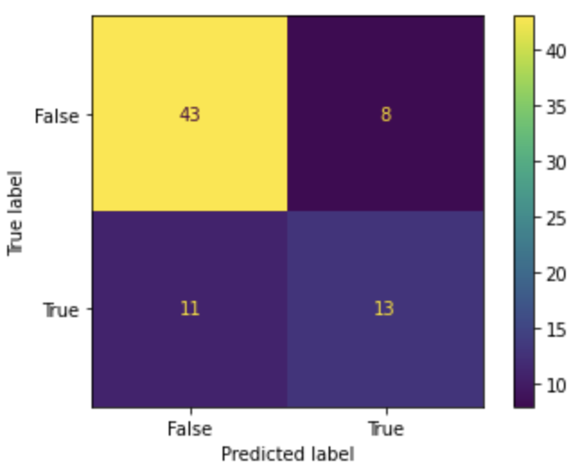
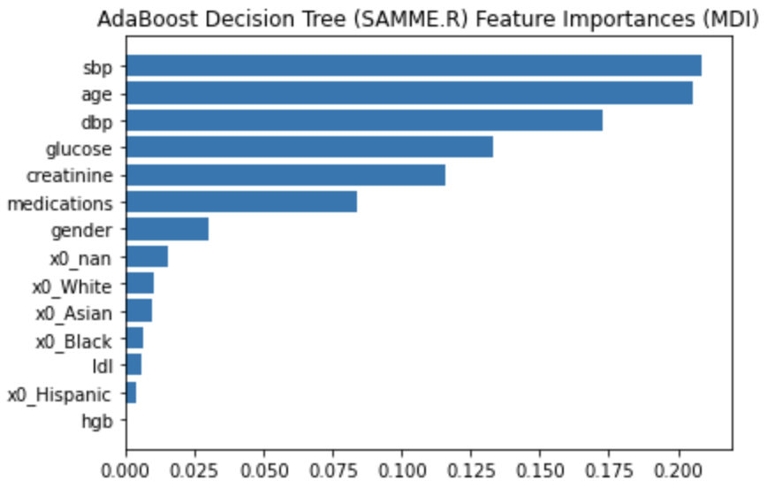
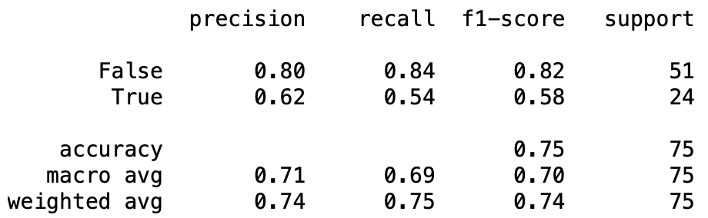
Ada Boosted Decision Tree: Results
ROCAUC score: 0.692
Accuracy score: 0.747
F1 score: 0.578
train accuracy: 1.000
test accuracy: 0.747

Slide 13
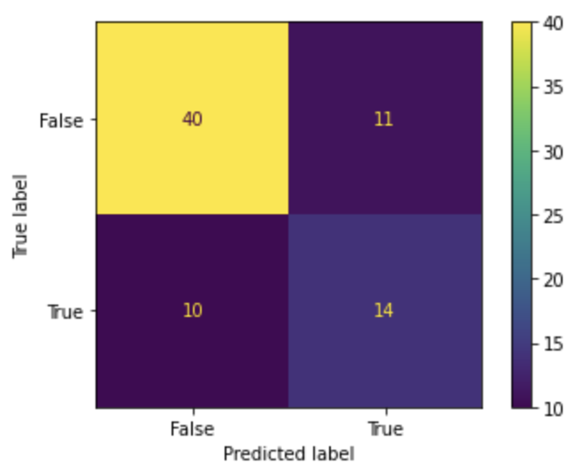
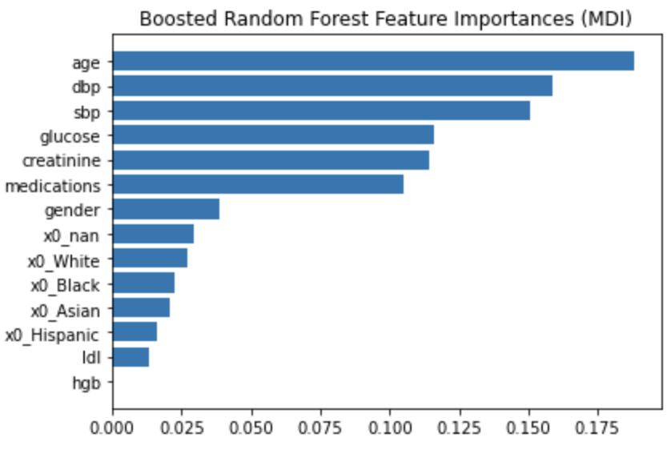

Ada Boosted Random Forest: Results Without Feature Selection
ROCAUC score: 0.684
Accuracy score: 0.72
F1 score: 0.5714
train accuracy: 0.996
test accuracy: 0.720

Slide 14
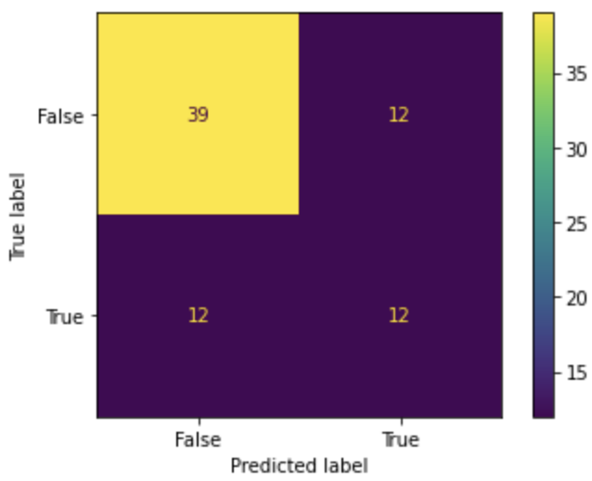
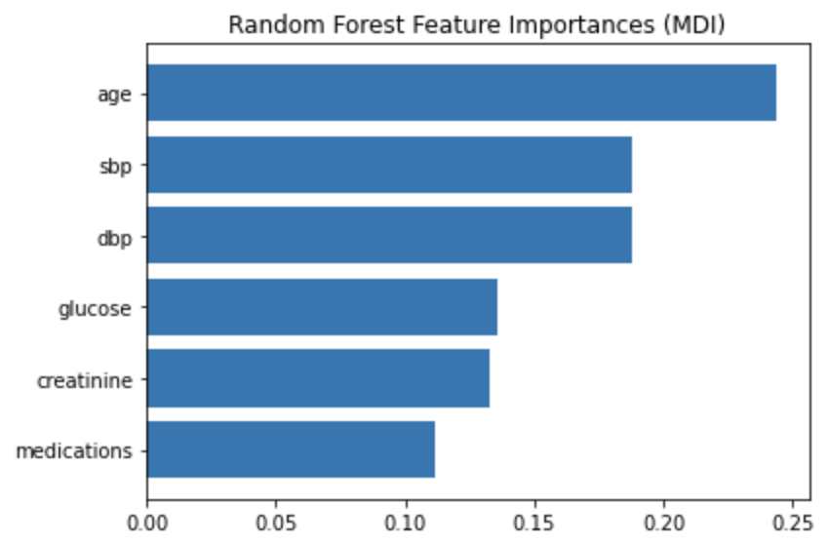

Ada Boosted Random Forest: Results With Feature Selection
ROCAUC score: 0.632
Accuracy score: 0.68
F1 score: 0.5
train accuracy: 1.000
test accuracy: 0.680

Slide 15
Discussion
Ada Boosted Decision Tree and Ada Boosted Random Forest without feature selection had the highest accuracy and F1 score
In this particular scenario, looking at the confusion matrix was particularly useful
Ada Boosted Random Forest without feature selection is the best model among the 4 reported
Least false negatives predicted
Predictive tool for encompassing more potential CKD patients for further clinical evaluation
Better to have a false positive than false negative as early medical intervention in CKD is crucial

Slide 16
Discussion
Ada Boosted Random Forest also showed age together with blood pressure as the top 3 features of importance when predicting CKD
In line with our knowledge of CKD
Interestingly, hemoglobin and LDL levels had low importance
Low hemoglobin levels is something that results from suffering from CKD
CKD patients are more prone to cardiovascular disease which is associated with high LDL levels, but LDL levels have weak association with CKD¹
1: Reiss, A. B., Voloshyna, I., De Leon, J., Miyawaki, N., & Mattana, J. (2015). Cholesterol Metabolism in CKD. American journal of kidney diseases : the official journal of the National Kidney Foundation, 66(6), 1071–1082. https://doi.org/10.1053/j.ajkd.2015.06.028

Slide 17
Flaws
Loss of information occurred when data was compressed to simplify data
Only 3 types of ML models were trialed
Other types of feature engineering could be trialed

Slide 18
Future Steps
Trial more feature engineering methods
Integrate time data better
Integrate medications data better
Calculate number of medications in each medicine class
Further research CKD disease development and risk factors
Try other machine learning algorithms
Convert Jupyter Notebook into a more deployable format

