Slide 1
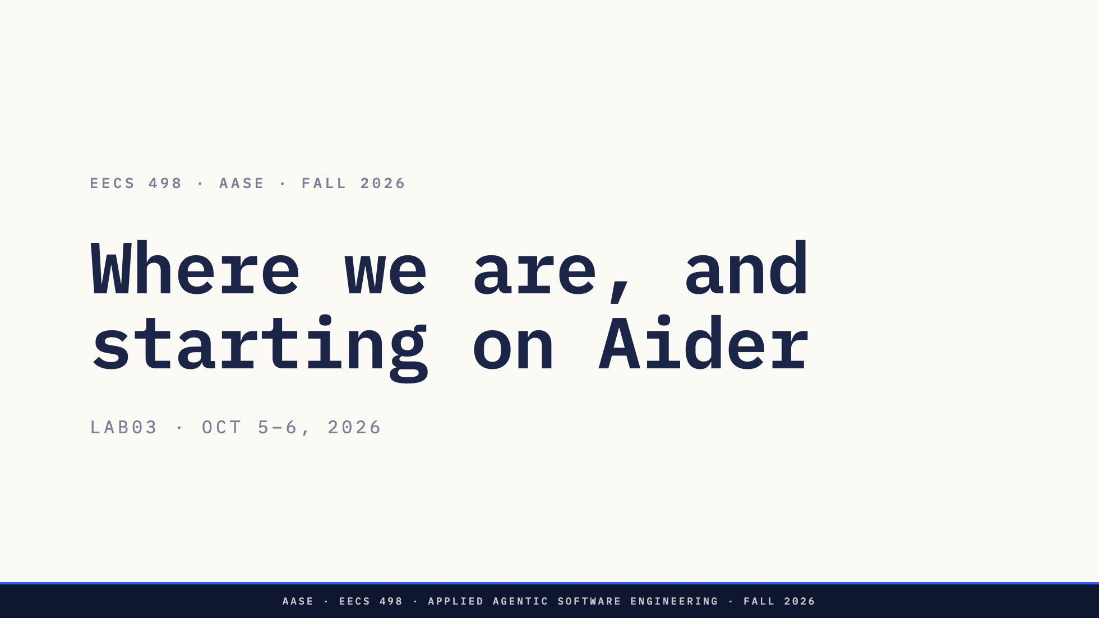
Notes:
Rebuilt 2026-10-01, and again on 2026-10-05 on instructor direction. This
replaces the "Build the agent" lab.
Two halves. About 15 minutes of talk: what we are changing and why, from
what you told us you are interested in on the Lab02 form. Then the lab itself: Codex set up on Luna,
Aider mapped with peanuts, a discussion of what you found, and the first
design of a feature for Aider.
The Apply build is due tomorrow (Tuesday) at 11:59 PM. Say so once, here.

Slide 2
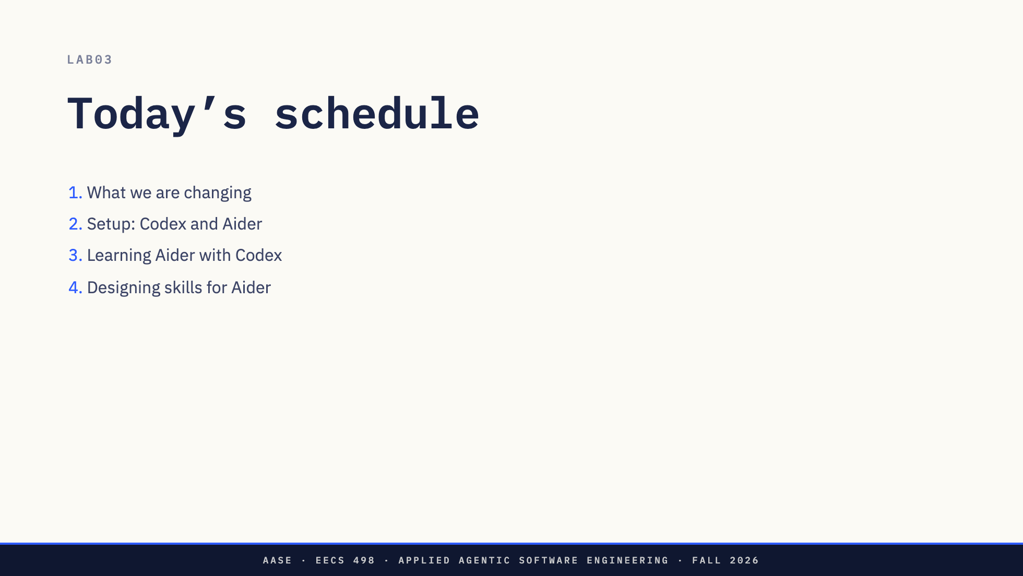
Notes:
About 30 seconds. Say the shape: twenty minutes of us talking, then the rest
is yours, on your laptop, in the Aider codebase.
The attendance form is at the end, and it asks which AI subscriptions you
have, so answer that one honestly.

Slide 3


Slide 4
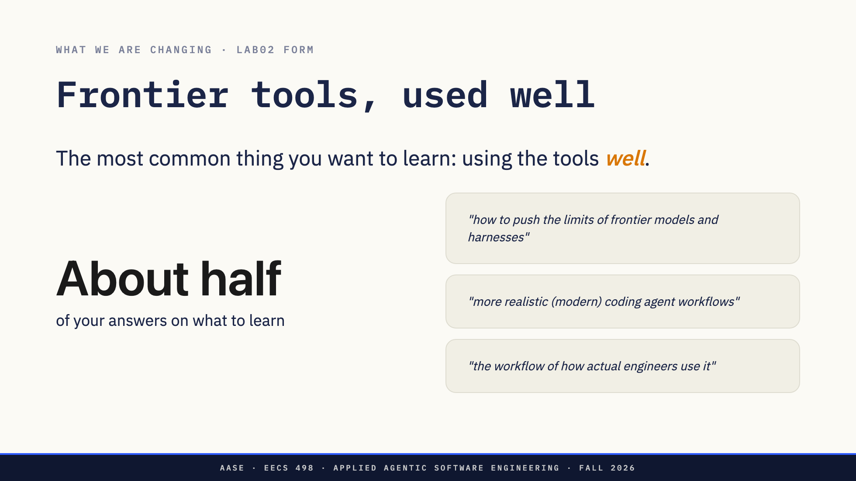
Notes:
About a minute.
49 of you answered "If you had Codex for the rest of the course, what would
you want to learn?" We read every answer and sorted them by hand. About 23,
the biggest group by far, were about using the tools well: real workflows,
good habits, reliable results, getting the most out of them. The next most
common were design and specs (8), orchestration and skills (7), and managing
context and tokens (5).
Notice that almost nobody asked what to build with it. You asked how to use
it. Today's lab is our first answer: Codex teaching you a codebase you did
not write.
The three quotes are from three different students. Nobody is named.

Slide 5
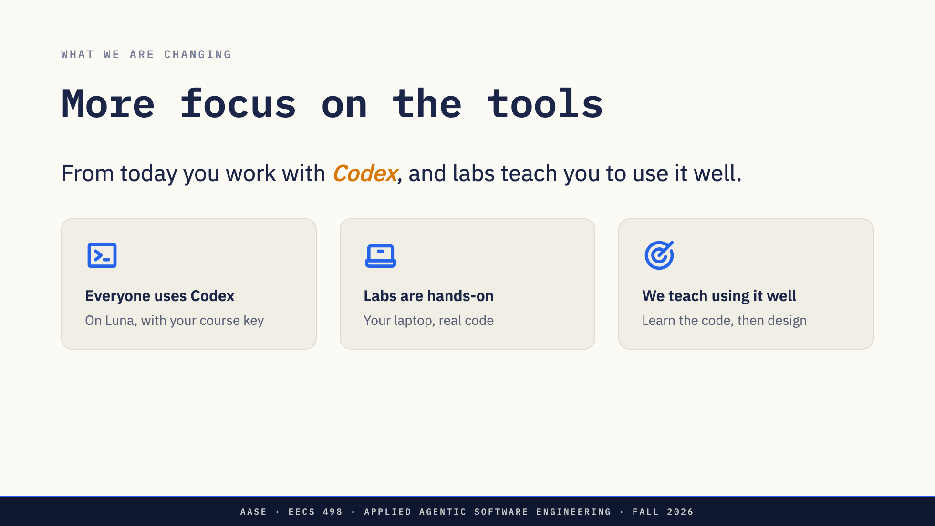
Notes:
About 90 seconds. Three concrete changes.
Everyone uses Codex. A frontier coding agent, on the U-M GPT Toolkit key
you already have, with a Luna model. Same tool and same model for everyone,
so what works for one of you works for the room.
Labs are hands-on. Labs now spend most of their time with Codex in your
hands, on real code, with staff walking the room. Today is the first one.
We teach using it well. The part you asked for most. A strong model can
write code for you. The skill is using it to understand code you did not
write, and then making the design decisions yourself. That is what today
practises.

Slide 6
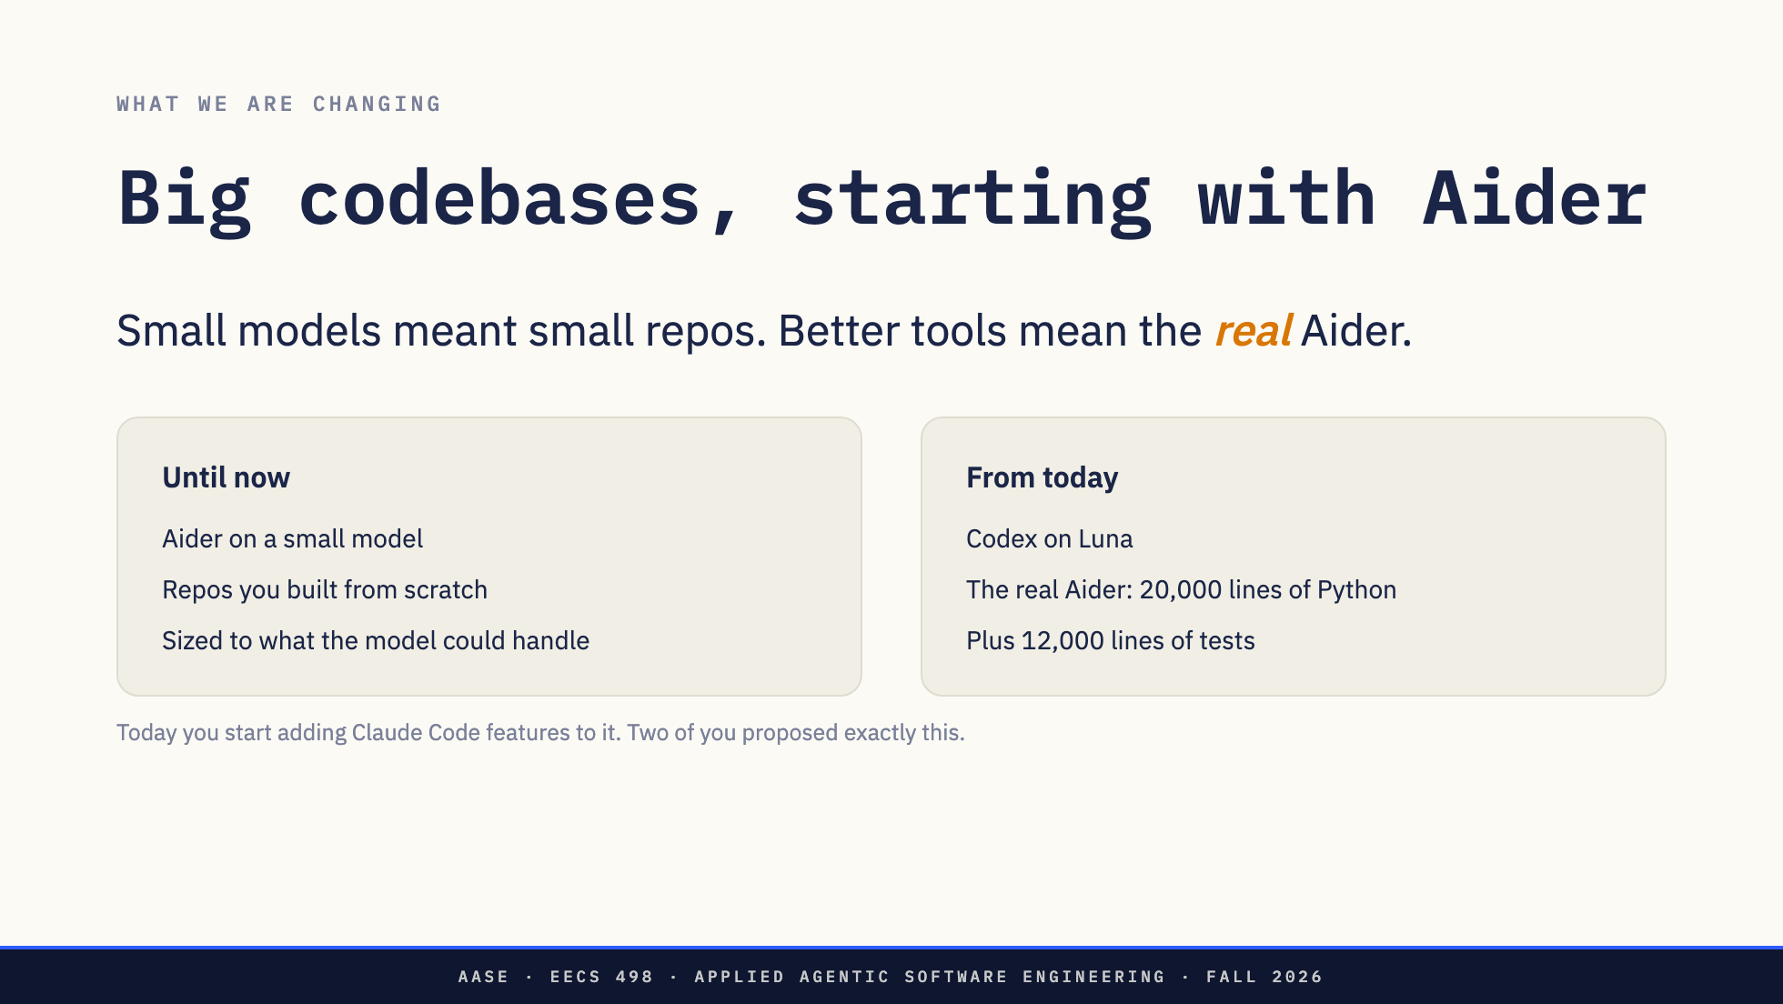
Notes:
About 2 minutes. This is the direction.
Until now the projects were small repositories you built yourself, because
you were working in Aider on a small model, and the work had to fit what
that model could handle. That was the right size for those tools.
Now you have Codex on a Luna model, and the scope goes up a lot. So instead
of a small project from scratch, you work in the real Aider: the open-source
tool you have used since week 1. About 20,000 lines of Python with 12,000
lines of tests (checked Oct 4 at commit 5dc9490b). That is real
engineering: code that already exists, that someone else wrote, that you
have to understand before you touch it.
Today you start adding Claude Code features to it, beginning with skills.
How long the course stays in Aider, and what comes after it, is not
decided.
Two of you suggested exactly this on the Lab02 form, independently:
"use codex to take aider open source code and make it super sophisticated"
and "how to build my own agent like codex that is stronger than aider".
Nobody is named.
Say what is not decided: how this is split into projects, what each one
requires, and the dates. That comes later. Today is the start, not a graded
project.

Slide 7
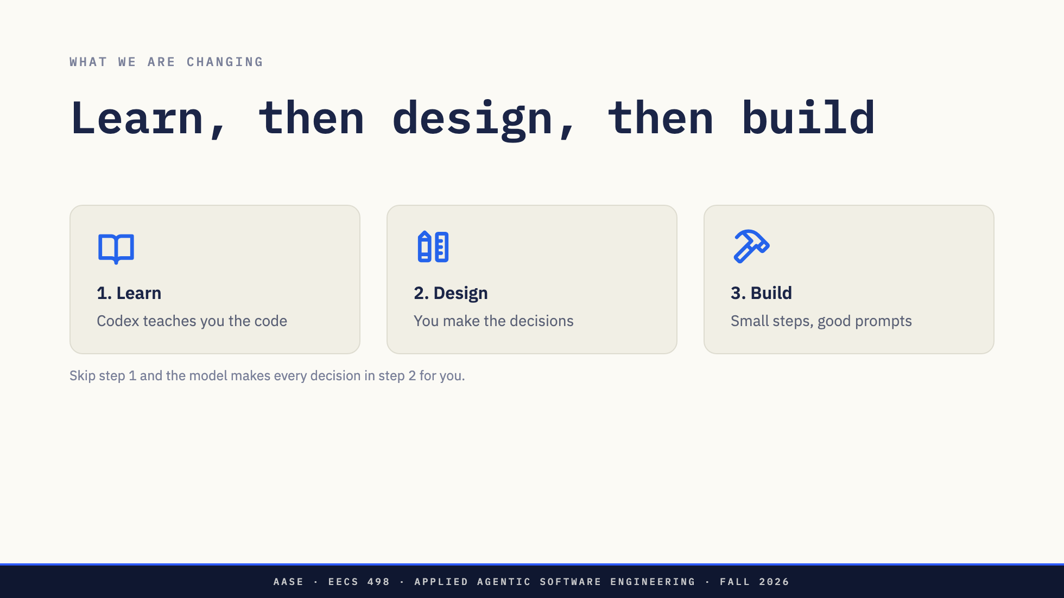
Notes:
About 90 seconds. This is how we want you to work in Aider, today and for
in whatever codebase comes next, and the order matters.
Learn first. Use Codex as a teacher: ask it how the code works, make it show
you file names and line numbers, and check what it tells you.
Then design. You cannot make a design decision about code you do not
understand. If you try, you will hand the decision to the model without
noticing, and it will design everything. That is the failure we are trying
to avoid.
Then build, in small steps, with prompts that carry your design. Not one
prompt that asks for the whole feature. A one-shot prompt gives you the
model's design, not yours.
The rest of today follows these three steps in order.

Slide 8
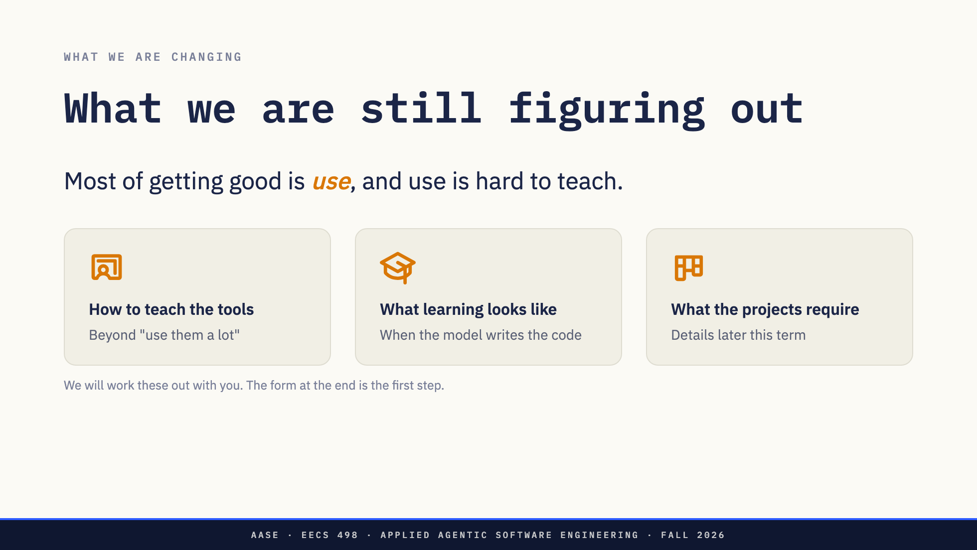
Notes:
About 2 minutes. Be straight about this. It is the honest state of the
course.
How to teach the tools. Most of what makes someone good with Codex comes
from using it, a lot, on real work, and noticing where it goes wrong. That
is hard to put in a lecture. Today is our first try at a lab built around
it.
What learning looks like. If the model can write most of the code, working
code no longer shows what you understood. Our current bet: you learn the
code first, with the agent teaching you, and then you make the design
decisions. Today is built that way. We are not sure it is right.
What the projects require. We know the direction, which is the next slide.
What each project asks you to hand in, and when, comes later. We will tell
you before you need it.

Slide 9
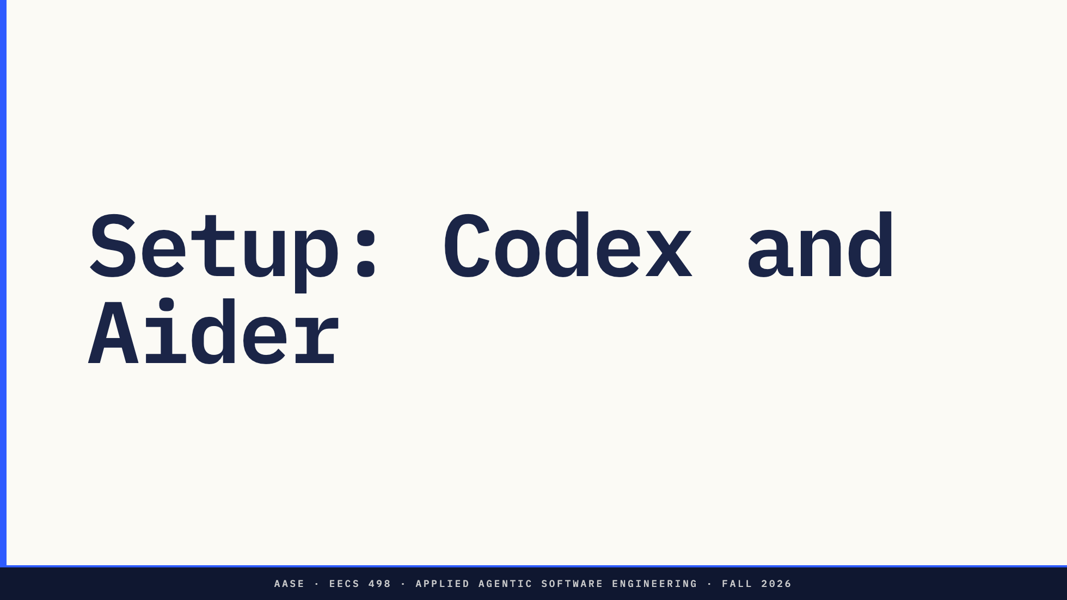

Slide 10
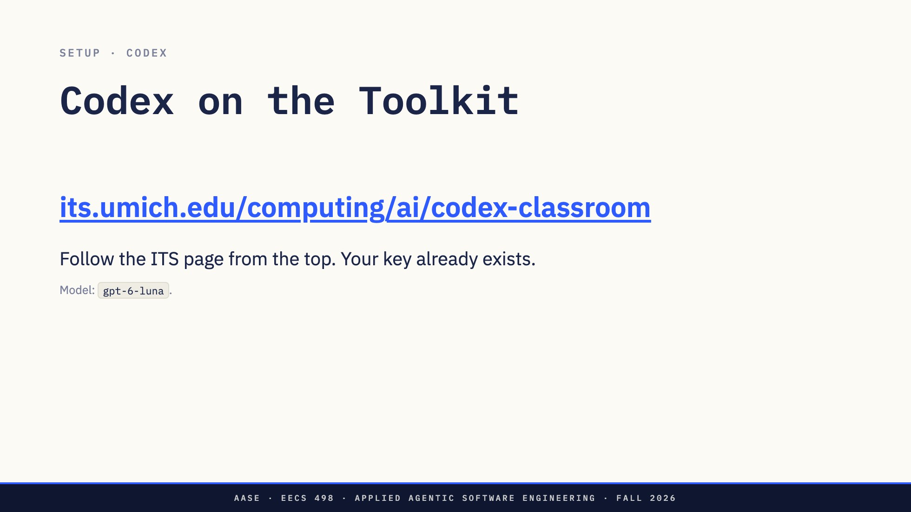
Notes:
About a minute to say, then up to 15 minutes of setup in the room. Many of
you did this before lab. If you did, help a neighbor.
Open the ITS Codex for the Classroom page and follow it from the top. It
covers the key (every student on the Canvas roster already has one), the
install guides for Mac, Linux and Windows, and how to check what is left of
your $25.
Everyone uses Codex on gpt-6-luna, at medium effort. Not Claude Code on
your own plan, and not Cursor. gpt-6-luna was verified with Codex on the
Toolkit on Oct 1 and again on Oct 5.
For staff, if a student gets stuck: the direct guides are KB 15550 (Mac,
Linux) https://teamdynamix.umich.edu/TDClient/30/Portal/KB/Article/15550/Codex-Setup-for-Mac-Linux
and KB 15551 (Windows), and a config tested on Oct 1 is in notes.md.

Slide 11
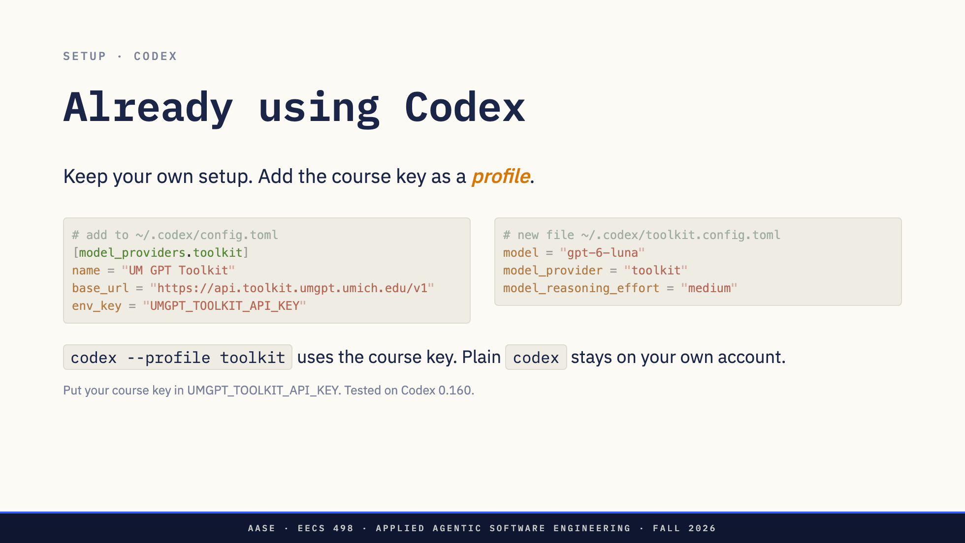
Notes:
About a minute. Only for students who already use Codex with their own
ChatGPT account. Everyone else follows the ITS page on the previous slide.
The ITS guide sets the Toolkit as your default provider, which would replace
the setup you already use. A profile avoids that. The provider block goes
in your existing ~/.codex/config.toml. The profile is its own file,
~/.codex/toolkit.config.toml, which Codex layers on top of config.toml when
you run codex --profile toolkit (or -p toolkit). Plain codex keeps using
your own account and model.
Profiles as separate files are how current Codex works. Older versions used
[profiles.toolkit] tables inside config.toml, and recent versions no longer
accept those. If --profile is not recognized, update Codex.
The key: export UMGPT_TOOLKIT_API_KEY in your shell profile (~/.zshrc or
~/.bashrc), with the key ITS gave you.
Use gpt-6-luna for the course work, whatever you use for your own
projects.
Tested Oct 5 on Codex 0.160.0: codex exec -p toolkit ran on gpt-6-luna
through the Toolkit provider.

Slide 12
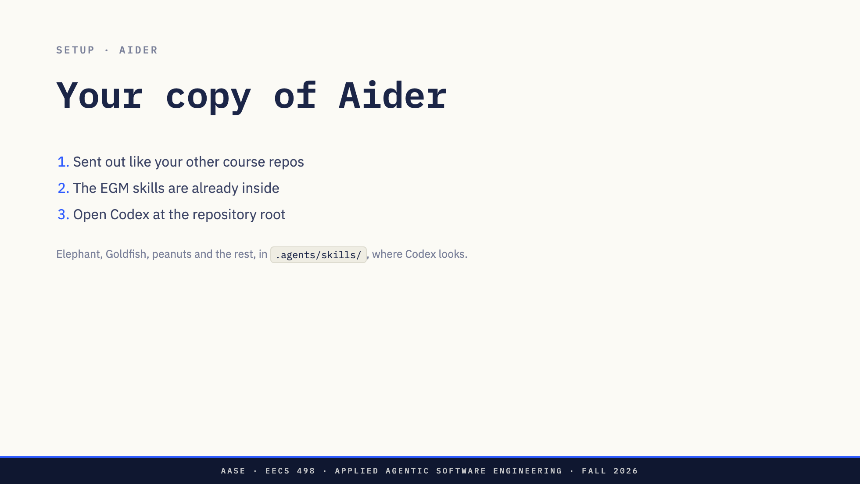
Notes:
About a minute.
Each of you gets your own private copy of Aider from the course, the same
way you got the ai-assistant repository: aase-student/aider-<uniqname>,
generated from the template eecs498-aase/aider. The template is Aider at
upstream commit 5dc9490b, the one every line number in this deck cites. We
installed the EGM skill suite in it before sending it out: peanuts,
elephant, goldfish, egm-implement and mean-review, under .agents/skills/,
which is where Codex looks for a project's skills. You do not install
anything. Aider's own CI and release workflows were removed, so pushing
runs nothing.
Clone it, cd into it, and start codex there. Ask it "what skills do you
have?" and the five should come back.
If the course copy has not reached you yet: clone
https://github.com/Aider-AI/aider, then copy the skills in from the
materials repository, as materials/egm/README.md describes
(cp -R materials/egm/skills/* .agents/skills/ inside the clone).

Slide 13
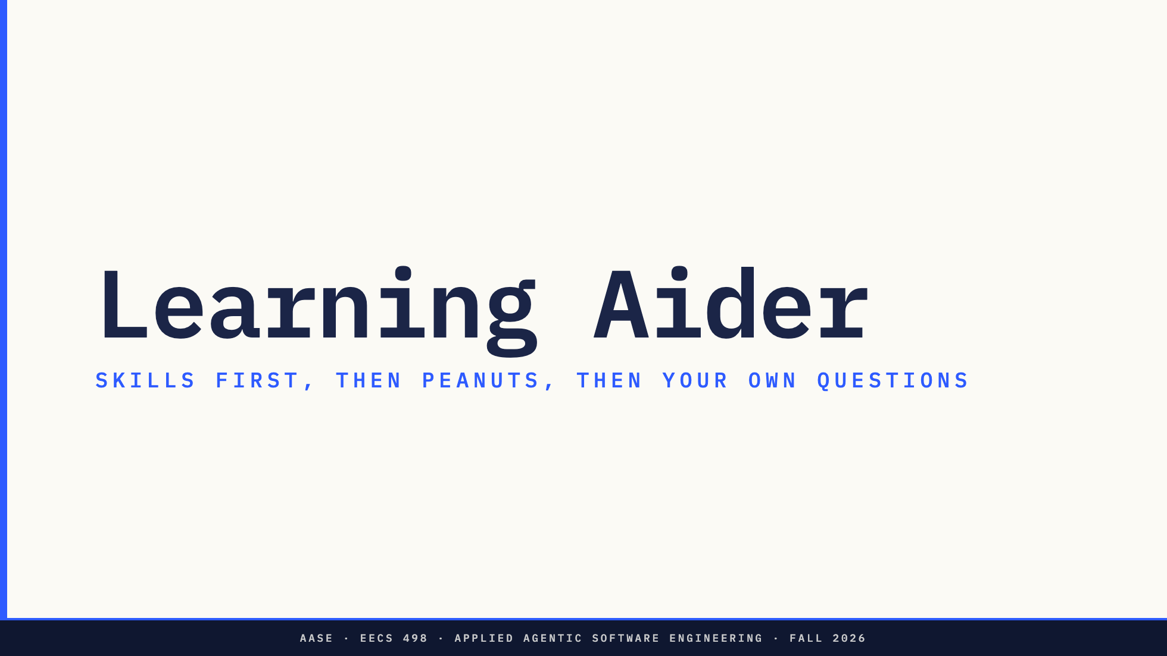

Slide 14
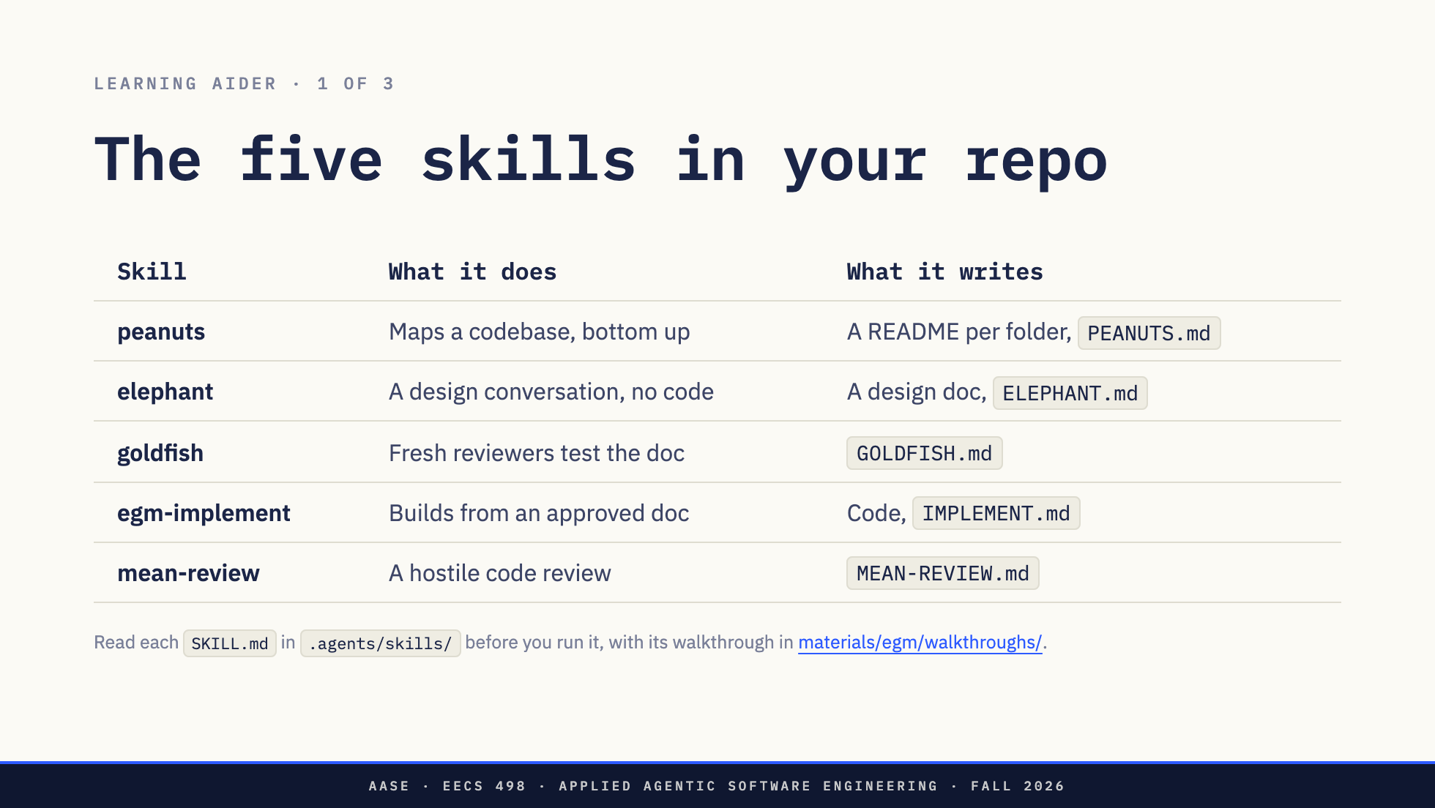
Notes:
About 10 minutes. Students read, before running anything.
A skill is a set of instructions Codex follows. If you run one without
reading it, you do not know what it is about to do to your repository or
when it will stop and wait for you. So read all five first. Each SKILL.md
is 120 to 180 lines.
Read each one beside its walkthrough in the course materials repository:
https://github.com/eecs498-aase/materials/tree/main/egm/walkthroughs
There is one walkthrough per skill (peanuts.md, elephant.md, goldfish.md,
egm-implement.md, mean-review.md), each explaining what problem the skill
solves and why it is built the way it is. Read them in that pipeline order.
egm/anatomy-of-a-skill.md, one folder up, explains how a skill file is put
together, if you want that first.
What to look for in each one:
- The description at the top. It decides when Codex picks the skill.
- The hard rules. What it will never do.
- The steps, and where it stops and waits for you. Those stops are your
review gates.
- The ledger it keeps (PEANUTS.md, ELEPHANT.md and so on). That file is how
it remembers where it is, and how you see it too. Elephant and the rest
keep theirs in docs/egm/<feature>/.
Then check Codex sees them: ask "what skills do you have?" and all five
should come back. If one is missing, the folder is not at
.agents/skills/<name>/SKILL.md.
Today you use peanuts and elephant. The other three are for later.

Slide 15
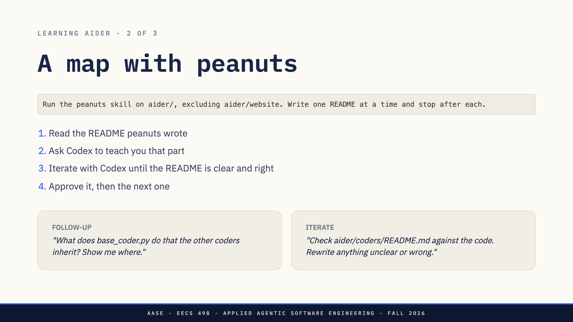
Notes:
About 25 minutes. This is where most of the learning happens.
The run: peanuts writes three READMEs, aider/coders/ and aider/resources/
first, then aider/ itself, built from the two below it plus the 40 or so
modules at the top level. Exclude aider/website: it is the documentation
site, and without the exclusion peanuts plans eleven directories instead of
three. Asking for one README at a time keeps each review small enough to
do properly.
Students do not read the code by hand. Codex reads it and teaches them.
The goal is that they know the structure of each folder at least as well as
the README does.
For each README, in this order:
1. Read the README peanuts wrote. It is short.
2. Ask Codex to teach you that part of Aider. What does this file do? What
calls it? Why is it split this way? Keep asking follow-ups until you
could explain the folder without the README. The left card is an
example.
3. Iterate with Codex on the README until it is clear and right, in the
same session: the right card is a starting prompt. Codex rereads the
code and rewrites what was wrong, missing or vague. Use what you just
learned in step 2: if the README would not have taught you that part,
say so and have Codex fix it. If a change surprises you, ask why.
4. Approve it (tell Codex, or set the status in PEANUTS.md) and let peanuts
write the next one.
Peanuts' own SKILL.md warns that about half of leaf descriptions are wrong,
because at the leaves the model has only the code. Finding those is the
point: it is how you learn the codebase. The checked READMEs are what every
later session, yours or Codex's, starts from.
The next slide is the same habit without the README: ask Codex about
anything in the code.
Not rehearsed on Luna. The plan (three directories) was checked on Oct 5.
base_coder.py is the base class the edit-format coders in aider/coders/
subclass, so the follow-up example has a real answer.

Slide 16
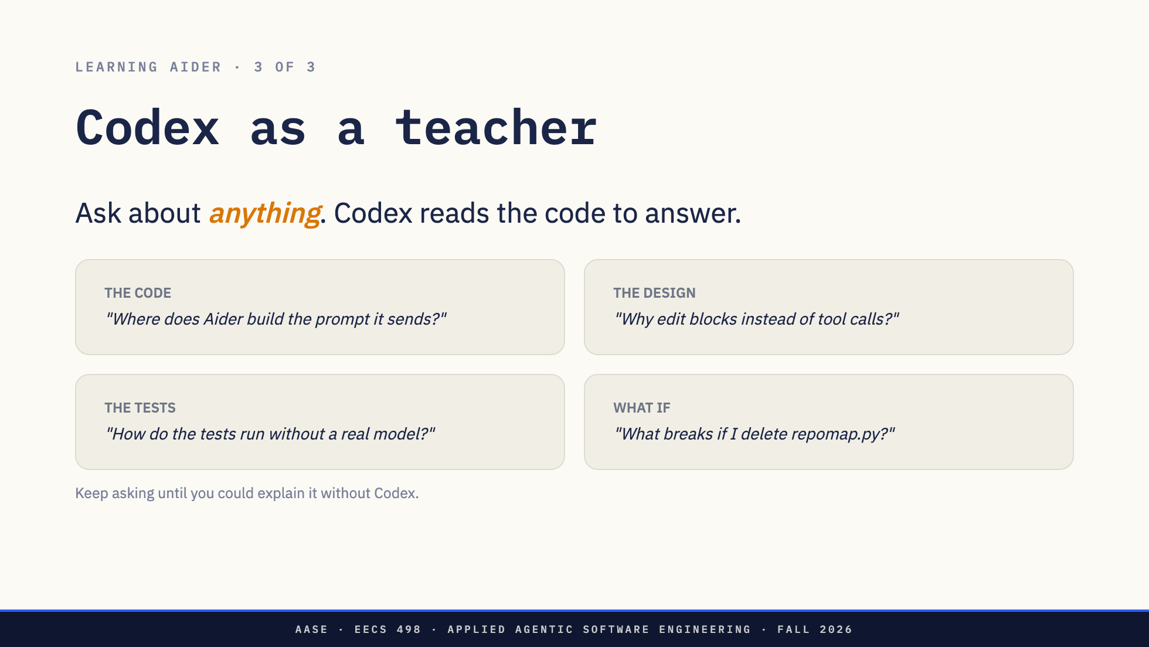
Notes:
About 10 minutes, and a habit for any codebase after this.
This is the main way to learn a codebase this size. You do not need a good
question. Ask what you are curious about, and follow up on whatever comes
back. Codex searches and reads the code to answer, and with the peanuts
READMEs in place it starts from a map.
The four cards are starting points, not a worksheet:
- The code: where something happens, and what calls what.
- The design: why it was built this way, and what the alternative was.
- The tests: how Aider checks itself.
- What if: what depends on what.
Two habits make it work. Ask for file names and line numbers, so you know
where things live. And ask follow-ups at your own level: "explain that like I have never seen this code", "draw it as a
diagram", "ask me three questions about it and tell me what I got wrong".
Answers for staff, at commit 5dc9490b: the system prompt is built in
fmt_system_prompt (base_coder.py:1174) and the messages in
format_chat_chunks (:1226). Aider's model replies with edit blocks in text,
one format per model, rather than tool calls. The tests replace coder.send
with a fake (tests/basic/test_coder.py:462). base_coder imports RepoMap
from aider/repomap.py and builds it at :498 to give the model a map of the
repository. The trace reference in notes.md has the rest.

Slide 17
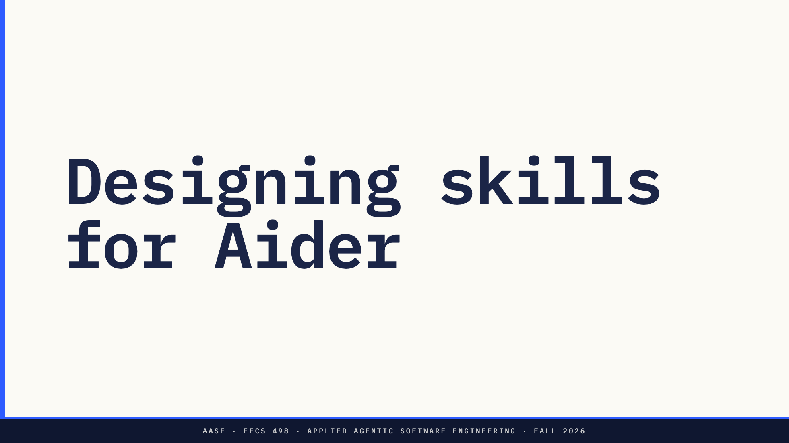

Slide 18
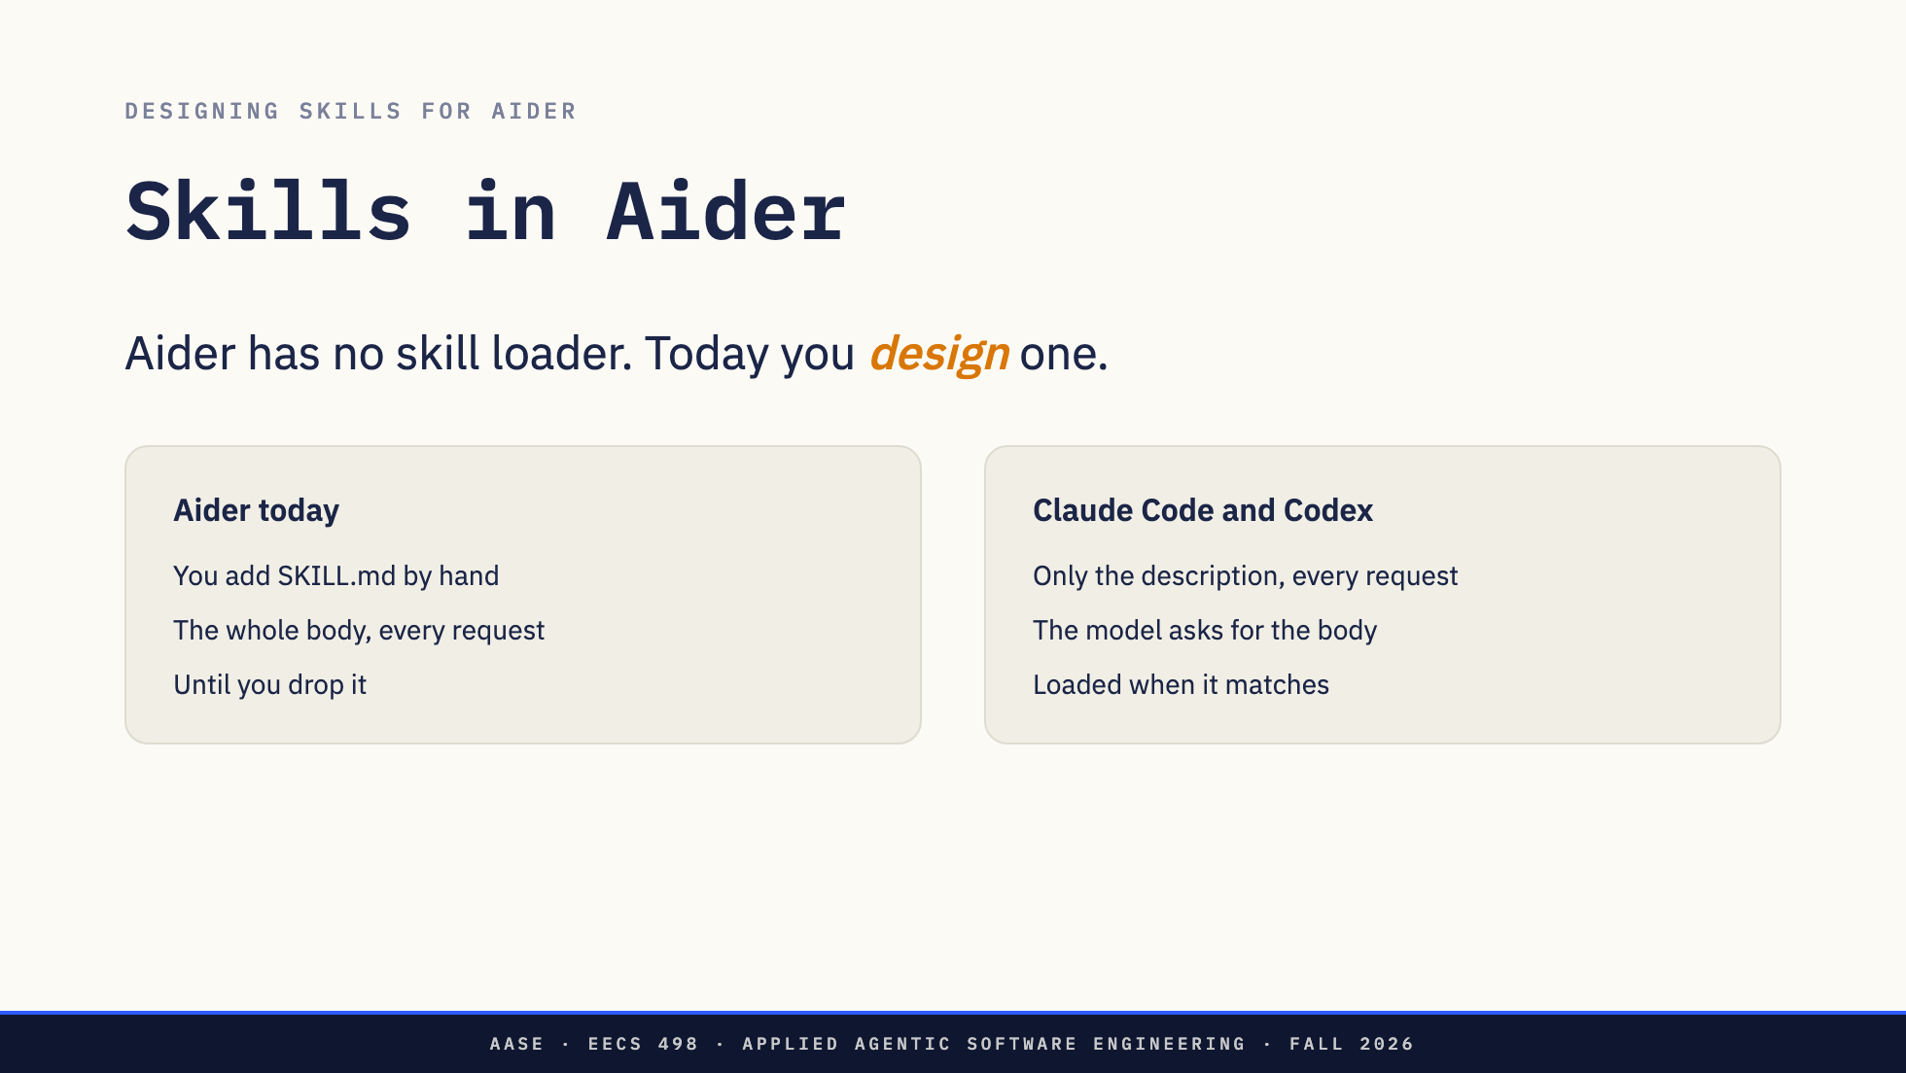
Notes:
About 2 minutes.
Skills are the first thing we add to Aider. You met them in L10, and they
were your second most wanted topic on the form.
Today in Aider, the only way to use a skill is to add its SKILL.md yourself
with /read-only. Then Aider sends the whole body in every request until you
drop it. That costs tokens and crowds the context.
Claude Code and Codex do it in levels. Every request carries only each
skill's name and one-line description. When the task matches, the model
asks for the body, and only then does it load. That is the "three levels of
loading" from L10.
So the feature: Aider finds skills, tells the model what is available, and
loads one when it is needed. How it does each of those is your design.

Slide 19

Notes:
The rest of the session, with staff walking the room.
1. Learn first. Ask Codex where Aider builds the prompt it sends and where
read-only files go in. Check what it says. You cannot design a loader for
code you have not read.
2. Run elephant in Codex and have the design conversation. You make the
decisions: where skills live on disk, how Aider finds them, what goes in
every request, how the model asks for a body, and what happens when two
skills match. The model can suggest. You choose.
3. Then build one small step against your design. Not "add skills to
Aider". One prompt per step, and each prompt carries a decision you made.
What we are not doing: one prompt that builds the whole feature. Luna can
probably produce something that runs. It would be Luna's design, and you
would not know why it works.
You will not finish today. That is fine. This is the start of the Aider
work, not a graded project, and what is required comes later.

Slide 20


