Slide 1
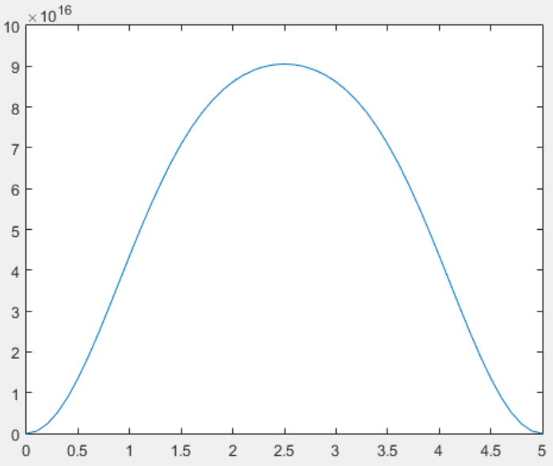
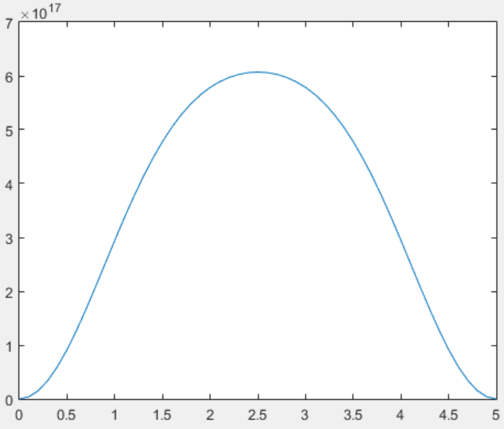
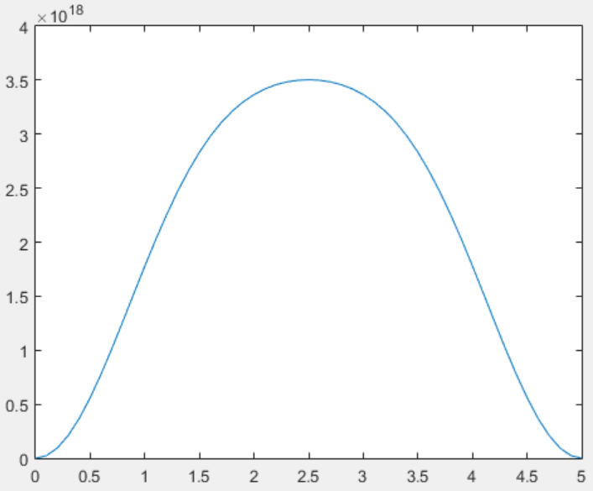
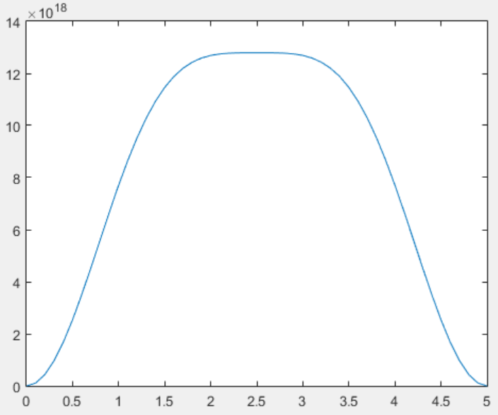
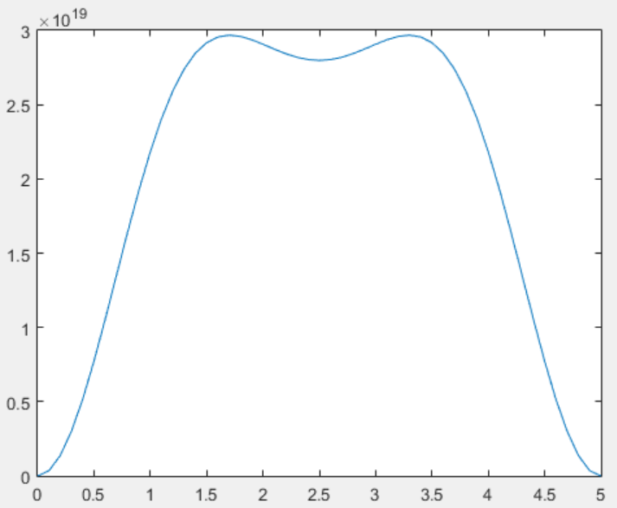





$$E_{F}=−0.1 eV$$
$$E_{F}=−0.05 eV$$
$$E_{F}=0 eV$$
$$E_{F}=0.05 eV$$
$$E_{F}=0.1 eV$$

