Slide 1
N-Grams and Corpus Linguistics
Julia Hirschberg
CS 4705
CS 4705

Slide 2
Linguistics vs. Engineering
“But it must be recognized that the notion (= fanciful idea) of “probability of a sentence” is an entirely useless one, under any known interpretation of this term.” Noam Chomsky (1969), linguist
“Anytime a linguist leaves the group the recognition rate goes up.”
Fred Jelinek (1988), NLP researcher

Slide 3
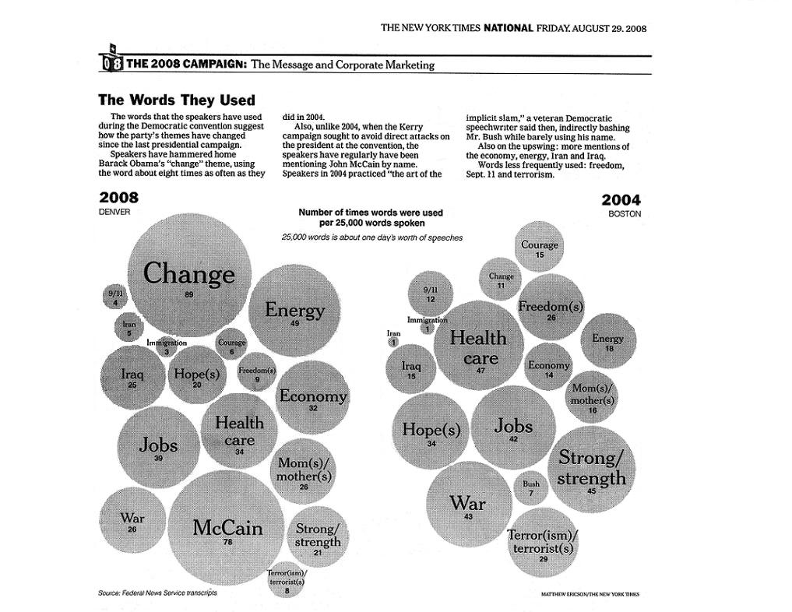

Slide 4
Next Word Prediction
Guest the following words appeared in news ...
  Joko Wi ...
  Joko Wi did …
  Joko Wi did “blusukan” …
  Joko Wi did “blusukan” to ...
  Joko Wi did “blusukan” to hear ...
  Joko Wi did “blusukan” to hear people’s ...
  Joko Wi did “blusukan” to hear people’s opinion ...

Slide 5
Human Word Prediction
Clearly, at least some of us have the ability to predict future words in an utterance (=spoken communication).
How?
  Domain knowledge: red… followed by <blood vs. hat>
  Syntactic (lang. structure) knowledge: the…<adj|noun>
  Lexical (dictionary-based) knowledge: baked…<potato vs. steak>

Slide 6
Claim
A useful part of the knowledge needed to allow Word Prediction can be captured using simple statistical techniques
In particular, we'll be interested in the notion/idea of the probability of a sequence (of letters, words,…)

Slide 7
Useful Applications
Why do we want to predict a word, given some preceding words?
  Rank the likelihood of sequences containing various alternative hypotheses, e.g. for ASR (=automatic speech recognition)
  Theatre owners say <popcorn/unicorn> sales have doubled...
  Assess the likelihood/goodness of a sentence, e.g. for text generation or machine translation
  The doctor recommended a cat scan.
  El doctor recommendó una exploración del gato. CT Scan

Slide 8
N-Gram Models of Language
Use the previous N-1 words in a sequence to predict the next word
Language Model (LM)
  unigrams, bigrams, trigrams,…
How do we train these models?
  Very large corpora

Slide 9
Corpora
Corpora are online collections of text and speech
  Brown Corpus
  Wall Street Journal
  AP newswire
  Hansards
  Timit
  DARPA/NIST text/speech corpora (Call Home, Call Friend, ATIS, Switchboard, Broadcast News, Broadcast Conversation, TDT, Communicator)
  TRAINS, Boston Radio News Corpus

Slide 10
Counting Words in Corpora
What is a word?
  e.g., are cat and cats the same word?
  September and Sept?
  zero and oh?
  Is _ a word? * ? ) . ,
  How many words are there in don’t ? Gonna ?
  In Japanese and Chinese text -- how do we identify a word?

Slide 11
Terminology
Sentence: unit of written language
Utterance: unit of spoken language
Word Form: the inflected form (=word alteration) as it actually appears in the corpus
Lemma: an abstract form, shared by word forms having the same stem, part of speech, word sense – stands for the class of words with same stem
Types: number of distinct words in a corpus (vocabulary size)
Tokens: total number of words

Slide 12
Simple N-Grams
Assume a language has T word types (=distinct words) in its lexicon, how likely is word x to follow word y?
  Simplest model of word probability: 1/T
  Alternative 1: estimate likelihood of x occurring in new text based on its general frequency of occurrence estimated from a corpus (unigram probability)
    popcorn is more likely to occur than unicorn
  Alternative 2: condition the likelihood of x occurring in the context of previous words (bigrams, trigrams,…)
    mythical unicorn is more likely than mythical popcorn

Slide 13
Computing the Probability of a Word Sequence
Compute the product of component conditional probabilities?
  P(the mythical unicorn) = P(the) * P(mythical|the) * P(unicorn|the mythical)
  P(w_{n-2},w_{n-1},w_{n}) = P(w_{n-2}) P(w_{n-1}|w_{n-2}) P(w_{n}|w_{n-1}w_{n-2})
But…the longer the sequence, the less likely we are to find it in a training corpus
    P(Most biologists and folklore specialists believe that in fact the mythical unicorn horns derived from the narwhal)
What can we do?

Slide 14


Bigram Model
Approximate by
  E.g., P(unicorn|the mythical) by P(unicorn|mythical)
Markov assumption: the probability of a word depends only on the probability of a limited history
Generalization: the probability of a word depends only on the probability of the n previous words
  trigrams, 4-grams, 5-grams,…
  the higher n is, the more data needed to train
  backoff models… (3-grams not possible, back to 2-grams)

Slide 15



Using N-Grams
For N-gram models
  ≈
    E.g. for bigrams, ≈
  P(w_{n-1},w_{n}) = P(w_{n} | w_{n-1}) P(w_{n-1})
  P(w₈₋₁,w₈) = P(w₈ | w₇) P(w₇)
  By the Chain Rule we can decompose a joint probability, e.g. P(w₁,w₂,w₃) as follows
    P(w₁,w₂, ...,w_{n}) = P(w₁|w₂,w₃,...,w_{n}) P(w₂|w₃, ...,w_{n}) … P(w_{n-1}|w_{n}) P(w_{n})

Slide 16
For bigrams then, the probability of a sequence is just the product of the conditional probabilities of its bigrams, e.g.
    P(the,mythical,unicorn) = P(unicorn|mythical) P(mythical|the) P(the|<start>)

Slide 17
Training and Testing
N-Gram probabilities come from a training corpus
  overly narrow corpus: probabilities don't generalize
  overly general corpus: probabilities don't reflect task or domain
A separate test corpus is used to evaluate the model
  held out test set; development (dev) test set
  Simple baseline/standard
  results tested for statistical significance – how do they differ from a baseline? Other results?

Slide 18
A Simple Bigram Example
Estimate the likelihood of the sentence I want to eat Chinese food.
  P(I want to eat Chinese food) = P(I | <start>) P(want | I) P(to | want) P(eat | to) P(Chinese | eat) P(food | Chinese) P(<end>|food)
What do we need to calculate these likelihoods?
  Bigram probabilities for each word pair sequence in the sentence
  Calculated from a large corpus

Slide 19
Early Bigram Probabilities from BERP
Eat on
.16
Eat Thai
.03
Eat some
.06
Eat breakfast
.03
Eat lunch
.06
Eat in
.02
Eat dinner
.05
Eat Chinese
.02
Eat at
.04
Eat Mexican
.02
Eat a
.04
Eat tomorrow
.01
Eat Indian
.04
Eat dessert
.007
Eat today
.03
Eat British
.001
The Berkeley Restaurant Project (BeRP) is a testbed for a speech recognition system developed by International Computer Science Institute in Berkeley, CA, contains approximately 7500 sentences, with 1500 words, comprising 6.4 hours of speech. The current system trained on 4786 sentences and tested on 364 sentences achieves a 21% word error.

Slide 20
<start> I
.25
Want some
.04
<start> I’d
.06
Want Thai
.01
<start> Tell
.04
To eat
.26
<start> I’m
.02
To have
.14
I want
.32
To spend
.09
I would
.29
To be
.02
I don’t
.08
British food
.60
I have
.04
British restaurant
.15
Want to
.65
British cuisine
.01
Want a
.05
British lunch
.01

Slide 21
P(I want to eat British food) = P(I|<start>) P(want|I) P(to|want) P(eat|to) P(British|eat) P(food|British) = .25*.32*.65*.26*.001*.60 = .000080
  Suppose P(food|Chinese) = .52?
  How would we calculate I want to eat Chinese food ?
Probabilities roughly capture ``syntactic'' facts and ``world knowledge''
  eat is often followed by an NP
  British food is more popular than Chinese food (0.60 but not eaten by most people => want to eat British food=?)
N-gram models can be trained by counting and normalization
Notes:
P(I|<start>) P(want|I) P(to|want) P(eat|to) P(Chinese|eat) P(food|Chinese) = .25*.32*.65*.26*.02*.52 =

Slide 22
Early BERP Bigram Counts
I
Want
To
Eat
Chinese
Food
lunch
I
8
1087
0
13
0
0
0
Want
3
0
786
0
6
8
6
To
3
0
10
860
3
0
12
Eat
0
0
2
0
19
2
52
Chinese
2
0
0
0
0
120
1
Food
19
0
17
0
0
0
0
Lunch
4
0
0
0
0
1
0
I want
want I

Slide 23
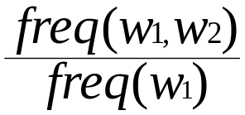
Early BERP Bigram Probabilities
Normalization: divide each row's counts by appropriate unigram counts for w_{n-1}
Computing the bigram probability of I I
  C(I,I)/C( I in call contexts )
  P (I|I) = 8 / 3437 = .0023
Maximum Likelihood Estimation (MLE): relative frequency
I
Want
To
Eat
Chinese
Food
Lunch
3437
1215
3256
938
213
1506
459

Slide 24
What do we learn about the language?
What's being captured with ...
  P(want | I) = P(“I want”)/P(“I”) = 1087/3437 = .32
  ⇒ probability “want” if “I”
  P(to | want) = .65
  P(eat | to) = .26
  P(food | Chinese) = .56
  P(lunch | eat) = .006
What about...
  P(I | I) = .0023
  P(I | want) = .0025
  P(I | food) = .013

Slide 25
  P(I | I) = .0023 I I I I want
  P(I | want) = .0025 I want I want
  P(I | food) = .013 the kind of food I want is ...

Slide 26
N-grams vs. FSA(Finite State Automata)s
How is N-gram modeling stronger than FSAs?
For what kinds of tasks would each be better?
What about automatic speech recognition (ASR)?

Slide 27
Approximating Shakespeare
Generating sentences with random unigrams...
  Every enter now severally so, let
  Hill he late speaks; or! a more to leg less first you enter
With bigrams...
  What means, sir. I confess she? then all sorts, he is trim, captain.
  Why dost stand forth thy canopy, forsooth; he is this palpable hit the King Henry.
Trigrams
  Sweet prince, Falstaff shall die.
  This shall forbid it should be branded, if renown made it empty.

Slide 28
Quadrigrams
  What! I will go seek the traitor Gloucester.
  Will you not tell me who I am?
  What's coming out here looks like Shakespeare because it is Shakespeare
Note: As we increase the value of N, the accuracy of an n-gram model increases, since choice of next word becomes increasingly constrained

Slide 29
N-Gram Training Sensitivity
If we repeated the Shakespeare experiment but trained our n-grams on a Wall Street Journal corpus, what would we get?
Note: This question has major implications for corpus selection or design

Slide 30
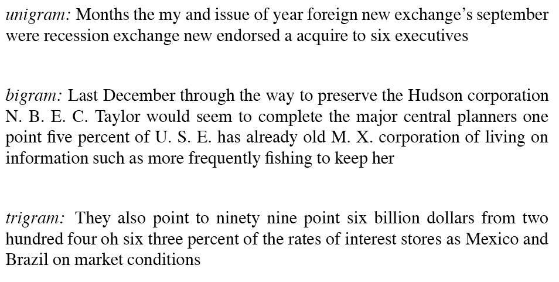
WSJ (Wall Street Journal) is not Shakespeare: Sentences Generated from WSJ

Slide 31
Evaluation and Data Sparsity Questions
Perplexity and entropy: how do you estimate how well your language model fits a corpus once you’re done?
Smoothing and Backoff : how do you handle unseen n-grams?

Slide 32
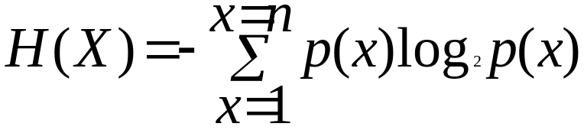
Perplexity and Entropy
Information theoretic metrics
  Useful in measuring how well a grammar or language model (LM) models a natural language or a corpus
Entropy: With 2 LMs and a corpus, which LM is the better match for the corpus? How much information is there (in e.g. a grammar or LM) about what the next word will be? More is better!
  For a random variable X ranging over e.g. bigrams and a probability function p(x), the entropy of X is the expected negative log probability

Slide 33
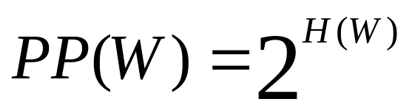
  Entropy is the lower bound on the # of bits it takes to encode information e.g. about bigram likelihood
Cross Entropy
  An upper bound on entropy derived from estimating true entropy by a subset of possible strings – we don’t know the real probability distribution
Perplexity
  At each choice point in a grammar
    What are the average number of choices that can be made, weighted by their probabilities of occurrence?
    I.e., Weighted average branching factor
  How much probability does a grammar or language model (LM) assign to the sentences of a corpus, compared to another LM? The more information, the lower perplexity

Slide 34
Some Useful Observations
There are 884,647 tokens, with 29,066 word form types, in an approximately one million word Shakespeare corpus
  Shakespeare produced 300,000 bigram types out of 844 million possible bigrams: so, 99.96% of the possible bigrams were never seen (have zero entries in the table)
A small number of events occur with high frequency
A large number of events occur with low frequency
You can quickly collect statistics on the high frequency events
You might have to wait an arbitrarily long time to get valid statistics on low frequency events
Some zeroes in the table are really zeros But others are simply low frequency events you haven't seen yet. How to address?

Slide 35
Smoothing
Words follow a Zipfian distribution
  Small number of words occur very frequently
  A large number are seen only once
  Zipf’s law: a word’s frequency is approximately inversely proportional to its rank in the word distribution list
Zero probabilities on one bigram cause a zero probability on the entire sentence
So….how do we estimate the likelihood of unseen n-grams?

Slide 36
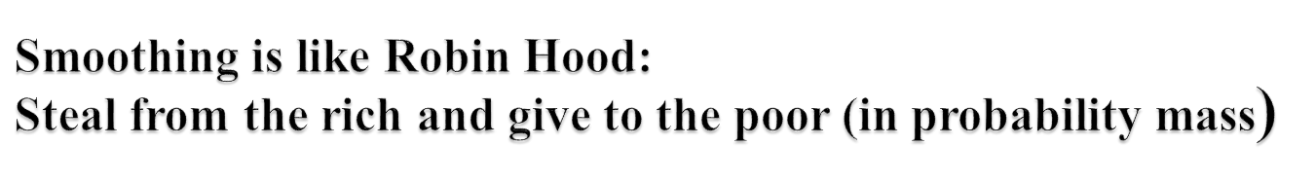
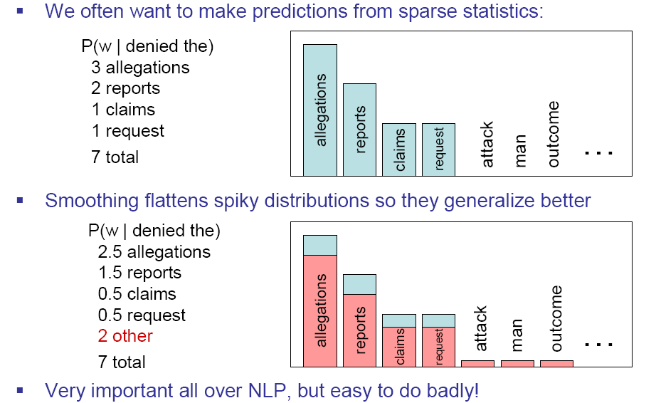
not dense
high freq
Slide from Dan Klein

Slide 37
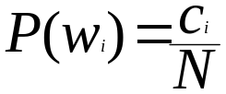
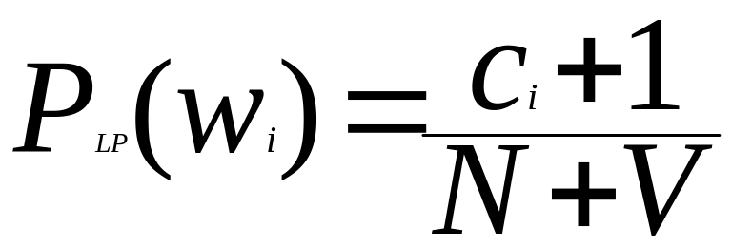
Laplace Smoothing
For unigrams:
  Add 1 to every word (type) count to get an adjusted count c*
  Normalize by N (#tokens) + V (#types)
  Original unigram probability
  c (#counts), N (#tokens)
  New unigram probability
Notes:
N= # tokens, V= #types (vocabulary size)

Slide 38
Unigram Smoothing Example
Tiny Corpus, V=4; N=20
Word | True Ct | Unigram Prob | New Ct | Adjusted Prob
eat | 10 | .5 | 11 | .46
British | 4 | .2 | 5 | .21
food | 6 | .3 | 7 | .29
happily | 0 | .0 | 1 | .04
 | 20 | 1.0 | ~20 | 1.0

Slide 39
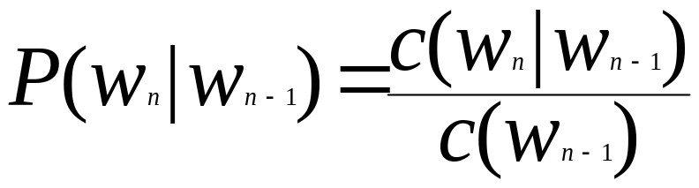
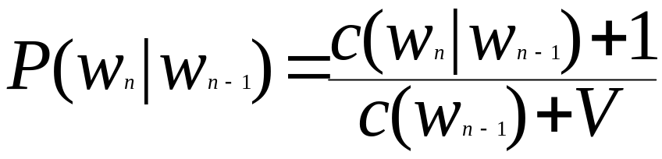
So, we lower some (larger) observed counts in order to include unobserved vocabulary
For bigrams:
  Original
  New
  But this change counts drastically:
    Too much weight given to unseen ngrams
    In practice, unsmoothed bigrams often work better!
    Can we smooth more usefully?

Slide 40
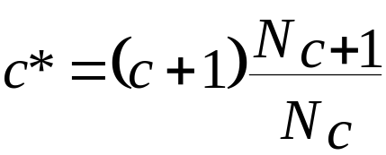
Good-Turing Discounting
Re-estimate amount of probability mass for zero (or low count) ngrams by looking at ngrams with higher counts
  Estimate
  E.g. N₀ (0 count word) is adjusted by the count of ngrams that occur once, N₁
  Assumes:
    Word bigrams each follow a binomial distribution
    We know number of unseen bigrams (VxV-seen)

Slide 41
Backoff Methods (e.g. Katz ’87)
For e.g. a trigram model
  Compute unigram, bigram and trigram probabilities
  Usage:
    Where trigram unavailable back off to bigram if available, o.w. back off to the current word’s unigram probability
    E.g An omnivorous unicorn
NB: check errata pages for changes to figures

Slide 42
Class-Based Backoff
Back off to the class rather than the word
  Particularly useful for proper nouns (e.g., names)
  Use count for the number of names in place of the particular name
  E.g. < N | friendly > instead of < dog | friendly>

Slide 43
Smoothing Summed Up
Add-one smoothing (easy, but inaccurate)
  Add 1 to every word count (Note: this is type)
  Increment normalization factor by Vocabulary size: N (tokens) + V (types)
Good-Turing
  Re-estimate amount of probability mass for zero (or low count) ngrams by looking at ngrams with higher counts
Backoff models
  When a count for an n-gram is 0, back off to the count for the (n-1)-gram
  These can be weighted – trigrams count more
Class-based smoothing
  For certain types of n-grams, back off to the count of its syntactic class….semantic category??
  E.g., Count ProperNouns in place of names (e.g., Obama)

Slide 44
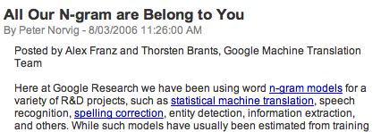

Google N-Grams

Slide 45
Example
serve as the incoming 92
serve as the incubator 99
serve as the independent 794
serve as the index 223
serve as the indication 72
serve as the indicator 120
serve as the indicators 45
serve as the indispensable 111
serve as the indispensible 40
serve as the individual 234

Slide 46
Summary
N-gram probabilities can be used to estimate the likelihood
  Of a word occurring in a context (N-1)
  Of a sentence occurring at all
Entropy and perplexity can be used to evaluate the information content of a language and the goodness of fit of a LM or grammar
Smoothing techniques and backoff models deal with problems of unseen words in corpus
Next Class: Read Ch. 5 on parts-of-speech (POS)

