Slide 1
21st Century Oil Mine: Big Data
Choirudin Emcha

Slide 2
Data
Data
"The quantities, characters, or symbols on which operations are performed by a computer, which may be stored and transmitted in the form of electrical signals and recorded on magnetic, optical, or mechanical recording media. ”, Oxford dictionary
Information
Knowledge

Slide 3
'Big Data'
'Big Data' is a term used to describe collection of data that is huge in size and yet growing exponentially with time. In short, such a data is so large and complex that none of the traditional data management tools are able to store it or process it efficiently.

Slide 4
Characteristics of 'Big Data'
Big data' could be found in three :
Volume
Velocity
Variety

Slide 5
Categories of 'Big Data'
Big data' could be found in three forms:
Structured
Un-structured
Semi-structured

Slide 6
Structured
Any data that can be stored, accessed and processed in the form of fixed format is termed as a 'structured' data
Do you know? Data stored in a relational database management system is one example of a 'structured' data.

Slide 7
Examples Of Structured Data
An 'Employee' table in a database is an example of Structured Data

Slide 8
Un-structured
Any data with unknown form or the structure is classified as unstructured data.
Typical example of unstructured data is, a heterogeneous data source containing a combination of simple text files, images, videos etc.

Slide 9
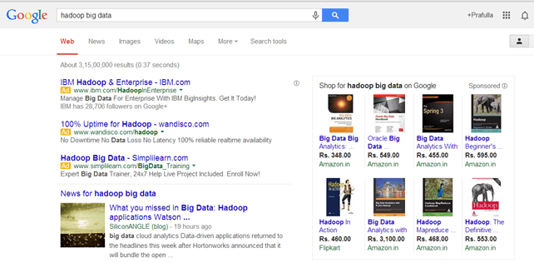
Examples Of Un-structured Data
Output returned by 'Google Search'

Slide 10
Semi-structured
Semi-structured data can contain both the forms of data.
We can see semi-structured data as a structured in form but it is actually not defined with e.g. a table definition in relational DBMS.

Slide 11
Examples Of Semi-structured Data
Personal data stored in a XML file-
<rec><name>Prashant Rao</name><sex>Male</sex><age>35</age></rec>
<rec><name>Seema R.</name><sex>Female</sex><age>41</age></rec>
<rec><name>Satish Mane</name><sex>Male</sex><age>29</age></rec>
<rec><name>Subrato Roy</name><sex>Male</sex><age>26</age></rec>
<rec><name>Jeremiah J.</name><sex>Male</sex><age>35</age></rec>

Slide 12
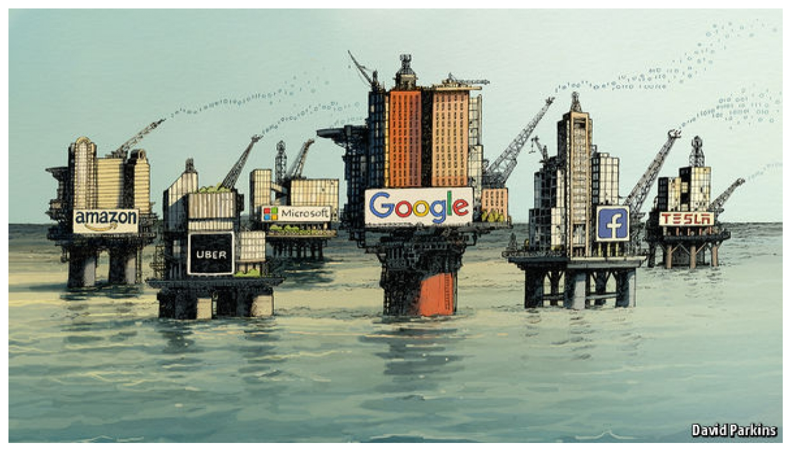
Why Big Data is New Oil Mine?

Slide 13
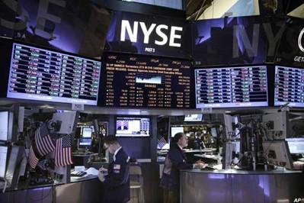
Examples Of 'Big Data'
The New York Stock Exchange generates about one terabyte of new trade data per day.

Slide 14

Examples Of 'Big Data'
Social Media Impact
Statistic shows that 500+terabytes of new data gets ingested into the databases of social media site Facebook, every day. This data is mainly generated in terms of photo and video uploads, message exchanges, putting comments etc.

Slide 15

Examples Of 'Big Data'
Single Jet engine can generate 10+terabytes of data in 30 minutes of a flight time. With many thousand flights per day, generation of data reaches up to many Petabytes.

Slide 16
Advantages Of Big Data Processing
Businesses can utilize outside intelligence while taking decisions.
Improved customer service.
Early identification of risk to the product/services, if any.
Better operational efficiency.

Slide 17
Data Collection
Is the process of gathering data and measuring information on targeted variable
Data Analysis
Is a process of inspecting, cleansing, transforming and modeling data with the goal of discovering useful information
Data Visualization
Is a process of visualize the data with graph or other

Slide 18
Scrapping Instagram

Slide 19
Collecting Data
Install Pyhton
Install via PIP
pip install InstagramApi
Or Download Repository
Download repository
https://github.com/LevPasha/Instagram-API-python.git
Navigate to Instagram-API-python
cd Instagram-API-python
Install the dependencies
pip install -r requirements.txt

Slide 20
Create Example
test.py
from InstagramAPI import InstagramAPI API = InstagramAPI(USERNAME, PASSWORD) API.login() API.getTimeline() result = API.LastJson print(result) API.logout()

Slide 21
RetrieveTagfeed.py
import time import json import random from datetime import datetime from InstagramAPI import InstagramAPI tag = 'ugm’ username = '’ pwd = '’ API = InstagramAPI(USERNAME, PASSWORD) API.login() page = 1 more_available = True data = [] while more_available: try: API.tagFeed(tag) datum = API.LastJson if not datum['more_available']: more_available = False data.append([datum]) print(str(page)) page += 1 time.sleep(5 * random.random()) if page >= 1: more_available = False except: more_available = False with open(tag+'.json', 'w') as outfile: json.dump(data, outfile, indent=4) API.logout()

Slide 22
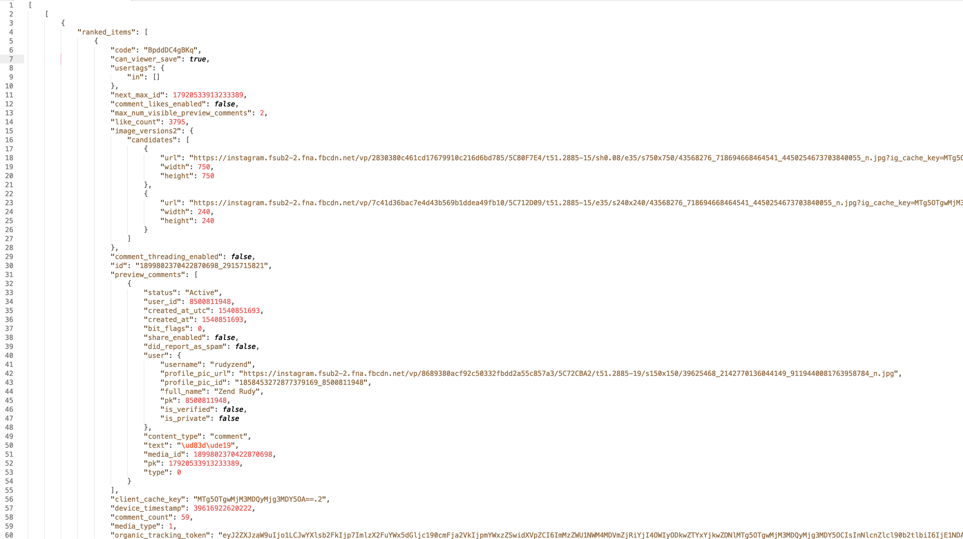

Slide 23
ELK
Insert ke ELK

Slide 24
Data Visualization
Pake kibana

Slide 25
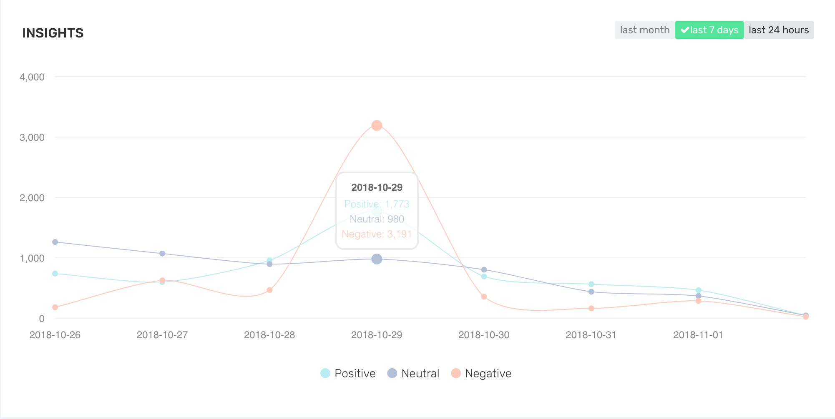
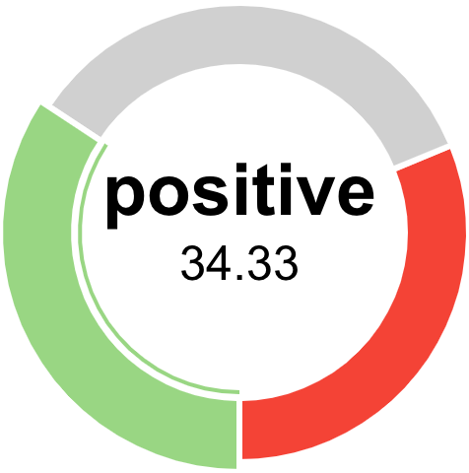
Sentiment

Slide 26


Slide 27
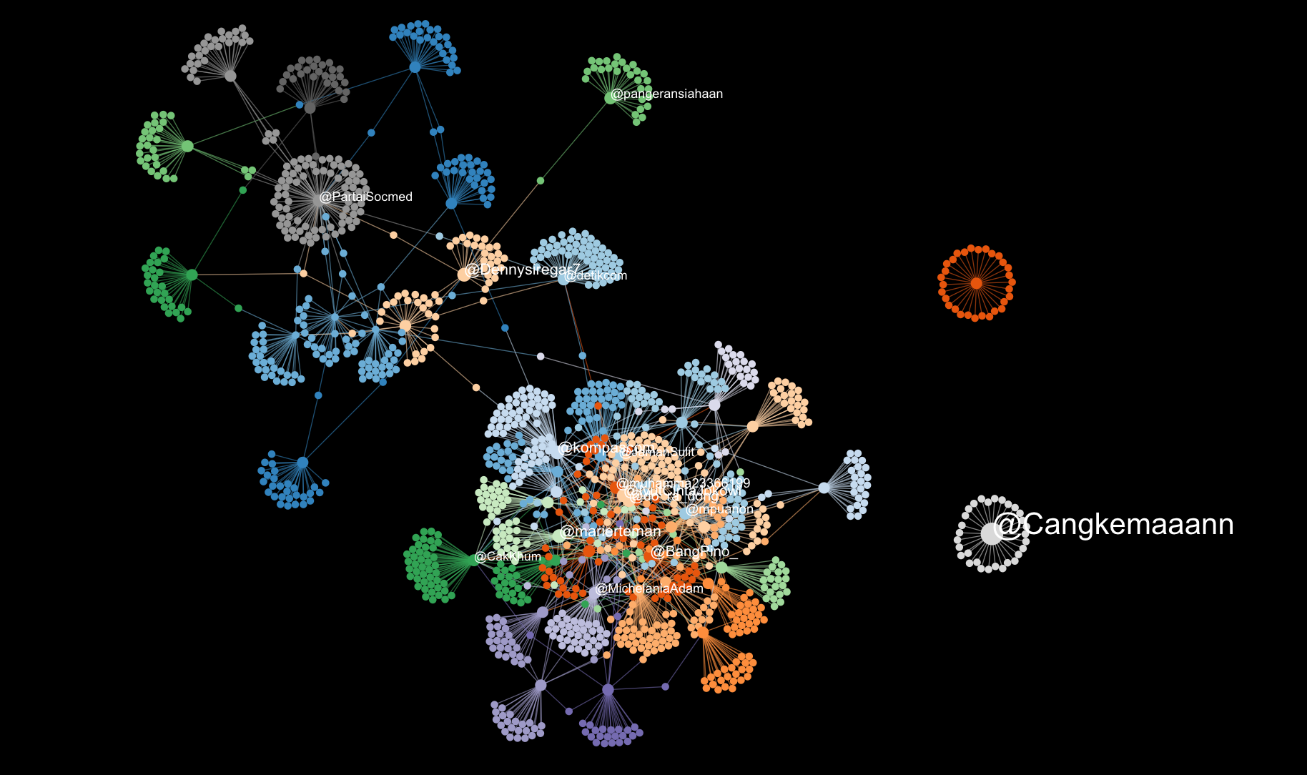

Slide 28

@choirudinemcha
Thank You

