Slide 1
기초전자회로실험및실습
Week 3
Moon-Kyu Cho
School of Computer Engineering & Information Technology Korea National University of Transportation
Moon-Kyu Cho, 2021
1
Moon-Kyu Cho, 2022

Slide 2
Contents
Object of Experiment
Ohm’s law
Voltage, Current, Power
Resistors
Ohm’s law
Experiment
Preliminary Report
2

Slide 3
Object of Experiment
Week 3
Learn “how to read the resistance value of some resistors”
Experiment the “how to measure the resistance (fixed and variable) using the multi-meter”
Experiment the “how to measure the voltage or current using the multi-meter”

Slide 4
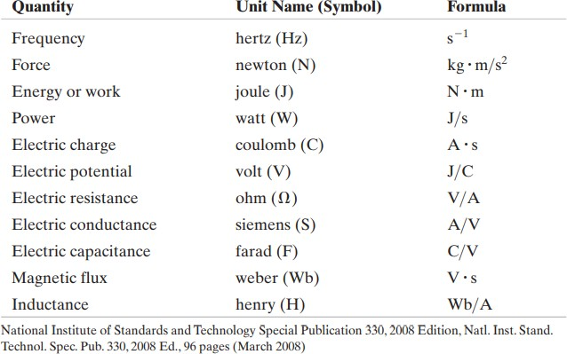
0. Preliminary Knowledge
The International System of Units (SI)

Slide 5
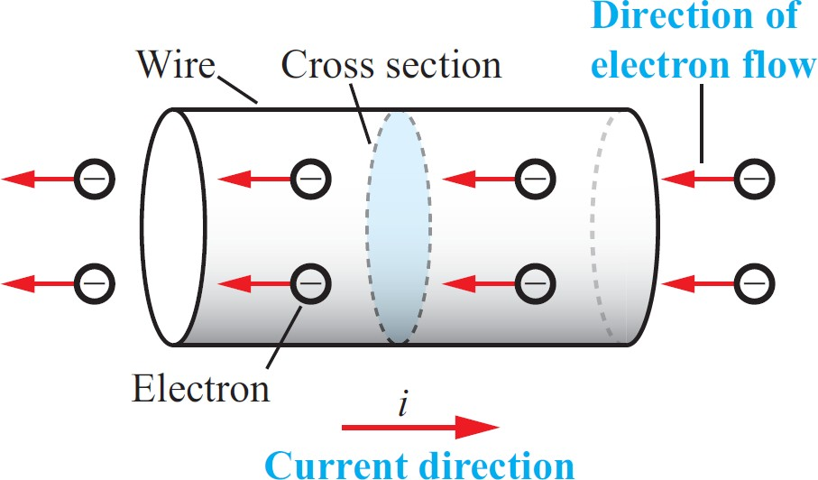
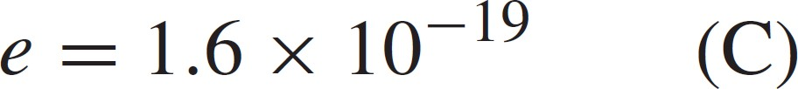
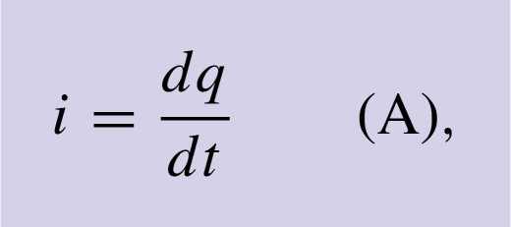
1.1 Charge and Current
Electric current is the rate of charge flow.
SI unit: ampere
Unit of charge = coulomb
C/S = A
1 C = 6.25 x 10¹⁸개의 전자
i = the current in amperes q = the charge in coulombs t = the time in seconds

Slide 6
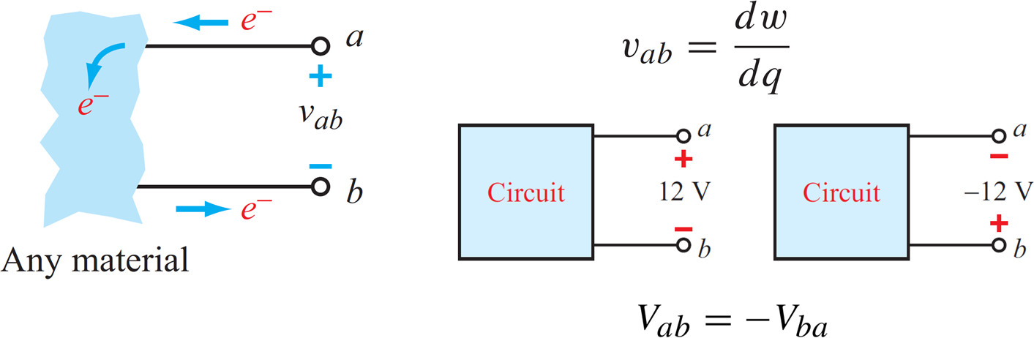
1.2 Voltage and Power
Voltage is the energy per unit charge created by charge separation.
SI unit: volt
v = the voltage in volts
w = the energy in joules
q = the charge in coulombs

Slide 7
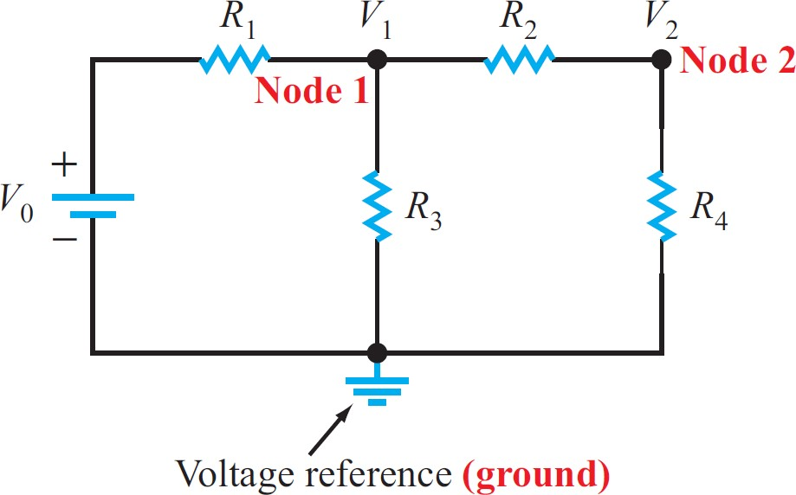
1.3 Voltage and Power
Ground is reference point for electric potential.
unit: 0

Slide 8
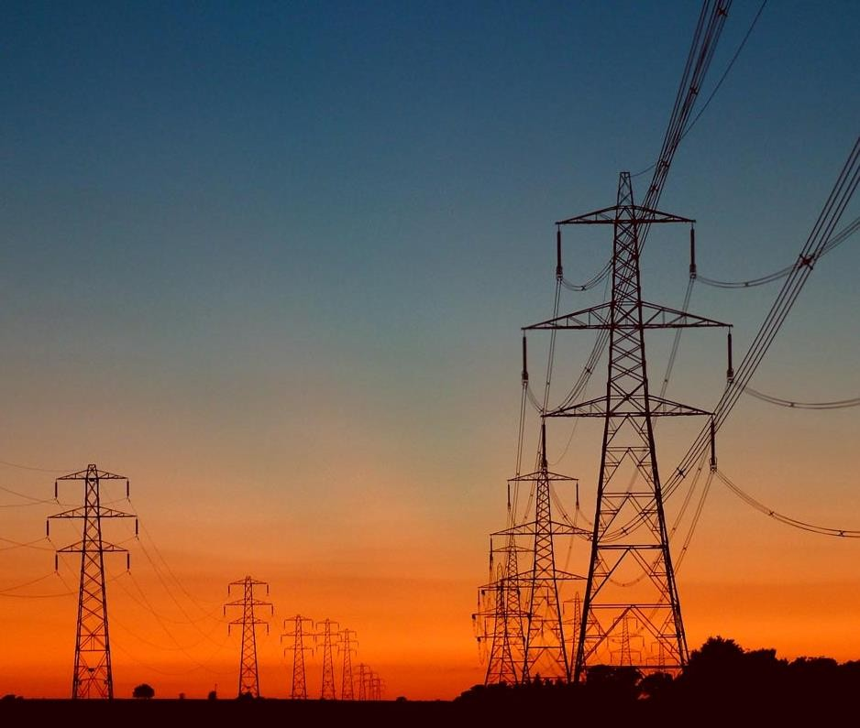
1.4 Voltage and Power
Power is energy per unit of time
SI unit: watt
_{P =} dw ₌ dw dq _{= vi} dt dq dt
p = the power in watts w = the energy in joules t = the time in seconds
i = the current in amperes
v = the voltage in volts

Slide 9
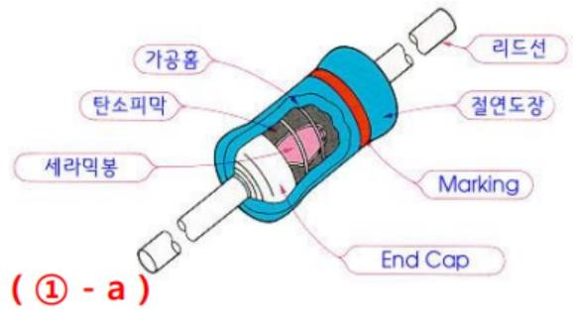
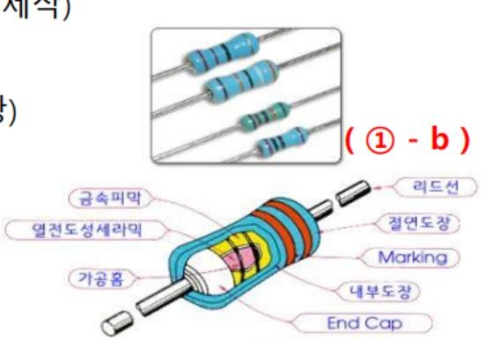
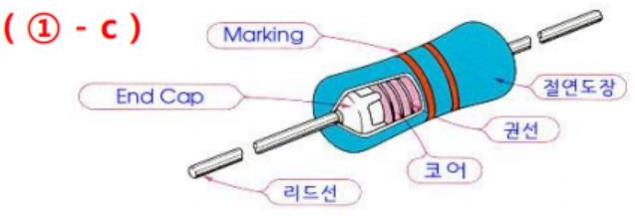
2.1 Resistor
Resistor
Passive electrical component that implements electrical resistance (unit: ohm)
Fixed or variable resistors
Carbon (composition or film) / metal film / wirewound
① Fixed resistor
Carbon film: 일반적인 용도로 많이 사용되고 가격이 저렴하나 잡음이 많이 발생한다는 단점
(미세한 신호의 변화를 감지하는 아날로그 회로에는 사용하기 어려우나, 디지털 회로용으로 사용 적합)
Metal film: Carbon film보다 온도에 따른 저항값의 변화가 적고, 잡음에도 강한 우수한 저항
(유리, 세라믹 기판에 니크롬 등의 금속 박막을 입혀 제작)
Wirewound: 코일형태로 제작, 선의 길이와 굵기 조절로 고정밀 저항 제작 (할로우 / 시멘트 저항)

Slide 10
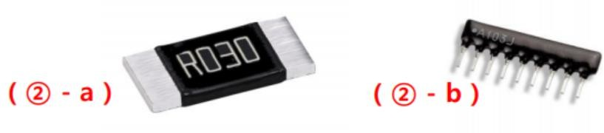
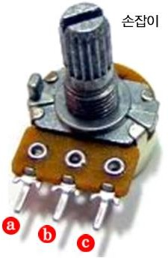
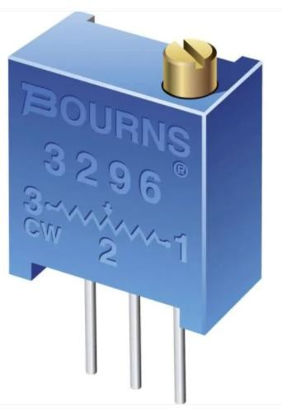
2.1 Resistor
② Other resistors
Chip resistor: PCB (Printed Circuit Board)에서의 실장 공간을 줄이기 위한 소형 저항
(리드선에 없고 바로 solderin을 이용하여 사용)
Array resistor: 같은 크기의 저항 여러 개가 나열된 일체형 저항
③ Variable resistor (potentiometer)
Three-terminal resistor with a sliding contact that forms an adjustable voltage divider
a – c: Maximum resistance
a – b: “a” ohms (smaller than maximal resistance)
b – c: maximal resistance – “a” ohms

Slide 11
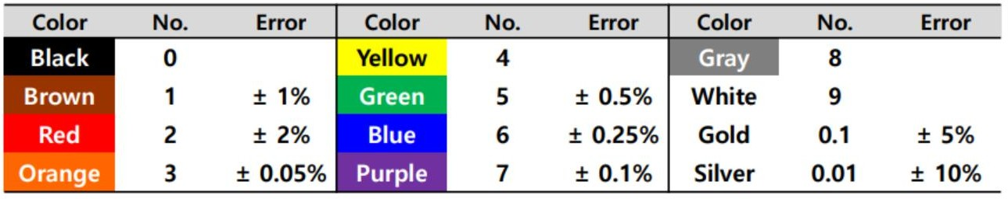
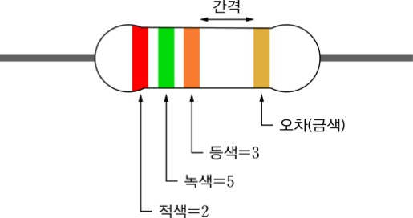
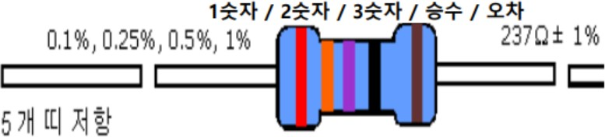
2.1 Resistor
④ Color code of resistance

Slide 12
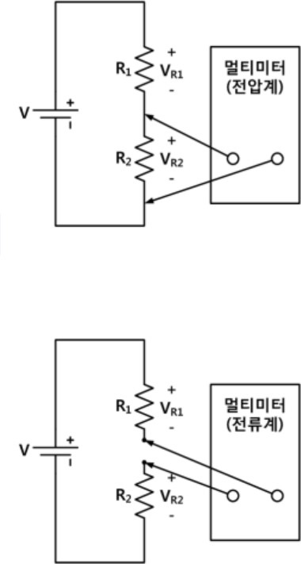
3.1 Measurement
How to measure voltage
Insert black and red lead-cables into COM/VΩHz ① sockets
Select Function switch ② (DC or AC voltage)
Select a range of measuring voltage ③
Connect the lead-cables into measuring part (parallel connection)
How to measure current
Insert black and red lead-cables into COM/mA ① sockets
Select Function switch ② (DC or AC current)
Select a range of measuring voltage ③
Connect the lead-cables into measuring part (series connection)

Slide 13
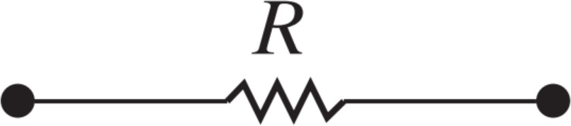
4.1 Electrical Resistance (Ohm’s Law)
Resistor
v = iR → R = v/i [Ω]
A resistor constrains its voltage and current to be proportional to each other.
The value of the proportional constant relating voltage and current in a resistor is called its resistance.
It is measured in: ohms

Slide 14
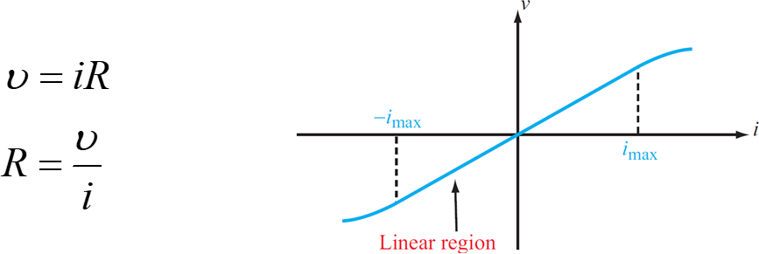
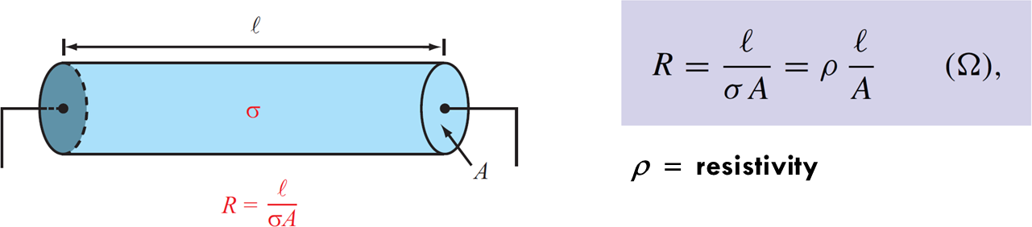
4.1 Electrical Resistance (Ohm’s Law)
Resistor
− Voltage across resistor is proportional to current

Slide 15
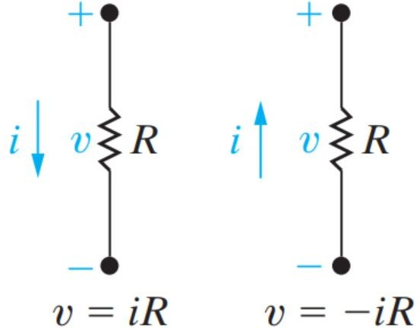
4.1 Electrical Resistance (Ohm’s Law)
Resistor
1
𝑅
v = iR → i = vG ⸪ G =
(𝑆)
v = the voltage in volts
i = the current in amperes
R = the resistance in ohms
G = the conductance in siemens (mho)
Ohm’s law establishes the proportionality of voltage and current in a resistor.
If the current flow in the resistor is in the direction of the voltage drop across it.

Slide 16
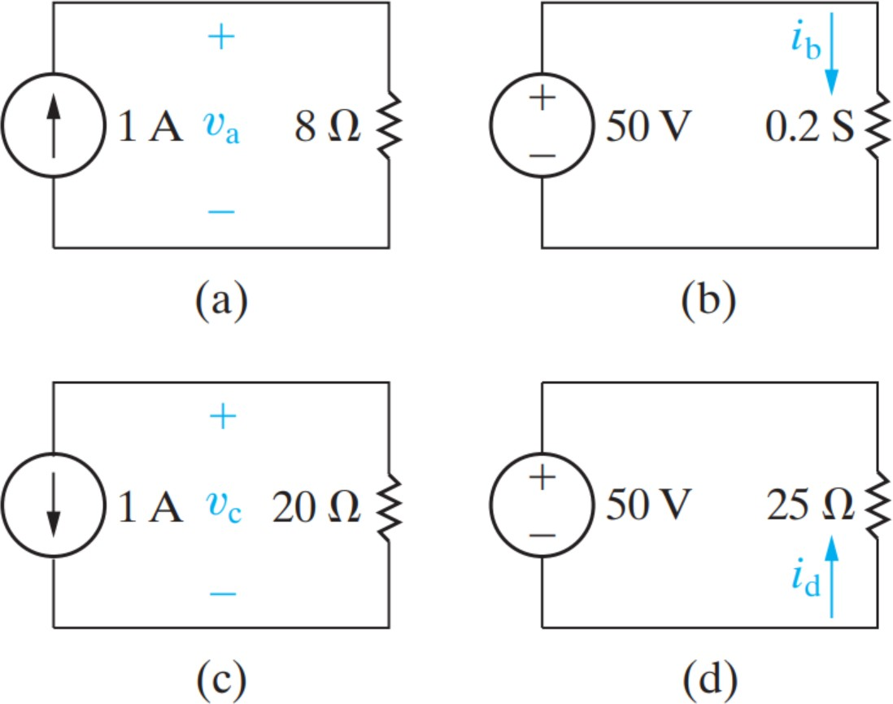
4.1 Electrical Resistance (Ohm’s Law)
Ex1) Calculating voltage, current, and power for a simple resistive circuit. In each circuit in figure, either the value of v or i is not known.
Calculate the values of v and i.
Determine the power dissipated in each resistor.

Slide 17
주의사항
모든 계측정비는 반드시 조작법을 숙지후 사용
디지털 멀티미터 (전류 측정 후 측정 모드를 바꾸지 않고 그대로 전압을 측정하면 손상)
DC 전원을 인가중에 부품 탈부착 절대 금지
DC 전원 사용시에는 회로의 동작 전류 양을 파악하여 compliance를 반드시 설정할 것
Bread board 사용 수칙을 준수할 것

