Slide 1
기초전자회로실험및실습
Week 10
Moon-Kyu Cho
School of Computer Engineering & Information Technology Korea National University of Transportation
Moon-Kyu Cho, 2021
1
Moon-Kyu Cho, 2022

Slide 2
Contents
Object of Experiment
Circuit Theory
− Maximum power transfer
Experiment
Preliminary Report
2

Slide 3
Object of Experiment
Week 10
Learn “maximum power transfer”
Experiment the “maximum power transfer”

Slide 4
Maximum Power Transfer
In some applications, the purpose of a circuit is to provide maximum power to a load. Some examples:
Stereo amplifier
Radio transmitters
Communications equipment
Charger

Slide 5
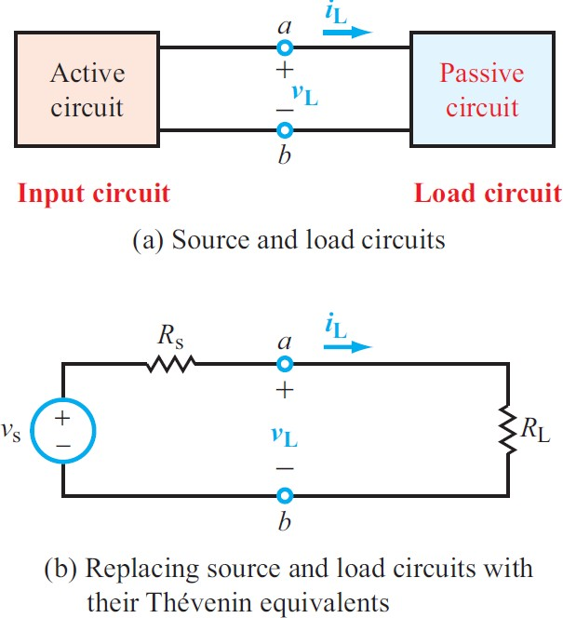
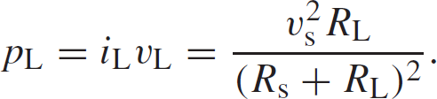
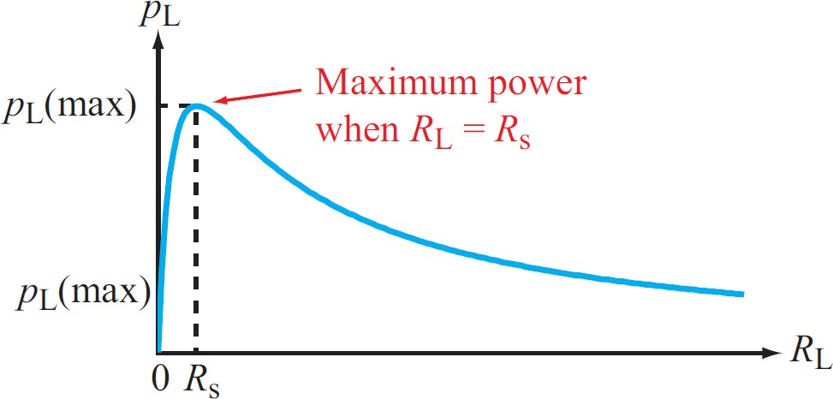
Maximum Power Transfer
The value of R_{L} to deliver maximum power to the load R_{L}

Slide 6
Maximum Power Transfer
The power delivered when R_{s}=R_{L} is
𝑣²𝑅 𝑣²𝑅
𝑣²𝑅
_{𝑣}2
₌ 𝑠 𝐿 ₌ 𝑠 𝑠 ₌ 𝑠 𝑠 ₌ 𝑠 _{= 𝑃}
𝑃_{𝐿} = 𝑖_{𝐿}𝑣_{𝐿}
2 2
𝑀𝐴𝑋
𝑅_{𝑠} + 𝑅_{𝐿} 𝑅_{𝑠} + 𝑅_{𝑠} 4𝑅_{𝑠}
4𝑅 ²
𝑠
Efficiency
− When maximum power is delivered to R_{L,} the efficiency is a 50%
^{𝑝}𝑜𝑢𝑡
𝑖²𝑅_{𝐿}
𝜂 =
𝑝
=
𝑖²𝑅 + 𝑖²𝑅
× 100% = 50%
𝑖𝑛
𝑠
𝐿

Slide 7
주의사항
모든 계측정비는 반드시 조작법을 숙지후 사용
디지털 멀티미터 (전류 측정 후 측정 모드를 바꾸지 않고 그대로 전압을 측정하면 손상 – 손상시에 마이너스 점수 부여)
DC 전원을 인가중에 부품 탈부착 절대 금지
DC 전원 사용시에는 회로의 동작 전류 양을 파악하여 compliance를 반드시 설정할 것
Bread board 사용 수칙을 준수할 것

