Slide 1
기초전자회로실험및실습
Week 9
Moon-Kyu Cho
School of Computer Engineering & Information Technology Korea National University of Transportation
Moon-Kyu Cho, 2021
1
Moon-Kyu Cho, 2022

Slide 2
Contents
Object of Experiment
Circuit Theory
− Superposition property
Experiment
Preliminary Report
2

Slide 3
Object of Experiment
Week 9
Learn “superposition property”
Experiment the “superposition property”

Slide 4
Principle of Superposition
In a linear system, the linear response of linear independent sources can be combined in a linear manner.
This allows us to solve circuits with on independent source at a time and then combine the solutions.
If an independent voltage source is not present it is replaced by a short circuit.
If an independent current source is not present it is replaced by an open circuit.
If dependent source allows us to solve circuits with on independent source at a time and then combine the solutions.

Slide 5
Principle of Superposition
Linear System
A system that satisfies the superposition properties
− If y₁(t) = H[x₁(t)] and y₂(t) = H[x₂(t)]
H[a · x₁(t)] = aH[x₁(t)] = ay₁(t) (homogeneous: 동질성)
scaling before and after the system is the same
2. H[x₁(t) + x₂(t)] = H[x₁(t)] + H[x₂(t)] = y₁(t) + y₂(t) (additivity: 가산성)
summing before and after the system is the same
H[ax₁(t) + bx₂(t)] = aH[x₁(t)] + bH[x₂(t)] = ay₁(t) + by₂(t), for a, b are constant
Input
ax₁(t) + bx₂(t)
System
H
Output
ay₁(t) + by₂(t)

Slide 6


Principle of Superposition
Meaning of linearity
System
H
System
H
x(t)
a
y(t)
x(t)
a
y(t)
System
H
x (t)
y(t)
x₁(t)
1
System
H
y(t)
System
H
x (t)
x₂(t)
2

Slide 7
Principle of Superposition
If dependent sources exist, they must remain in the circuit for each solution.
Nonlinear responses such as power cannot be found directly by superposition.
Only voltages and currents can be found by superposition.

Slide 8
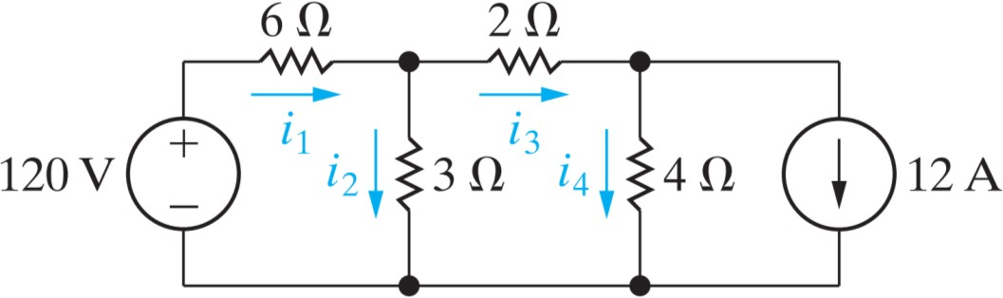
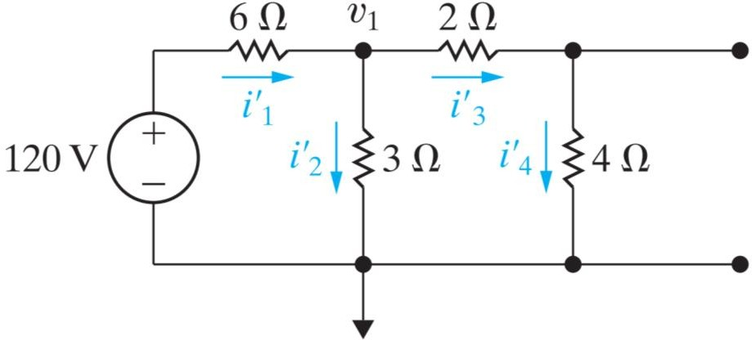
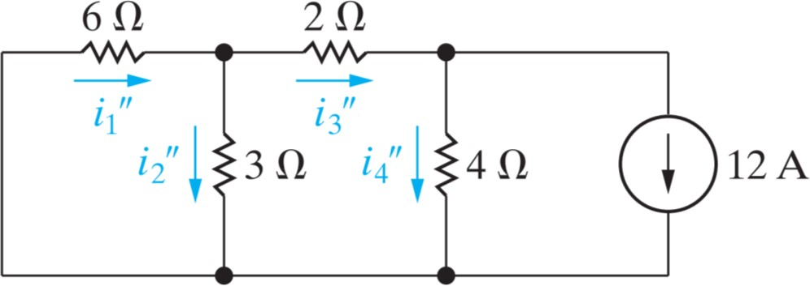
Principle of Superposition
Circuit with multiple independent sources.
− Consider each independent source separately and add each results

Slide 9
주의사항
모든 계측정비는 반드시 조작법을 숙지후 사용
디지털 멀티미터 (전류 측정 후 측정 모드를 바꾸지 않고 그대로 전압을 측정하면 손상 – 손상시에 마이너스 점수 부여)
DC 전원을 인가중에 부품 탈부착 절대 금지
DC 전원 사용시에는 회로의 동작 전류 양을 파악하여 compliance를 반드시 설정할 것
Bread board 사용 수칙을 준수할 것

Slide 10
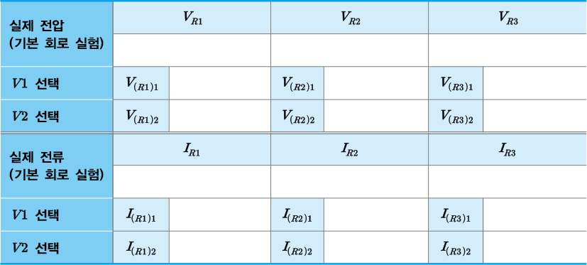
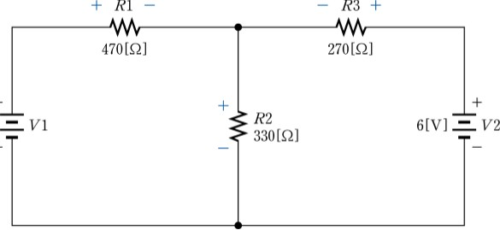
9주차 실험
(기본 회로 실험) 아래와 같이 회로를 구성한 후 각 저항에 걸린 전압 및 전류를
측정하여 표에 기록하라. (R₁, R₂, R₃값을 모두 다르게 구성)
V₁를 제거한 후 각 저항에 걸린 전압 및 전류를 측정하여 표에 기록하라.
V₂를 제거한 후 각 저항에 걸린 전압 및 전류를 측정하여 표에 기록하라.

