Slide 1
Master UI
_EU_Interactive_Component_B2B
Last Update : 2019.01.30 Ver. 1.0

Slide 2
0. Index
0. IA
0. Break Point
1. Common
2. Behaviour

Slide 3
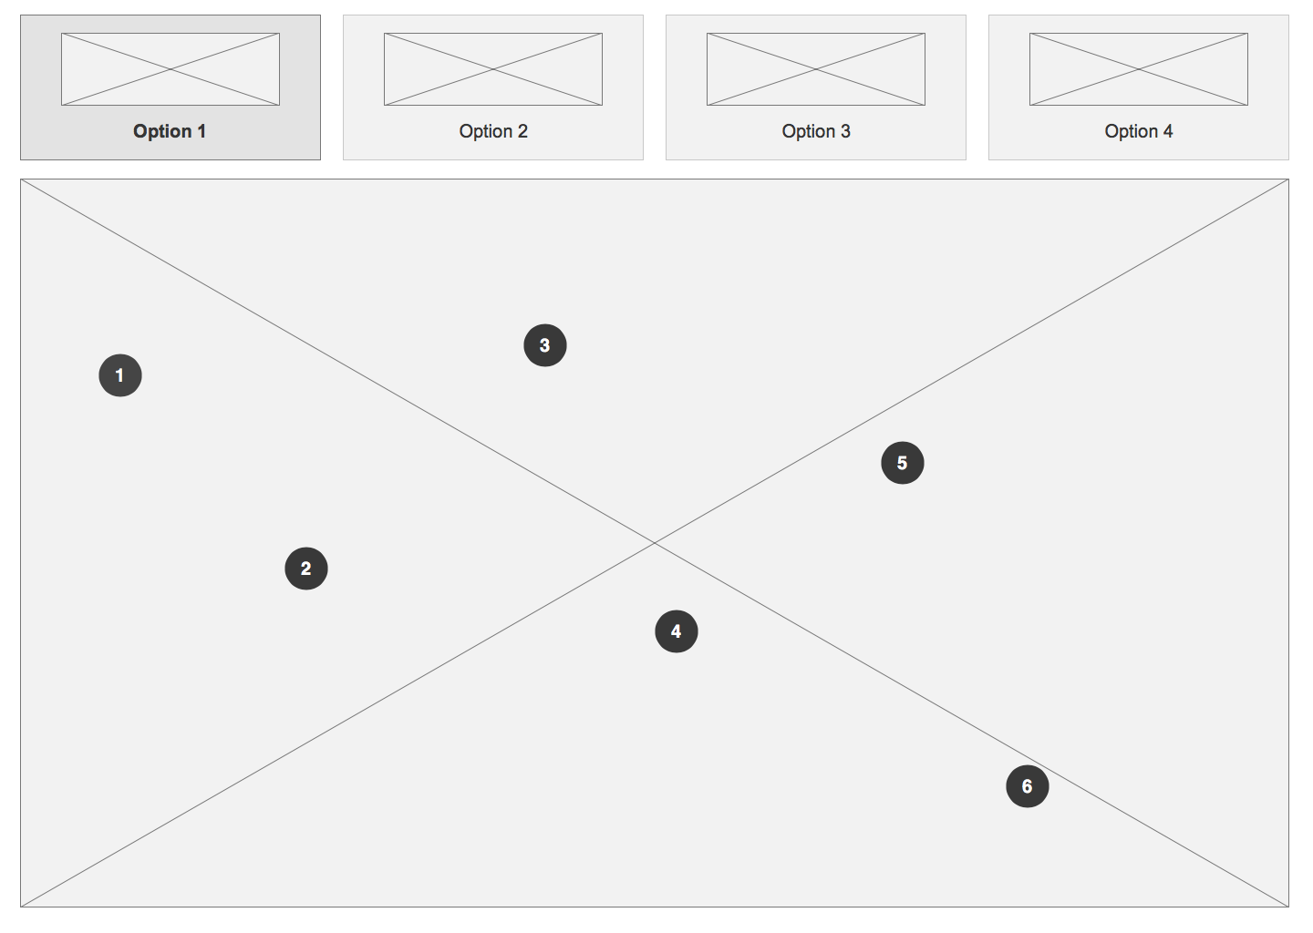
0. Description
The component is an interactive image (2D or 3D).
Image is annotated with numbers, which can be clicked to expand more information on different parts.
Functions similar to:
https://www.aircon.panasonic.eu/GB_en/applications/shops/

Slide 4
0. IA

Slide 5
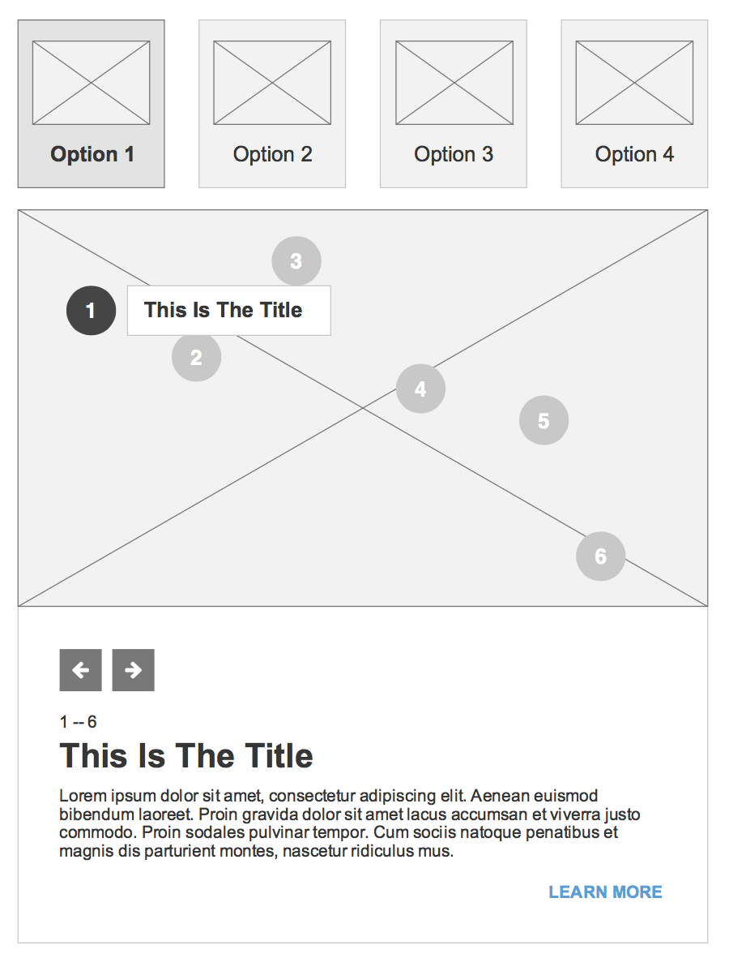
0. Overview
Desktop
Mobile

Slide 6
0. Overview (General Structure)
Image Selector
Allows the user to change the active image. Optional Component.
Interactive image
Contains multiple interactive areas with a background image.

Slide 7
0. Overview (General Structure)
Image Selector can have 2 to 4 options. If there is only one option, the section is hidden. Less than 4 options is displayed as in this image.

Slide 8
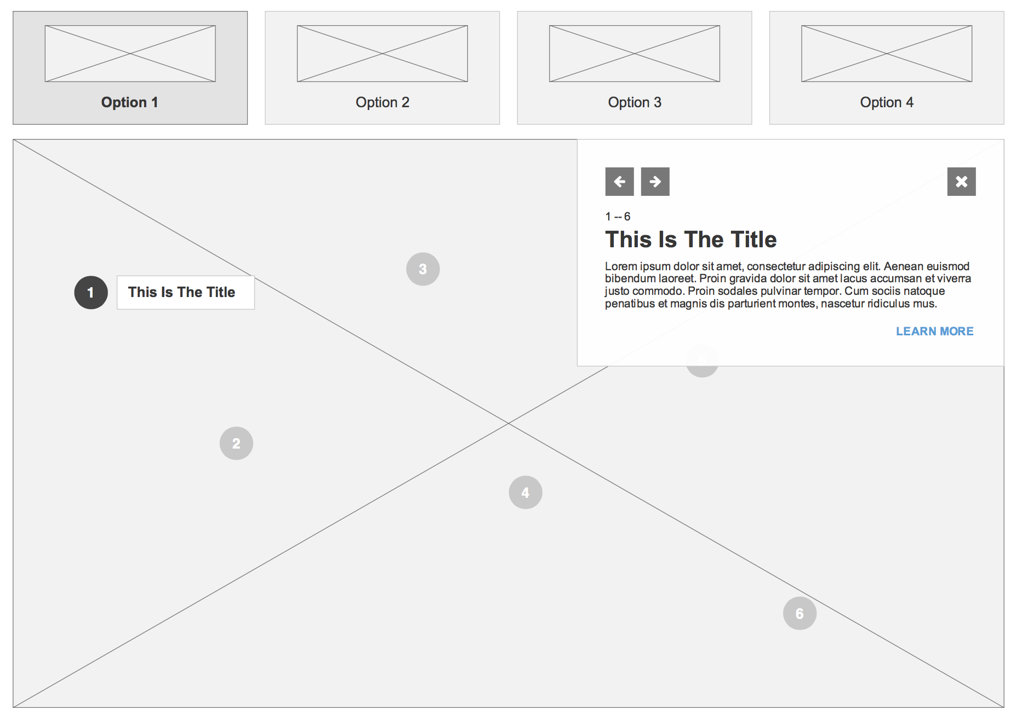
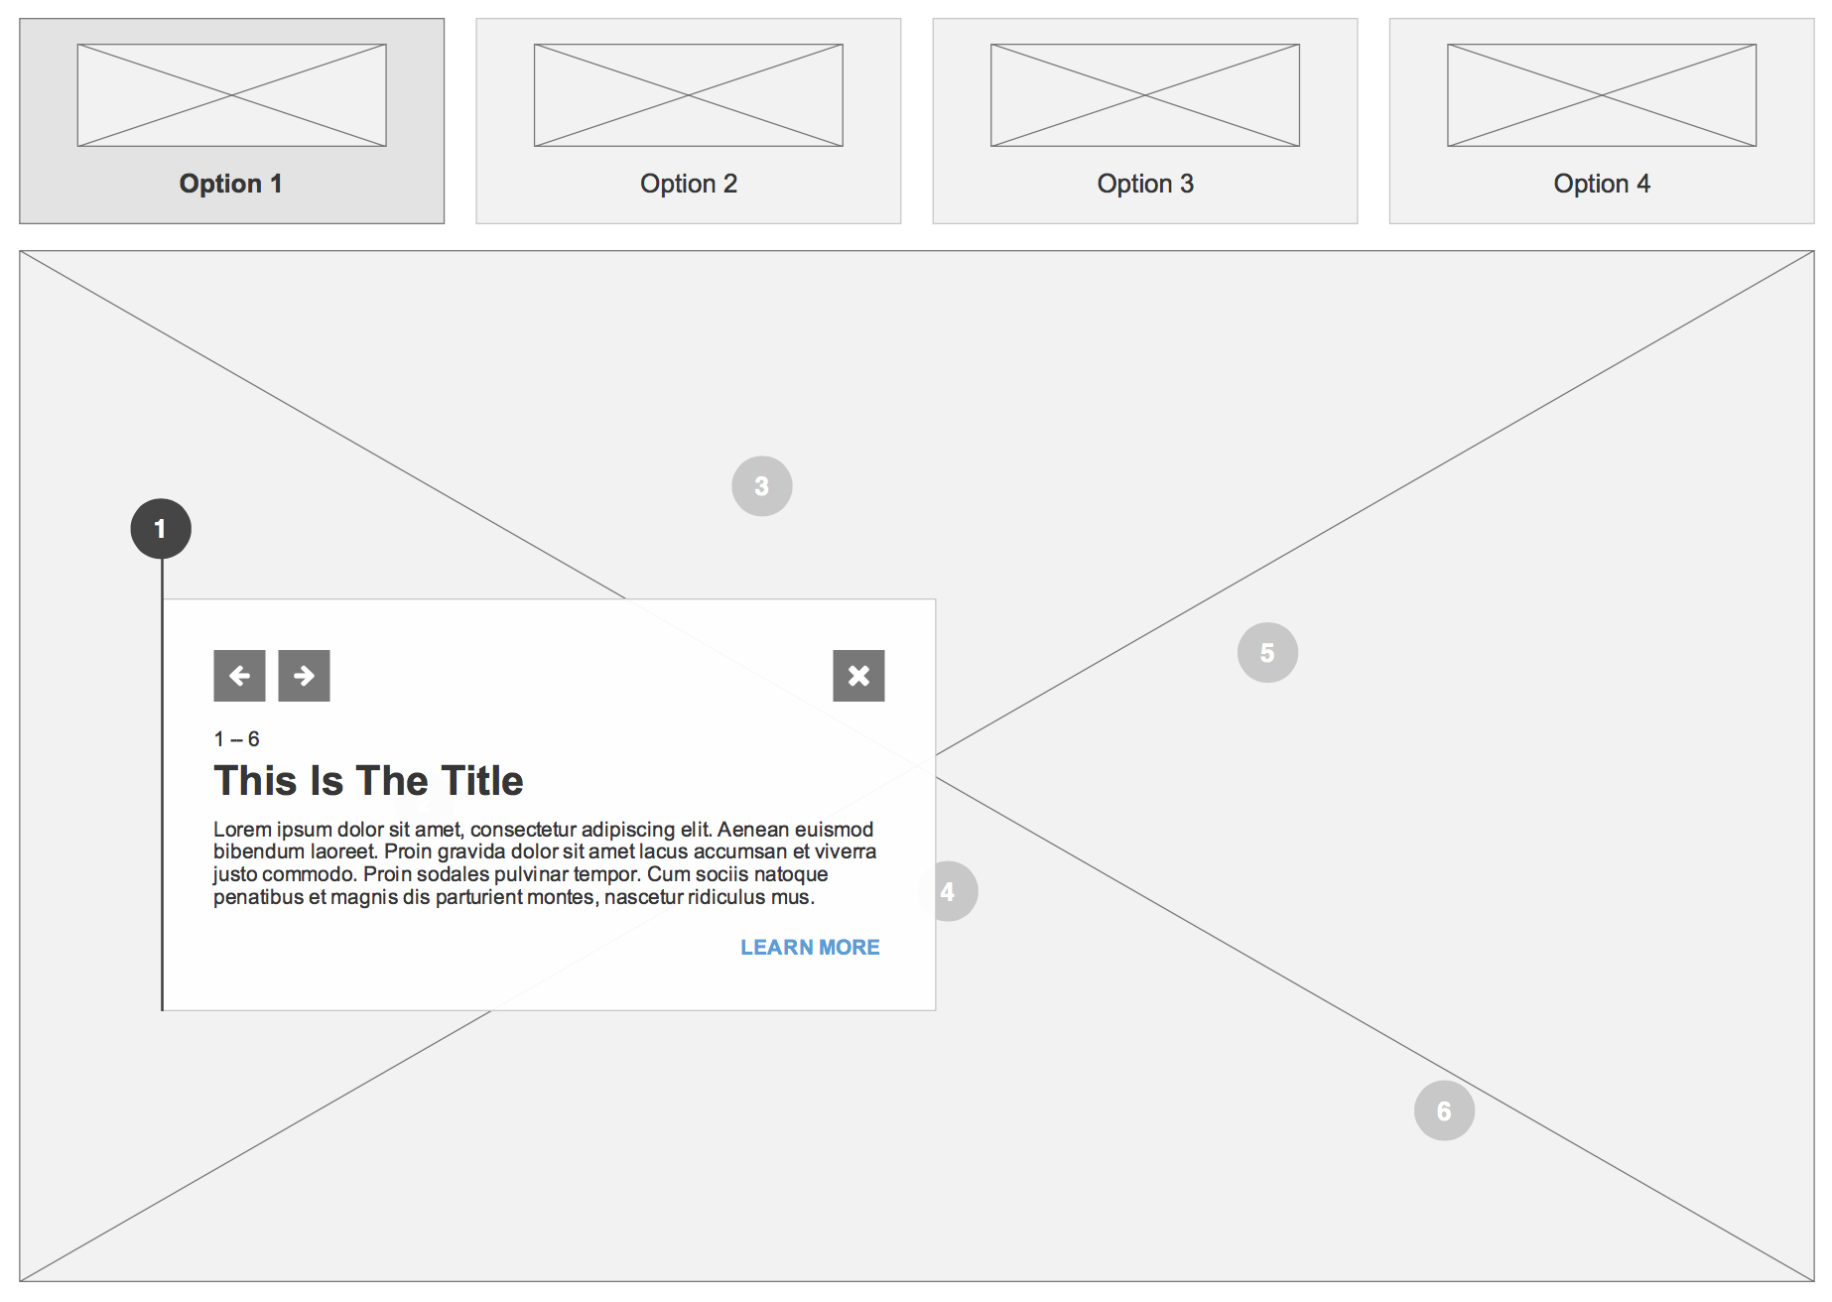
0. Overview (On Click)
Fixed Position Descriptions
Floating Descriptions

Slide 9
0. Overview (On Click - Fixed Position)
Desktop
Mobile
On mobile it will be fixed only to the bottom center of the component.

Slide 10
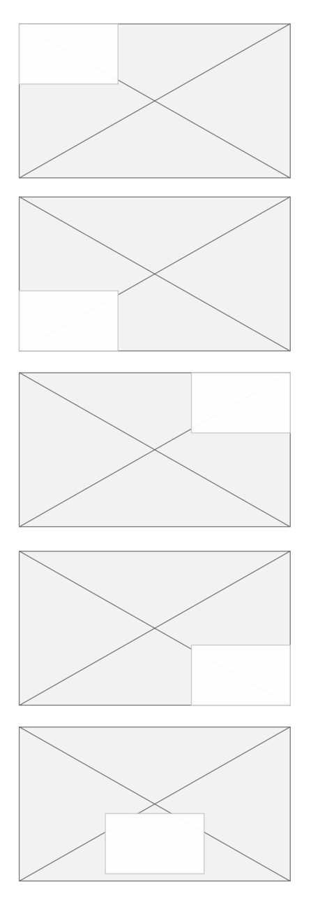
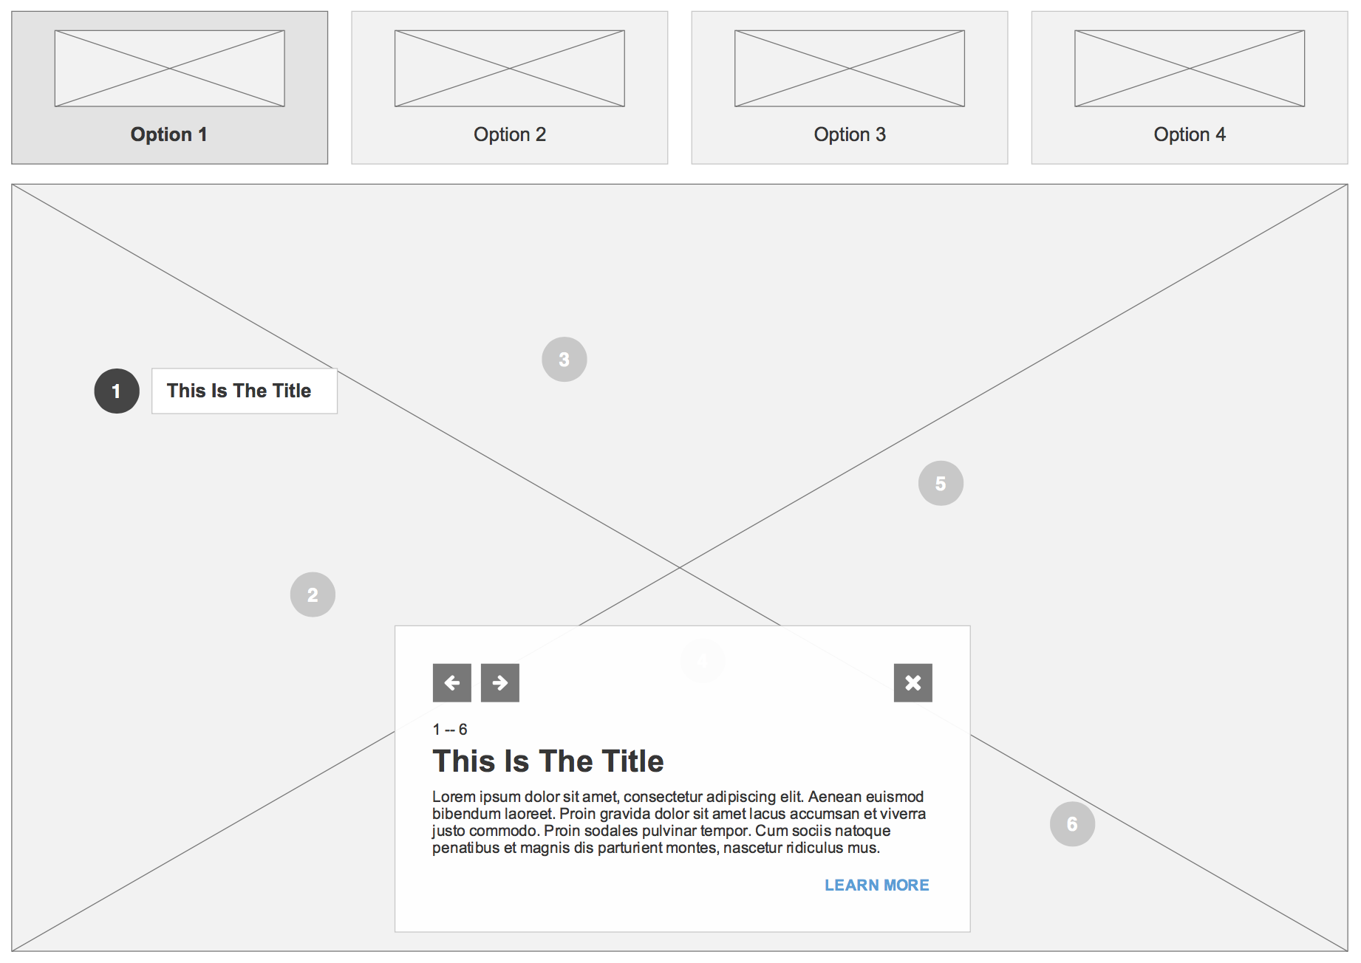
0. Overview (On Click - Fixed Position)
Centered at the Bottom, View
On desktop, the descriptions can be placed on any corner, or at the bottom center.
This is an image setting and will apply to all descriptions per image.
All interactive elements on a single image must be placed in the same description location.
Different images can have different description placements.

Slide 11
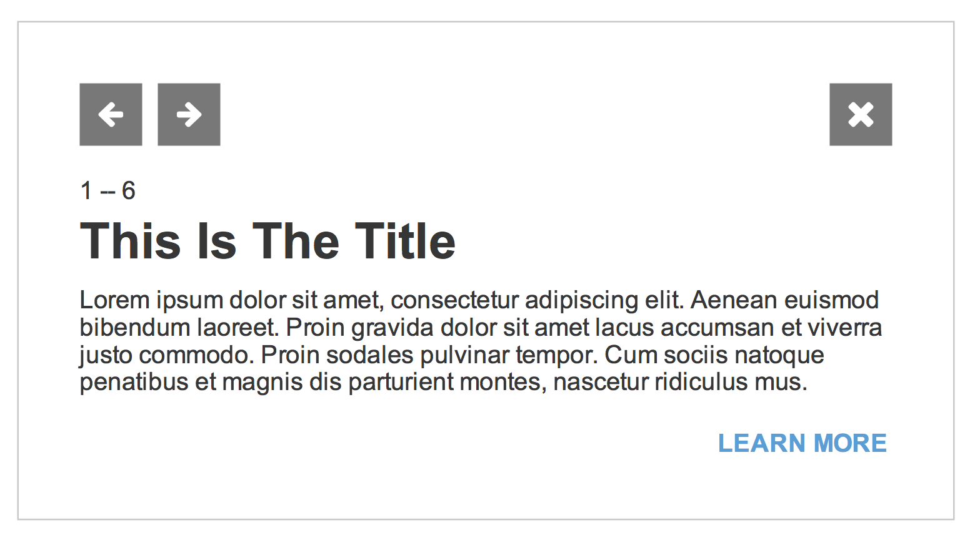
0. Overview (Information Card)
Information Card
Loads when an interactive area is clicked. Includes a succinct description of the elements displayed.
Next/Previous Toggle
Close Button
Item number v. Total
Item Title
Item Description
Call to Action

Slide 12
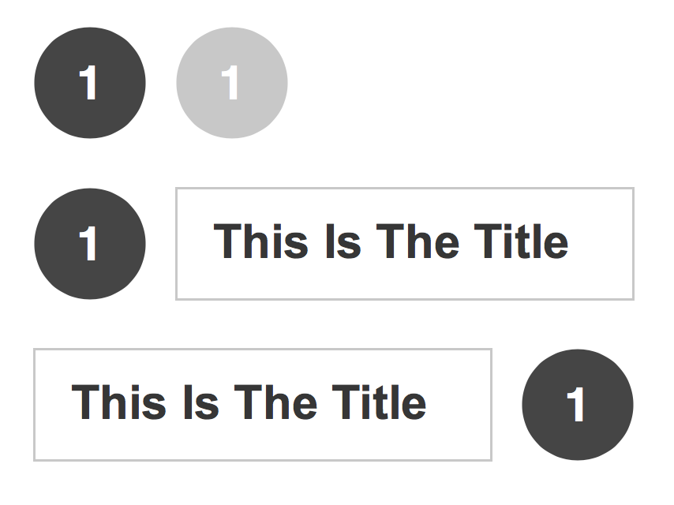
0. Overview (Number Element)
Number Element
They signal the interactive areas. The different status are as follows:
Idle Number
Inactive Number
Active – Tag on Right
Active – Tag on Left

Slide 13
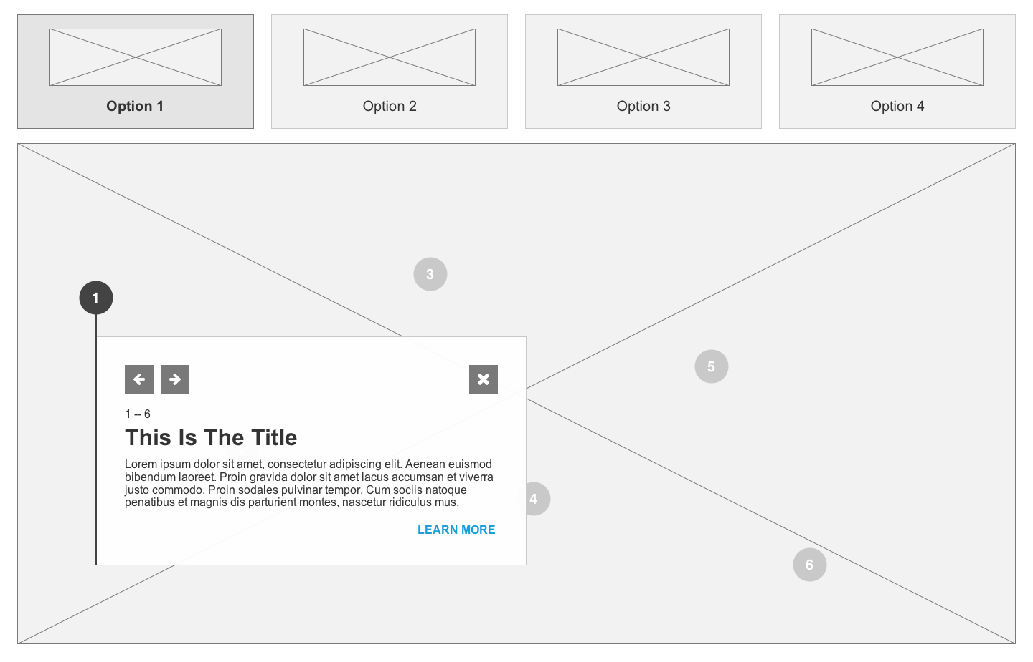
0. Overview (On Click - Floating)
Desktop Only

Slide 14
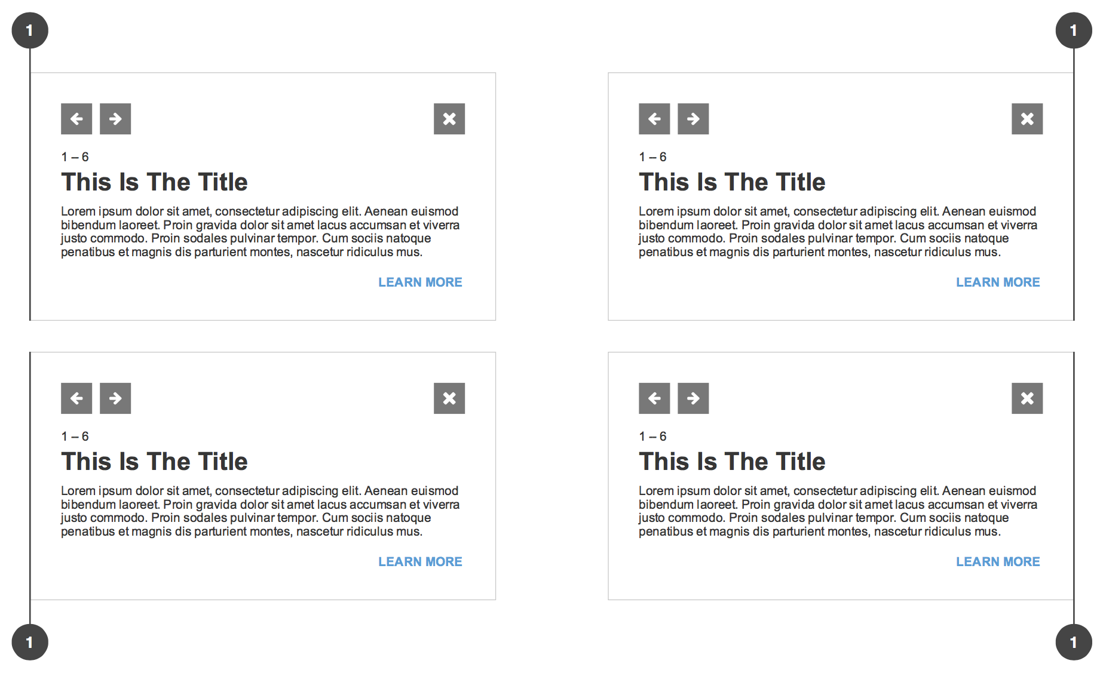
0. Overview (On Click - Floating)
The number can float on every direction.
If on the center, the description will open preferentially to the right and the top.

Slide 15
0. BREAK POINTS

Slide 16
0. Break Proints
Desktop
Mobile
1440px
720px

Slide 17
1. COMMON

Slide 18
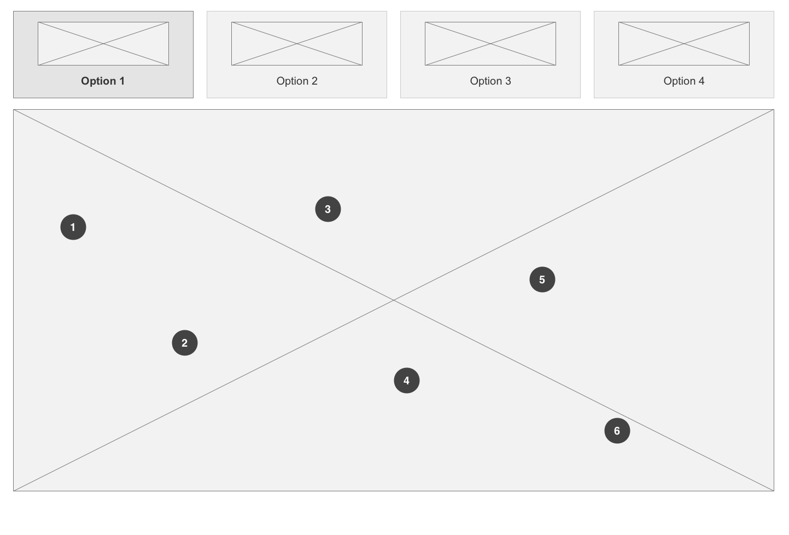
Static with GNB (P5)
<EU> Interactive Component
Interactive Component
Description
1 | Image Selector (Optional)
 | Maximum 4 items. Minimum 2 (if 1 only this section is hidden) Tab size: 330x160 Image Dimensions: 240x80 Text Alignment: Centre When less than 4 items, refer to slide 7
2 | Image Frame Image Frame maximum height: 800px Image can be 2D or 3D
3 | Hotspot Maximum 8 Minimum size: 40x40px Position anywhere within image frame area.
1
2
3
Desktop

Slide 19
Static with GNB (P5)
<EU> Interactive Component
Interactive Component
Description
1 | Information Card
 | Can be positioned on the four corners of the image, centred at the bottom or floating. (Slides 8 to 14) Dimensions: 600x320px Only one card open at a time.
2 | Previous/Next Buttons When at the last card, next button will open item number 1. When at the first card, previous will open the last item.
3 | Close Button Closes card and sets all numbers to idle state. (Slide 12)
4 | Title and Number Number always indicates current number over the total of hotspots. Title Max Char.: 36 Title Maximum lines: 1 Alignment: Left
5 | Body Max CHAR: 280 Alignment: Left
6 | CTA (OPTIONAL ELEMENT) Learn more CTA to product page. Text link style only
1
2
3
4
5
6
Desktop

Slide 20
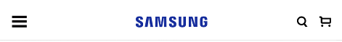
Static with GNB (P5)
<EU> Industry Review
Interactive Component - Mobile
Description
1 | Image selector
 | Same as desktop. Arranged to a 4 column layout.
2 | Image Frame Scales proportionally on mobile. Loads with the first hotspot active.
3 | Information Card Adapts to full width of the image frame. Always active on mobile. Close button is disabled.
1
2
3
Mobile

Slide 21
2. BEHAVIOUR

Slide 22
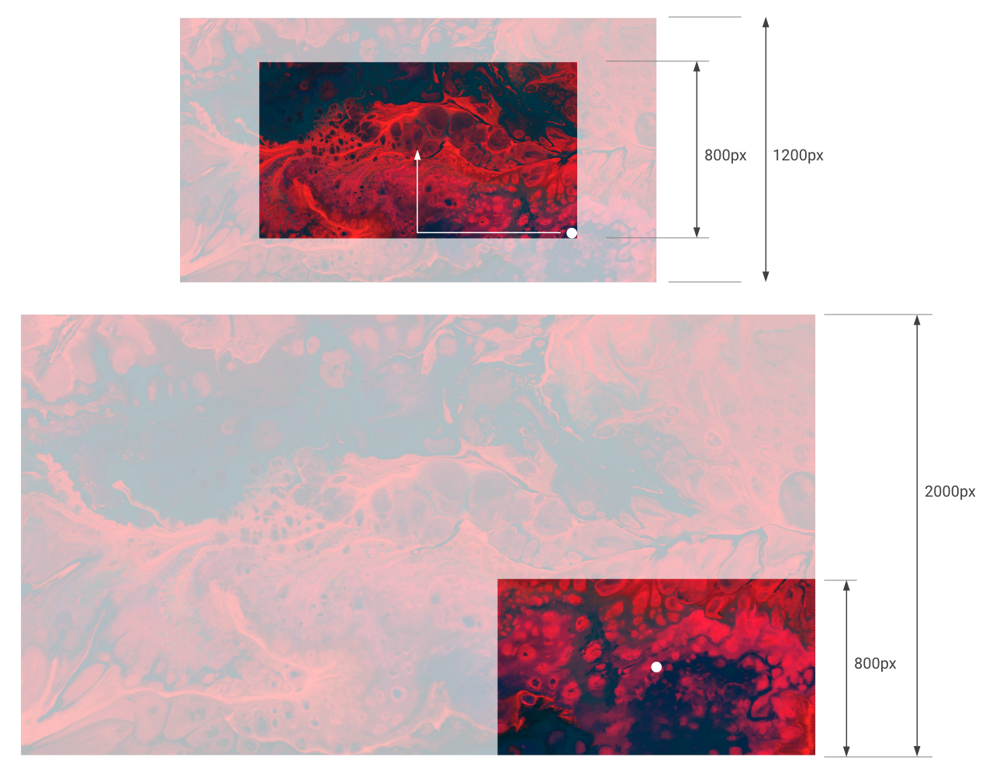
2. Behaviour
The image used within the frame must be 150% larger than the frame.
On click:
Image scales by 166.67%
Hotspot translates to the center of the frame.

