Slide 1
git

Slide 2
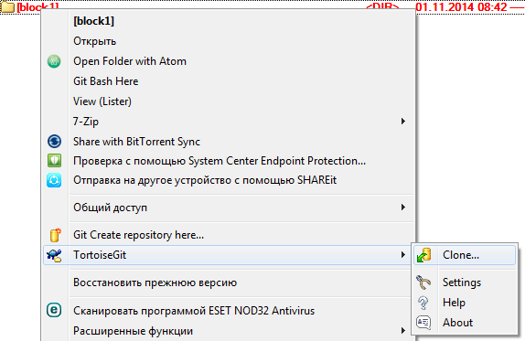
История директории локально
Снэпшот — commit
Процесс создания снэпшота — тоже commit
git clone git init

Slide 3
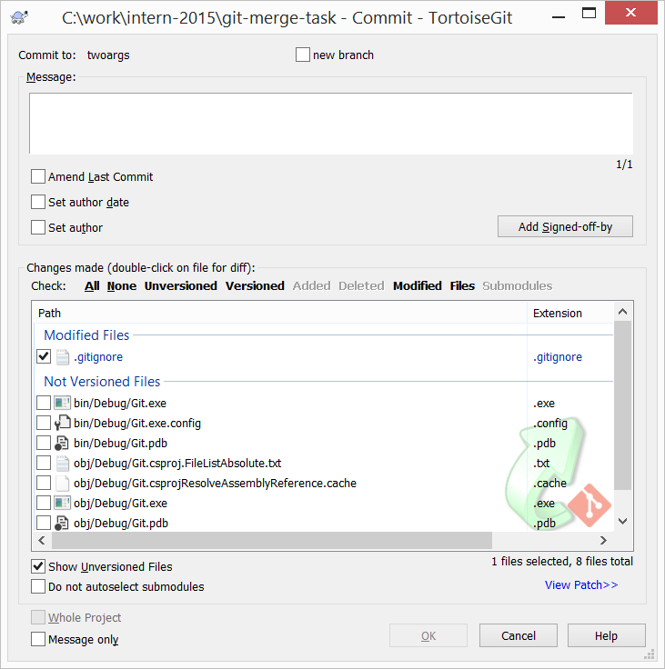
commit
git add
git commit
.gitignore

Slide 4
Immutable history — DAG
Ничего не теряется!

Slide 5
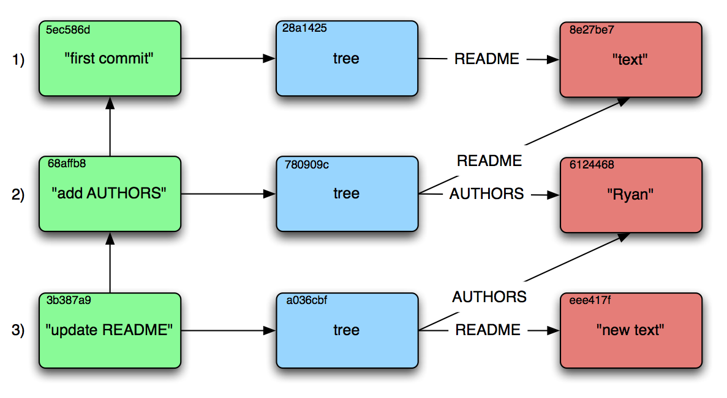
Blob & sha1

Slide 6
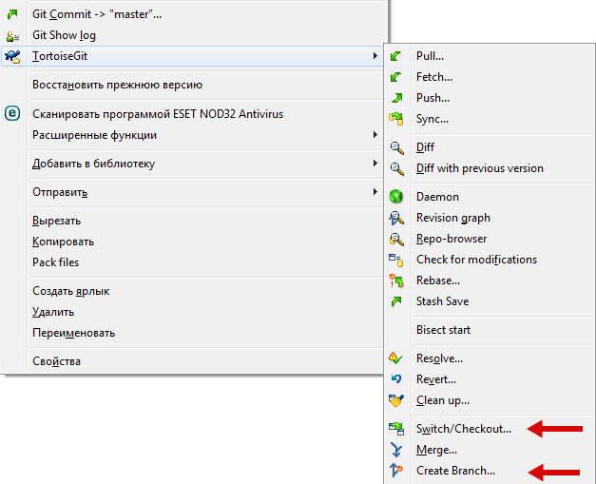
Branch Branch pointer
feature1
master
fix-bug-1234
checkout
commit
HEAD

Slide 7
github.com
Social coding
Fork me!
Pull request — модель авторизации наоборот

Slide 8
remotes
master
remote/origin/master
clone
master

Slide 9
fetch
master
remote/origin/master
master

Slide 10
merge
master
remote/origin/master
master

Slide 11
merge conflicts
the number of planets are
<<<<<<< HEAD
nine
=======
eight
>>>>>>> branch-a

Slide 12
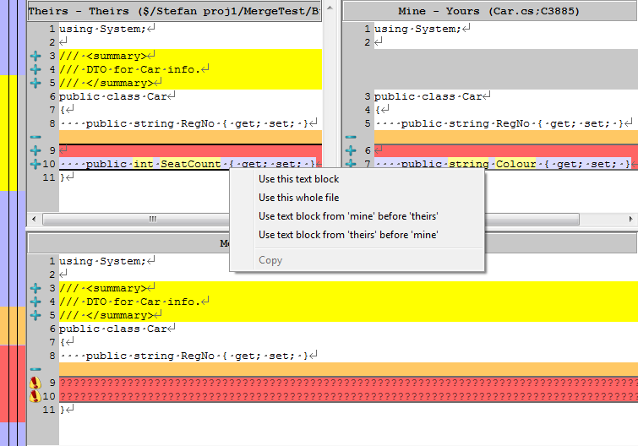
merge conflicts

Slide 13
rebase — альтернатива merge
master
remote/origin/master
1’
2’
diff₁
diff₂
diff₁
1
2
master
diff₂

Slide 14
pull = fetch + merge pull --rebase = fetch + rebase

Slide 15
push
master
1’
2’
remote/origin/master
1’
2’
master
1
2

Slide 16
push conflict
master
remote/origin/master
1’
2’
master
1
2

Slide 17
.git directory
config
HEAD
logs
objects

Slide 18
Задача
bit.ly/git-merge
(https://github.com/kontur-edu/git-merge-task)

