Slide 1
Chapter 1 Introduction to Smart Contract
CSB202-Programming to Blockchain I

Slide 2
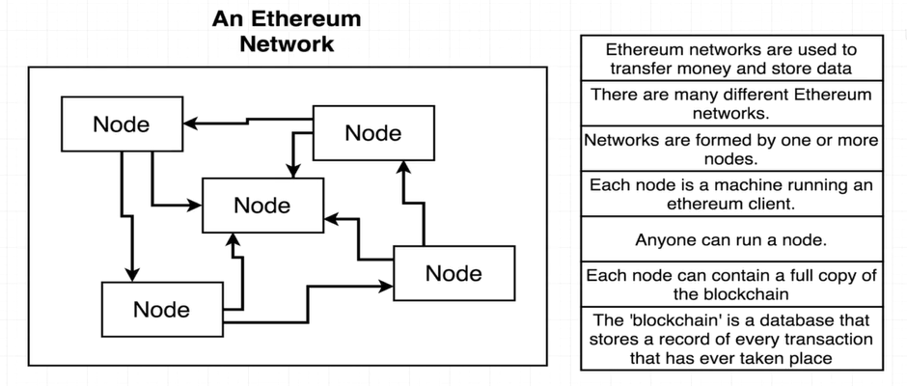
Ethereum Blockchain

Slide 3
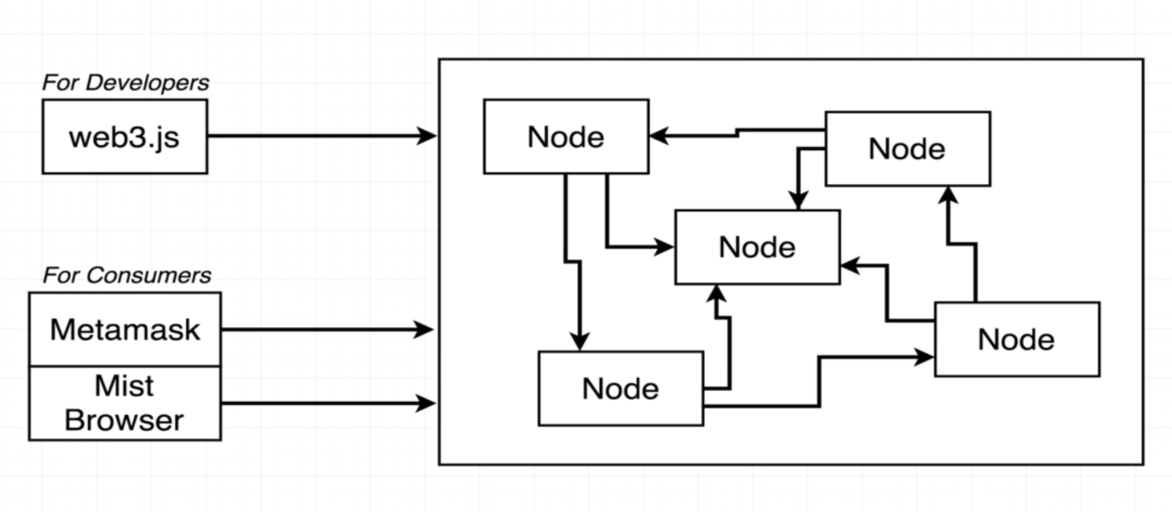
Interfacing with Ethereum Network
Tools & Technologies
Ethereum Network
UI

Slide 4
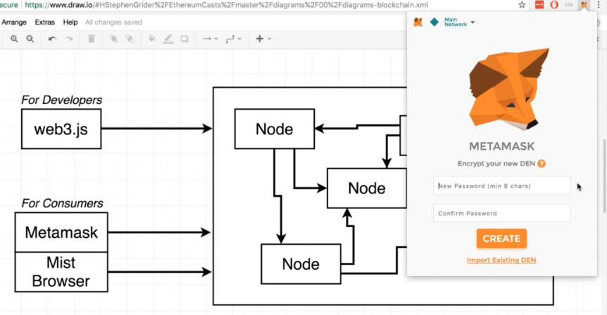
Metamask for Ethereum Blockchain

Slide 5
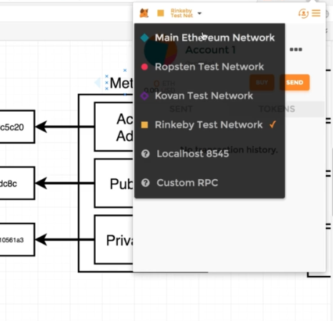
Types of Network in Metamask
Main Network
Test Network

Slide 6
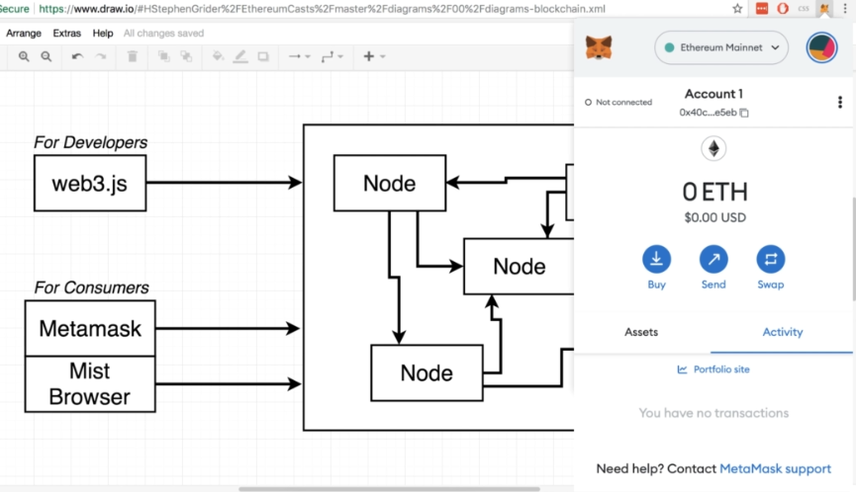
Main Net in Metamask

Slide 7
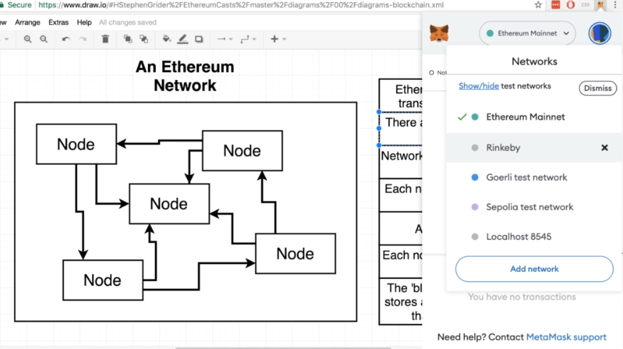
Test Net in Metamask

Slide 8
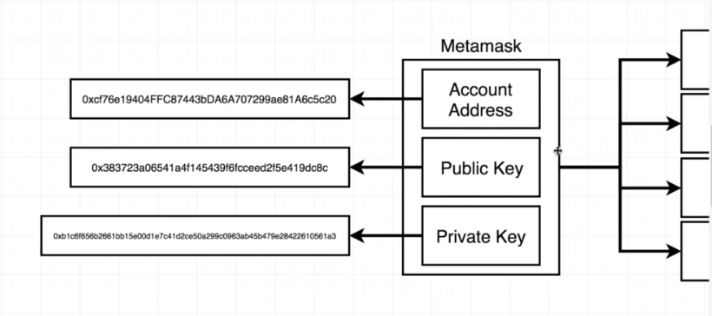
Ethereum Accounts

Slide 9
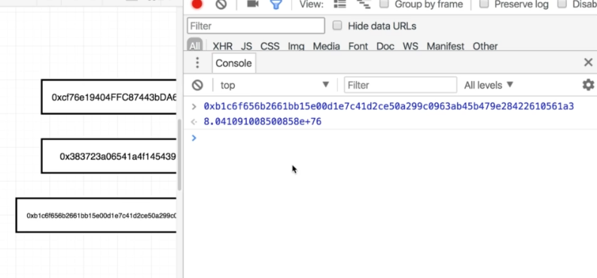
Hexa-Decimal representation of Eth Acc
Hexa-Decimal
form
Decimal form

Slide 10
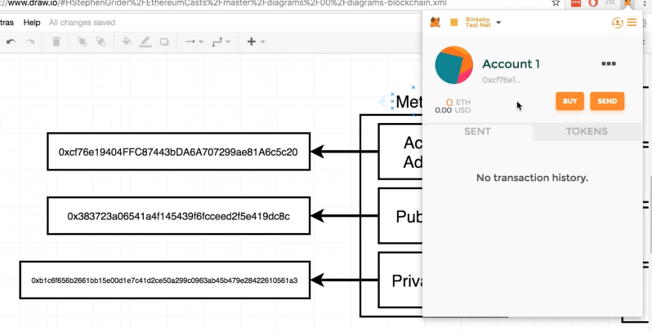
Using Test Net: Rinkeby

Slide 11
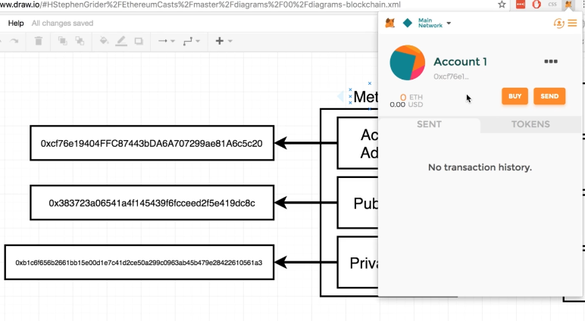
Change to Main Net

Slide 12
Question on Ethereum Account
What do you observe sigficantly ?

Slide 13
Question on Ethereum Account
No Answer ! ! !
Let us check and observe again

Slide 14
Answer to the Question
The Account Detail remains the same even if we change the Network on Ethereum Blockchain

Slide 15
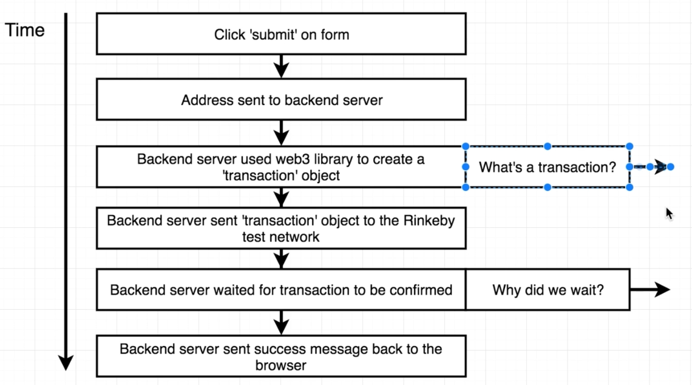
Flow of Sending Money Ethereum Network

Slide 16
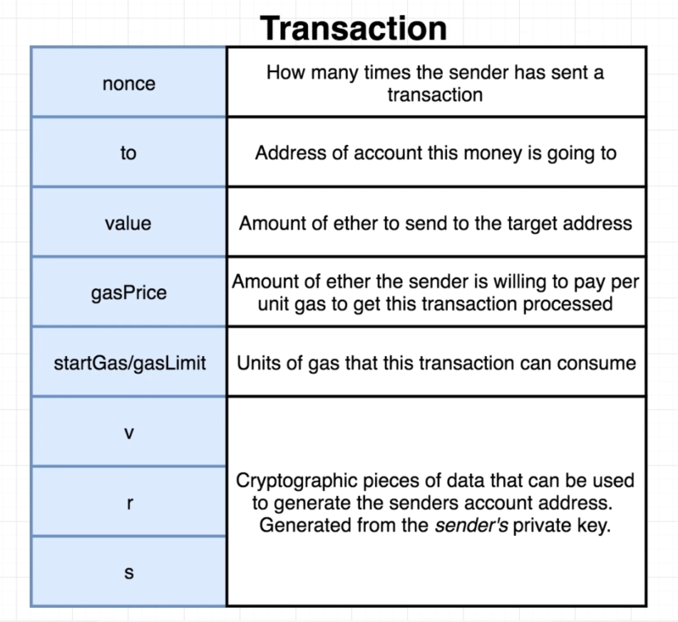
Transaction on Ethereum Blockchain
Transaction
A Record

Slide 17
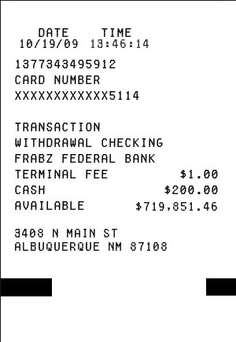
Bank ATM Transaction Receipt

Slide 18
Salient Features of REMIX IDE
You do not require to use Metamask along with REMIX IDE.
You do not require to create any accounts on REMIX IDE.
Free ETHER is already available on REMIX IDE.
Transactions are performed even on REMIX IDE.

Slide 19
Let’s try a simple Smart Contract
Visit: https://remix.ethereum.org

Slide 20
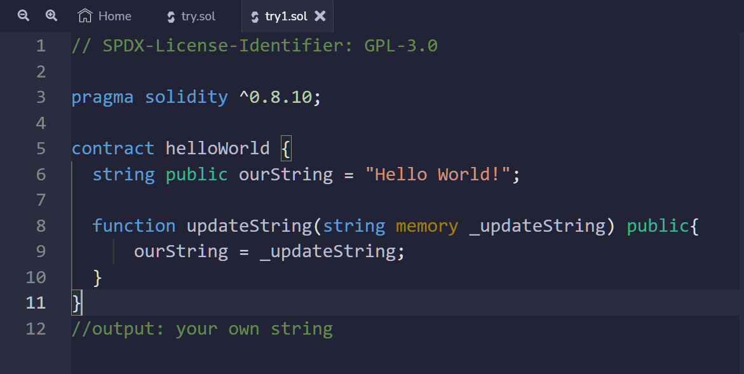
Copy and Compile the Smart Contract

Slide 21
What is new in this Smart Contract ?
Function “updateString()” has been introduced.

Slide 22
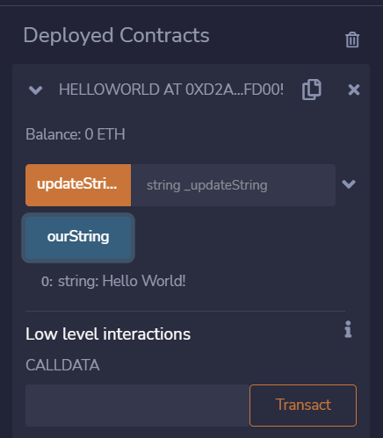
Output-1 of the Smart Contract
The Basic output “Hello World!” as observed in the previous exercise.

Slide 23
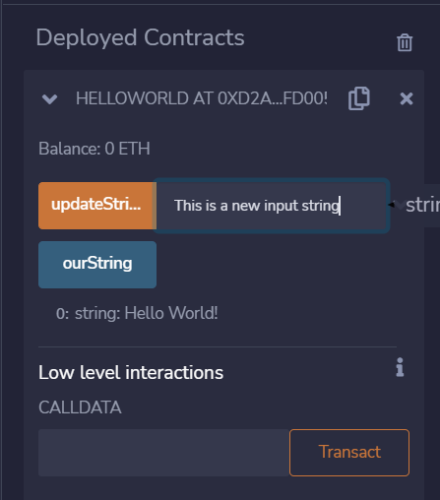
Output-2 of the Smart Contract
The new function allows you to update the value of local variable “ourString” of the SC.
Local Variables of any SC are known as State Variables.
However it was not observed in the previous exercise.

Slide 24
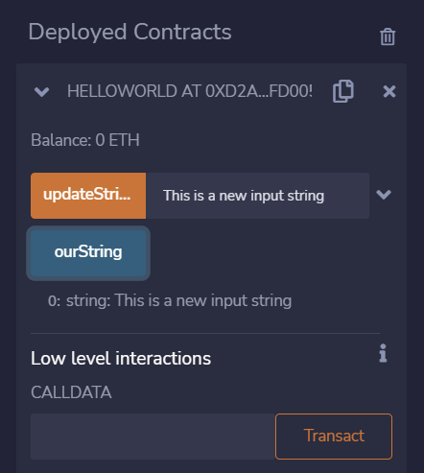
Output-2 of the Smart Contract
“ourString” button representing the State Variable ourString of the SC, outputs the result as “This is a new input string” , which was updated by ourselves.
It is the power of the new function implemented in the SC.

Slide 25
Any Questions?

Slide 26
C O N G R A T U L A T I O N S ! ! !
You compiled your second simple Solidity Smart Contract successfully

Slide 27
THANK YOU

