Slide 1
Project 4 CREATE AN ALGORITHM TO ANALYZE HORSE RACING DATA AND PREDICT FUTURE OUTCOMES
A.Sheikh - C Mafavuke - M Ansah - M Amjad

Slide 2
AIM
The aim is to clean the data, utilizing columns that we need and uploading to a SQL database. We will use machine learning models to create a binary supervised algorithm to make predictions for unseen data in the future.

Slide 3
RESOURCES
Kaggle (CSV File)
Jupyter Notebook (Data cleaning and Machine Learning Codes)
PG Admin (SQL Database)

Slide 4
Data Processing and Cleaning

Slide 5
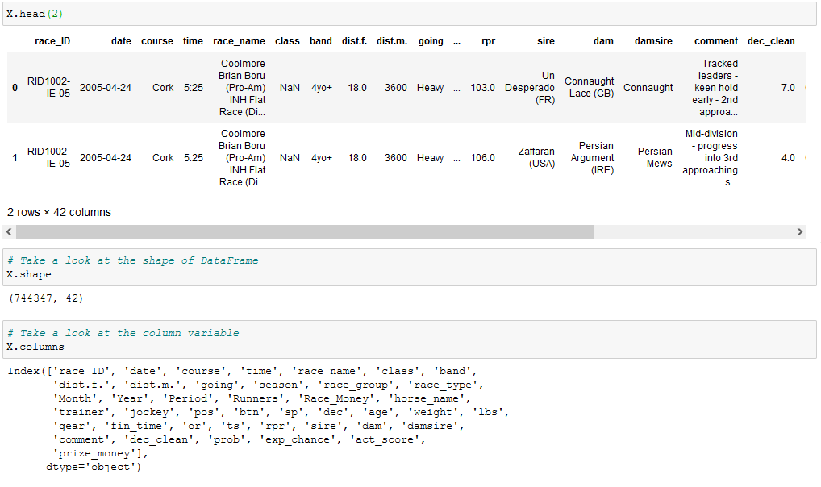
Initial review of the CSV file showed that there were over 700K rows across 42 columns.

Slide 6
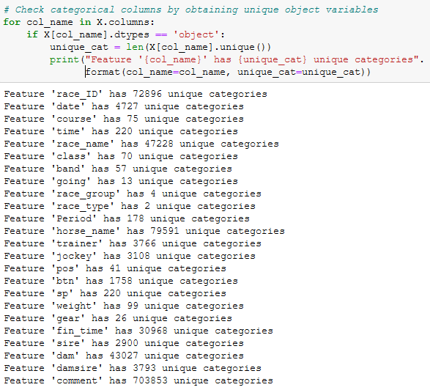
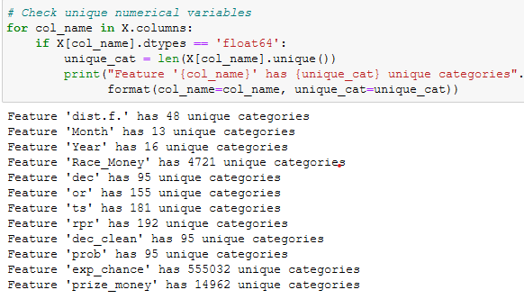
Check categorical and numeric variables

Slide 7
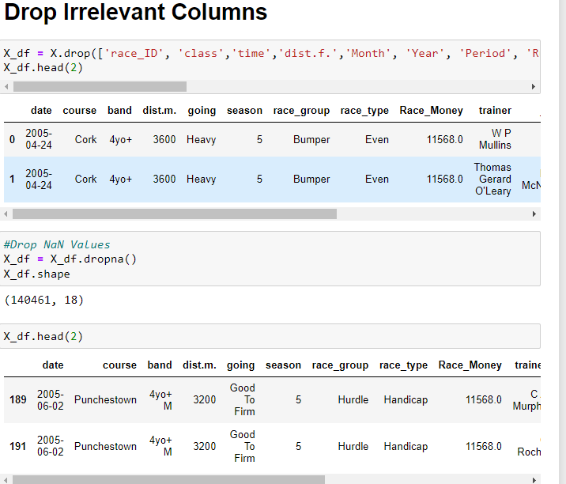
DROPPED COLUMNS: A review of the column data was performed and those features that were duplicates in meaning e.g. columns with heading month, time, year were dropped and instead only 'Date' was kept. Also dist.f (distance in furlong) was dropped and dist.m (distance in metres) was kept. Other features were dropped based on the same assessment. Having duplicate meanings in features would not have added value to the model.

Slide 8
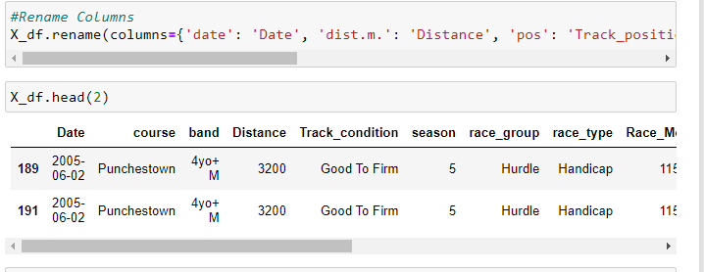
RENAME FEATURES

Slide 9
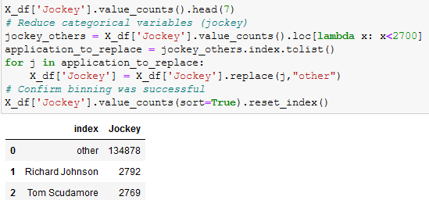
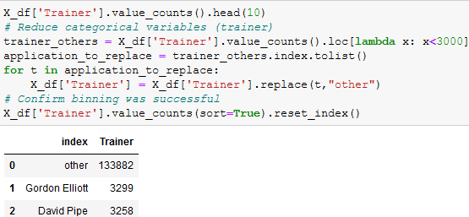
Reduce number of unique values by binning ‘rare’ categorical variables
Jockey
Trainer
Track condition

Slide 10
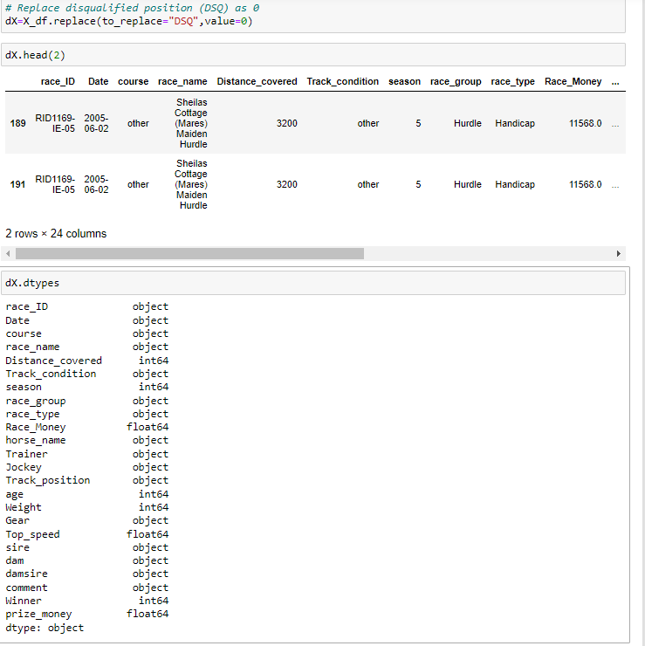
CONVERSION TO NUMERICAL DATA

Slide 11
EXPORT TO CSV FILE

Slide 12
SQL DATABASE

Slide 13
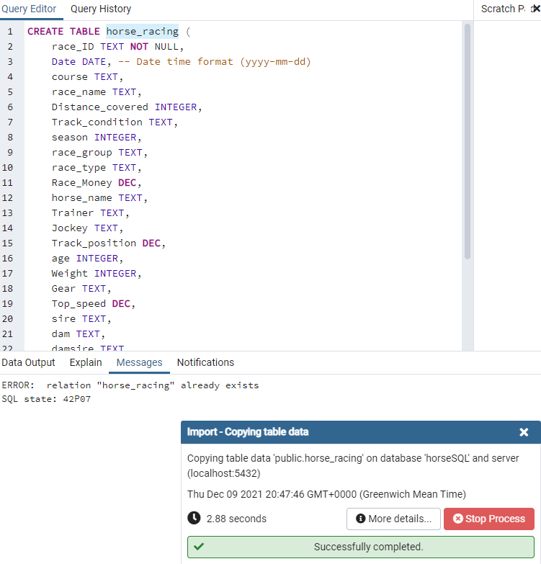
Importing clean CSV file and creating a table in the database

Slide 14
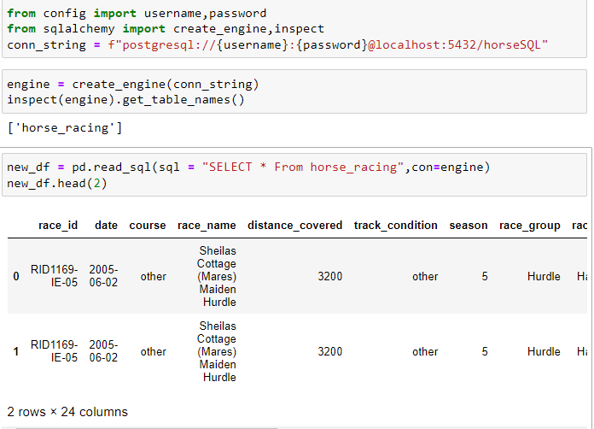
Creation of connections to the SQL Database

Slide 15
MACHINE LEARNING

Slide 16
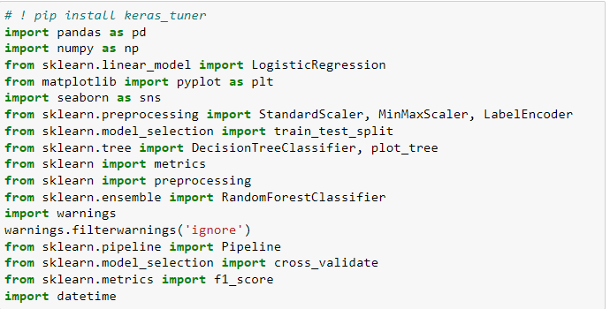
DEPENDENCIES IMPORTED

Slide 17
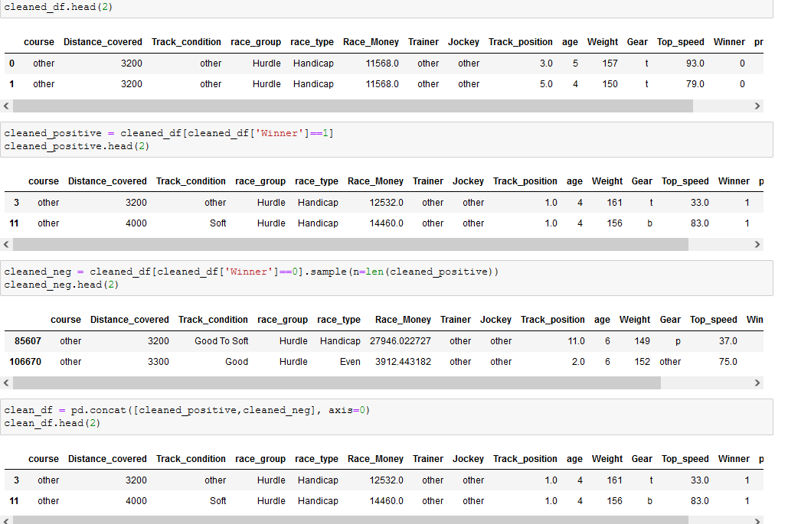
Data Balancing for Machine Learning

Slide 18
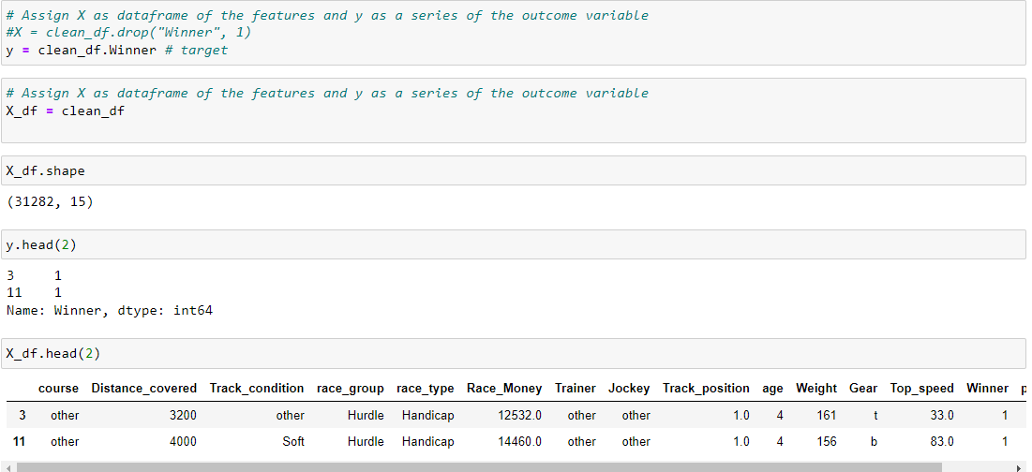
X,Y LABELS

Slide 19
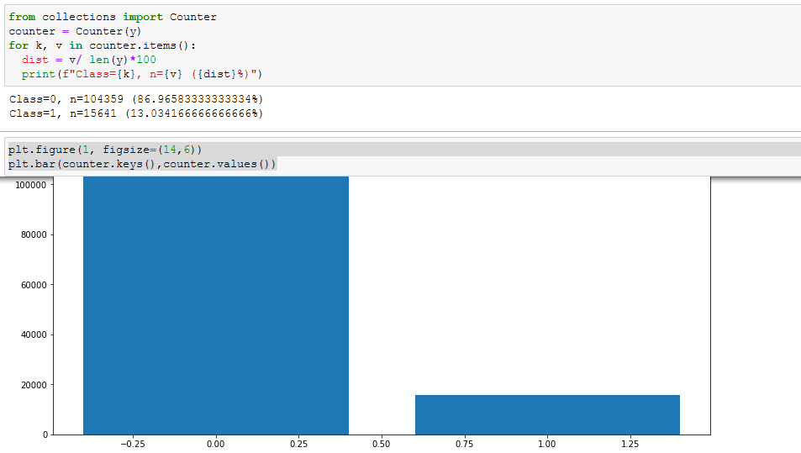
INITIAL DATA BALANCE

Slide 20
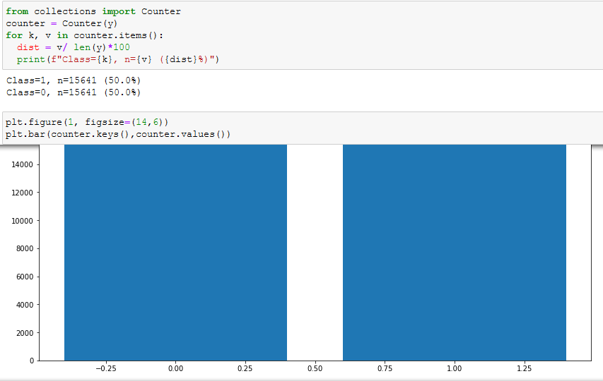
DATA BALANCE

Slide 21
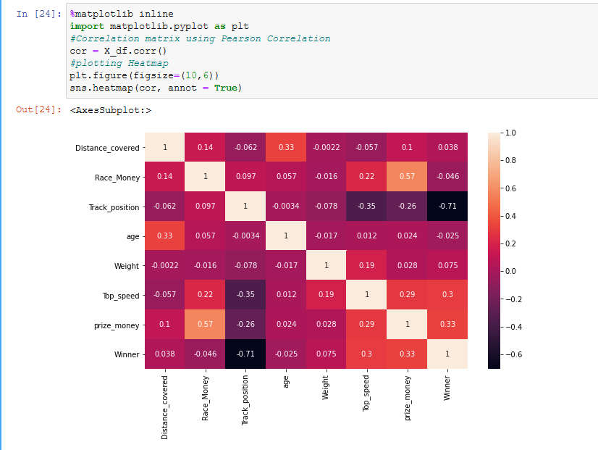
FEATURE SELECTION
PEARSON CORRELATION
From the Pearson Correlation carried out on the feature selection for the model, we observe that the following features produce a positive relationship with the target.
Distance covered by horse.
Weight of the horse.
prize money which is linked to the trainer and jockey for the particular race
Top speed which is the speed of the horse

Slide 22
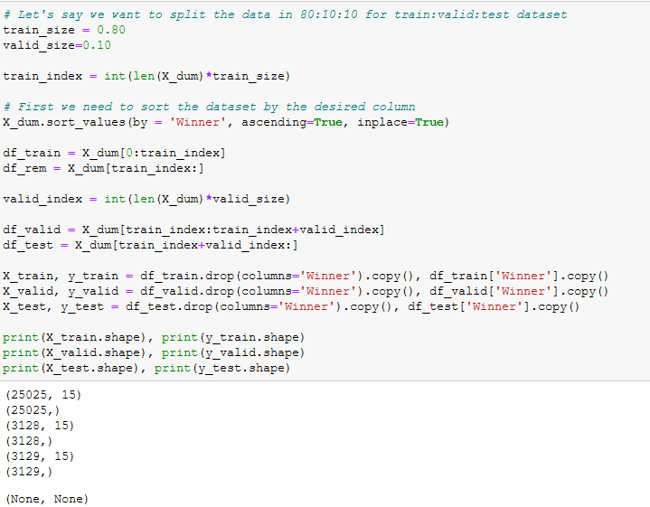
From sklearn-train:validate:test split split ratio- 80:10:10

Slide 23
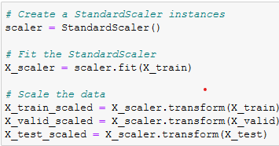
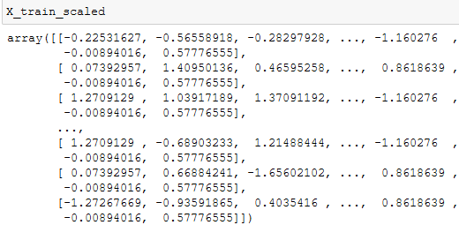
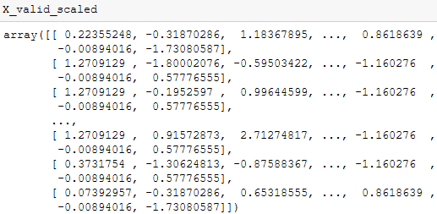
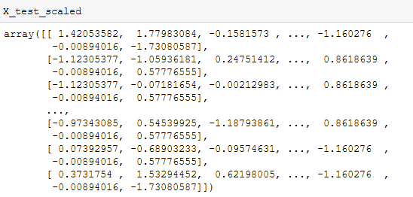
from sklearn.preprocessing import StandardScaler,

Slide 24
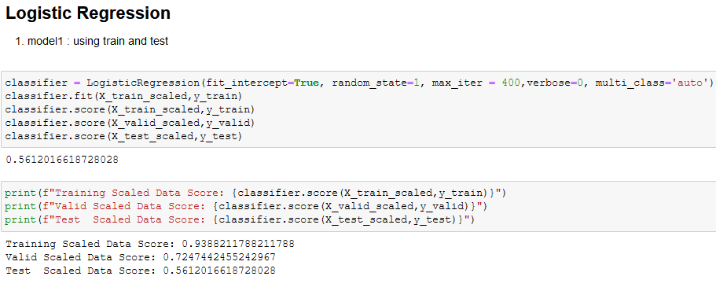
LOGISTIC REGRESSION

Slide 25
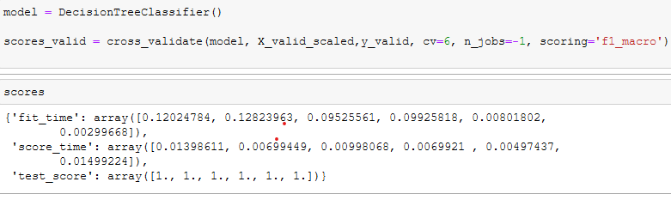
DECISION TREE CLASSIFIER

Slide 26
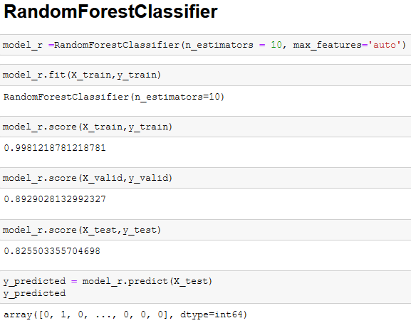
RANDOM FOREST CLASSIFIER

Slide 27
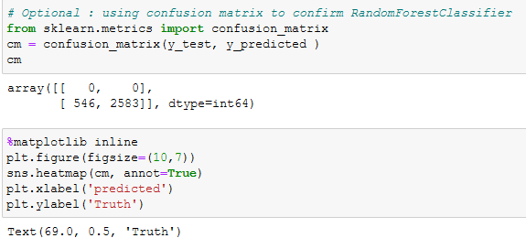
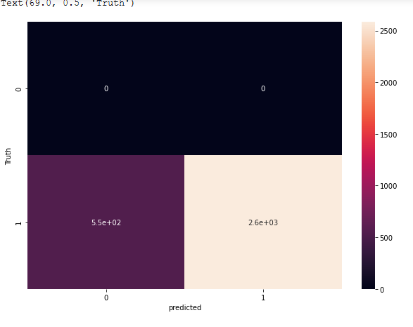
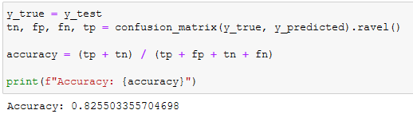
Confusion Matrix as confirmation of model

Slide 28
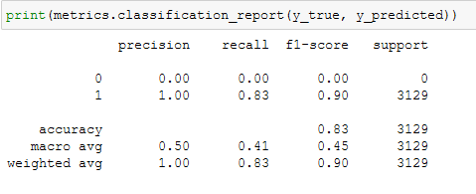
Metrics Classification Report

Slide 29
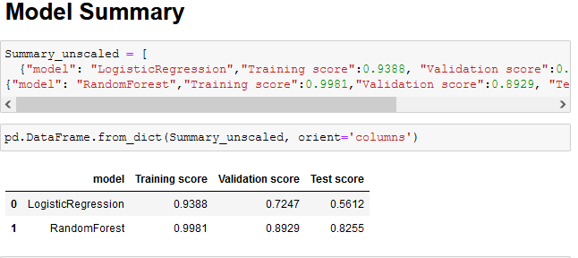
MODEL SUMMARY

Slide 30
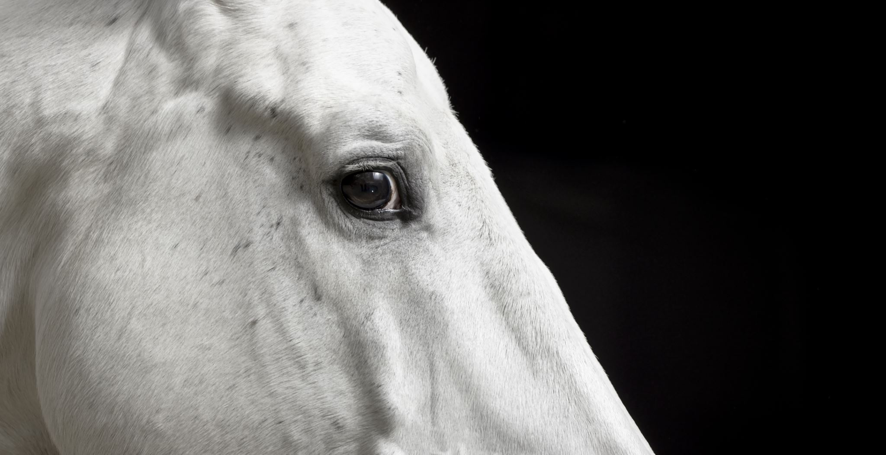
THANK YOU!!!!

